Slide 1

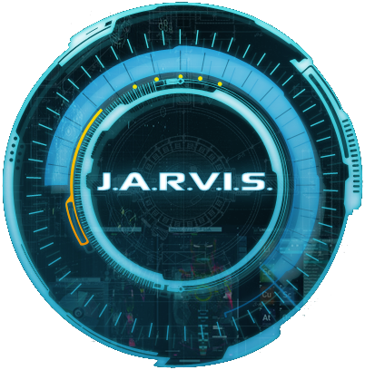
Sean Byrne
C16503889
Sarah Jane Cregan
C16703349
Paul Davis
C16324311
Matt McCormack
D16124336
Ryan McManus
C16334863

Slide 2
Table of Contents
Tony Stark Biography
The Creation of J.A.R.V.I.S.
Evolution of J.A.R.V.I.S. Throughout the Movies
J.A.R.V.I.S. at Home
J.A.R.V.I.S. Interface
Modern Day J.A.R.V.I.S.

Slide 3
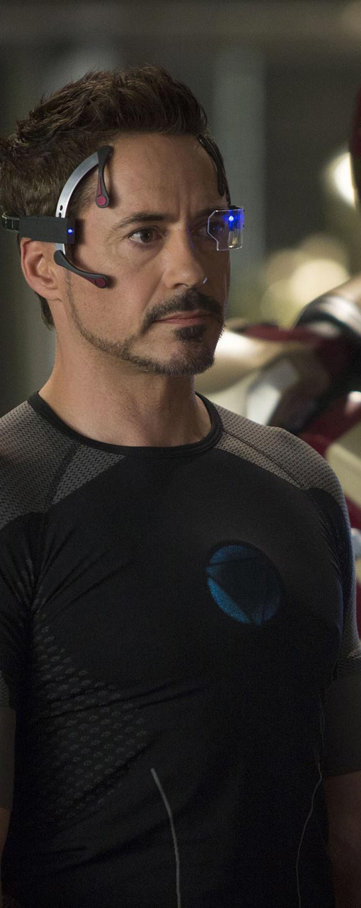
The Creation of J.A.R.V.I.S.
Tony Stark –
Son of Howard and Maria Stark.
Current owner of Stark Enterprises.
Created the Mark I Iron Man armour to protect his heart form shrapnel

Slide 4
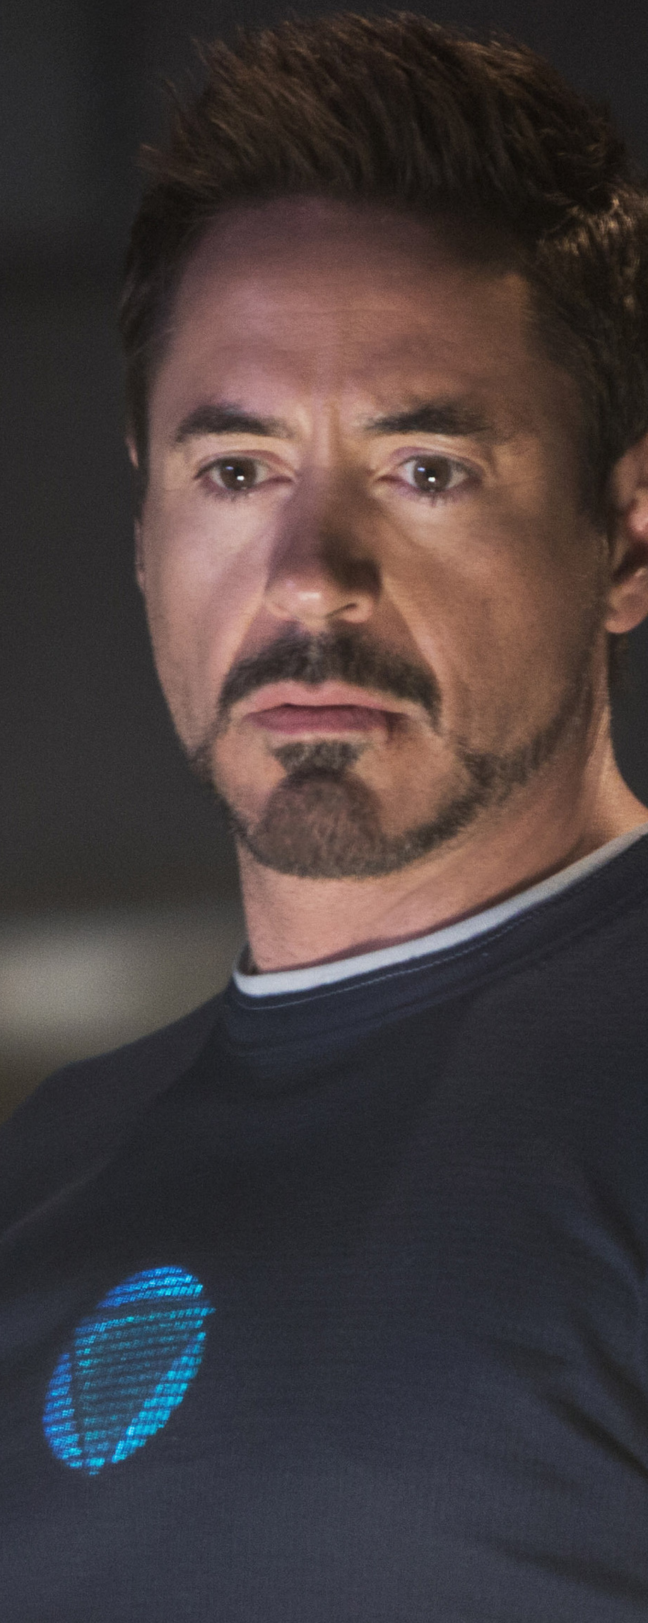
The Creation of J.A.R.V.I.S.
Tony Stark -
Created J.A.R.V.I.S. to keep him company in his mansion and to assist him with day-to-day tasks.
Later adapted it for the Iron Man suit.
Modelled after his butler, Edwin Jarvis.

Slide 5
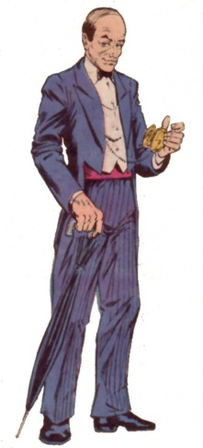
The Creation of J.A.R.V.I.S
Edwin Jarvis –
Butler of Howard and Maria Stark as well as Tony.
Adapted into the J.A.R.V.I.S. Operating System for the Iron Man movies.

Slide 6
Evolution of J.A.R.V.I.S. Throughout the Iron Man Movies

Slide 7
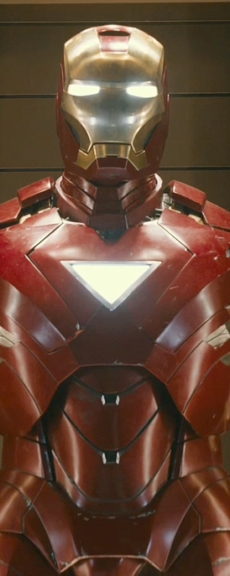
Evolution of J.A.R.V.I.S. Throughout the Iron Man Movies
Iron Man -
Controls Home System
Suits from Mark 2 Onwards
Preforms Simple Processes

Slide 8
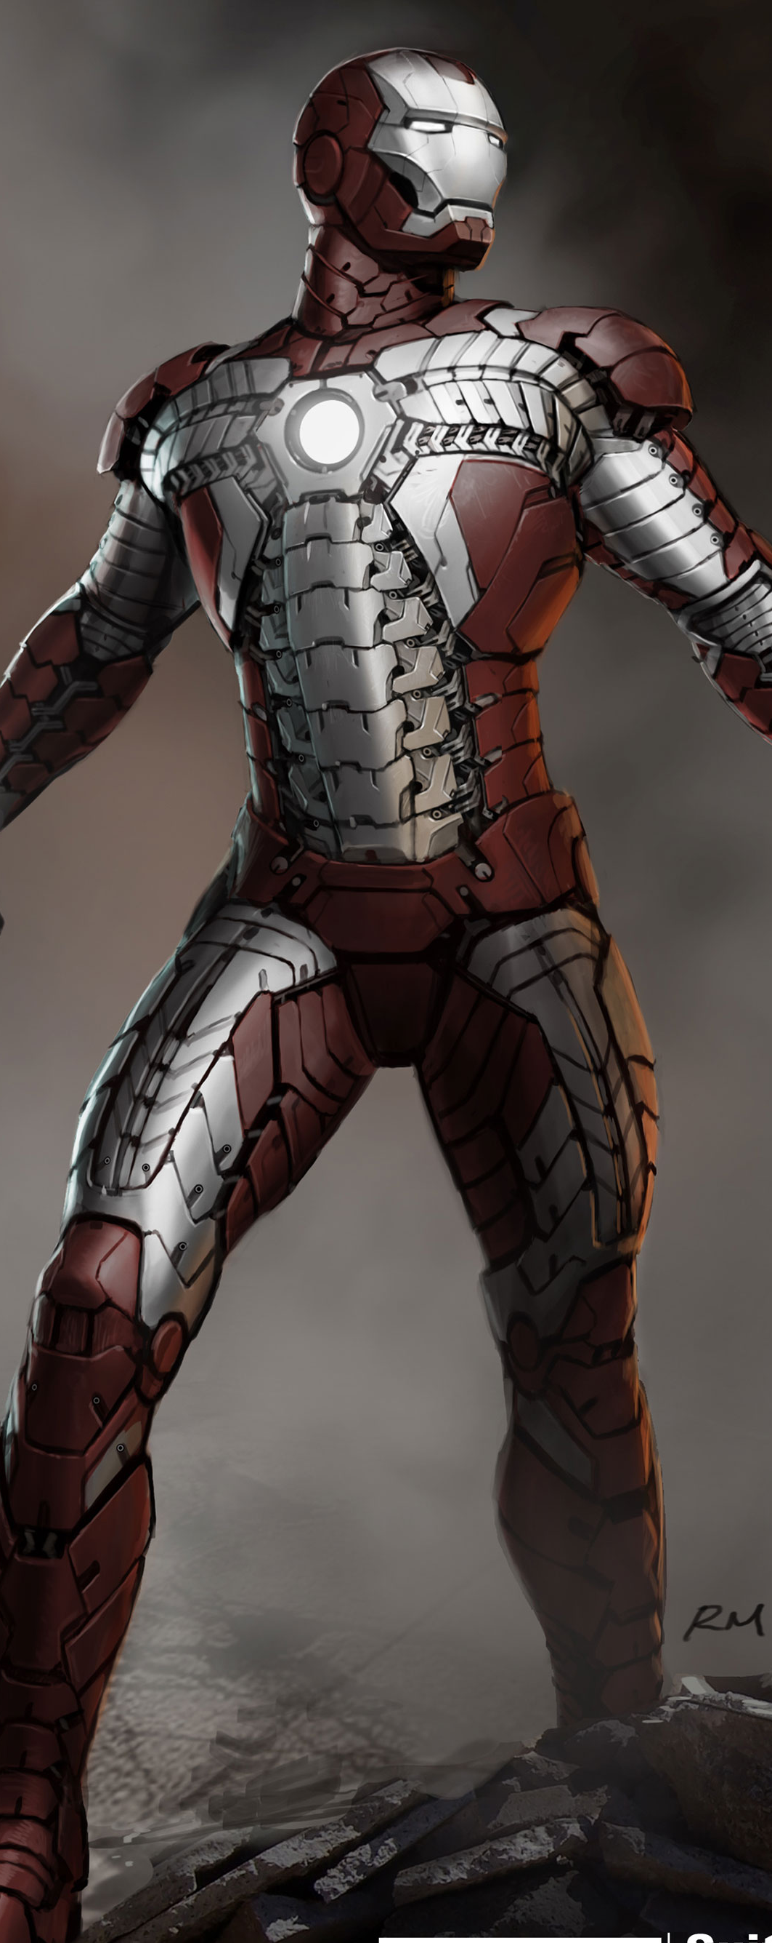
Evolution of J.A.R.V.I.S. Throughout the Iron Man Movies
Iron Man 2 -
More battle driven
Status updates
Pinpoints weaknesses

Slide 9
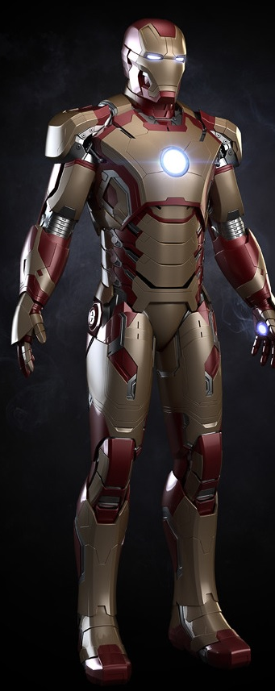
Evolution of J.A.R.V.I.S. Throughout the Iron Man Movies
Iron Man 3 -
Controls multiple suits as drones
Re-Suits Stark when his suit is damaged.
Initiates “clean slate” protocol at the very end.

Slide 10
J.A.R.V.I.S. in the Iron Man Suit
Motion sense
Flight
Mask
Missiles
Voice control
Controls the lab/house
Asks for information
Suit override
Visual detection
Enemies weaknesses
Lock on
Threat evasion

Slide 11
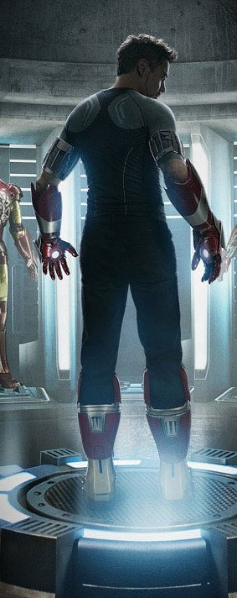
J.A.R.V.I.S. at Home
J.A.R.V.I.S controls Tony’s house
It tells him time, date, weather & humidity when he wakes up.
It controls heating and cooling systems and the engine analysis of Tony’s Hot Rod in the garage.
J.A.R.V.I.S controls the security in Tony’s house

Slide 12
J.A.R.V.I.S. Interface
J.A.R.V.I.S’s interface is through the form of a HUD.
Gives Stark Information like times and dates.
Uses Holograms to show information about things around the suit.
Voice Recognition.

Slide 13
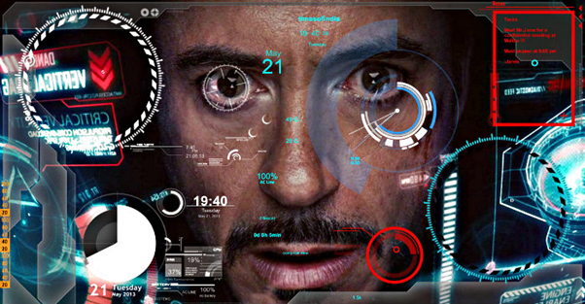

Slide 14
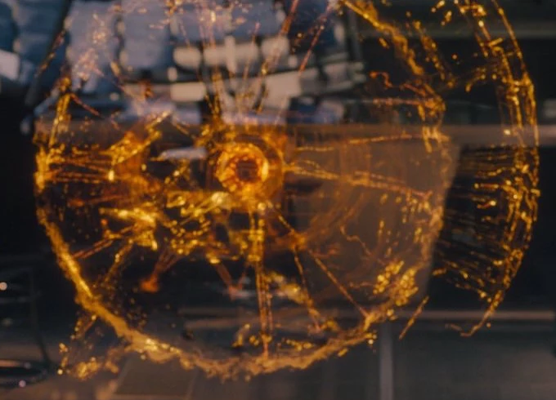
Modern Day J.A.R.V.I.S.
Modern artificial intelligence systems are much less advanced than the J.A.R.V.I.S. we see in the movies.
The Allen Institute for Artificial Intelligence is a think-tank funded by co-founder of Microsoft, Paul Allen.
The institute recently ran a contest to see if a system could be made to pass a second year science test. Unfortunately no one could create an AI to achieve over a 60%.

Slide 15
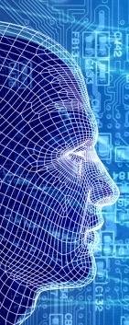
Modern Day J.A.R.V.I.S.
A huge advance in the advancement of AI was the creation of the Neural Network.
A neural network is a sort of artificial brain, created by mimicking the neurons in the brain.
This allows the AI to think and learn
This is what powers J.A.R.V.I.S. abilities

Slide 16
Conclusion
J.A.R.V.I.S. is a very intelligent operating system seen in the Iron Man movies.
The movies were set in the years they came out in the 2000’s and 2010’s.
J.A.R.V.I.S. was made by a prophet engineer called Tony Stark.
J.A.R.V.I.S. is way ahead of its time since the most advanced AI we have in the world today wouldn’t be able to pass a 2nd year science test.

Slide 17
