Slide 1
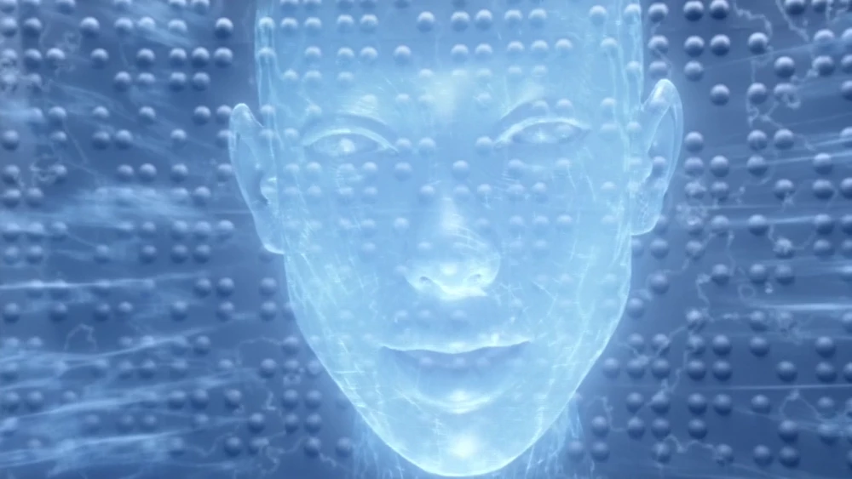
GIDEON
By Ankit( C16465504), Ferdia (C16300581), Aodh( C16405246), Nafeesa(C16715071), Justin(C16402272) and Mikee( C16363646)

Slide 2
Table of Contents
Creation of Gideon
About Barry Allen/The Flash
Diagram of the OS Architecture
Image of OS Desktop
Conclusions

Slide 3
Introduction
How was Gideon created?
Who uses Gideon?
What is Gideon?

Slide 4
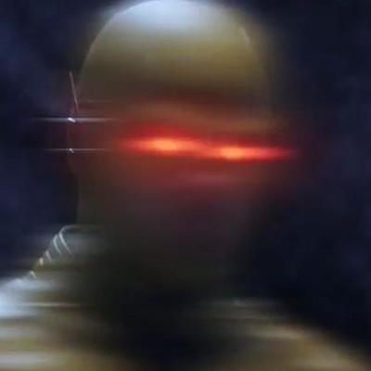
Creation of Gideon
AI used by Barry Allen
Created and brought from future by Barry
Must obey Barry no matter what
Usually used by Eobard Thawne
Eobard Thawne

Slide 5
Biography of Barry Allen

Slide 6
Biography of Barry Allen
Forensic Scientist in Central City
25 years old
Son of Nora and Henry Allen
Is also the Flash
Engaged to Iris West

Slide 7
Early Life
Mother murdered when he was a child and Father was blamed.
Adopted by Joe West.
Bullied as a child.

Slide 8
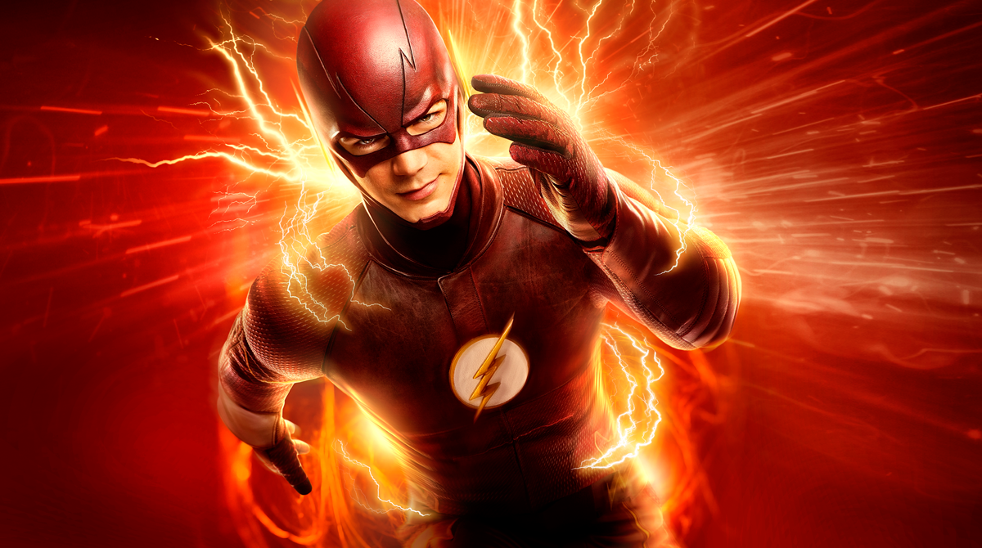
Current Life
He works as a forensic scientist,he also secretly acts as a meta-human vigilante known as the Flash.
Works alongside Team Flash to combat metahuman criminals.
Saved the world numerous times but also irresponsibility changed time a couple of times which caused Flashpoint

Slide 9
Personality of Barry Allen
Barry Allen believes in justice which is caused mostly by his childhood where his Dad was wrongfully accused of his mom’s murder.
Barry is also very stubborn and isn’t quick to learn.
Barry Allen is a good person and wishes to do good in the world however he feels like all the world’s problems rests on his shoulders only.

Slide 10
Powers and features / Weakness

Slide 11
^{Abilities}
Abilities:
Knowledge of the timeline
Medical Knowledge
Telepathy

Slide 12
Weaknesses
Requires electricity: Gideon requires electrical power to operate. \
Shutdown code: Gideon has a shutdown code.

Slide 13
Physical Aspects of Gideon

Slide 14
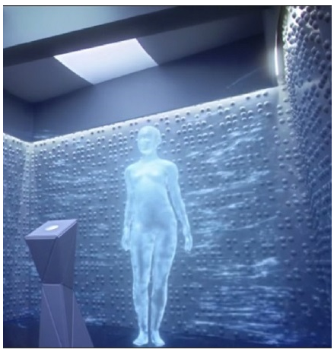
Gideon’s full body when active.

Slide 15
Physical Aspects of Gideon
Conveyed in the show as a holographic human.
Gideon personality is that of a female human.
Is mostly shown as a full-sized holographic head.

Slide 16
Diagram of Gideon’s functionality

Slide 17
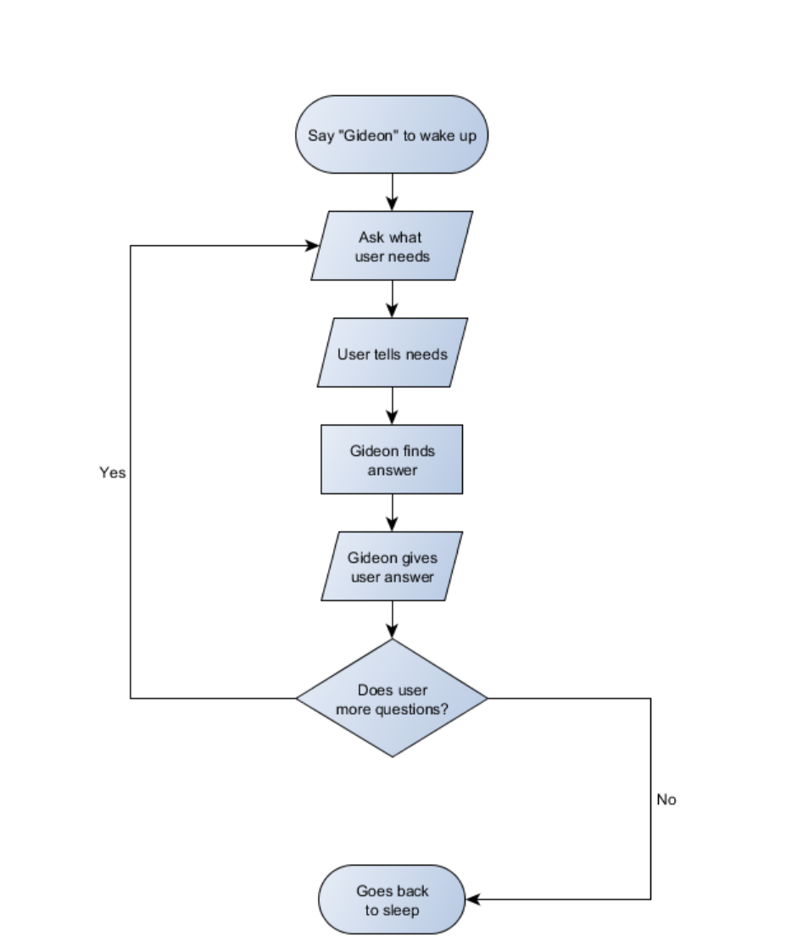

Slide 18
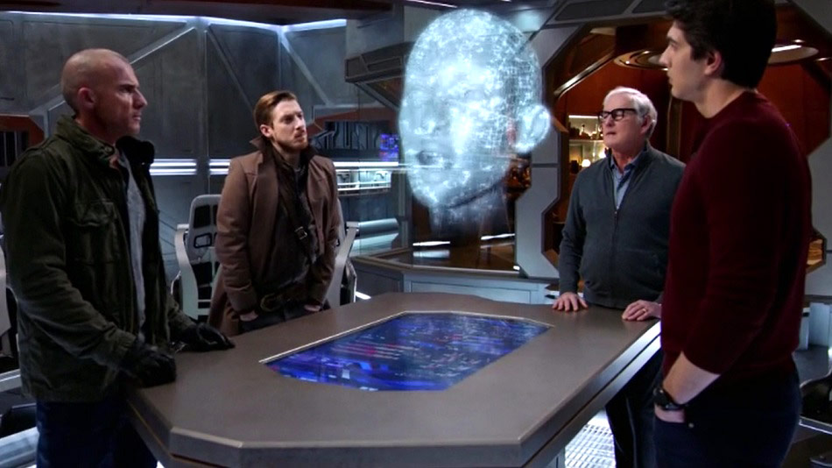
Uses of Gideon
In the Flash, Gideon showed hints of the future for the Barry Allen.
In Legends of Tomorrow, Gideon was shown to be able to heal injured crew members.

Slide 19
Conclusion

Slide 20
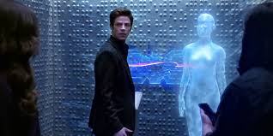
Conclusion
Gideon - created by Barry, used by Thawne
Barry’s mother killed by Thawne
Struck by lightning, became The Flash
Gideon used for information about Past, Present and Future
Used after Thawne by Barry and on the Waverider

