Slide 1
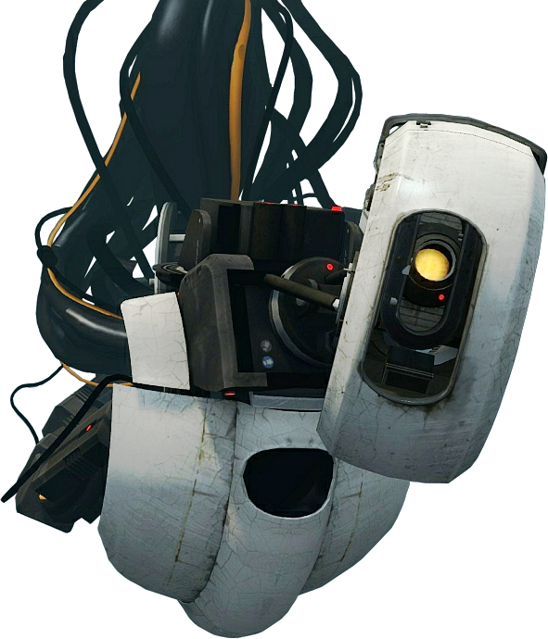
GLADOS
By Combustible Lemons
Combustible Lemons are Patrick Horan C16416742, Thomas Killeen C16394453, Daniel O’Connor C16776635, Yuwei Chen D16123951, Ciaran McHale C16486904, Kieran MacHale C16777089 and Victor Odunlami C16356956

Slide 2
Table Of Contents
Introduction
Biography: Cave Johnson
Purpose/Uses of GLaDOS
Physical Aspects of GLaDOS
Versions of GLaDOS
Architecture/Diagram
GLaDOS running
Conclusions

Slide 3
Introduction
GLaDOS(Genetic Lifeform and Disk Operating System) is essentially the overseer of the Aperture Science enrichment centre.
Made of various cores, GLaDOS is capable of performing a wide variety of tasks.

Slide 4
Biography: Cave Johnson

Slide 5
Cave Johnson
Cave Johnson founded Aperture Fixtures in 1943 as a shower curtain manufacturer.
Later renamed to Aperture Science he innovated in creating new technologies.
As a result of moon rock poisoning his health was deteriorating.
GLaDOS was created as a way to memory map his brain into a computer.

Slide 6
Purpose/uses of Glados

Slide 7
GLaDOS’ Purpose
GLaDOS was initially designed to help run the Aperture Science facility and its test subjects
However, When she was turned on she tried to kill everyone in the Aperture science facility
In response the Aperture scientists made personality cores to attach to GLaDOS

Slide 8
GLaDOS’ Purpose
After this she claimed to have no hostility or desire to hurt anyone
She attained neurotoxin to test a version of the Schrodinger's cat experiment
She flooded the aperture facility with neurotoxin and resumed to complete the experiment with the remaining survivors

Slide 9
GLaDOS’ Abilities
GLaDOS is a complex artificial intelligence system composed of robotic parts
She was installed to act as the enrichment centers central control computer
She guides the test subjects through each test and also controls the entire testing facility by herself

Slide 10
Physical aspects of glados

Slide 11
Personality Cores
Central Core
The power to regulate and control the Enrichment centre, e.g. Camera feeds, Turret Production Lines
Designed to operate as the central core, it can be switched out with other personality cores.

Slide 12
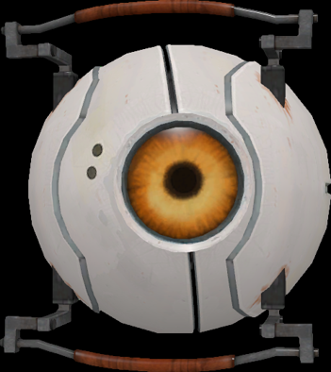
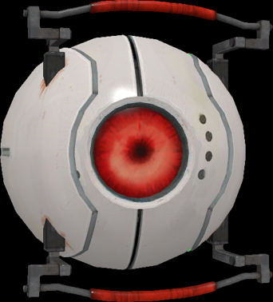
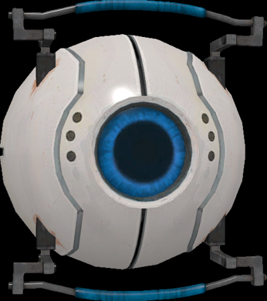
Working Cores
Morality -
Prevents Release of Neurotoxin
Curiosity – Constantly asks questions
Cake/Intelligence – Rambles on about a unique cake recipe
Anger/Emotion – snarls and growls ferociously

Slide 13
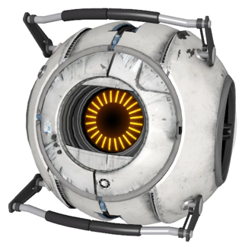
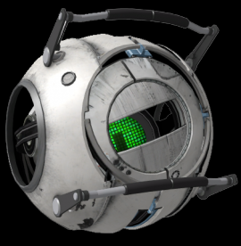
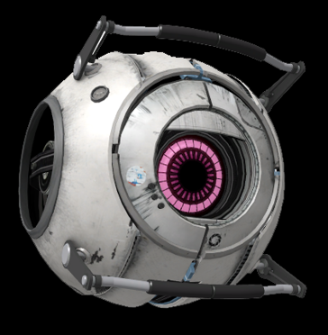
Corrupted Cores
Space Core - “SPAAAAAAAAAAAAAAAAACE
Adventure/Rick Core - “Do you have a gun? 'Cause I should really have a gun. What is that thing you're holding?”
Fact Core - “In 1948, at the request of a dying boy, baseball legend Babe Ruth ate seventy-five hot dogs, then died of hot dog poisoning.”

Slide 14
GLaDOS Architecture

Slide 15
Versions of glados

Slide 16
Early Versions of GLaDOS
Construction began in 1986, with the aim of accelerating the Portal project, however initial work and research began in 1982!
Version 1.0 came online in 1986!
First prototype was completed in 1989, but later abandoned

Slide 17
Evolution of GLaDOS
Version 2.0 came online in 1990
This version of GLaDOS displayed a worrying murderous intent that would later be somewhat remedied by a morality core
In 1996, after the DOS had been brought to a state of basic functionality, work began on the genetic life form component!
Version 3.0 came online in 1998, with the main improvements being the partially functional disk operator !

Slide 18
Current version of GLaDOS
In 1998, GLaDOS’ somewhat finalised version was 3.11!
The same year, GLaDOS was first activated, but quickly shut back down despite Aperture scientists best efforts!
After an unspecified disaster during Aperture’s annual ‘Bring your daughter to work’ day, a morality core was developed to enhance GLaDOS 3.11!
Version 3.11 is the current version of GLaDOS!

Slide 19
GLaDOS running.

Slide 20
Conclusion
After being stabilised with a morality core, GLaDOS became a very important part of Aperture Science as a whole.
GLaDOS is the core reason why Aperture Science was able to continue operating its enrichment centre and the Portal project.

Slide 21
References
Tgrills, GLaDOS(Character), http://www.giantbomb.com/glados/3005-722/, Date Accessed: March 2017
Music Brainz, GLaDOS(Portal-Wiki), https://theportalwiki.com/wiki/GLaDOS, Date Accessed: March 2017
Image Valve, Cave Johnson(Character), https://upload.wikimedia.org/wikipedia/en/f/fa/Portal2_cave_johnson_and_caroline.png , Date Accessed: Apr. 2017
, Cave Johnson (Portal-Wiki) https://theportalwiki.com/wiki/Cave_Johnson, Date Accessed: April 2017
Image Valve, GLaDOS(Character) https://i1.theportalwiki.net/img/thumb/7/79/GLaDOS_P2.png/400px-GLaDOS_P2.png, Date Accessed: Apr. 2017.
Image Valve, GLaDOS(Wikia) http://vignette2.wikia.nocookie.net/epicrapbattlesofhistory/images/d/d7/GLaDOS_Based_On.png/revision/latest?cb=20160507071909, Date Accessed: Apr. 2017
Image Valve, Morality Core(Character), https://theportalwiki.com/wiki/File:MoralityCore.png, Date Accessed: Apr. 2017
Image Valve, Curiosity Core(Character), https://theportalwiki.com/wiki/File:CuriousityCore.png, Date Accessed: Apr. 2017
Image Valve, Logic Core(Character), https://i1.theportalwiki.net/img/5/58/LogicCore.png, Date Accessed: Apr. 2017
Image Valve, Space Core(Character), https://theportalwiki.com/wiki/File:SpaceCore.png, Date Accessed: Apr. 2017
Image Valve, Adventure Core(Character), https://theportalwiki.com/wiki/File:AdventureCore.png. Date Accessed: Apr. 2017
Image Valve, Fact Core (Character), https://theportalwiki.com/wiki/File:FactCore.png,, Date Accessed: Apr. 2017

