Slide 1
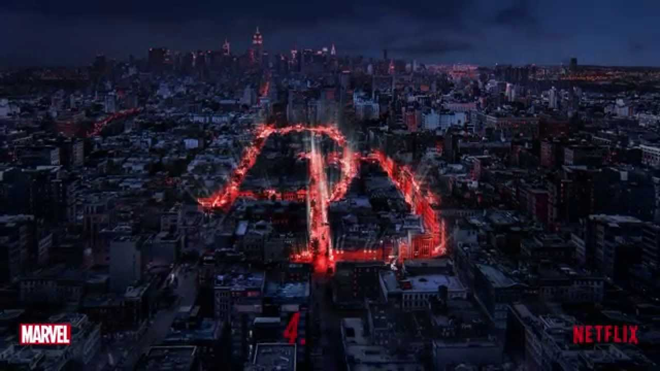
The xDD
Models
The
FDD
Model
Damian Gordon
Damian Gordon

Slide 2
1. Overview

Slide 3
Timeline of Methodologies
1950s Code & Fix
1960s Design-Code-Test-Maintain
1970s Waterfall Model
1980s Spiral Model
1990s Rapid Application Development, V Model
2000s Agile Methods

Slide 4
Overview
xDD
  FDD (Feature-driven Development)
  TDD (Test-driven Development)
  BDD (Behaviour-driven Development)
  MDD (Model-driven Development)
  DDD (Documentation-Driven Development)
  DDD (Domain-Driven Design)
  DDD (Defect-Driven Development)
  RDD (Responsibility-Driven Design)
  UGDD (User Guide-Driven Development)

Slide 5
Overview
xDD
  A collection of software development processes that rely on the repetition of very short development cycles
  Requirements are turned into very specific goals, e.g. features or tests or behaviours.

Slide 6
Timeline of Methodologies
1999
FDD
2004
BDD
2003
TDD
Manifesto for Agile Software Development

Slide 7
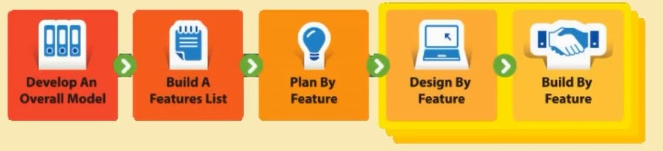
Feature-Driven Development

Slide 8
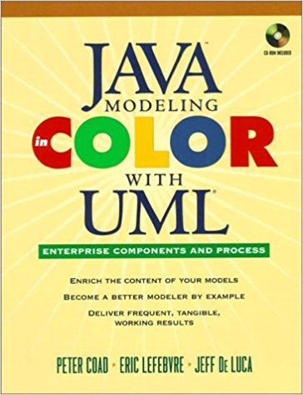
Feature-Driven Development
Coad, P., Lefebvre, E., De Luca, J. (1999) “Java Modelling In Color With UML: Enterprise Components and Process”, Prentice Hall International.

Slide 9

Jeff De Luca
Jeff De Luca is a global information technology strategist and an author in the field of software development methodology.
He is considered the primary architect of Feature Driven Development (FDD)

Slide 10
2. Details

Slide 11
Feature-Driven Development

Slide 12
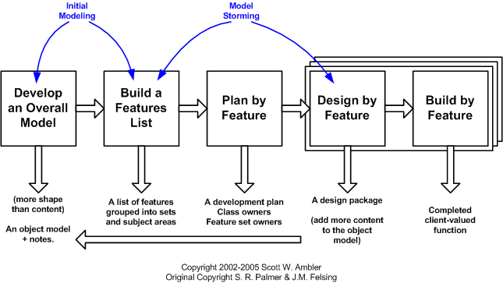
Feature-Driven Development

Slide 13
Feature-Driven Development
FEATURES: Small, client-valued requirements.
A lot of Agile methods are designed for small teams of developer, almost uniquely, FDD was originally developed for a large team.
And as such is designed to compensate for the range of skills that could be found in a large team.

Slide 14
Feature-Driven Development
Develop overall model
Build feature list
Plan by feature
Design by feature
Build by feature

Slide 15
Feature-Driven Development
Initial
Project-wide
Activities
Develop overall model
Build feature list
Plan by feature
Design by feature
Build by feature

Slide 16
Feature-Driven Development
Initial
Project-wide
Activities
Develop overall model
Build feature list
Plan by feature
Design by feature
Build by feature
Iterations
1 … n

Slide 17
Feature-Driven Development
1. Develop overall model
This is unusual for an Agile approach, to build a domain object model, but in FDD this isn’t a large, upfront analysis and design which is a long, drawn-out, activity.
Instead, the model is built in an intense, highly iterative, collaborative and generally enjoyable activity involving ‘domain and development members under the guidance of an experienced object modeller in the role of Chief Architect‘
While not mandatory, the object model is typically built using Peter Coad's modelling in colour technique.

Slide 18
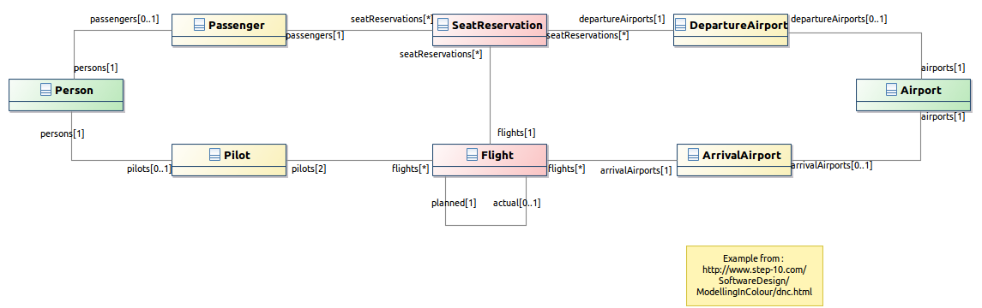
Feature-Driven Development
Coloured UML
Role | Moment, Interval
Description | Party, Place, Thing

Slide 19
Feature-Driven Development
Part of this phase is to help everyone to gain a good, shared understanding of the problem domain. This phase also ensures that there is a high level of communication between all stakeholders.
The object model developed concentrates on breadth rather than depth; depth is added iteratively through the lifetime of the project. The model is a living artefact, throughout the project, the model becomes the primary vehicle around which the team discusses, challenges, and clarifies requirements.

Slide 20
Feature-Driven Development
2. Build feature list
As mentioned above, features are small, client-valued requirements. Small means a feature typically takes 1-3 days to implement, occasionally 5 days but never 10 or more days to implement.
The feature list is a three-level hierarchy. The upper levels in the feature list hierarchy are a set of domain subject areas from the high-level breakdown of the problem domain. Then within these areas, the team identifies the business activities of that area and places individual features within one of those activities.

Slide 21
Feature-Driven Development
3. Plan by Feature
The last initial phase involves constructing an initial schedule and assigning initial responsibilities.
The development team sequence the feature sets based on activities that represent best relative business value, but will later readjust to take into account technical risk and dependencies where appropriate.

Slide 22
Feature-Driven Development
FDD also departs from traditional agile thinking, in that it chooses not to adopt collective ownership of source code. Instead, it assigns individual developers to be responsible for particular classes.
Class ownership implies responsibility not exclusivity, so a class owner may allow another developer to make a change to a class they own. The big difference is that the class owner is aware of, and approves of, the change and is responsible for checking that the change is made correctly.

Slide 23
Feature-Driven Development
4. Design by Feature
Each feature is tackled by a feature team (3-5 designers/developers usually working together for 1-3 days).
Once formed, the Chief Programmer facilitates the collaborative analysis and design of the features for that iteration. Depending on the complexity, this may involve the team walking through the requirements in detail with a domain expert, and studying any existing relevant documents.

Slide 24
Feature-Driven Development
The final step in this phase is to review the design. For simple features, this may be a brief sanity check of the design held within the feature team. For more significant features, the Chief Programmer will typically involve other Chief Programmers or class owners so that they are aware and can comment on the impact of the proposed design.

Slide 25
Feature-Driven Development
5. Build by Feature
This involves the team members coding up the features, testing them at both unit level and feature level, and holding a code inspection before promoting the completed features into the project's regular build process.
FDD expects developers to unit test their code. It expects feature teams to test their features.

Slide 26
Feature-Driven Development
The reason FDD mandates code inspections is that research has shown time and again that when done well, inspections find more defects and different kinds of defects than testing. Not only that but by examining the code of the more experienced, knowledgeable developers on the team and having them explain the idioms they use, less experienced developers learn better coding techniques.

Slide 27
3. Advantages

Slide 28
Advantages
Significantly reduces debug time

Slide 29
Advantages
Shorter software development cycles

Slide 30
Advantages
Code being developed is focused on meeting client requirements

Slide 31
Advantages
Accommodates teams of developers with a wide variety of experience

Slide 32
Advantages
Offers well defined progress tracking and reporting capabilities

Slide 33
Advantages
Project costing is done with greater accuracy

Slide 34
4. Disadvantages

Slide 35
Disadvantages
Can often have very little documentation compared to other methodologies

Slide 36
Disadvantages
Can result in over-reliance on Chief Programmer

Slide 37
Disadvantages
Might not be suitable for a very small team or single developer

Slide 38
Disadvantages
If the requirements are changing rapidly, the goals keep moving

Slide 39
5. Interesting

Slide 40
Interesting
FDD was initially devised to accomplish specific needs of a 15 month, 50 person project at a large Singapore bank.

Slide 41
6. Reflections

Slide 42
Reflections
FDD is designed both for large software development teams and small developments as well.

Slide 43
Reflections
It has been argued that these approaches are more productive than other methodologies, as those are attempting to code in large steps.

Slide 44
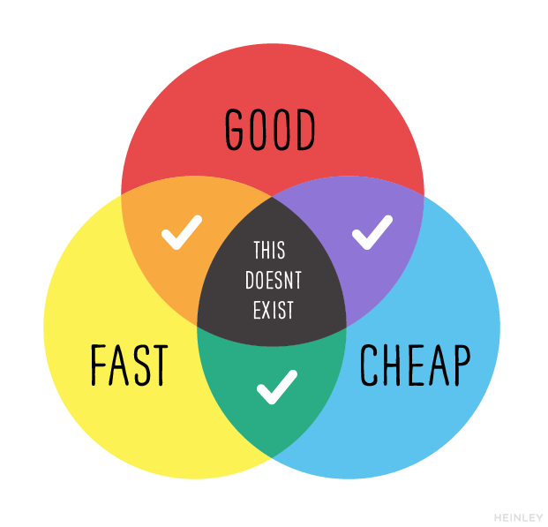
Reflections

Slide 45
8. Summary

