Slide 1
The Java Programming Language
Damian Gordon

Slide 2
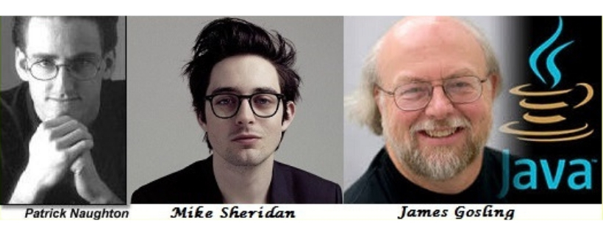
Java Programming Language
Developed by James Gosling, Mike Sheridan, and Patrick Naughton, starting in 1991, with the first public implementation released as Java 1.0 in 1996

Slide 3
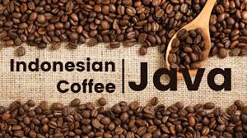
Java Programming Language
Java is an object-oriented programming language, named after the coffee.
Designed as a general-purpose programming language intended to let developers write once, run anywhere (WORA) meaning that compiled Java code can run on all platforms without the need for recompilation.

Slide 4
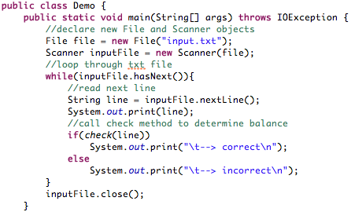
Java Programming Language
What does it look like?

Slide 5
Java Programming Language
The syntax of Java is similar to C and C++, but has fewer low-level facilities than either of them.
Javadoc is a comprehensive documentation system, created by Sun Microsystems. It provides developers with an organized system for documenting their code.

Slide 6
Java Programming Language
Java Version History
JDK Alpha and Beta (1995)
JDK 1.0 (January 23, 1996)
JDK 1.1 (February 19, 1997)
J2SE 1.2 (December 8, 1998)
J2SE 1.3 (May 8, 2000)
J2SE 1.4 (February 6, 2002)
J2SE 5.0 (September 30, 2004)
Java SE 6 (December 11, 2006)
Java SE 7 (July 28, 2011)
Java SE 8 (March 18, 2014)
Java Version History
Java SE 9 (Sept. 21, 2017)
Java SE 10 (March, 20, 2018)
Java SE 11 (September 2018)
Java SE 12 (March 2019)
Java SE 13 (September 2019)
Java SE 14 (March 2020)
Java SE 15 (September 2020)
Java SE 16 (March 2021)
Java SE 17 (September 2021)

