Slide 1
DARK PATTERNS
Damian Gordon

Slide 2
Dark Patterns
Dark Patterns are tricks used in websites and apps that make you do things that you didn't mean to, like buying or signing up for something. The purpose of this site is to spread awareness and to shame companies that use them.

Slide 3
TYPES OF DARK PATTERNS
Trick questions
Sneak into Basket
Roach Motel
Privacy Zuckering
Price Comparison Prevention
Misdirection
Hidden Costs
Bait and Switch
Confirmshaming
Disguised Ads
Forced Continuity
Friend Spam

Slide 4
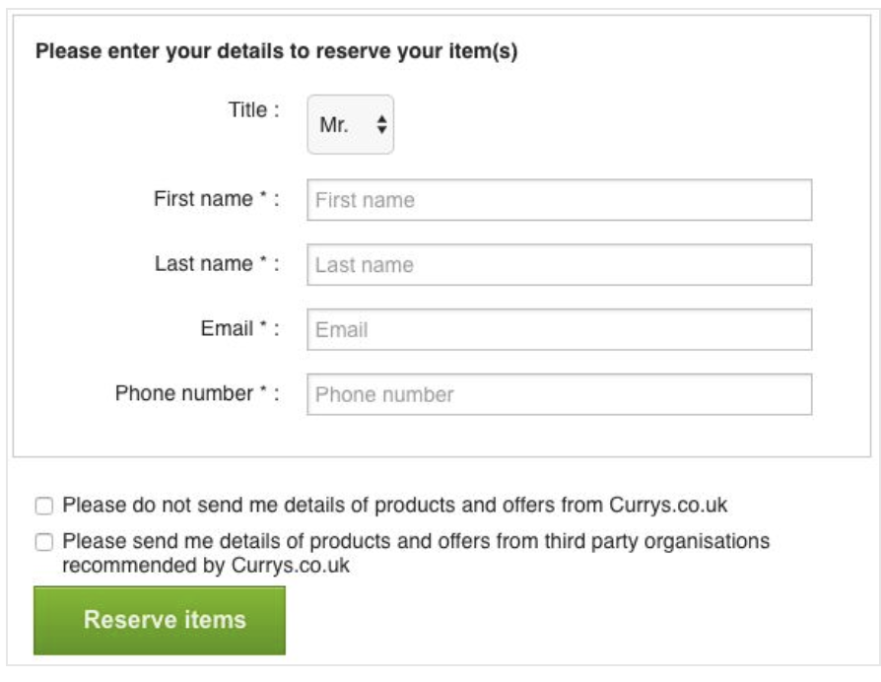
Trick Questions
This is very common when registering with a service. Typically a series of checkboxes is shown, and the meaning checkboxes is alternated so that ticking the first one means "opt out" and the second means "opt in".

Slide 5
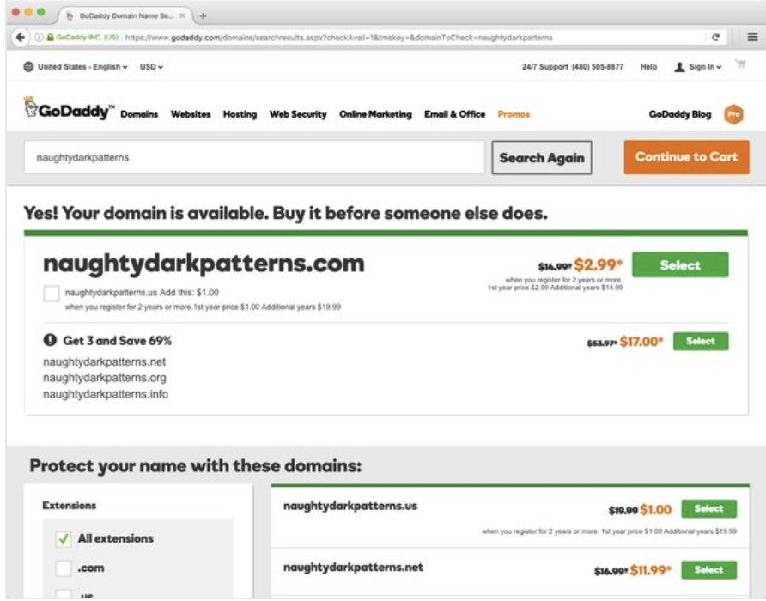
Sneak into Basket
You attempt to purchase something, but somewhere in the purchasing journey the site sneaks an additional item into your basket, often through the use of an opt-out radio button or checkbox on a prior page.

Slide 6
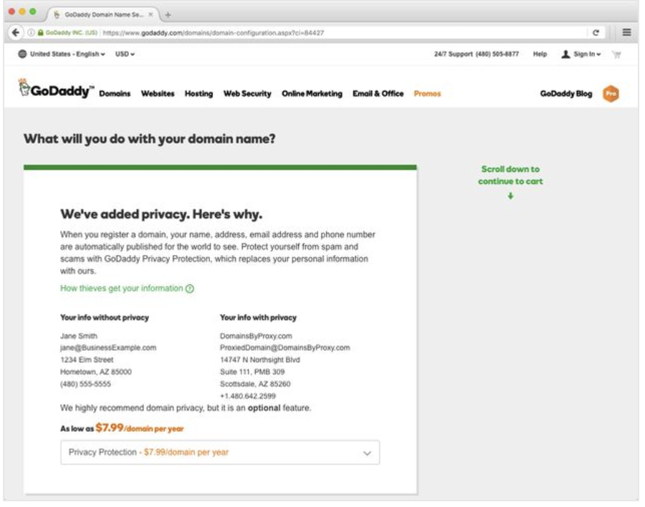
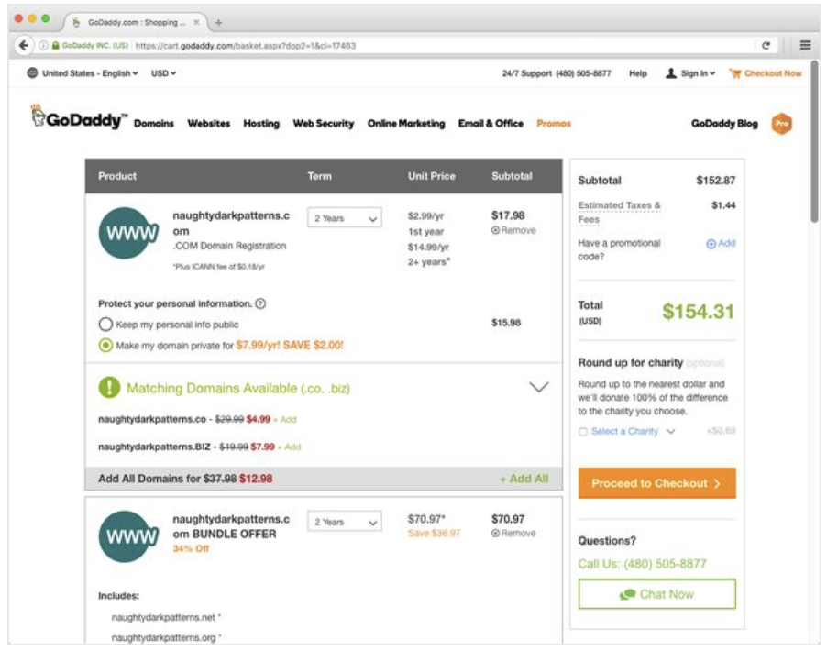
Sneak into Basket
2 years was “sneaked into basket”. Costing of multiple domain names was unclear from the outset.

Slide 7
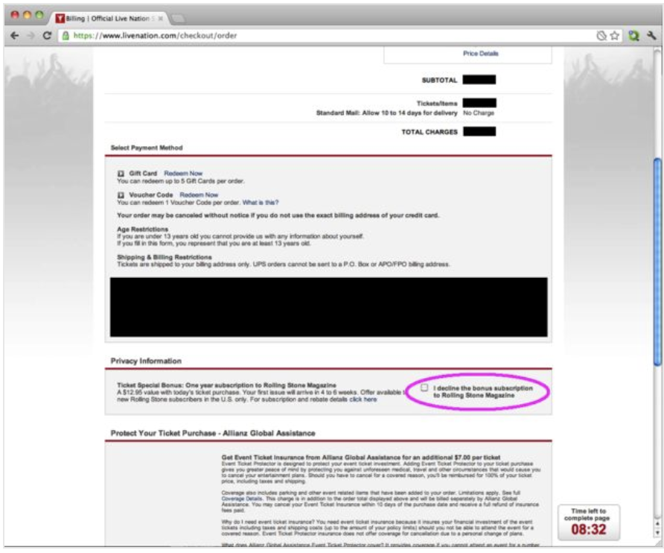
Roach Motel
When purchasing tickets, livenation.com tries to sneak a subscription to a magazine ( into your basket via a trick question on the checkout page, shown in screenshot.
Note that the design is "opt out" - the purchase is made for you automatically unless you notice the checkbox and realise you need to tick it to opt out.

Slide 8
Privacy Zuckering
You are tricked into publicly sharing more information about yourself than you really intended to. Named by Tim Jones as a homage to Facebook CEO Mark Zuckerberg.
In its early days, Facebook had a reputation for making it difficult for users to control their privacy settings, and generally making it very easy to "overshare" by mistake. In response to feedback from consumers and privacy groups, Facebook has created a clearer, easier to use privacy settings area.

Slide 9
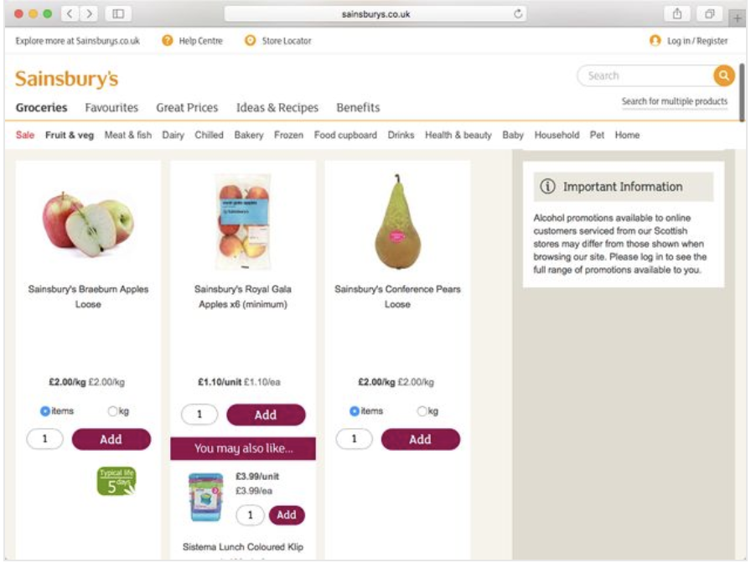
Price Comparison Prevention
The retailer makes it hard for you to compare the price of an item with another item, so you cannot make an informed decision.
Retailers typically achieve this by creating different bundles where it is not easy work out the unit price of the items within the bundles.
In the Sainsbury’s website, it is not possible to compare the price of the first item to the second item.

Slide 10
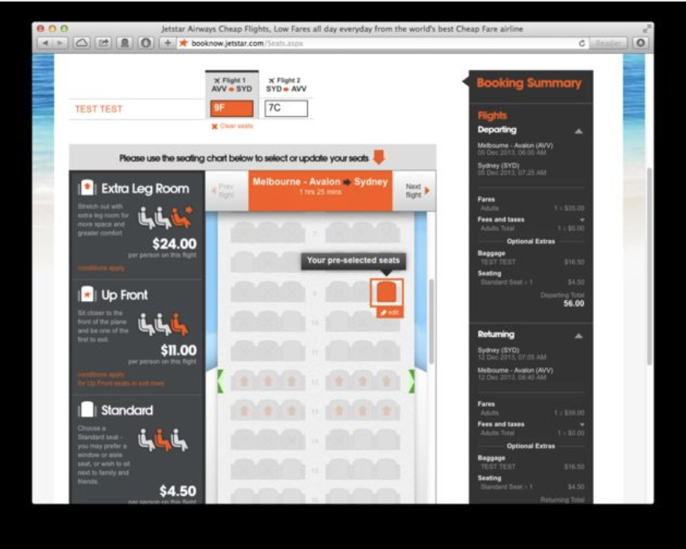
Misdirection
The design purposefully focuses your attention on one thing in order to distract you attention from another.
On jetstar.com, when this page loads, they have already preselected a random seat for you.
They use word-play trickery, as a "preselected" random seat here costs $5, but if you opt out via the tiny "skip seat selection" link at the bottom of the page, you're assigned a random seat without the $5 charge.

Slide 11
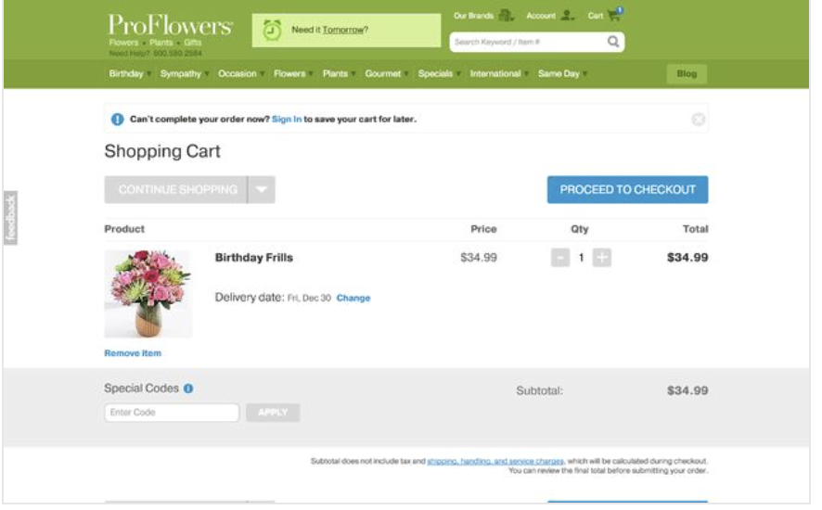
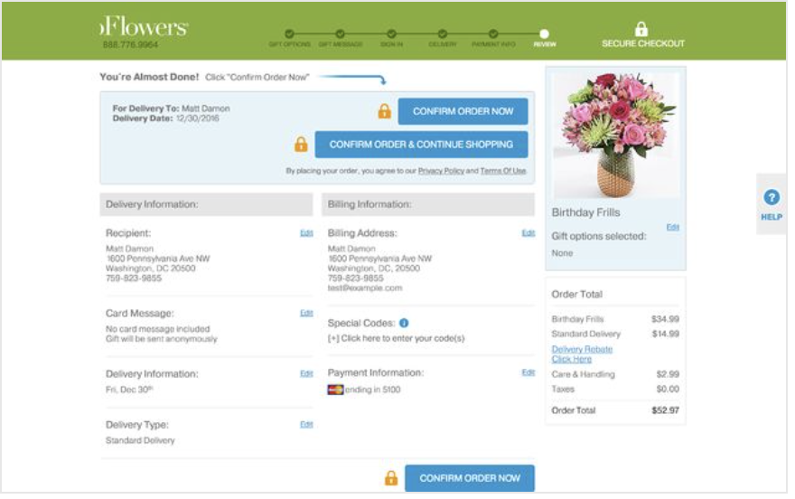
Hidden Costs
You get to the last step of the checkout process, only to discover some unexpected charges have appeared, e.g. delivery charges, tax, etc.

Slide 12
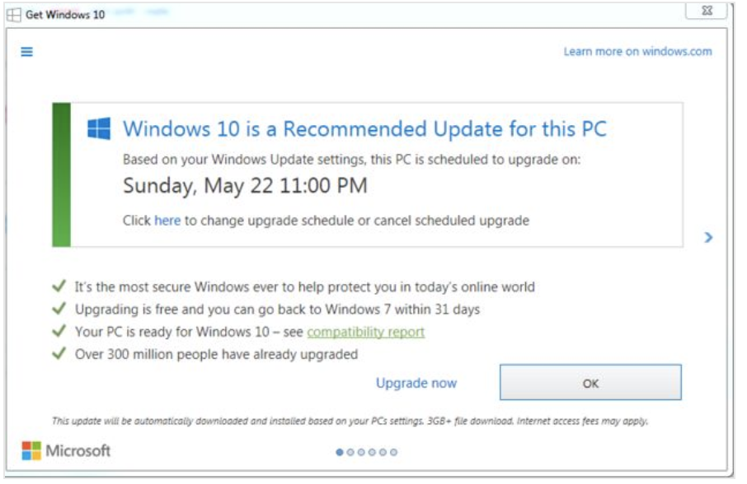
Bait & Switch
The user sets out to do one thing, but a different, undesirable thing happens instead.
The most famous example of digital bait and switch was Microsoft’s misguided approach to getting people to upgrade their computers to Windows 10.

Slide 13
Bait & Switch
They switched the meaning of the “X” button at the top right to mean the opposite of what it normally means. In all other versions of Windows going back to the 1980s, this button means “close”. In this specific instance, they changed it to mean “Yes, I do want to upgrade my computer to Windows 10”.

Slide 14
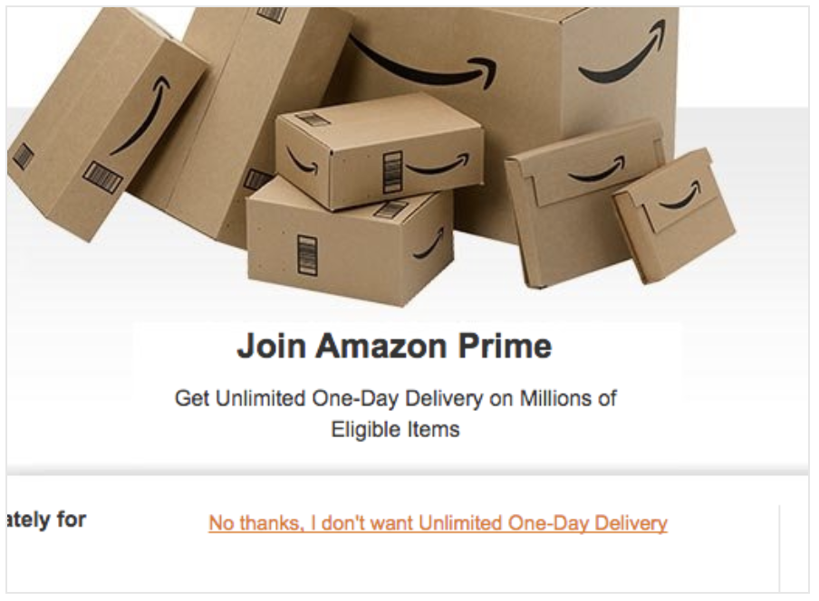
Confirmshaming
Confirmshaming is the act of guilting the user into opting in to something. The option to decline is worded in such a way as to shame the user into compliance.
Amazon uses confirmshaming to guilt users and discourage them from opting out.

Slide 15
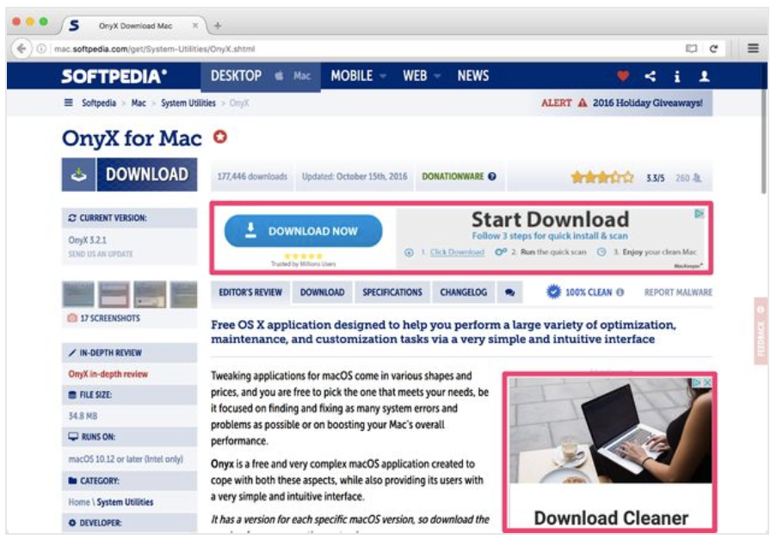
Disguised Ads
Adverts that are disguised as other kinds of content or navigation, in order to get you to click on them.
Softpedia often run advertisements that look like a download button, tricking users into clicking on the ads rather than getting the thing they wanted.
The real download link is at the top left of the page. The disguised ads are highlighted in red.

Slide 16
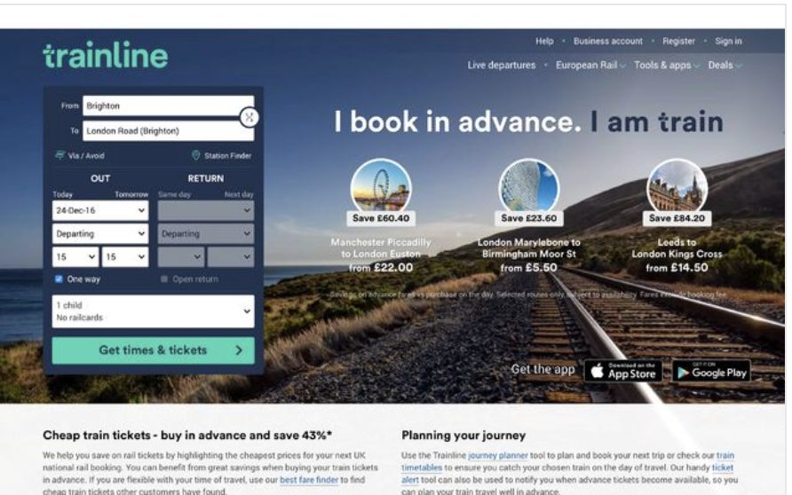
Forced Continuity
When your free trial with a service comes to an end and your credit card silently starts getting charged without any warning. You are then not given an easy way to cancel the automatic renewal.
thetrainline.com allows you to buy a ticket in the normal way.

Slide 17
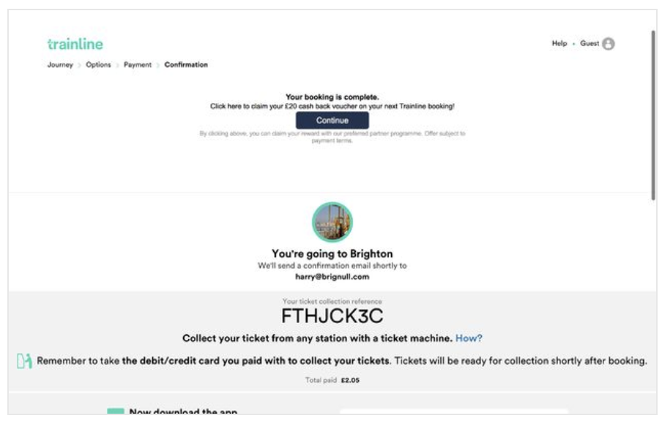
Forced Continuity
When you complete the process, you are taken to a confirmation page, as shown below. The top box of content on the page is a disguised ad, using the same font and the same dark blue button style used by thetrainline.com.
Having clicked a continue button a few times during the checkout process, you're very likely to think you need to click this button too, just to finish your booking. In fact, this isn't true.

Slide 18
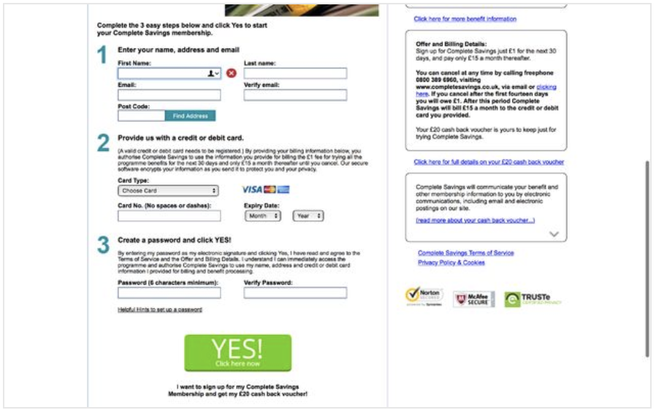
Forced Continuity
When you click the continue button, you're taken to another site (one-time-offer.com), which tries to convince you to sign up for a £20 money-off voucher.
If you sign up to this service, you are enrolled into a £15 a month subscription which continues forever

Slide 19
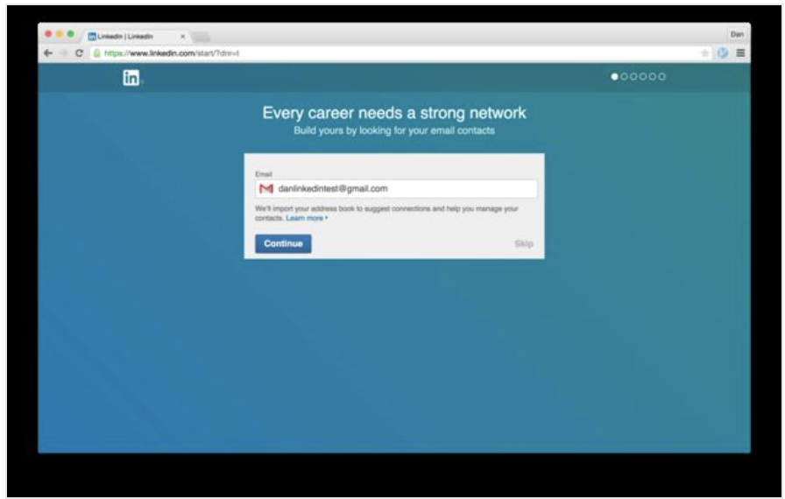
Friend Spam
The product asks for your email or social media permissions under the pretence it will be used for a desirable outcome (e.g. finding friends), but then spams all your contacts in a message that claims to be from you.
As part of the sign-up process to Linkedin, they encourage you to give them access to your email account, on the premise that it will give "your career a strong network" (see below).

Slide 20
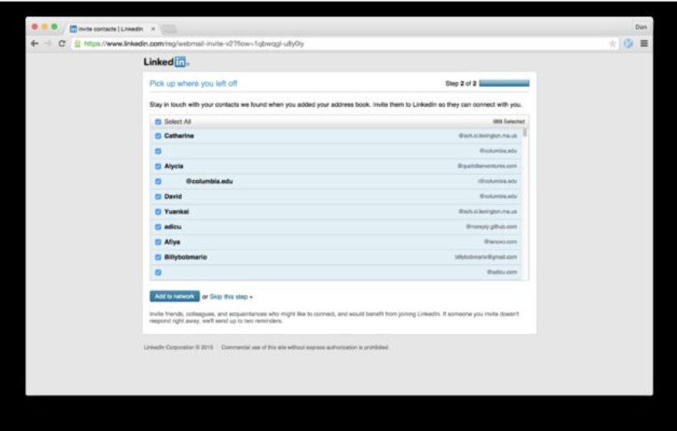
Friend Spam
If you allow yourself to be guided through the steps, you're taken to the page shown below. If you click the innocent-sounding button "Add to network" you are inadvertently giving Linkedin permission to spam every person you've ever emailed.

