Slide 1
The Java Programming Language: Object-Oriented Programming
Damian Gordon

Slide 2
Java Programming Language
We remember the “Hello, World!” program:

Slide 3
Java Programming Language
public class HelloWorld {
public static void main(String args[]) {
System.out.print("Hello World\n");
}
}

Slide 4
Java Programming Language
public class HelloWorld {
public static void main(String args[]) {
System.out.print("Hello World\n");
}
}
METHOD

Slide 5
Java Programming Language
CLASS
public class HelloWorld {
public static void main(String args[]) {
System.out.print("Hello World\n");
}
}
METHOD

Slide 6
Java Programming Language
public class HelloWorld {
public static void main(String args[]) {
System.out.print("Hello World\n");
}
}

Slide 7
Java Programming Language
public class HelloWorld {
public static void main(String args[]) {
System.out.print("Hello World\n");
}
}

Slide 8
Java Programming Language
public class HelloWorld {
public static void main(String args[]) {
System.out.print("Hello World\n");
}
}

Slide 9
Java Programming Language
public class HelloWorld {
public static void main(String args[]) {
System.out.print("Hello World\n");
}
}

Slide 10
Java Programming Language
public class HelloWorld {
public static void main(String args[]) {
System.out.print("Hello World\n");
}
}

Slide 11
Java Programming Language
public class HelloWorld {
public static void main(String args[]) {
System.out.print("Hello World\n");
}
}

Slide 12
Java Programming Language
Let’s look at that one line at a time:

Slide 13
Java Programming Language
System.out.print("Hello World\n");
System: A class that contains several useful Input/Output attributes and methods. It cannot be instantiated.
out: An output class that helps write content to the screen.
print: Prints the string enclosed in double quotes.

Slide 14
Java Programming Language
public static void main(String args[]) {
public: Public is an access modifier for classes and methods, and means they are accessible by any other class.
static: There won’t be an object created from the class that this method is in.
void: means that this method doesn’t return anything.
main: This is the first method Java will visit, the main method.
String []args: Any command line arguments are put into the argument-string, like parameters that go into the program.

Slide 15
Java Programming Language
public static void main(String args[]) {
public: Public is an access modifier for classes and methods, and means they are accessible by any other class.
static: There won’t be an object created from the class that this method is in.
void: means that this method doesn’t return anything.
main: This is the first method Java will visit, the main method.
String []args: Any command line arguments are put into the argument-string, like parameters that go into the program.
class HelloWorld {
public static int main(String args[])
{
System.out.println(“Hello World");
return 1;
}
}

Slide 16
Java Programming Language
public static void main(String []args) {
public: Public is an access modifier for classes and methods, and means they are accessible by any other class.
static: There won’t be an object created from the class that this method is in.
void: means that this method doesn’t return anything.
main: This is the first method Java will visit, the main method.
String []args: Any command line arguments are put into the argument-string, like parameters that go into the program.
class HelloWorld {
public static int main(String args[])
{
System.out.println(“Hello World");
return 1;
}
}

Slide 17
Java Programming Language
public class HelloWorld {
public: Public is an access modifier for classes and methods, and means they are accessible by any other class.
class: Used to create a class.
HelloWorld: This can be whatever name you want (except for keywords and built-in function names.

Slide 18
Java Programming Language
public class HelloWorld {
public static void main(String args[]) {
System.out.print("Hello World\n");
}
}

Slide 19
Java Programming Language
public class HelloWorld {
public static void main(String args[]) {
System.out.print("Hello World\n");
}
}

Slide 20
Java Programming Language
public class HelloWorld{public static void main(String args[]){System.out.print("Hello World\n");}}

Slide 21
Java Programming Language
public class HelloWorld{public static void main(String args[]){System.out.print("Hello World\n");}}

Slide 22
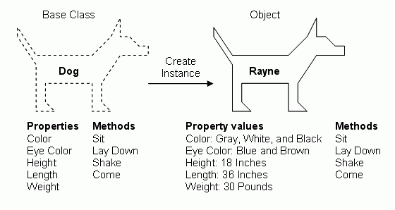
Tiny

Slide 23
Java Programming Language
public class MyDog {
// Attributes
String HairColour;
public static void main(String[] args) {
MyDog Tiny = new MyDog();
Tiny.HairColour = "Black";
System.out.println(Tiny.HairColour);
}
}

Slide 24
Java Programming Language
public class AddressBook {
// Attributes
String FirstName;
String LastName;
int age;
public static void main(String[] args) {
AddressBook MyBook = new AddressBook();
MyBook.FirstName = "Damian";
MyBook.LastName = "Gordon";
MyBook.age = 24;
System.out.println("Name: " + MyBook.FirstName + " " + MyBook.LastName);
System.out.println("Age: " + MyBook.age);
}
}

Slide 25
etc.

