Slide 1
We’ll Start at 7pm !!!

Slide 2
The Java Programming Language: History
Damian Gordon

Slide 3
Java Programming Language
ALGOL 58 (1958) => ALGOL 60 (1960) => CPL (1963) => BCPL (1967) => B (1969) => C (1972) => C++ (1985) => Java (1996)

Slide 4
Java Programming Language
In 1990 Sun Microsystems created a team (the Green Team) to explore next generation smart appliances.
The began to develop a new programming language, originally called Oak, but changed to Java.

Slide 5
Java Programming Language
Members of the Green Team included Al Frazier, Joe Palrang, Mike Sheridan, Ed Frank, Don Jackson, Faye Baxter, Patrick Naughton, Chris Warth, James Gosling, Bob Weisblatt, David Lavallee, Jon Payne, Cindy Long, Chuck Clanton, Sheueling Chang and Craig Forrest.

Slide 6
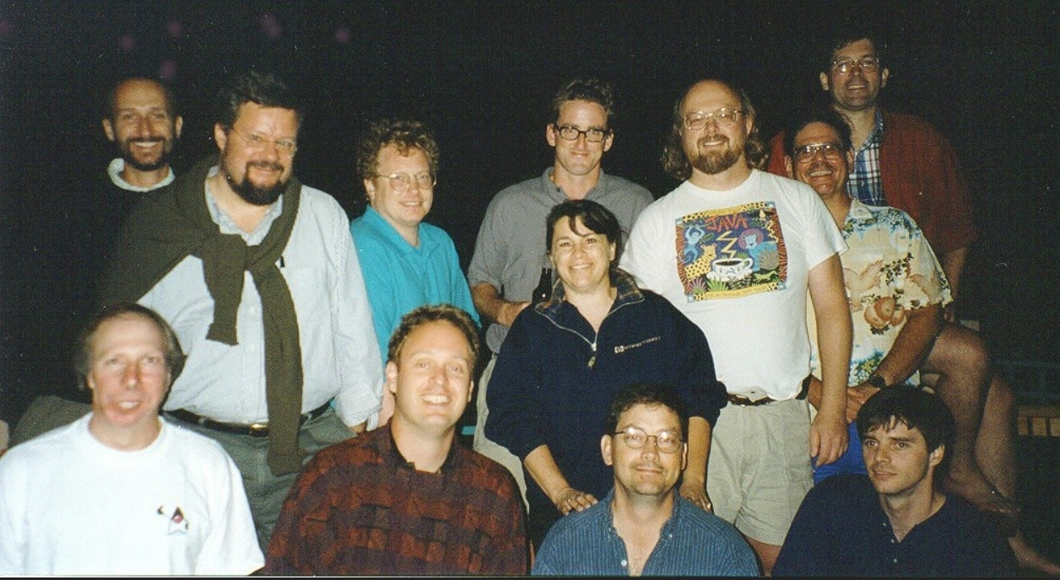

Slide 7
Patrick
Naughton
James
Gosling
Mike
Sheridan

Slide 8
Java Programming Language
James Gosling, Patrick Naughton and Mike Sheridan were the principal architects of Java.

Slide 9
Java Programming Language
Java is an object-oriented programming language designed to be as portable as possible, meaning that compiled Java code can run on all platforms that support Java without the need for recompilation.
Java applications are typically compiled to bytecode that can run on any Java virtual machine (JVM) regardless of the underlying computer architecture.

