Slide 1
Object-Orientated Design: Part 1
Damian Gordon

Slide 2
Object Orientation
An object is any tangible thing we can see touch and manipulate.

Slide 3
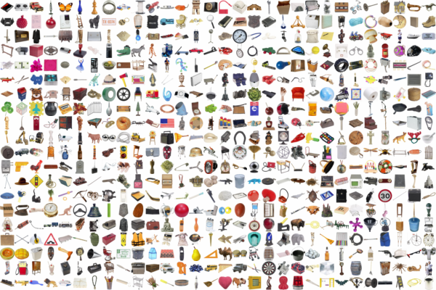
Object Orientation

Slide 4
Object Orientation
Software objects are models are similar in the sense that they have certain features and can do certain things.

Slide 5
Object

Slide 6
Features
Behaviours

Slide 7
Attributes
Methods

Slide 8
Attributes:
A Collection of variables
Attributes
Methods

Slide 9
Attributes:
A Collection of variables
Attributes
Methods
Methods:
A Collection of procedures

Slide 10
Dog
Weight
Height
Eye Colour
Hair Colour
Length
Lie Down( )
Fetch( )
Roll Over( )
Sit( )
Bark( )

Slide 11
Encapsulation
Attributes
Methods

Slide 12
Object Orientation
To create an object what we typically do is first create the general class that a specific object comes from, and then we create a specific object of that class.
For example, if a want to model a specific dog, first create the general CLASS of DOG, and then create a specific instance of that class, an OBJECT, called TINY the dog.

Slide 13
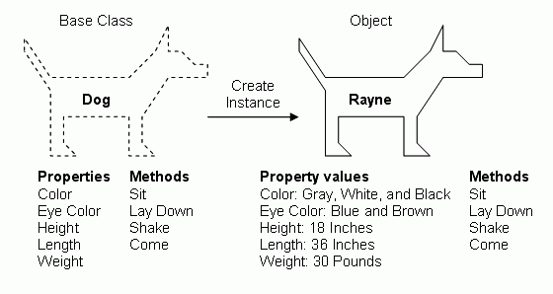
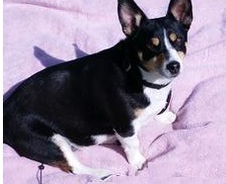
Tiny

Slide 14
Object Orientation
Sometimes it’s easier to model things as an OBJECT, but often it’s easier to model a collection of things as a CLASS, and then create instances (‘OBJECTS’) of that CLASS.
We can use UML (the Unified Modelling Language) to model Object-Orientated programs, and one modelling tool within UML is called a CLASS DIAGRAM.

Slide 15
Object Orientation
Let’s imagine we wanted to create a CLASS DIAGRAM for the following scenario:
We work in a greengrocer, we sell APPLES and ORANGES; APPLES are stored in BARRELS and ORANGES are stored in BASKETS.

Slide 16
Object Orientation
APPLES are stored in BARRELS and ORANGES are stored in BASKETS.

Slide 17
Object Orientation
APPLES are stored in BARRELS and ORANGES are stored in BASKETS.
Apple

Slide 18
Object Orientation
APPLES are stored in BARRELS and ORANGES are stored in BASKETS.
Apple
Barrel

Slide 19
Object Orientation
APPLES are stored in BARRELS and ORANGES are stored in BASKETS.
Apple
Barrel
Orange

Slide 20
Object Orientation
APPLES are stored in BARRELS and ORANGES are stored in BASKETS.
Apple
Barrel
Orange
Basket

Slide 21
Object Orientation
Let’s add in more rules to the scenario:
Many APPLES are stored in one BARREL and many ORANGES are stored in one BASKET.

Slide 22
Object Orientation
Many APPLES are stored in one BARREL and many ORANGES are stored in one BASKET.
Apple
Barrel
*
1
*
1
Orange
Basket

Slide 23
Object Orientation
Many APPLES are stored in one BARREL and many ORANGES are stored in one BASKET.
Apple
Barrel
*
go in >
1
go in >
*
1
Orange
Basket

Slide 24
Object Orientation
Let’s add some attributes:

Slide 25
Object Orientation
Apple
Barrel
+colour
+weight
+size
*
go in >
1
go in >
*
1
Orange
Basket
+weight
+orchard
+date_picked
+location

Slide 26
Object Orientation
Apple
Barrel
+colour: string
+weight: float
+size: int
*
go in >
1
go in >
*
1
Orange
Basket
+weight: float
+orchard: string
+date_picked: date
+location: string

Slide 27
Object Orientation
Apple
Barrel
+colour: string
+weight: float
+barrel: Barrel
+size: int
+apples: list
*
go in >
1
go in >
*
1
Orange
Basket
+weight: float
+orchard: string
+date_picked: date
+basket: Basket
+location: string
+oranges: list

Slide 28
Object Orientation
Now let’s add some methods:

Slide 29
Object Orientation
Apple
Barrel
+colour: string
+weight: float
+barrel: Barrel
+size: int
+apples: list
+pick(backet: Basket)
+squeeze( ): juice
+sell(cust: Customer)
+discard( )
*
go in >
1

Slide 30
Object Orientation
go in >
*
1
Orange
Basket
+weight: float
+orchard: string
+date_picked: date
+basket: Basket
+location: string
+oranges: list
+pick(backet: Basket)
+squeeze( ): juice
+sell(cust: Customer)
+discard( )

Slide 31
etc.

