Slide 1
Attributes:
A Collection of variables
Attributes
Methods
Methods:
A Collection of procedures

Slide 2
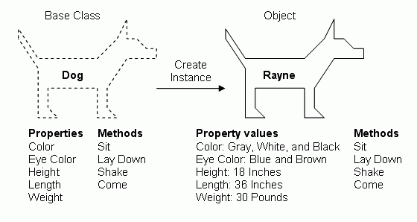
Tiny

Slide 3
Object Orientation
Apple
Barrel
+colour: string
+weight: float
+barrel: Barrel
+size: int
+apples: list
+pick(backet: Basket)
+squeeze( ): juice
+sell(cust: Customer)
+discard( )
*
go in >
1

Slide 4
Object Orientation
go in >
*
1
Orange
Basket
+weight: float
+orchard: string
+date_picked: date
+basket: Basket
+location: string
+oranges: list
+pick(backet: Basket)
+squeeze( ): juice
+sell(cust: Customer)
+discard( )

Slide 5
Object Orientation
Player
Position
2
64
make_move >
1
1
Chess Set
1
1
32
Piece
1
Board

Slide 6
Object Orientation
Piece
Castle
+chess_set: ChessSet
+colour: Sting
Pawn
+shape: String
+shape: String
+move(Board)
+move(Board)
Bishop
Queen
King
Knight
+shape: String
+shape: String
+shape: String
+shape: String
+move(Board)
+move(Board)
+move(Board)
+move(Board)

Slide 7
Java Programming Language
public class HelloWorld {
public static void main(String args[]) {
System.out.print("Hello World\n");
}
}

Slide 8
Java Programming Language
CLASS
public class HelloWorld {
public static void main(String args[]) {
System.out.print("Hello World\n");
}
}
METHOD

Slide 9
Java Programming Language
import java.util.Scanner;
public class GetFibonacci {
public static void main(String args[])
{
// Variables
int NumberInputted;
int previouspreviousNumber;
int previousNumber = 0;
int currentNumber = 1;
// Read In
Scanner input = new Scanner(System.in);
NumberInputted = input.nextInt();

Slide 10
Java Programming Language
// Close Scanner
input.close();
//Get Fibonacci
for (int i = 1; i < NumberInputted ; i++) {
previouspreviousNumber = previousNumber;
previousNumber = currentNumber;
currentNumber = previouspreviousNumber + previousNumber;
}
System.out.println("The Fib number is " + currentNumber);
}
}

Slide 11
Arrays
We declare an array as follows:
int[] Age;
Which means we declare an unspecified number of integer variables, all can be accessed using the Age name.
0
1
2
3
4
5
6
7
……..…
38
39
Age

Slide 12
Arrays
public class AverageArray {
public static void main(String args[]) {
int[] Age = {45,24,43,34,17,55,35,19};
int Total = 0;
for (int i=0; i < Age.length; i++) {
Total = Total + Age[i];
}
System.out.println(Total/Age.length);
}
}

Slide 13
Sorting: Bubble Sort
public class BubbleSort {
public static void main(String args[]) {
int[] Age = {44,23,42,33,16,54,34,18};
int TempValue = 0;

Slide 14
Sorting: Bubble Sort
for (int j=0; j < Age.length; j++) {
for (int i=0; i < Age.length - 1; i++) {
if (Age[i+1] < Age[i]) {
TempValue = Age[i+1];
Age[i+1] = Age[i];
Age[i] = TempValue;
}
}
}

Slide 15
Sorting: Bubble Sort
for (int k=0; k < Age.length; k++)
System.out.println(Age[k]);
}
}

Slide 16
Modularisation
public static void main(String args[])
{
// Variables
int NumberInputted;
// Print Out
//System.out.println("Please enter an Integer number:");
// Read In
Scanner input = new Scanner(System.in);
NumberInputted = input.nextInt();
// Close Scanner
input.close();

Slide 17
Modularisation
if (CheckPrime(NumberInputted) == true)
System.out.println(NumberInputted + " is a prime.");
else
System.out.println(NumberInputted + " is not a prime.");
}
}

Slide 18
Modularisation
static boolean CheckPrime(int NumberPassedIn) {
boolean IsPrime = true;
for (int i = 2; i < NumberPassedIn; i = i + 1) {
if (NumberPassedIn % i == 0) {
IsPrime = false;
}
}
return IsPrime;
}

Slide 19
Searching: Sequential Search
public class SequentialSearchClass {
public static void main(String[] args) {
int[] ExampleArray = {2, 9, 6, 7, 4, 5, 3, 0, 1};
int ExampleTarget = 4;
SequentialSearch(ExampleArray, ExampleTarget);
}

Slide 20
Searching: Sequential Search
static void SequentialSearch(int[] InputArray, int InputTarget)
{
int index = -1;
for (int i = 0; i < InputArray.length; i++) {
if (InputArray[i] == InputTarget) {
index = i;
break;
}
}

Slide 21
Variable Scope
Local
Variable
public class VariableScope {
// Attributes
String GlobalVar = "Global Variable";
public class VariableScope {
// Attributes
public static String GlobalVar = "Global Variable";
Global
Variable

Slide 22
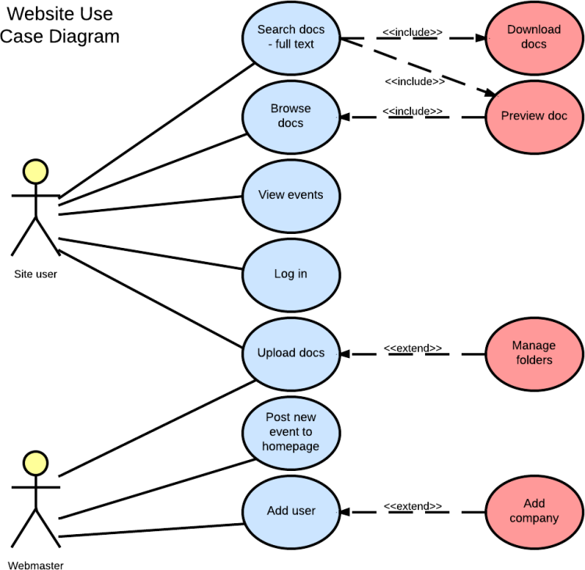

Slide 23
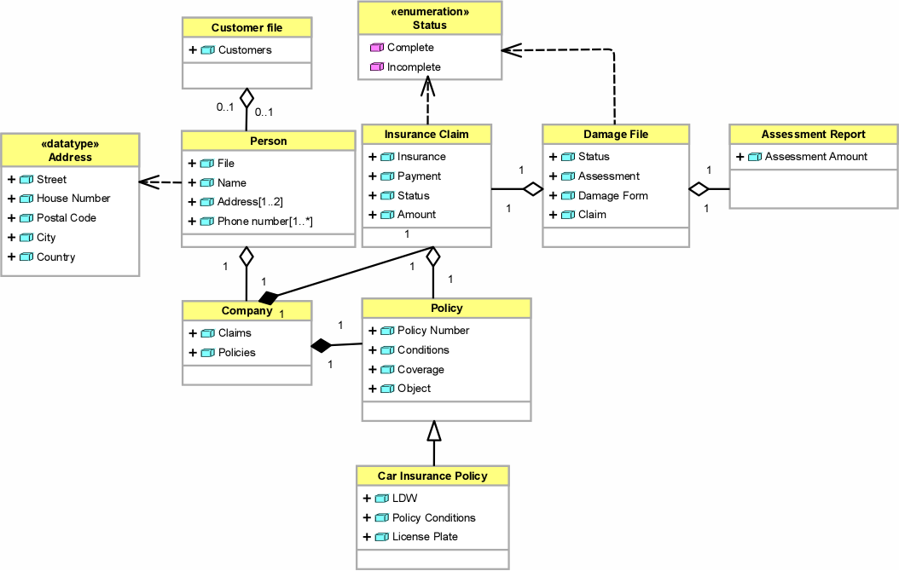

Slide 24
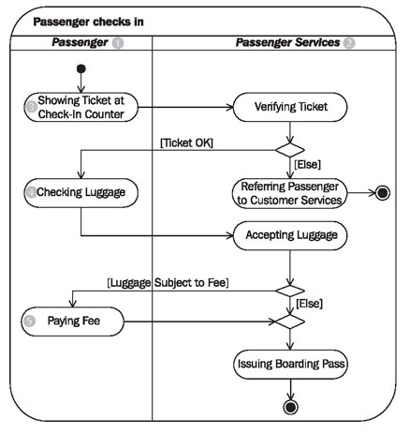
Activity Diagram

Slide 25
Object Orientation
public static void main(String[] args) {
Animal myAnimal = new Animal(); // Create Animal object
Animal myDog = new Dog(); // Create a Dog object
Animal myPig = new Pig(); // Create a Pig object
Animal myCat = new Cat(); // Create a Cat object
myAnimal.animalSound();
myDog.animalSound();
myPig.animalSound();
myCat.animalSound();
}
}

Slide 26
Sample Design Patterns
Type | Description
Algorithm strategy patterns | Addressing concerns related to high-level strategies.
Computational design patterns | Addressing concerns related to key computation identification.
Execution patterns | Addressing concerns related to lower-level support of application execution.
Implementation strategy patterns | Addressing concerns related to implementing source code.
Structural design patterns | Addressing concerns related to global structures.

Slide 27
Object-Oriented Programming
public static void main(String[] args) {
GetAndSet myGetAndSet = new GetAndSet();
System.out.println(myGetAndSet.get_X());
myGetAndSet.set_X(5);
System.out.println(myGetAndSet.get_X());
}
}

Slide 28
Access Modifiers
For attributes and methods
public means the code is accessible by any other class.
private means the code is accessible only within this class.
protected means the code is accessible within this class and all subclasses.
blank (or default) means the class is accessible only by classes that this class is in the same folder as.

Slide 29
Interfaces
// Interface
interface Animal {
public void animalSound();
public void sleep();
}

Slide 30
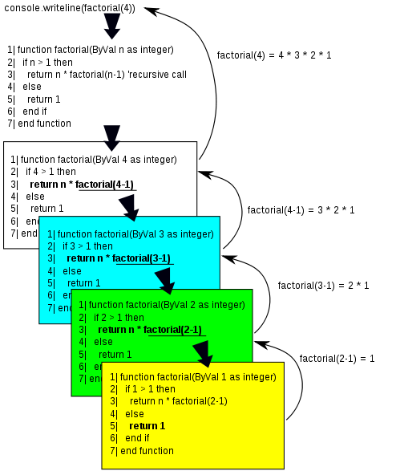
Recursion

Slide 31
Super
Animal
Dog
class Dog extends Animal { // Subclass (child)
public void animalSound() {
super.animalSound(); // Call the superclass
System.out.println("The dog says: bow wow");
}
}

Slide 32
Super
The super keyword refers to superclass (parent) objects.
It is used to call superclass methods, and to access the superclass constructor.
When we use the keyword super, we say “the child class overrides the parent class”.

Slide 33
Try-Catch Statement
public class Main {
public static void main(String[ ] args) {
try {
int[] myNumbers = {1, 2, 3};
System.out.println(myNumbers[10]);
} catch (Exception e) {
System.out.println("Something went wrong.");
}
}
}

