Slide 1
The Java Programming Language: Recursion
Damian Gordon

Slide 2
Recursion

Slide 3
Recursion

Slide 4
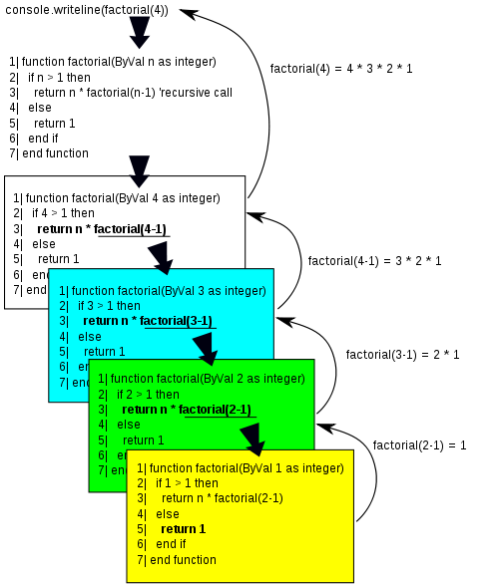
Recursion

Slide 5
Recursion: Factorial
Recursion is a feature of modularisation, when a module can call itself to complete a solution.

Slide 6
Recursion: Factorial
Recursion is a feature of modularisation, when a module can call itself to complete a solution.
Let’s remember factorial:
7! = 7 * 6 * 5 * 4 * 3 * 2 * 1

Slide 7
Recursion: Factorial
Recursion is a feature of modularisation, when a module can call itself to complete a solution.
Let’s remember factorial:
7! = 7 * 6 * 5 * 4 * 3 * 2 * 1
and
6! = 6 * 5 * 4 * 3 * 2 * 1

Slide 8
Recursion: Factorial
So
7! = 7 * (6 * 5 * 4 * 3 * 2 * 1)

Slide 9
Recursion: Factorial
So
7! = 7 * (6 * 5 * 4 * 3 * 2 * 1)
is
7! = 7 * 6!

Slide 10
Recursion: Factorial
So
7! = 7 * (6 * 5 * 4 * 3 * 2 * 1)
is
7! = 7 * 6!
and
9! = 9 * 8 * 7 * 6 * 5 * 4 * 3 * 2 * 1
9!= 9 * (8 * 7 * 6 * 5 * 4 * 3 * 2 * 1)
9! = 9 * 8!

Slide 11
Recursion: Factorial
Or, in general:

Slide 12
Recursion: Factorial
Or, in general:
N! = N * (N-1)!

Slide 13
Recursion: Factorial
Or, in general:
N! = N * (N-1)!
or
Factorial(N) = N * Factorial(N-1)

Slide 14
Recursion: Factorial
Let’s remember how we did Factorial iteratively:

Slide 15
Recursion: Factorial
PROGRAM Factorial:
READ Value;
Total <- 1;
WHILE (Value != 0)
DO Total <- Value * Total;
Value <- Value - 1;
ENDWHILE;
PRINT Total;
END.

Slide 16
Recursion: Factorial
Now this is how we implement the following:
Factorial(N) = N * Factorial(N-1)

Slide 17
Recursion: Factorial
MODULE Fact(N):
IF (N <= 0)
THEN RETURN 1;
ELSE RETURN N * Fact(N-1);
ENDIF;
END.
PROGRAM Factorial:
Get Value;
PRINT Fact(Value);
END.

Slide 18
Recursion: Factorial
MODULE Fact(N):
IF (N <= 0)
THEN RETURN 1;
ELSE RETURN N * Fact(N-1);
ENDIF;
END.
PROGRAM Factorial:
Get Value;
PRINT Fact(Value);
END.

Slide 19
Recursion: Factorial
So if N is 5

Slide 20
Recursion: Factorial
So if N is 5
MODULE Fact(5) returns
5 * Fact(4)

Slide 21
Recursion: Factorial
So if N is 5
MODULE Fact(5) returns
5 * Fact(4)
5 * 4 * Fact(3)

Slide 22
Recursion: Factorial
So if N is 5
MODULE Fact(5) returns
5 * Fact(4)
5 * 4 * Fact(3)
5 * 4 * 3 * Fact(2)

Slide 23
Recursion: Factorial
So if N is 5
MODULE Fact(5) returns
5 * Fact(4)
5 * 4 * Fact(3)
5 * 4 * 3 * Fact(2)
5 * 4 * 3 * 2 * Fact(1)

Slide 24
Recursion: Factorial
So if N is 5
MODULE Fact(5) returns
5 * Fact(4)
5 * 4 * Fact(3)
5 * 4 * 3 * Fact(2)
5 * 4 * 3 * 2 * Fact(1)
5 * 4 * 3 * 2 * 1 * Fact(0)

Slide 25
Recursion: Factorial
So if N is 5
MODULE Fact(5) returns
5 * Fact(4)
5 * 4 * Fact(3)
5 * 4 * 3 * Fact(2)
5 * 4 * 3 * 2 * Fact(1)
5 * 4 * 3 * 2 * 1 * Fact(0)
5 * 4 * 3 * 2 * 1 * 1

Slide 26
Recursion: Factorial
So if N is 5
MODULE Fact(5) returns
5 * Fact(4)
5 * 4 * Fact(3)
5 * 4 * 3 * Fact(2)
5 * 4 * 3 * 2 * Fact(1)
5 * 4 * 3 * 2 * 1 * Fact(0)
5 * 4 * 3 * 2 * 1 * 1
120

Slide 27
Recursion: Factorial
public class Factorial {
public static void main(String[] args) {
int result = Fact(5);
System.out.println(result);
}
public static int Fact(int n) {
if (n > 1) {
return n * Fact(n - 1);
} else {
return 1;
}
}
}

Slide 28
Recursion: Factorial
public class Factorial {
public static void main(String[] args) {
int result = Fact(5);
System.out.println(result);
}
public static int Fact(int n) {
if (n > 1) {
return n * Fact(n - 1);
} else {
return 1;
}
}
}

Slide 29
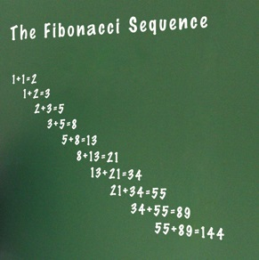
Recursion: Fibonacci
The Fibonacci numbers are numbers where the next number in the sequence is the sum of the previous two.
The sequence starts with 1, 1,
And then it’s 2
Then 3
Then 5
Then 8
Then 13

Slide 30
Recursion: Fibonacci
Let’s remember how we did Fibonacci iteratively:

Slide 31
Recursion: Fibonacci
PROGRAM FibonacciNumbers:
READ A;
FirstNum <- 1;
SecondNum <- 1;
WHILE (A != 2)
DO Total <- SecondNum + FirstNum;
FirstNum <- SecondNum;
SecondNum <- Total;
A <- A – 1;
ENDWHILE;
PRINT Total;
END.

Slide 32
Recursion: Fibonacci
Now let’s look at the recursive version:

Slide 33
Recursion: Fibonacci
MODULE RecurFib(N):
IF N == 1 OR N == 2:
THEN RETURN 1;
ELSE RETURN RecurFib(N-1) + RecurFib(N-2);
ENDIF;
END.
PROGRAM FibonacciNumbers:
READ A;
PRINT RecurFib(A);
END.

Slide 34
Recursion: Fibonacci
public class FibonacciNumbers {
public static void main(String[] args) {
int result = RecurFib(6);
System.out.println(result);
}
public static int RecurFib(int n) {
if (n > 2) {
return RecurFib(n - 1) + RecurFib(n - 2);
} else {
return 1;
}
}
}

Slide 35
etc.

