Slide 1
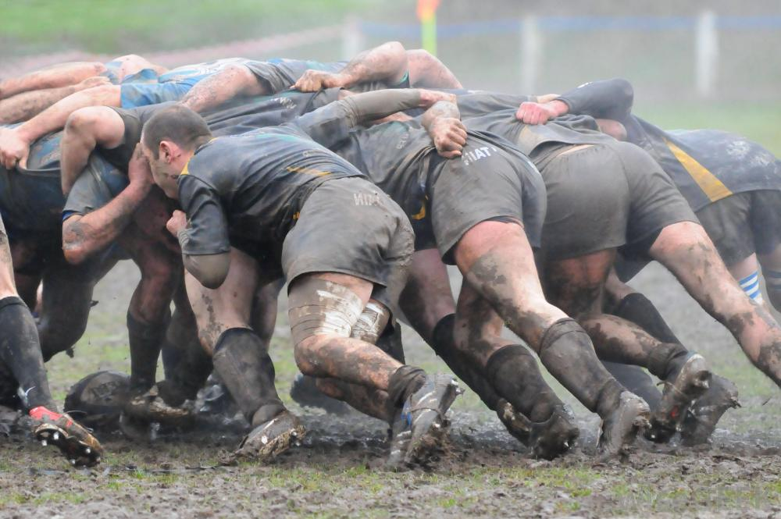
The Scrum Model
The Scrum Model
Damian Gordon
Damian Gordon

Slide 2
Contents
Overview
Details
Advantages
Disadvantages
Interesting
Reflection
Review
Summary

Slide 3
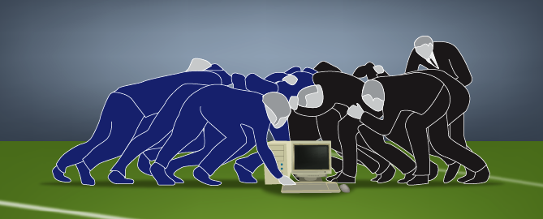

Slide 4
1. Overview

Slide 5
Overview
The “Scrum Model” is a model that represents one method as to how software can be developed.

Slide 6
Timeline of Methodologies
1950s Code & Fix
1960s Design-Code-Test-Maintain
1970s Waterfall Model
1980s Spiral Model
1990s Rapid Application Development, V Model
2000s Agile Methods

Slide 7
Timeline of Methodologies
1950s Code & Fix
1960s Design-Code-Test-Maintain
1970s Waterfall Model
1980s Spiral Model
1990s Rapid Application Development, V Model
2000s Agile Methods

Slide 8
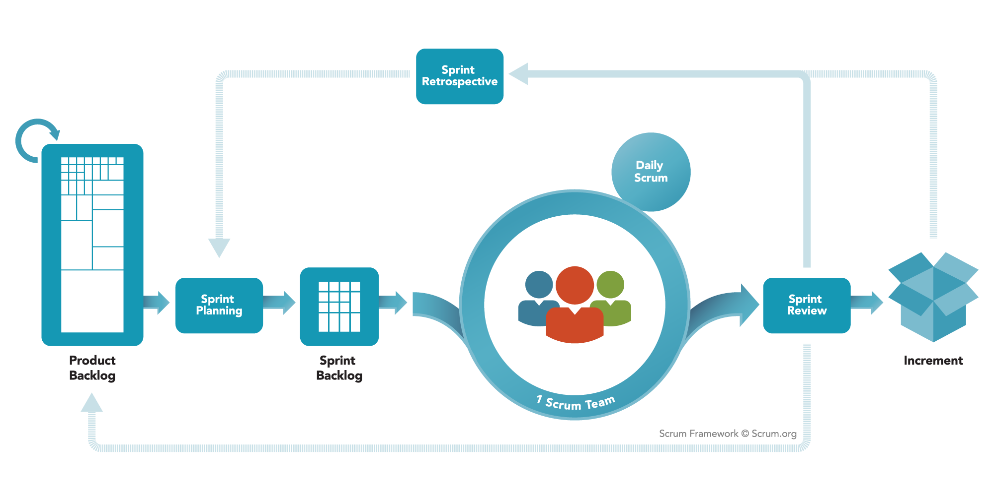
Overview

Slide 9
Overview
Scrum has its roots in a 1986 paper by Hirotaka Takeuchi and Ikujiro Nonaka.
They talk about how forming effective teams is like a rugby match scrum.

Slide 10
Reference
Takeuchi, H., Nonaka, I. (1986) "The New Product Development Game“, Harvard Business Review, pp.137-146.

Slide 11
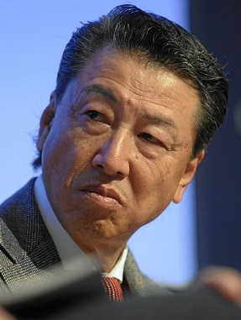
Hirotaka Takeuchi
Born in 1946.
a Japanese international business strategy professor, who works Hitotsubashi University
Takeuchi is best known for his book written with Ikujirō Nonaka “The Knowledge-Creating Company: How Japanese Companies Create the Dynamics of Innovation”

Slide 12
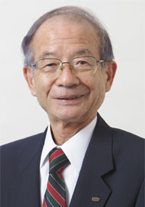
Ikujirō Nonaka
Born in 1935.
a Japanese international business strategy professor, who works Hitotsubashi University
Takeuchi is best known for his book written with Hirotaka Takeuchi “The Knowledge-Creating Company: How Japanese Companies Create the Dynamics of Innovation”

Slide 13
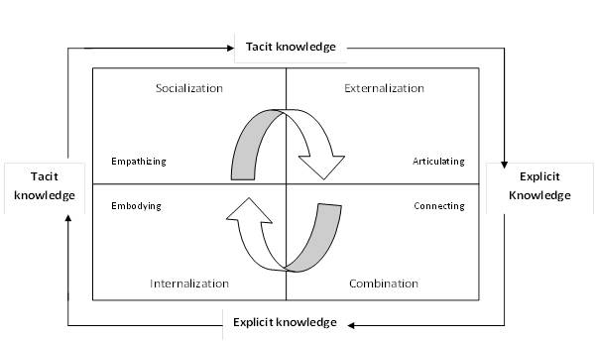
SECI Model
Also created by Takeuchi and Nonaka

Slide 14
Overview
Following on from Takeuchi and Nonaka’s work, Ken Schwaber and Jeff Sutherland jointly presented a paper describing the Scrum framework at the Business Object Design and Implementation workshop.

Slide 15
Reference
Sutherland, J., Schwaber, K. (1995) “Business Object Design and Implementation”, Object-Oriented Programming, Systems, Languages & Applications (OOPSLA) '95 workshop Proceedings, University of Michigan. pp.118-141.

Slide 16
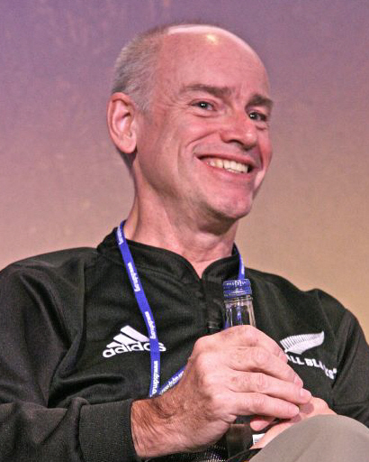
Ken Schwaber
Born in 1945.
a software developer, product manager and industry consultant.
Schwaber is one of the leaders of the Agile Software Development movement, and is a founder of the Agile Alliance, and he is responsible for founding the Scrum Alliance.

Slide 17
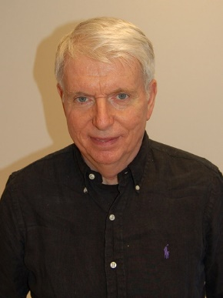
Jeff Sutherland
a Top Gun pilot, a medical doctor and a product manager and industry consultant.
Sutherland is one of the leaders of the Agile Software Development movement, and is a founder of the Agile Alliance.

Slide 18
2. Details

Slide 19
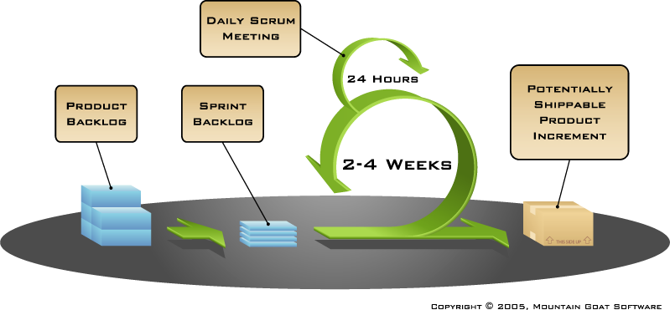
Scrum

Slide 20
Scrum
Divide the project into little parts.
Develop each part in 2-4 weeks.
During those 2-4 weeks have a meeting every day.
Use visual aids to motivate the development process.

Slide 21
Scrum
Scrum focuses on developing the product in a series of fixed-length iterations called sprints (usually 2-4 weeks).
This give teams a framework for shipping software on a regular rhythm.
Milestones – i.e., the end of a sprint – come frequently, bringing with them a feeling of tangible progress with each cycle that focuses and energizes everyone.

Slide 22
Scrum
Scrum calls for four ceremonies that bring structure to each sprint:
Sprint planning: A team planning meeting that determines what to complete in the coming sprint.
Daily stand-up: Also known as a Daily Scrum, a 15-minute mini-meeting for the software team to sync.
Sprint demo: A sharing meeting where the team shows what they've shipped in that sprint.
Sprint retrospective: A review of what did and didn't go well with actions to make the next sprint better.

Slide 23
Scrum
During a sprint, visual artefacts like task boards and burndown charts, visible to the team and spectators alike, are powerful motivators.

Slide 24
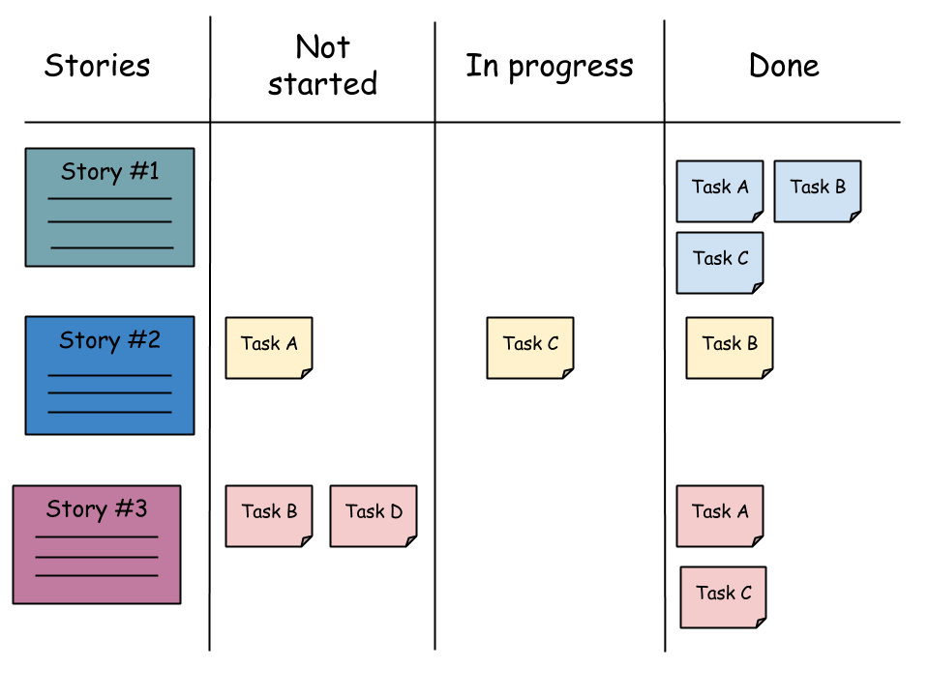
Scrum
Task boards:

Slide 25
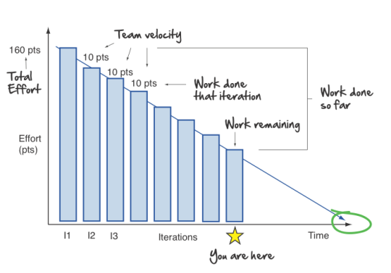
Scrum
Burndown charts:

Slide 26
Scrum
A scrum team has a slightly different composition than a traditional waterfall project, with three specific roles:
product owner,
scrum master, and
the development team.
Because scrum teams are cross-functional, "the development team" includes testers, designers, and ops engineers in addition to developers.

Slide 27
Scrum
The Project Owner:
creates a prioritized wish list called a product backlog
closely partners with the business and the team to ensure everyone understands the work items in the product backlog
gives the team clear guidance on which features to deliver next
decides when to ship the product with a preference towards more frequent delivery

Slide 28
Scrum
This is a role has to be done by a single individual who bring a single unified view to the project.
This role is not the same as a project manager.
The Project Owner ensures that the development team delivers the most value to the business.

Slide 29
Scrum
The Scrum Master is the champion for scrum within their team.
They coach the team, the product owner, and the business on the scrum process and look for ways to fine-tune their practice of it.
An effective scrum master deeply understands the work being done by the team and can help the team optimize their delivery flow.
They schedule the needed resources (both human and logistical) for sprint planning, stand-up, sprint review, and the sprint retrospective.

Slide 30
Scrum
The Scrum Master also look to resolve impediments and distractions for the development team, insulating them from external disruptions whenever possible.
Part of the scrum master's job is to defend against a pattern common among teams new to scrum: changing the sprint's scope after it has already begun.

Slide 31
Scrum
The Scrum Team controls its own destiny and self-organizes around their work.
Agile teams use pull models where the team pulls a certain amount of work off the backlog and commits to completing it that sprint, which is very effective in maintaining quality and ensuring optimum performance of the team over the long-term.

Slide 32
Scrum
The most effective Scrum Teams are tight-knit, co-located, and usually 5 to 7 members. Team members have differing skill sets, and cross-train each other so no one person becomes a bottleneck in the delivery of work.
The Scrum Team drives the plan for each sprint. They forecast how much work they believe they can complete over the iteration using their historical velocity as a guide.

Slide 33
3. Advantages

Slide 34
Advantages
Large project are divided into manageable amounts

Slide 35
Advantages
Software developments are coded and tested during the sprint review

Slide 36
Advantages
Works well for fast-moving development projects

Slide 37
Advantages
Scrum, being agile, adopts feedback from customers and stakeholders

Slide 38
Advantages
The individual effort of each team member is visible during daily scrum meetings

Slide 39
Advantages
Short sprints enable changes based on feedback a lot more easily

Slide 40
4. Disadvantages

Slide 41
Disadvantages
Scrum often leads to scope creep, due to the lack of a definite end-date

Slide 42
Disadvantages
Adopting the Scrum framework in large teams is challenging

Slide 43
Disadvantages
The framework can be successful only with experienced team members

Slide 44
Disadvantages
If any team member leaves the project in the middle, it has a huge negative impact on the project

Slide 45
Disadvantages
Quality is hard to implement, until the team goes through aggressive testing process

Slide 46
5. Interesting

Slide 47
Interesting
Many projects involve learning, innovation and surprises, so a major recurring theme of Scrum is to “inspect and adapt”

Slide 48
Interesting
Scrum is not just about processes – it’s a different style of working which is energetic, collaborative, and flexible.

Slide 49
Interesting
The Scrum team need to create their own Definition of Done
A programmer might call something done when the code has been written. The tester might think that done means that all of the tests have passed. A business person may think that done means we can now sell it to customers, and it's ready for them to use.

Slide 50
Interesting
The Scrum Guide was written and is maintained by the creators of Scrum, Ken Schwaber and Jeff Sutherland and is considered as the Body of Knowledge for Scrum.
http://www.scrumguides.org

Slide 51
Interesting
The scrum of scrums is a technique to operate Scrum at scale, for multiple teams working on the same product, allowing them to discuss progress on their interdependencies, focusing on how to coordinate delivering software, especially on areas of overlap and integration.

Slide 52
Interesting
Scrum is an great solution to support rapid project progress of almost any type of project. It is extremely effective in creating agility for any organization.

Slide 53
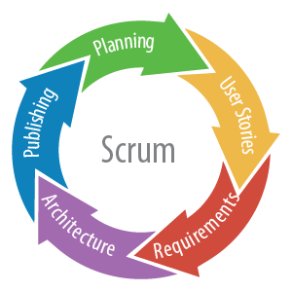
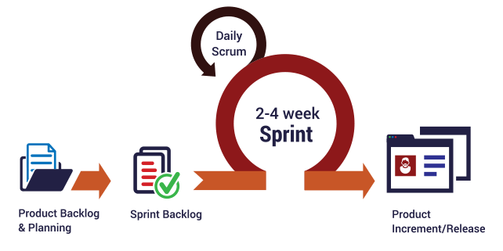
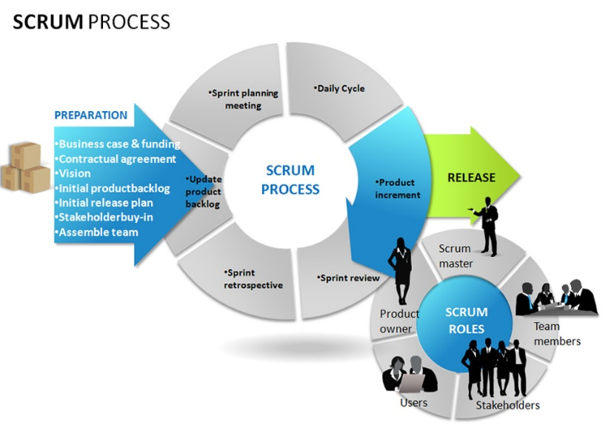
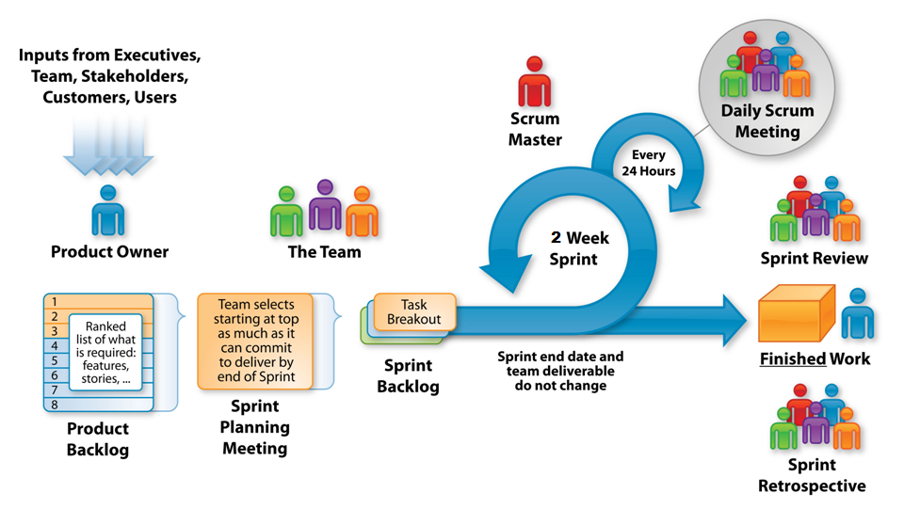
Interesting
There are other versions of the Model:

Slide 54
6. Reflections

Slide 55
Reflections
You don’t have to be a technical person to understand Scrum

Slide 56
Reflections
Scrum has a definite and repeating rhythm for completing work.

Slide 57
Reflections
The ability of individuals is trusted and their availability is known before committing to anything.

Slide 58
Reflections
Some people on the team will love Scrum and some people will hate it.
This is perfectly normal and you should encourage people on the team to give it a proper try before they give up.
If an individual ends up giving up, then remove them from the team and let another one step in.

Slide 59
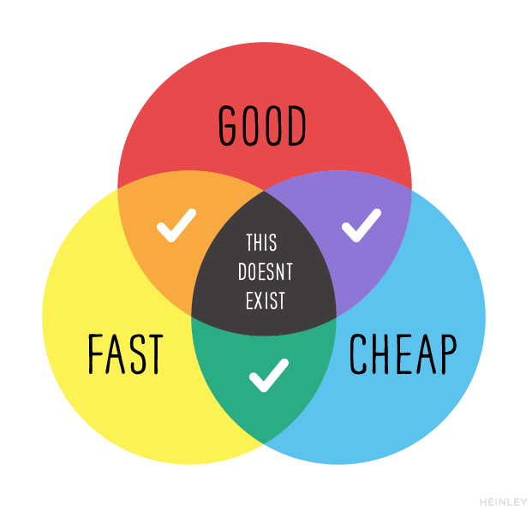
Reflections

Slide 60
7. Review

Slide 61
Review
What did we learn?

Slide 62
8. Summary

Slide 63
Summary

Slide 64
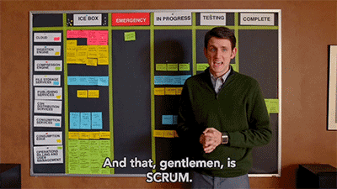
And that, ladies and gentlemen, is SCRUM.

