Slide 1
The xDD Models
The xDD Models
Damian Gordon
Damian Gordon

Slide 2
Contents
Overview
Details
Advantages
Disadvantages
Interesting
Reflection
Review
Summary

Slide 3
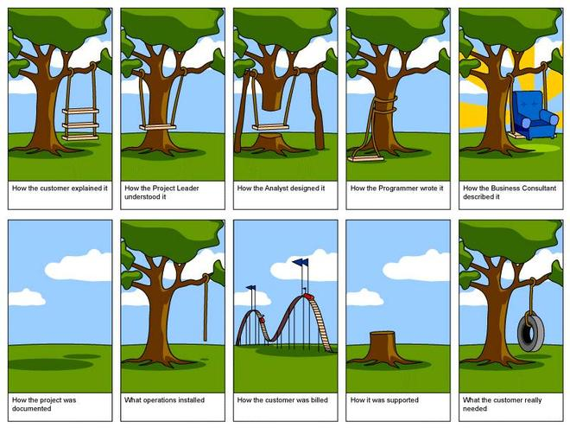

Slide 4
1. Overview

Slide 5
Overview
xDD
FDD (Feature-driven Development)
TDD (Test-driven Development)
BDD (Behaviour-driven Development)
MDD (Model-driven Development)
DDD (Documentation-Driven Development)
DDD (Domain-Driven Design)
DDD (Defect-Driven Development)
RDD (Responsibility-Driven Design)
UGDD (User Guide-Driven Development)

Slide 6
Overview
xDD
A collection of software development processes that rely on the repetition of very short development cycles
Requirements are turned into very specific goals, e.g. features or tests or behaviours.

Slide 7
Timeline of Methodologies
1950s Code & Fix
1960s Design-Code-Test-Maintain
1970s Waterfall Model
1980s Spiral Model
1990s Rapid Application Development, V Model
2000s Agile Methods

Slide 8
Timeline of Methodologies
1950s Code & Fix
1960s Design-Code-Test-Maintain
1970s Waterfall Model
1980s Spiral Model
1990s Rapid Application Development, V Model
2000s Agile Methods

Slide 9
Timeline of Methodologies
1999
FDD
2004
BDD
2003
TDD
Manifesto for Agile Software Development

Slide 10
Feature-Driven Development

Slide 11
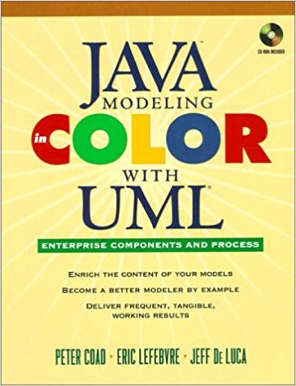
Feature-Driven Development
Coad, P., Lefebvre, E., De Luca, J. (1999) “Java Modelling In Color With UML: Enterprise Components and Process”, Prentice Hall International.

Slide 12
Jeff De Luca
Jeff De Luca is a global information technology strategist and an author in the field of software development methodology.
He is considered the primary architect of Feature Driven Development (FDD)

Slide 13
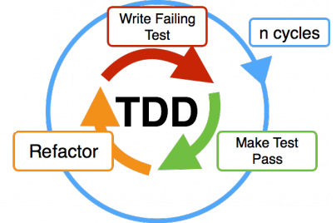
Test-Driven Development

Slide 14
Test-Driven Development
Beck, K. (2003) “Test-Driven Development by Example”, Addison Wesley.

Slide 15
Kent Beck
Born in 1961.
An American software engineer and the creator of extreme programming, and “rediscoverer” of Test-Driven Development.

Slide 16
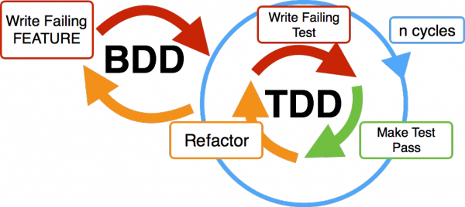
Behaviour-Driven Development

Slide 17
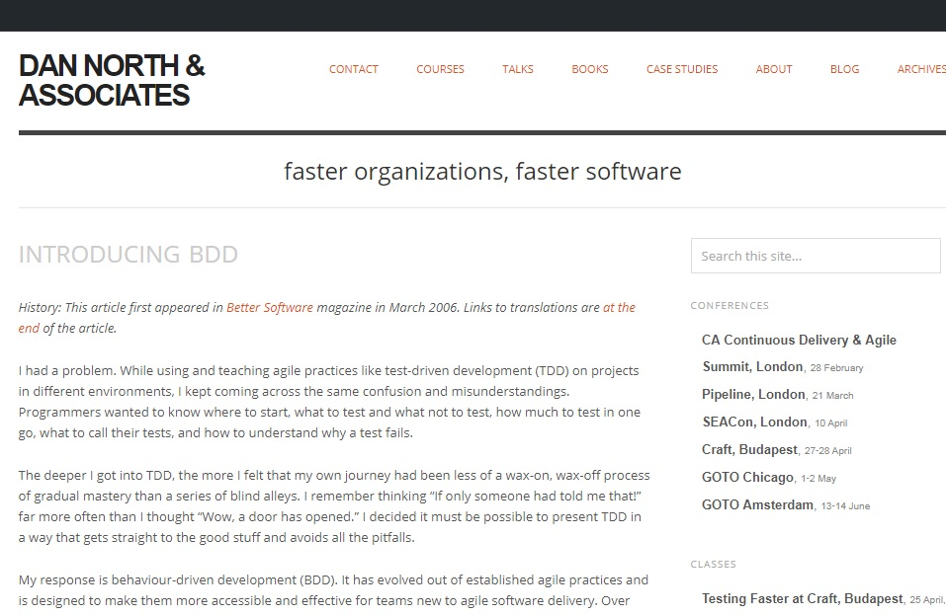
Behaviour-Driven Development
North, D., (2004) “Introducing BDD”, https://dannorth.net/introducing-bdd/

Slide 18
Dan North
Born in 1932.
An American engineer, business consultant, and with Kevin Forsberg co-founder and executive director of The Center for Systems Management

Slide 20
2. Details

Slide 21
Feature-Driven Development

Slide 22
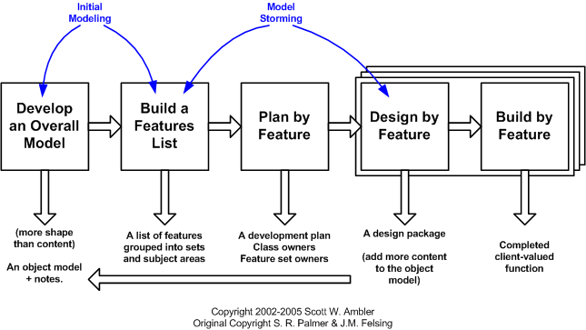
Feature-Driven Development

Slide 23
Feature-Driven Development
FEATURES: Small, client-valued requirements.
A lot of Agile methods are designed for small teams of developer, almost uniquely, FDD was originally developed for a large team.
And as such is designed to compensate for the range of skills that could be found in a large team.

Slide 24
Feature-Driven Development
Develop overall model
Build feature list
Plan by feature
Design by feature
Build by feature

Slide 25
Feature-Driven Development
Initial
Project-wide
Activities
Develop overall model
Build feature list
Plan by feature
Design by feature
Build by feature

Slide 26
Feature-Driven Development
Initial
Project-wide
Activities
Develop overall model
Build feature list
Plan by feature
Design by feature
Build by feature
Iterations
1 … n

Slide 27
Feature-Driven Development
1. Develop overall model
This is unusual for an Agile approach, to build a domain object model, but in FDD this isn’t a large, upfront analysis and design which is a long, drawn-out, activity.
Instead, the model is built in an intense, highly iterative, collaborative and generally enjoyable activity involving ‘domain and development members under the guidance of an experienced object modeller in the role of Chief Architect‘
While not mandatory, the object model is typically built using Peter Coad's modelling in colour technique.

Slide 28
Feature-Driven Development
Coloured UML
Role | Moment, Interval
Description | Party, Place, Thing

Slide 29
Feature-Driven Development
Part of this phase is to help everyone to gain a good, shared understanding of the problem domain. This phase also ensures that there is a high level of communication between all stakeholders.
The object model developed concentrates on breadth rather than depth; depth is added iteratively through the lifetime of the project. The model is a living artefact, throughout the project, the model becomes the primary vehicle around which the team discusses, challenges, and clarifies requirements.

Slide 30
Feature-Driven Development
2. Build feature list
As mentioned above, features are small, client-valued requirements. Small means a feature typically takes 1-3 days to implement, occasionally 5 days but never 10 or more days to implement.
The feature list is a three-level hierarchy. The upper levels in the feature list hierarchy are a set of domain subject areas from the high-level breakdown of the problem domain. Then within these areas, the team identifies the business activities of that area and places individual features within one of those activities.

Slide 31
Feature-Driven Development
3. Plan by Feature
The last initial phase involves constructing an initial schedule and assigning initial responsibilities.
The development team sequence the feature sets based on activities that represent best relative business value, but will later readjust to take into account technical risk and dependencies where appropriate.

Slide 32
Feature-Driven Development
FDD also departs from traditional agile thinking, in that it chooses not to adopt collective ownership of source code. Instead, it assigns individual developers to be responsible for particular classes.
Class ownership implies responsibility not exclusivity, so a class owner may allow another developer to make a change to a class they own. The big difference is that the class owner is aware of, and approves of, the change and is responsible for checking that the change is made correctly.

Slide 33
Feature-Driven Development
4. Design by Feature
Each feature is tackled by a feature team (3-5 designers/developers usually working together for 1-3 days).
Once formed, the Chief Programmer facilitates the collaborative analysis and design of the features for that iteration. Depending on the complexity, this may involve the team walking through the requirements in detail with a domain expert, and studying any existing relevant documents.

Slide 34
Feature-Driven Development
The final step in this phase is to review the design. For simple features, this may be a brief sanity check of the design held within the feature team. For more significant features, the Chief Programmer will typically involve other Chief Programmers or class owners so that they are aware and can comment on the impact of the proposed design.

Slide 35
Feature-Driven Development
5. Build by Feature
This involves the team members coding up the features, testing them at both unit level and feature level, and holding a code inspection before promoting the completed features into the project's regular build process.
FDD expects developers to unit test their code. It expects feature teams to test their features.

Slide 36
Feature-Driven Development
The reason FDD mandates code inspections is that research has shown time and again that when done well, inspections find more defects and different kinds of defects than testing. Not only that but by examining the code of the more experienced, knowledgeable developers on the team and having them explain the idioms they use, less experienced developers learn better coding techniques.

Slide 37
Test-Driven Development

Slide 38
Test-Driven Development
Test-Driven Development starts with developing tests for each one of the features.
The test might fail as the tests are developed even before the development.
Development team then develops and rewrites the code to pass the test.

Slide 39
Test-Driven Development
Add a Test
Run all tests and see if the new one fails
Write some code
Run tests and Refactor code
Repeat

Slide 40
Test-Driven Development
As we can see from the steps, there is no explicit process to develop the feature list.
TDD doesn’t care how the features are developed, but using the Increment Zero phases of FDD are a good way to go:
Develop overall model
Build feature list
Plan by feature

Slide 41
Test-Driven Development
1. Add a Test
Once the feature list is completed, a feature is selected, and a test is written that defines a function or improvements of a function (which should be very succinct).
To write a test, the developer must clearly understand the feature's specification and requirements. The developer can accomplish this through use cases and user stories to cover the requirements and exception conditions, and can write the test in whatever testing framework is appropriate to the software environment.

Slide 42
Test-Driven Development
User Stories:
A user story is an informal, natural language description of one or more features of a software system. User stories are often written from the perspective of an end user or user of a system. They are often recorded on index cards, on Post-it notes, or in project management software.

Slide 43
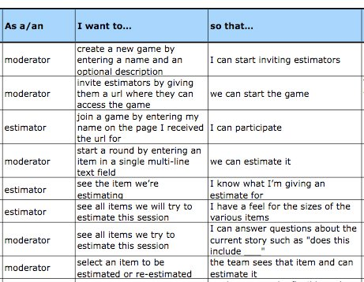
Test-Driven Development
User Story template:

Slide 44
Test-Driven Development
2. Run all tests and see if the new test fails
We do this BEFORE the code is written, so the goal here is to ensure that the test harness is working correctly.
If we run the test and it passes, we can conclude there is something wrong with the test, if not, the developers can be more confident in the new test.

Slide 45
Test-Driven Development
3. Write the Code
TDD encourages a collective ownership of source code. The code written at this stage is not perfect and may, for example, pass the test in an inelegant way. That is acceptable because it will be improved in Step 5.
At this point, the only purpose of the written code is to pass the test. The programmers should not write code that is beyond the functionality that the test checks.

Slide 46
Test-Driven Development
4. Run Tests and Refactor Code
If all test cases now pass, the programmers can be confident that the new code meets the test requirements, and does not break or degrade any existing features. If they do not, the new code must be adjusted until they do.
Next the refactoring process occurs.

Slide 47
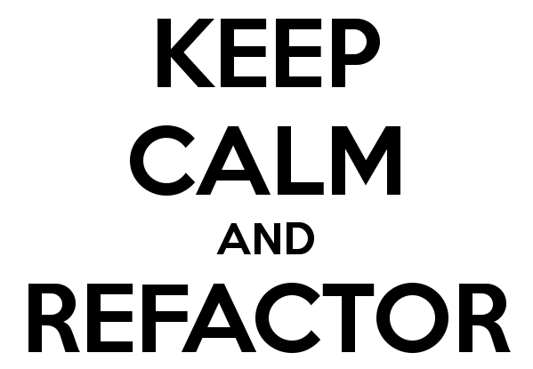
Test-Driven Development
Refactoring:
Restructuring or rewriting the source code to improve the non-functional requirements (internal consistency, readability, etc.), without changing its function.

Slide 48
Test-Driven Development
The growing code base must be cleaned up regularly during test-driven development.
Duplication must be removed.
Object, class, module, variable and method names should clearly represent their current purpose and use, as extra functionality is added.
As features are added, method bodies can get longer and other objects larger. They benefit from being split and their parts carefully named to improve readability and maintainability, which will be increasingly valuable later in the software lifecycle.

Slide 49
Test-Driven Development
5. Repeat
Start with another new test, the cycle is then repeated to push forward the functionality. The size of the steps should always be small, with as few as 1 to 10 edits between each test run.
If new code does not rapidly satisfy a new test, or other tests fail unexpectedly, the programmer should undo or revert in preference to excessive debugging.
Continuous integration helps by providing revertible checkpoints.

Slide 50
Behaviour-Driven Development

Slide 51
Behaviour-Driven Development
Behaviour-Driven Development is an extension of TDD where there is an additional focus on the business interests (or “business drivers”).
Behaviour-driven development combines the general techniques and principles of TDD with ideas from domain-driven design and object-oriented analysis and design

Slide 52
Behaviour-Driven Development
BDD adds new strategies:
Think from the Outside In
Use the Five Whys on User Stories
Single Notation
Consistent Usage

Slide 53
Test-Driven Development
1. Think from the Outside In
Only implement those features and behaviours that contribute most directly to these business outcomes, so as to minimize waste

Slide 54
Test-Driven Development
2. Use the Five Whys on User Stories
The Five Whys is an iterative interrogative technique used to explore the root cause underlying a particular issue.
The technique does this by repeating the question "Why?“ five times. Each answer forms the basis of the next question.
The use of Five in the name derives from an anecdotal observation on the number of iterations needed to resolve the problem.

Slide 55
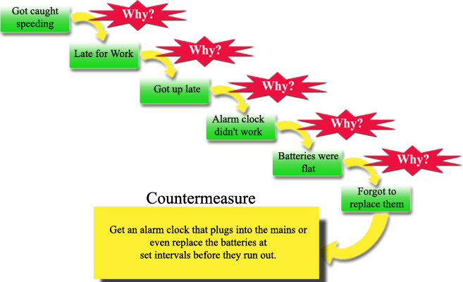
Test-Driven Development
2. Use the Five Whys on User Stories

Slide 56
Test-Driven Development
3. Single Notation
Describe features and behaviours in a single notation which is directly accessible to domain experts, testers and developers, so as to improve communication

Slide 57
Test-Driven Development
4. Consistent Usage
Apply these techniques all the way down to the lowest levels of abstraction of the software, paying particular attention to the distribution of features and behaviours, so that evolution remains cheap.

Slide 58
3. Advantages

Slide 59
Advantages
Significantly reduces debug time

Slide 60
Advantages
Shorter software development cycles

Slide 61
Advantages
Code being developed is focused on meeting client requirements

Slide 62
Advantages
Accommodates teams of developers with a wide variety of experience

Slide 63
Advantages
Offers well defined progress tracking and reporting capabilities

Slide 64
Advantages
Project costing is done with greater accuracy

Slide 65
4. Disadvantages

Slide 66
Disadvantages
Can often have very little documentation compared to other methodologies

Slide 67
Disadvantages
Can result in over-reliance on Chief Programmer

Slide 68
Disadvantages
Might not be suitable for a very small team or single developer

Slide 69
Disadvantages
If the requirements are changing rapidly, the goals keep moving

Slide 70
5. Interesting

Slide 71
Interesting
FDD was initially devised to accomplish specific needs of a 15 month, 50 person project at a large Singapore bank.

Slide 72
Interesting
FDD defines six milestones per feature that are to be completed sequentially:

Slide 73
Interesting
A 2005 study found that using TDD meant writing more tests and, in turn, programmers who wrote more tests tended to be more productive.
Erdogmus, Hakan; Morisio, Torchiano. "On the Effectiveness of Test-first Approach to Programming". Proceedings of the IEEE Transactions on Software Engineering, 31(1). January 2005. (NRC 47445). Retrieved 2008-01-1

Slide 74
Interesting
Test-driven development has been adopted by Quality Control teams. The six steps of the TDD sequence are applied with minor semantic changes:
"Add a check" replaces "Add a test"
"Run all checks" replaces "Run all tests"
"Do the work" replaces "Write some code"
"Run all checks" replaces "Run tests"
"Clean up the work" replaces "Refactor code"
"Repeat"

Slide 75
Interesting
There are several different examples of BDD software tools in use in projects today, for different platforms and programming languages. Possibly the most well-known is JBehave, which was developed by Dan North.
http://jbehave.org

Slide 76
Interesting
BDD User Stories usually follow the following format:
Title: The story should have a clear, explicit title.
Narrative: A short, introductory section that specifies
who: (which business or project role) is the driver or primary stakeholder of the story (the actor who derives business benefit from the story)
what: effect the stakeholder wants the story to have
why: business value the stakeholder will derive from this effect
Acceptance Criteria or Scenarios: a description of each specific case of the narrative. Such a scenario has the following structure:
It starts by specifying the initial condition that is assumed to be true at the beginning of the scenario. This may consist of a single clause, or several.
It then states which event triggers the start of the scenario.
Finally, it states the expected outcome, in one or more clauses.

Slide 77
6. Reflections

Slide 78
Reflections
FDD, TDD and BDD are focused on specific themes:
Documentation: The amount of documentation in xDD methodologies is designed to be “just enough” as opposed to “a lot”.
Team Skills: The xDD methodologies acknowledge that different members of the team have different skill levels.

Slide 79
Reflections
FDD is designed both for large software development teams and small developments as well.
TDD and BDD are designed principally for small development teams.

Slide 80
Reflections
It has been argued that these approaches are more productive than other methodologies, as those are attempting to code in large steps.

Slide 81
Reflections
TDD and BDD have testing as a significant part of their processes, but nonetheless a testing phase is also necessary in these methodologies.

Slide 82
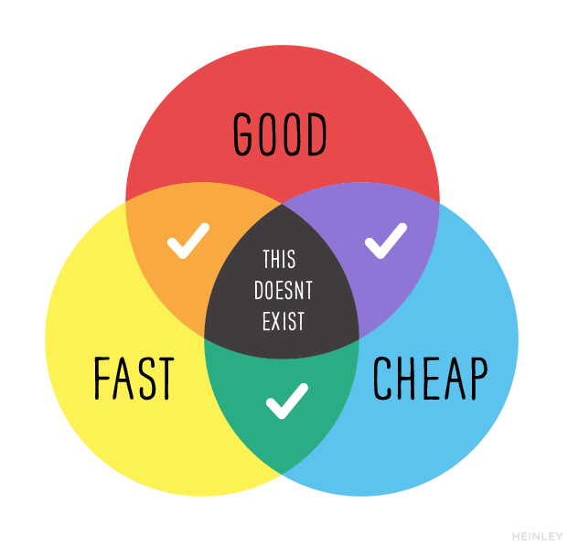
Reflections

Slide 83
7. Review

Slide 84
Review
What did we learn?

Slide 85
8. Summary

Slide 86
Summary

