Slide 1
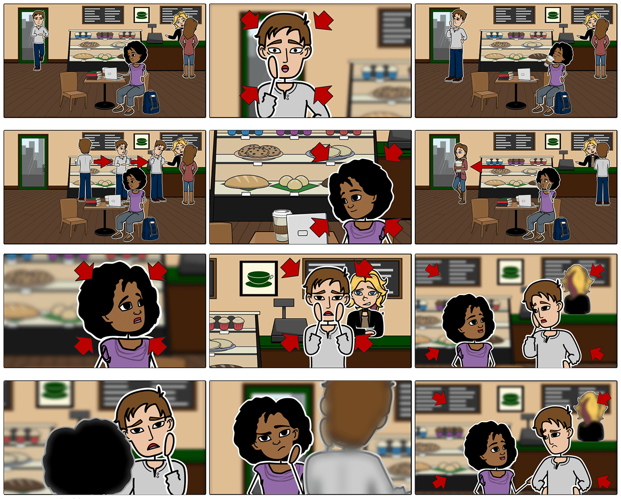
Storyboards,
Personas,
User Stories
Storyboards,
Personas,
User Stories
Damian Gordon
Damian Gordon

Slide 2
Storyboarding

Slide 3
Storyboarding
“Storyboards are visual organizers, typically a series of illustrations displayed in sequence for the purpose of pre-visualizing a video, web-based training, or interactive media sequence.”
http://www.instructionaldesign.org/storyboarding.html

Slide 4
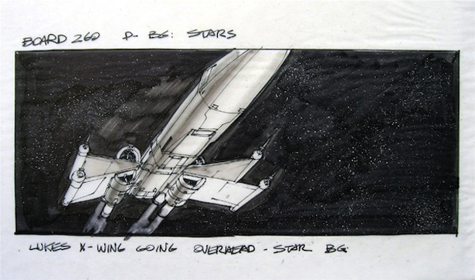
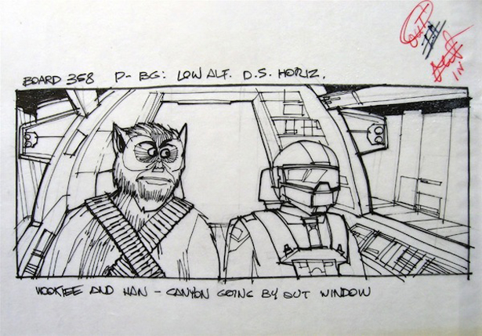
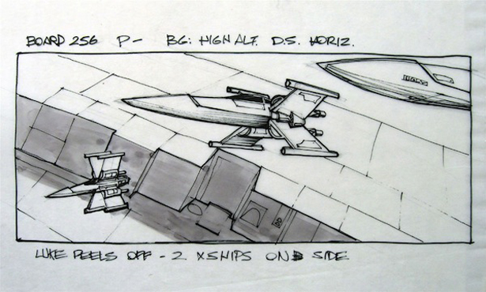
Star Wars

Slide 5
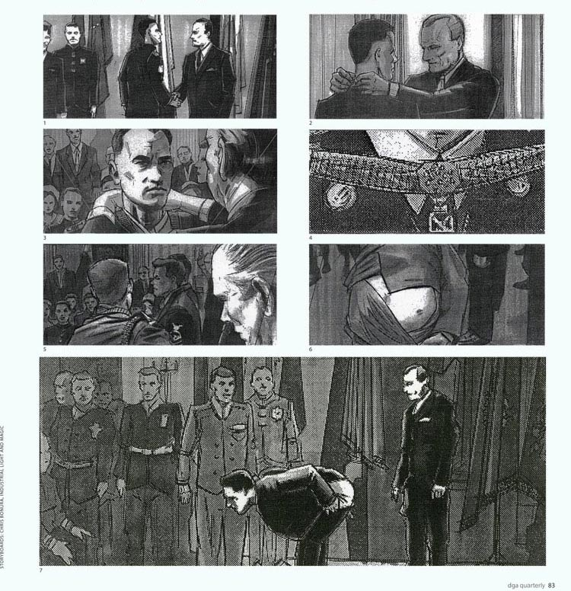
Forrest Gump

Slide 6
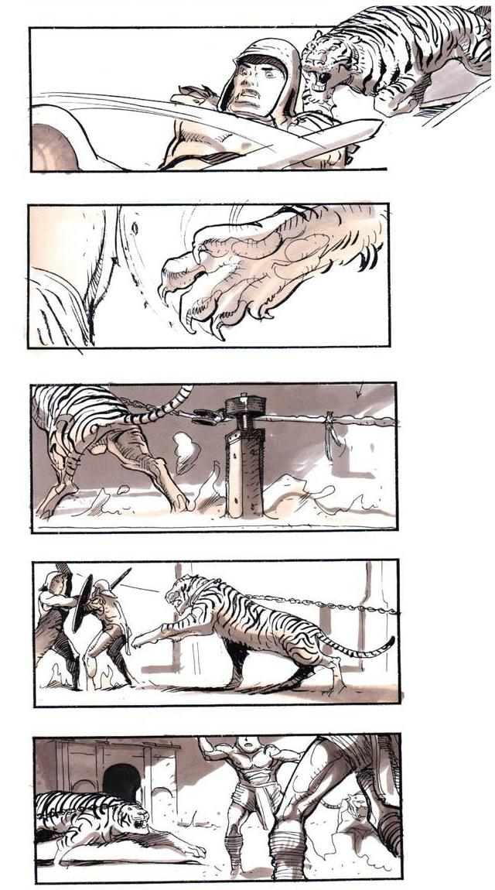
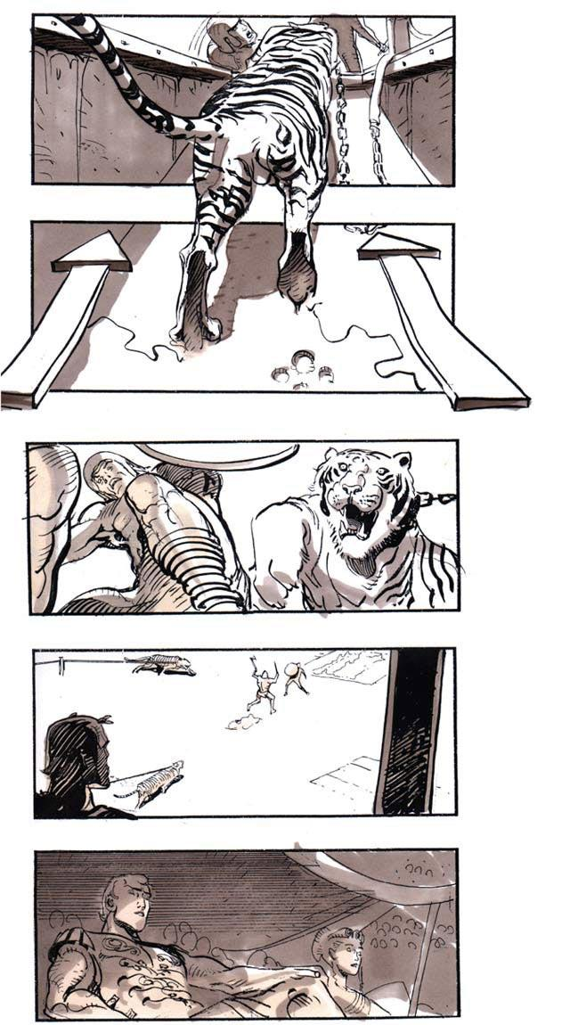
Gladiator

Slide 7
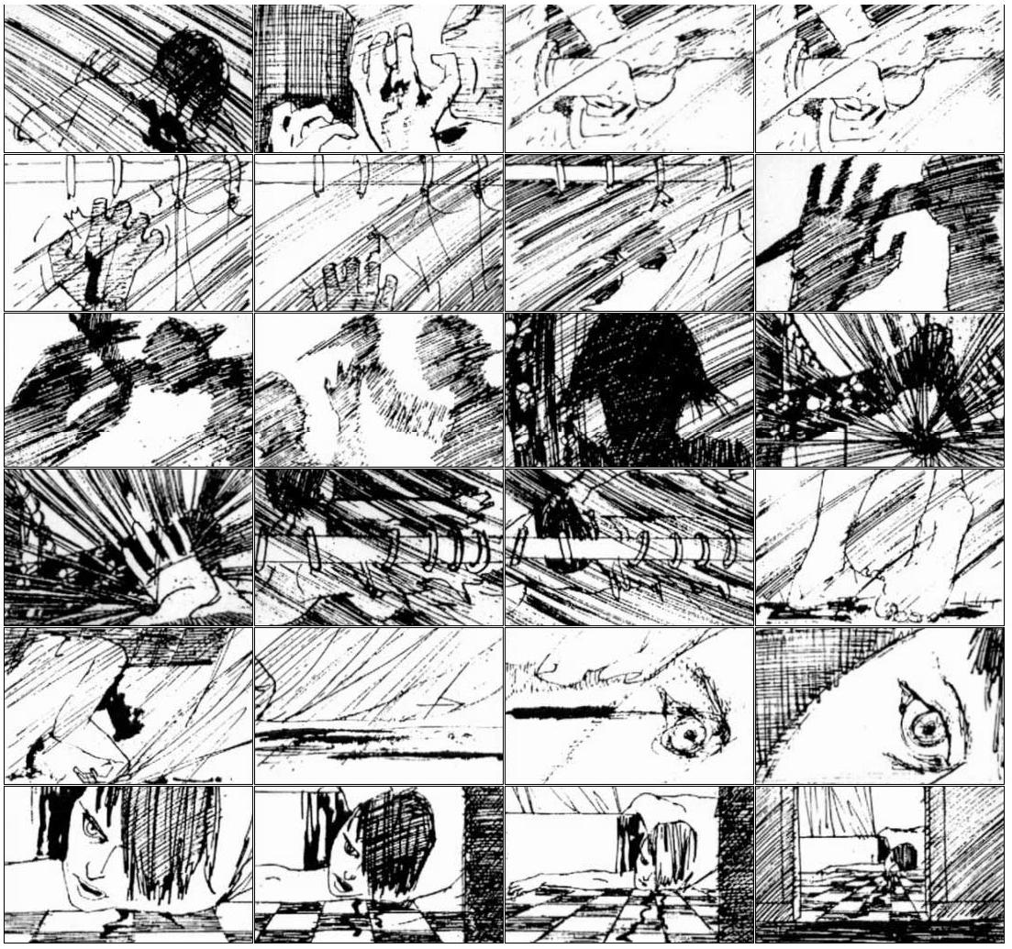
Psycho

Slide 8
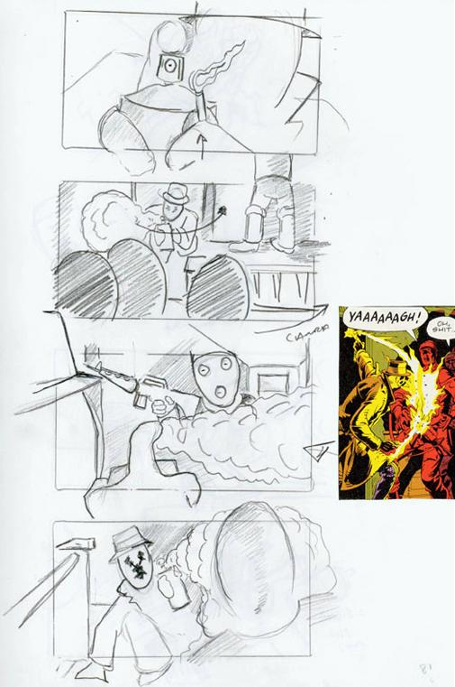
Watchmen

Slide 9
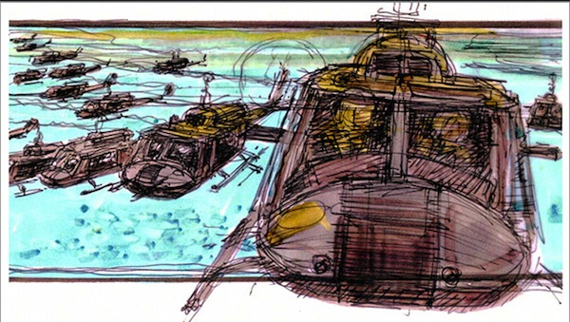
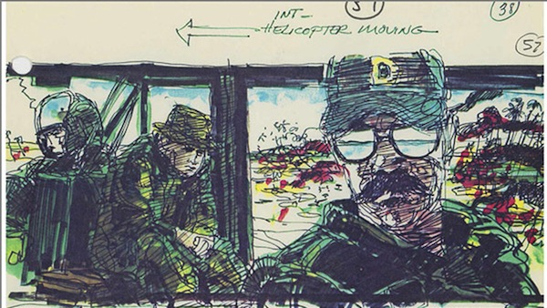
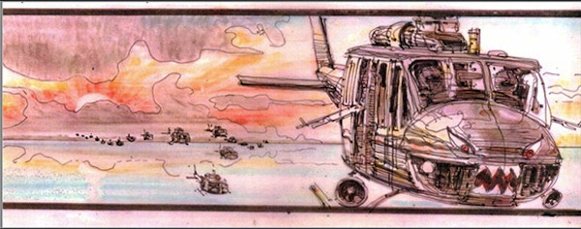
Apocalypse Now

Slide 10
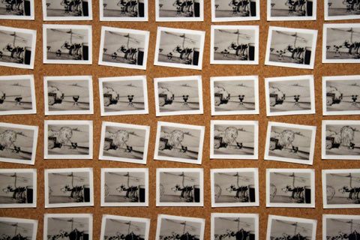
Storyboarding: History
Developed by Disney Studios in 1930s.

Slide 11
Storyboarding: Purpose
The goal of storyboarding is to get ideas down on paper and communicate effectively to all members of the team (and end-users?)
They provide a tangible baseline focus for discussion, and alteration.
They are
  Inexpensive
  Easy to understand for anyone
  Easy to make
  Good at giving you an early picture of the system

Slide 12
Storyboarding: Types
Passive
  Sketches, pictures, screenshots
  PowerPoint or example outputs
Active
  Slideshows, simple animations
  “Demo mode” of typical behaviour of system
Interactive
  Interactive tools
  Requires user participation

Slide 13
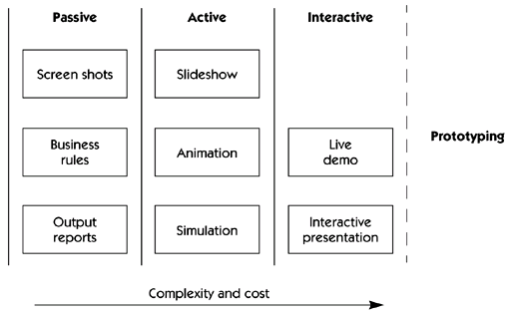
Storyboarding: Types

Slide 14
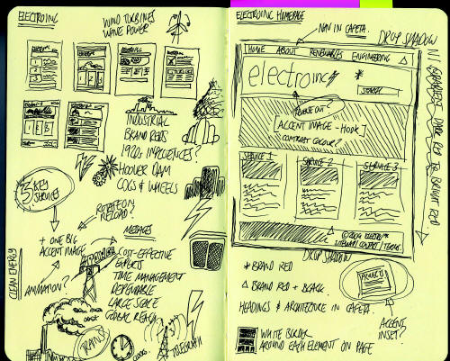
Storyboarding: Features

Slide 15
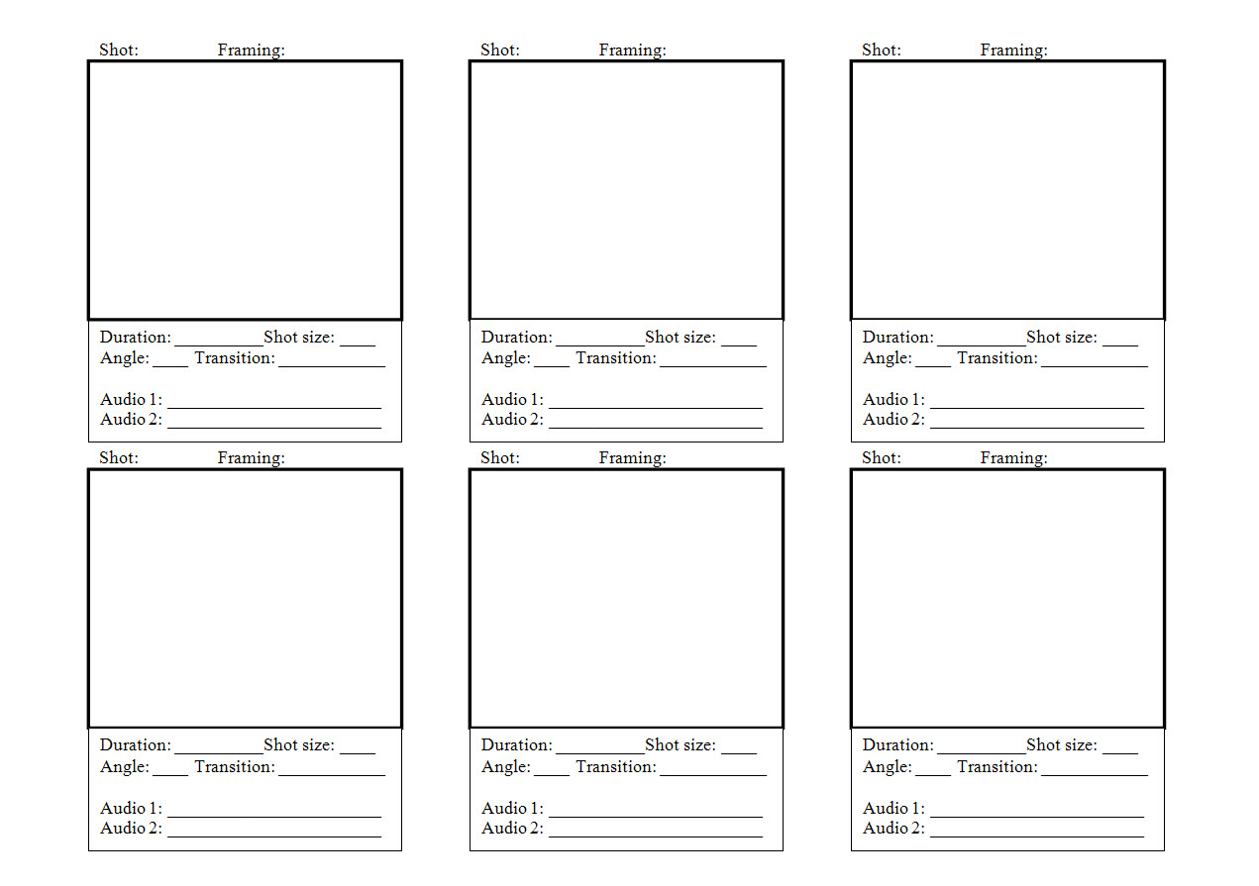
Storyboarding: Features

Slide 16
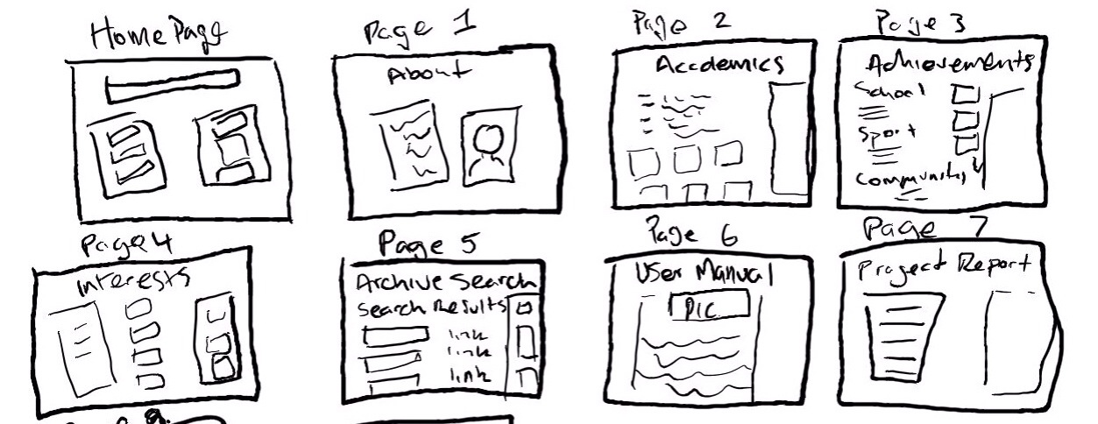
Storyboarding: Features

Slide 17
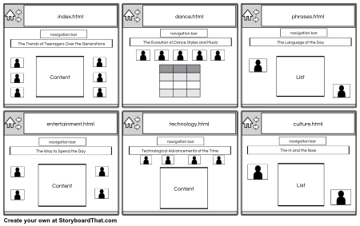
Storyboarding: Features

Slide 18
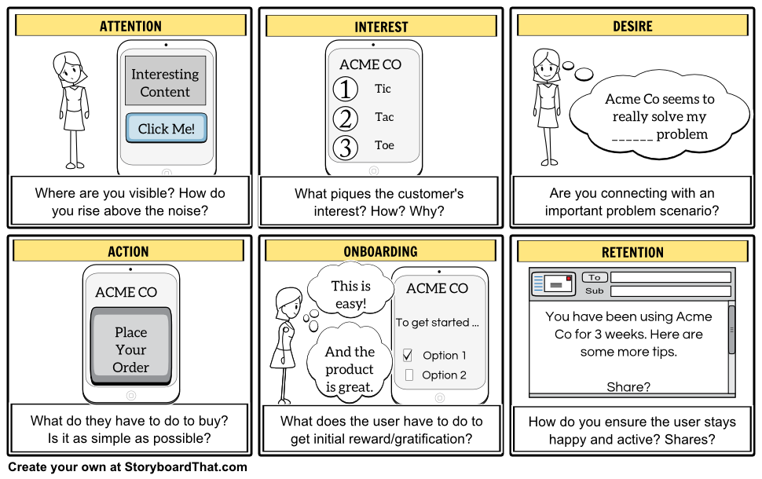
Storyboarding: Features

Slide 19
Storyboarding: Tools
Celtx
http://www.celtx.com
Lectora Snap
http://lectora.com/
Articulate Storyline
http://www.articulate.com/products/storyline-overview.php
Adobe Captivate
http://www.adobe.com/products/captivate.html

Slide 20
Related Ideas

Slide 21
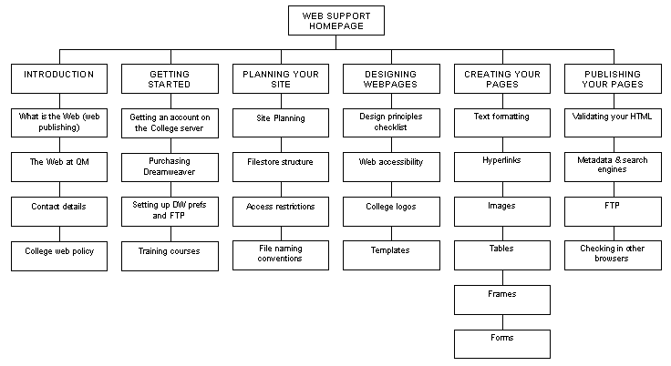
Site Map

Slide 22
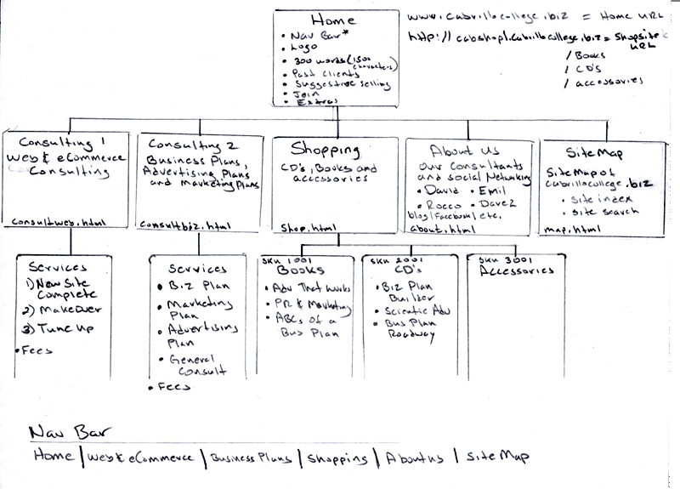
Site Map

Slide 23
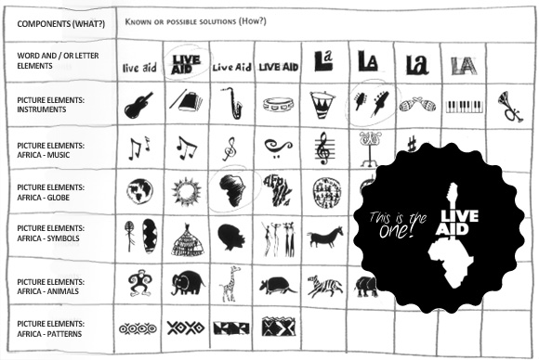
Morphological Matrix

Slide 24
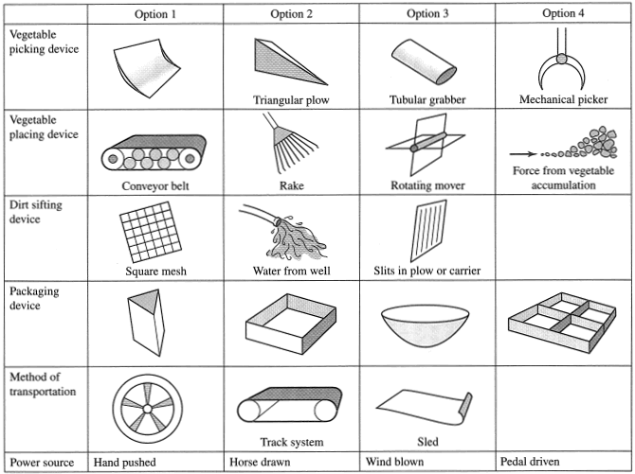
Morphological Matrix

Slide 25
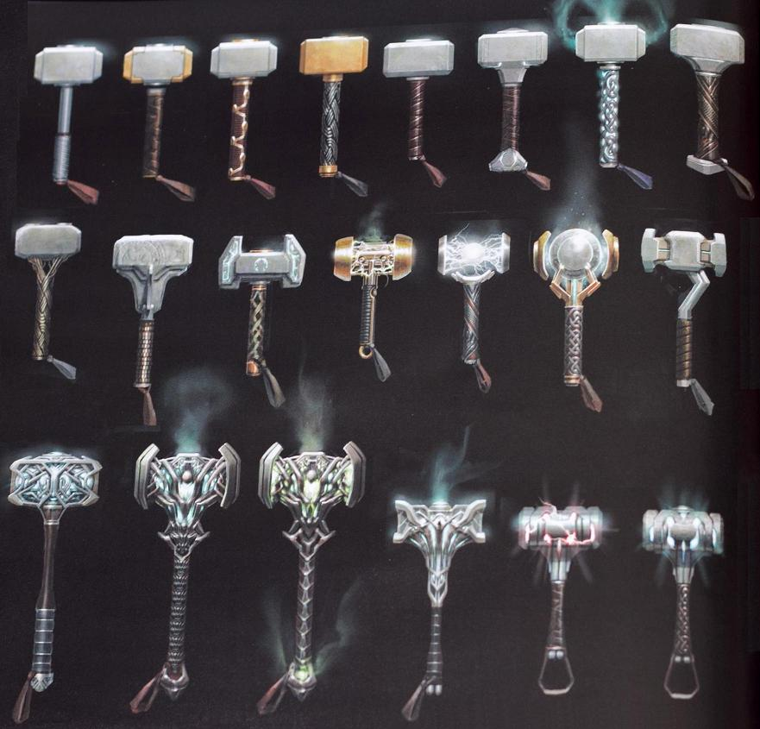
Design Options

Slide 26
Personas

Slide 27
Personas
A persona is a fictional character that can be used to represent a collection of some of the kinds of people who could potentially be using a particular design.

Slide 28
Personas
Typically in user-centred design the designers will use several personas to test the viability of a design. The personas allow the designers to consider the range of stakeholders that might be using their designs, and allows the designer to look at their designs from these stakeholders’ perspectives.

Slide 29
Personas
The need for personas was initially identified in the mid-1990s in the marketing sector, followed quickly by the software sector, and then quickly spreading to a range of design disciplines.

Slide 30
Personas
Benefits that have been suggested for personas include a suggestion that for designers working in groups, they are given a common, consistent understanding of the dimensions of diversity and can communicate and brainstorm more effectively about diversity to each other. It also allows the designers to focus on the users of their design and encourages the designers to learn more about those users and understand how they will use the design.

Slide 31
Personas
Some researchers have criticised the use of personas by indicating that for evaluating a design, the use of real customers who will be using the design is more realistic and preferable to the use of personas which are fictional characters. There is no doubt that using a wide range of real customers is one of the strongest forms of evaluation, but there are many cases where this is not possible, and personas are an effective alternative.

Slide 32
Personas
Some scientific studies (e.g. Frank Long, 2009, “Real or Imaginary: The effectiveness of using personas in product design”) on the use of personas have shown that personas can result in more usable designs, more user-centred discussions, and more effective communication in design teams.

Slide 33
V.O.: Meet the Normals
Meet the Normal Family

Slide 34

V.O.: This is Betty Normal, she’s the Grandparent of the family, she’s not as fast as she used to be.

Slide 35
V.O.: This is her daughter, Mary Normal, she works as the manager in a supermarket, she is left-handed and has Gluten allergy.

Slide 36

V.O.: This is Mary’s husband, Harry, Harry is a stay at home dad.

Slide 37
V.O.: Susie Normal is their daughter, she is just eighteen years old this week, and...

Slide 38
V.O.: ...she is always listening to her iPod, and wears glasses.

Slide 39

V.O.: This is Susie’s brother, Johnny, Johnny is 10 years old and uses a wheelchair.

Slide 40
V.O.: This is the baby of the family, P.J. Normal, he’s one year old...

Slide 41
V.O.: ...this is his blue blankey, he loves his blankey...

Slide 42
V.O.: This is P.J. zooming around in his buggy...

Slide 43
V.O.: ...watch him go.

Slide 44
So this is The Normals – Version 1

Slide 45

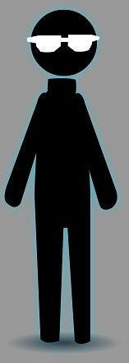



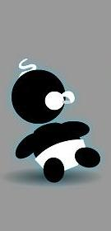
Here’s Version 2

Slide 46
Betty Normal
Name: Elizabeth “Betty” Normal
Age: 69 years old
Size: 5’6”

Slide 47
Betty Normal
Betty is the grandparent of the family; she is Harry's mother. She is somewhat slow moving and sometimes uses a walker or a cane, but is very active. She is an exceptionally intelligent person, with an incredible memory for events that occurred decades ago, and has a natural affinity for mathematics that she passed onto her son. Think of her as being like Jessica Fletcher from “Murder, She Wrote”.

Slide 48
Betty Normal
She lives in the Normal family home in her own “granny annex” where she keeps her small astronomical telescope; one of her many hobbies is amateur astronomy. She is beginning to experience mild hearing impairment, but it isn’t letting it impact her significantly, and has developed mild arthritis in her left knee, hence the need for a walker or cane.

Slide 49
Betty Normal
Nonetheless she likes to play the Wii regularly with her grandchildren, and has recently taken up painting based on Mary’s encouragement, Betty has been painting some of her favourite starscapes, which she does with Mary and Johnny’s help.

Slide 50
Mary Normal
Name: Mary Normal
Age: 34 years old
Size: 6’2”

Slide 51
Mary Normal
Mary is the mother of the family; she works as a manager in the local supermarket, and works Tuesday to Saturday. She enjoys her job a great deal and has a natural authority about her that makes her a natural leader, and constantly supports and enthuses her staff in doing their jobs.

Slide 52
Mary Normal
She is left-handed, which makes using office scissors and winding her wrist watch awkward. She is also the tallest member of the family. She has recently discovered that she has a mild gluten allergy, and keeps an eye on what she eats.

Slide 53
Mary Normal
She is an avid painter and has been most of her life; her enthusiasm has spread to Betty and Johnny, and now the three of them have regular sessions where they all paint together.

Slide 54
Mary Normal
She has a degree in Business and is constantly reminding her children of the importance of education for their future. She is the stricter of the two parents but is never unfair or overly hard, but she occasionally switches into her “manager” personality at home dealing with the children.

Slide 55
Harry Normal
Name: Harold “Harry” Normal
Age: 36 years old
Size: 6’0”

Slide 56
Harry Normal
Harry is the father of the family, he is a stay-at-home dad who looks after the children and takes care of the house. He really enjoys being able to spend time with his children and is a wonderful father who loves his children dearly.

Slide 57
Harry Normal
He also loves cooking and likes trying out new recipes on the family which are usually very successful. Although his mother, Betty, has her own cooking facilities in her “granny annex” Harry insists that the whole family have dinner together each night, which Betty loves.

Slide 58
Harry Normal
He is a qualified maths teacher and taught for five years, but he is finding his home life more preferable, personally and financially for the family. He keeps up to date on mathematics research and is writing a book focussing on Riemannian geometry. He also loves watching quiz shows on television, and is colour blind.

Slide 59
Susie Normal
Name: Susan “Susie” Normal
Age: 18 years old
Size: 5’8”

Slide 60
Susie Normal
Susie just turned 18 years old last week, and is in first year in college where she is doing a degree in Universal Design. She is actively involved in the Students’ Union and is a member of several of the college societies.

Slide 61
Susie Normal
She has just moved from home into a flat (which is 35 miles away from her home) with two flatmates who were friends of hers in secondary school. She is finding the changes going on in her life a significant adjustment but is getting on with it.

Slide 62
Susie Normal
Suzy wears glasses to read, and loves music so she is rarely seen without her iPod and guitar. She also loves going to bingo with her father and grandmother every Tuesday evening, which is something that she is convinced would ruin her “street credit” in college if anyone ever found out.

Slide 63

Johnny Normal
Name: Jonathan “Johnny” Normal
Age: 10 years old
Size: 5’4”

Slide 64
Johnny Normal
Johnny is 10 years old, and he is going to primary school where his favourite subjects are Art, Music and History. He has a natural talent for art and loves painting alongside his mother Mary and his grandmother Betty.

Slide 65
Johnny Normal
Whereas Betty’s paintings are always very realistic, and Mary’s are often abstract in style (Cubist), Johnny can easily turn his hand to any style of painting, but he mostly loves creating paintings and drawings of superheroes fighting monsters based on the comics he reads. He has a similar passion for music and listens to his iPod all the time just like his older sister.

Slide 66
Johnny Normal
He has a few close friends that he likes to hang around with, and gets up to the usual things with them: discussing comics and music, wondering what the big deal about girls is, and telling jokes. Johnny does not have the use of his legs, and uses a manual wheelchair for mobility.

Slide 67
P.J. Normal
Name: Patrick Joseph “P.J.” Normal
Age: 1 year old
Size: 1’6”

Slide 68
P.J. Normal
P.J. is the baby of the family, he is 1 year old. He is a surprisingly calm baby and often his facial expressions suggest that he understands a lot more of what is going on in the world around him than you would expect for a baby. He is also absorbed by the world around him; the sights, the sounds, and the smells are all new to him and each new discovery is fascinating to him.

Slide 69
P.J. Normal
If there is one thing you will never see P.J. without, it is his blue blanket, he loves it very much and finds a myriad of uses for it: the simplest of which is keeping him warm, he also likes to bundle it up and pretend that it is a teddy bear, and he loves to put it on his head when he needs to hide from people.

Slide 70
P.J. Normal
As P.J. has only taken his first steps a few weeks ago, and finds the whole “walking” thing a big drag, he is usually pushed around in a pram.

Slide 71
V.O.: Episode two, Going for a walk
EPISODE II:
Going for a Walk

Slide 72
V.O.: The Normals go for a walk
EPISODE II:
Going for a Walk
The Normals go for a walk, they
are going to walk along a street
encountering curb-cuts and ATMs
Bus-stops and littler bins.

Slide 73
V.O.: They are going to walk along a street...
EPISODE II:
Going for a Walk
The Normals go for a walk, they
are going to walk along a street
encountering curb-cuts and ATMs
Bus-stops and littler bins.

Slide 74
V.O.: ...encountering curb-cuts and ATMs
Bus-stops and littler bins.
The Normals go for a walk, they
are going to walk along a street
encountering curb-cuts and ATMs
Bus-stops and littler bins.

Slide 75
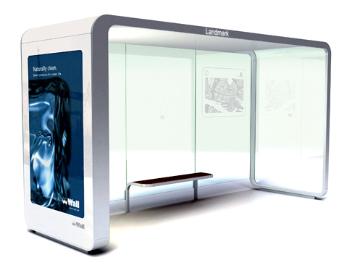
The Bus Stop

Slide 76
ATM

Slide 77
ATM

Slide 78
ATM

Slide 79
ATM

Slide 81
ATM

Slide 82
Other stuff: The street
ATM

Slide 83
V.O.: Episode four, the supermarket
EPISODE IV:
The Supermarket

Slide 84
V.O.: The Normals got to the supermarket to get some shopping
EPISODE IV:
The Supermarket
The Normals got to the supermarket
to get some shopping. They are going
to buy a lot of fun stuff, and Mary will
meet some of her staff along the way.

Slide 85
V.O.: They are going to buy a lot of fun stuff...
EPISODE IV:
The Supermarket
The Normals got to the supermarket
to get some shopping. They are going
to buy a lot of fun stuff, and Mary will
meet some of her staff along the way.

Slide 86
V.O.: and Mary will meet some of her staff along the way.
The Normals got to the supermarket
to get some shopping. They are going
to buy a lot of fun stuff, and Mary will
meet some of her staff along the way.

Slide 87
Other stuff: The Supermarket

Slide 88

Other stuff: Shopping Trolley

Slide 89
User Stories

Slide 90
User Stories
A user story is one or more sentences in the everyday language that captures what a user does or needs to do as part of their job function.
  As a user, I want to search for my customers by their first and last names.
  As a non-administrative user, I want to modify my own schedules but not the schedules of other users.

Slide 91
User Stories
User stories are often written from the perspective of an end user or user of a system.
They are often recorded on index cards, on Post-it notes, or in project management software.

Slide 92
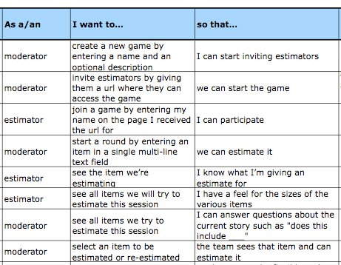
User Stories
User Story template:

