Slide 1
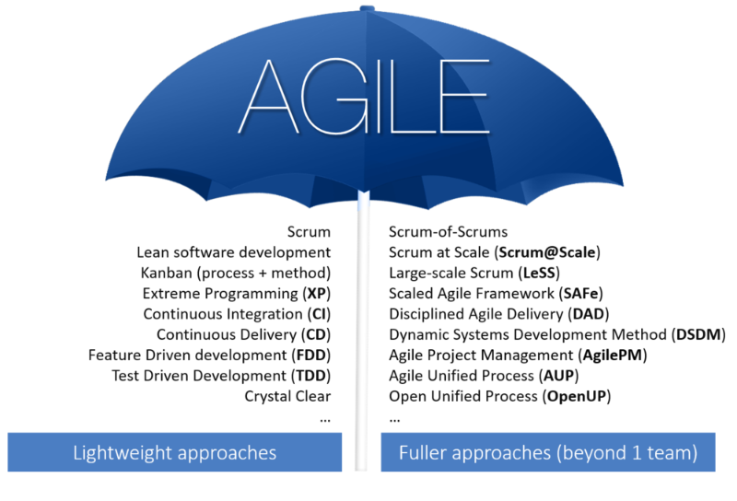
Agile Development
Agile Development
Damian Gordon
Damian Gordon

Slide 2
Background
In February 2001, 17 software developers met at the Snowbird, Utah resort, to discuss lightweight development methods.

Slide 3


Slide 4
Background
They published the Manifesto for Agile Software Development to define the approach now known as Agile Software Development.

Slide 5
Manifesto for Agile Software Development
We are uncovering better ways of developing
software by doing it and helping others do it.
Through this work we have come to value:
Individuals and interactions over processes and tools
Working software over comprehensive documentation
Customer collaboration over contract negotiation
Responding to change over following a plan
That is, while there is value in the items on
the right, we value the items on the left more.

Slide 6
Reference
Kent Beck, James Grenning, Robert C. Martin, Mike Beedle, Jim Highsmith, Steve Mellor, Arie van Bennekum, Andrew Hunt, Ken Schwaber, Alistair Cockburn, Ron Jeffries, Jeff Sutherland, Ward Cunningham, Jon Kern, Dave Thomas, Martin Fowler, Brian Marick (2001). “Manifesto for Agile Software Development”. Agile Alliance, http://agilemanifesto.org
Beck, K. et al. (2001) “Manifesto for Agile Software Development”, Agile Alliance, http://agilemanifesto.org

Slide 7
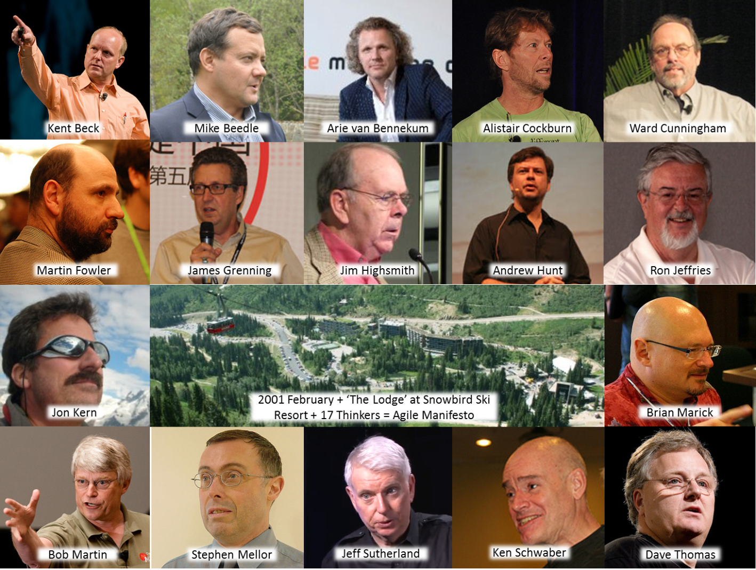
Manifesto for Agile Software Development

Slide 8

Agile Alliance
Some of the manifesto's authors formed the Agile Alliance, a non-profit organization that promotes software development according to the manifesto's principles.

Slide 9
Agile Methods
Well-known Agile Software Development Methods include:
  Agile Modelling (AM)
  Agile Unified Process (AUP)
  Dynamic Systems Development Method (DSDM)
  Essential Unified Process (EssUP)
  Extreme Programming (XP)
  Feature Driven Development (FDD)
  Open Unified Process (OpenUP)
  Scrum
  Velocity tracking

Slide 10


