Slide 1

Rapid
Application
Development
Rapid
Application
Development
Damian Gordon
Damian Gordon

Slide 2
Contents
Overview
Details
Advantages
Disadvantages
Interesting
Reflection
Review
Summary

Slide 3
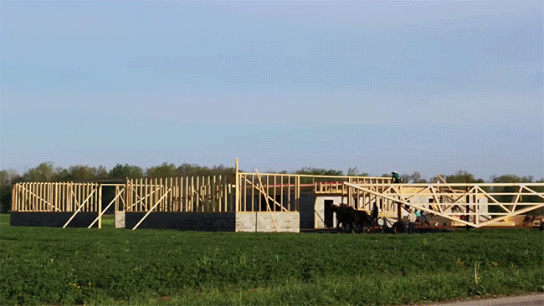

Slide 4
1. Overview

Slide 5
Overview
“Rapid Application Development” is a model that represents one method as to how software can be developed.

Slide 6
Timeline of Methodologies
1950s Code & Fix
1960s Design-Code-Test-Maintain
1970s Waterfall Model
1980s Spiral Model
1990s Rapid Application Development, V Model
2000s Agile Methods

Slide 7
Timeline of Methodologies
1950s Code & Fix
1960s Design-Code-Test-Maintain
1970s Waterfall Model
1980s Spiral Model
1990s Rapid Application Development, V Model
2000s Agile Methods

Slide 8
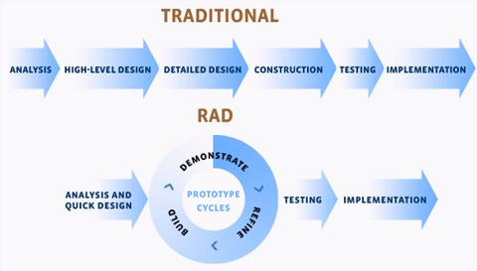

Slide 9
Reference
Martin, J., RAD: Rapid Application Development, 1991, MacMillan Publishing Co., New York.

Slide 10

Reference
Martin, J., RAD: Rapid Application Development, 1991, MacMillan Publishing Co., New York.

Slide 11

James Martin
Born in 1933.
Died 24 June 2013
Born in Ashby, Leicestershire
a British Information Technology consultant and author, who was nominated for a Pulitzer prize for his book, The Wired Society: A Challenge for Tomorrow (1977).

Slide 12
2. Details

Slide 13
RAD

Slide 14
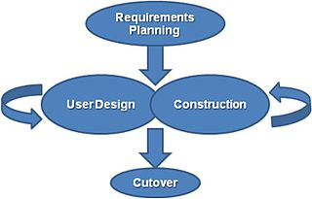
RAD
Rapid Application Development is a lightweight approach to development. It is divided into four phases:
  1. Requirements Planning Phase
  2. User Design Phase
  3. Construction Phase
  4. Cutover Phase

Slide 15
RAD
1. Requirements Planning Phase
  Also called “Joint Requirements Planning (JRP) Phase”
  Combines the Planning and Analysis phases from the Waterfall Model
  End-users and IT staff agree on business needs, project scope, constraints, and system requirements
  This phase ends when the team agree on the key issues and obtain management authorization to continue

Slide 16
RAD
2. User Design Phase
  End-users and IT staff jointly develop the system processes, inputs, and outputs.
  They use a combination of Joint Application Design (JAD) and CASE tools.
  This needs to be a continuous interactive process that allows End-users to understand, modify, and eventually approve a working model of the system that meets their needs.

Slide 17
RAD
3. Construction Phase
  Similar to the Development phase in the Waterfall model, but End-users continue to participate and can still suggest changes or improvements as actual screens or reports are developed.
  The key tasks in this phase are programming and application development, coding, unit-integration and system testing.

Slide 18
RAD
4. Cutover Phase
  Similar to the Installation, Testing and Maintenance phases of the Waterfall model, including data conversion, testing, changeover to the new system, and user training.
  Compared with traditional methods, the entire process is compressed, and as a result, the new system is built, delivered, and placed in operation much sooner

Slide 19
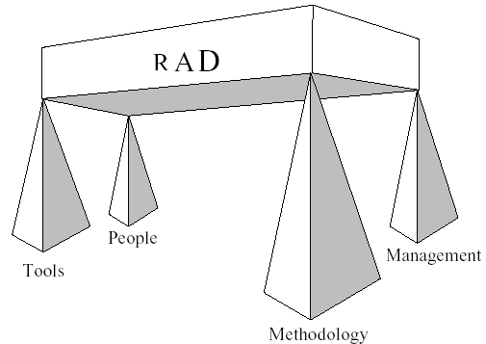
RAD

Slide 20
RAD
Tools
  Using CASE tools provides automation support for systems development through features such as code generation and automatic consistency checking.
  CASE tools that generate prototypes can be used to support the iterative development approach, allowing end users to see the application evolve as it is being built.

Slide 21
RAD
Methodology
  The most effective family of techniques must be formalised and used to deliver the system.
  A complete list of tasks is provided to ensure that no essential activity is overlooked, while techniques are fully documented to ensure that a task is performed in the proper way.

Slide 22
RAD
People
  The best people must be well-trained in both the methodology and the tools.
  Small teams that work consistently well together should be grouped together on assignments.

Slide 23
RAD
Management
  The project must be managed for speed through the use of techniques such as facilitated Joint Requirements Planning (JRP) and Joint Application Design (JAD) workshops to extract users' requirements quickly.
  Timebox Management is used in Rapid Construction to iteratively deliver the system to the users.

Slide 24
3. Advantages

Slide 25
Advantages
Significantly reduced development time compared to other models.

Slide 26
Advantages
The approach increases reusability of components

Slide 27
Advantages
Quick initial reviews occur

Slide 28
Advantages
It encourages customer feedback

Slide 29
Advantages
Integration from very beginning solves a lot of integration issues.

Slide 30
4. Disadvantages

Slide 31
Disadvantages
Depends on strong team and individual performances for identifying business requirements.

Slide 32
Disadvantages
Only system that can be easily modularized can be built using RAD.

Slide 33
Disadvantages
Requires highly skilled developers/designers.

Slide 34
Disadvantages
High dependency on modelling skills.

Slide 35
Disadvantages
Inapplicable to cheaper projects as cost of modelling and automated code generation is very high.

Slide 36
5. Interesting

Slide 37
Interesting
RAD is a way to deliver systems very fast, but it should be noted that the longer a project, the greater its likelihood of failure.

Slide 38
Interesting
RAD uses proven technologies and methodologies effectively.

Slide 39
Interesting
RAD should be used when there is a need to create a system that can be modularized in 2-3 months of time.

Slide 40
Interesting
RAD should only be used be used:
  if there’s high availability of designers for modelling
  if the budget is high enough to afford their cost along with the cost of automated code generating tools.
  if resources with high business knowledge are available and there is a need to produce the system in a short span of time (2-3 months).

Slide 41
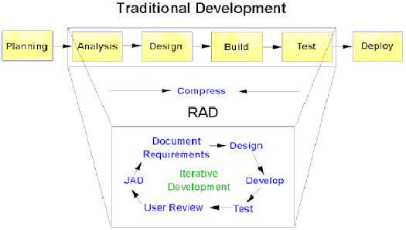
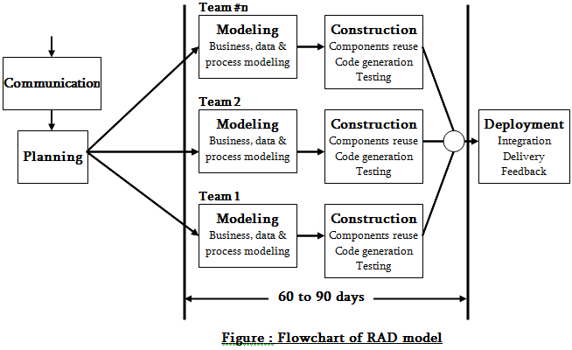
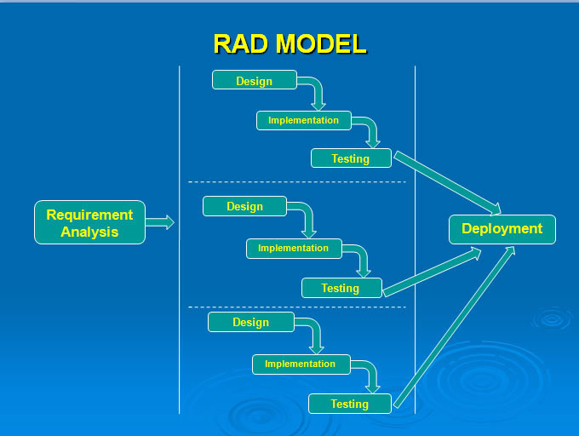
Interesting
There are other versions of the Model:

Slide 42
6. Reflections

Slide 43
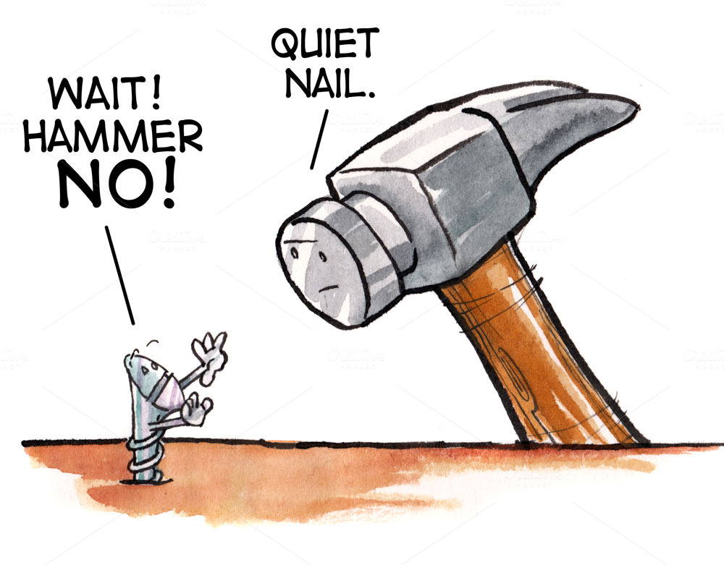
RAD
There may be a tendency to make the solution fit within the capabilities of the tools provided by RAD.

Slide 44
RAD
RAD can’t be used in all situations, and required highly motived and skills IT staff and End-users.

Slide 45
RAD
Modelling might include:
  Data Flow Diagram
  UML Activity Models
  Use Case Diagrams
  Interaction Sequence Diagrams

Slide 46
RAD
Software Tools might include:
  MicroSoft Visio (drawing tool)
  FileMaker (wed publishing)
  MicroSoft Access (front-end & back-end prototypes)
  Visual Basic (GUIs)
  Oracle Enterprise Development Suite
  Microsoft Visual Studio (front-end & back-end prototypes)
  Rational Rose XDE (drawing tool)

Slide 47
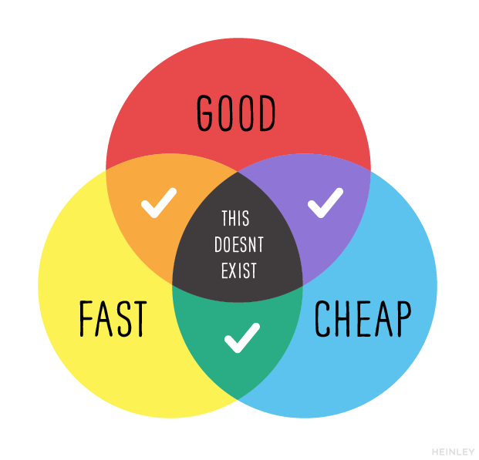
Reflections

Slide 48
7. Review

Slide 49
Review
What did we learn?

Slide 50
8. Summary

Slide 51
Summary

Slide 52


