Slide 1
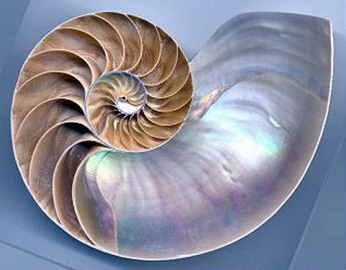
The Spiral Model
The Spiral Model
Damian Gordon
Damian Gordon

Slide 2
Contents
Overview
Details
Advantages
Disadvantages
Interesting
Reflection
Review
Summary

Slide 4
1. Overview

Slide 5
Overview
The “Spiral Model” is a model that represents one method as to how software can be developed.

Slide 6
Timeline of Methodologies
1950s Code & Fix
1960s Design-Code-Test-Maintain
1970s Waterfall Model
1980s Spiral Model
1990s Rapid Application Development, V Model
2000s Agile Methods

Slide 7
Timeline of Methodologies
1950s Code & Fix
1960s Design-Code-Test-Maintain
1970s Waterfall Model
1980s Spiral Model
1990s Rapid Application Development, V Model
2000s Agile Methods

Slide 8
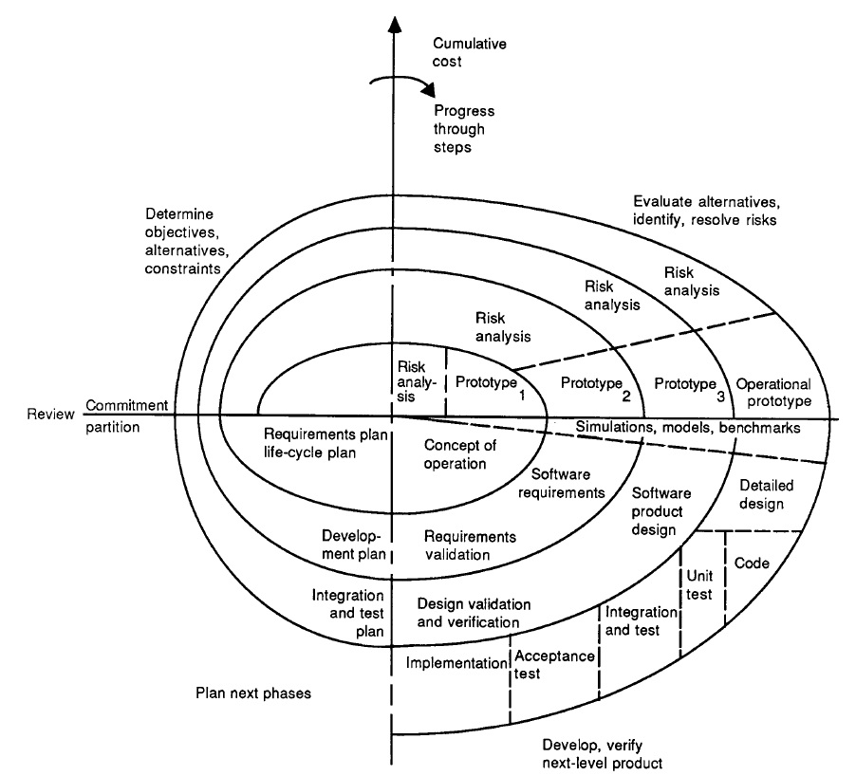

Slide 9
Reference
Boehm, B., 1986, "A Spiral Model of Software Development and Enhancement", ACM SIGSOFT Software Engineering Notes, 11(4) (August), pp.14-24.

Slide 10
Barry Boehm
Born in 1935.
An American software engineer, TRW Emeritus Professor of Software Engineering at the Computer Science Department of the University of Southern California.
Known for his many contributions to software engineering.

Slide 11
2. Details

Slide 12
Abstract
“Stop the life cycle—I want to get off!”
“Life-cycle Concept Considered Harmful.”
“ The waterfall model is dead.”
“No, it isn’t, but it should be.”
“These statements exemplify the current debate about software life-cycle process models. The topic has recently received a great deal of attention.”

Slide 13
Abstract
“The Defense Science Board Task Force Report on Military Software issued in 1987 highlighted the concern that traditional software process models were discouraging more effective approaches to software development such as prototyping and software reuse. The Computer Society has sponsored tutorials and workshops on software process models that have helped clarify many of the issues and stimulated advances in the field”.

Slide 14
Abstract
“The spiral model presented in this article is one candidate for improving the software process model situation. The major distinguishing feature of the spiral model is that it creates a risk-driven approach to the software process rather than a primarily document-driven or code-driven process. It incorporates many of the strengths of other models and resolves many of their difficulties.”

Slide 15
Abstract
“This article opens with a short description of software process models and the issues they address. Subsequent sections outline the process steps involved in the spiral model; illustrate the application of the spiral model to a software project, using the TRW Software Productivity Project as an example; summarize the primary advantages and implications involved in using the spiral model and the primary difficulties in using it at its current incomplete level of elaboration; and present resulting conclusions.”

Slide 16
Background
The primary functions of a software process model are to determine the order of the stages involved in software development and evolution and to establish the transition criteria for progressing from one stage to the next.

Slide 17
Background
Thus the key questions that a process model must consider are:
What shall we do next?
How long shall we continue to do it?

Slide 18
Background
Problem with the Waterfall Model:
It emphasises fully elaborated documents as a completion criteria for the stages. This may not be always desirable, for example, for end-user applications a large amount of documentation is not necessarily desirable or needed.

Slide 19
The Spiral Model
The spiral model of the software process has been evolving for several years, based on experience with various refinements of the waterfall model as applied to large government software projects.

Slide 21
The Spiral Model
The radial dimension represents the cumulative cost incurred in accomplishing the steps to date; the angular dimension represents the progress made in completing each cycle of the spiral.

Slide 22
The Spiral Model
The model reflects the underlying concept that each cycle involves a progression that addresses the same sequence of steps, for each portion of the product and for each of its levels of elaboration, from an overall concept of operation document down to the coding of each individual program.

Slide 25
1

Slide 26
The Spiral Model
1.
A typical cycle of the spiral. Each cycle of the spiral begins with the identification of
the objectives of the portion of the product being elaborated (performance, functionality, ability to accommodate change, etc.);
the alternative means of implementing this portion of the product (design A , design B, reuse, buy, etc.); and
the constraints imposed on the application of the alternatives (cost, schedule, inter-face, etc.).

Slide 29
2

Slide 30
The Spiral Model
2.
The next step is to evaluate the alternatives relative to the objectives and constraints.
Frequently, this process will identify areas of uncertainty that are significant sources of project risk.
If so, the next step should involve the formulation of a cost-effective strategy for resolving the sources of risk.
This may involve prototyping, simulation, benchmarking, reference checking, administering user questionnaires, analytic modelling, or combinations of these and other risk resolution techniques.

Slide 33
3

Slide 34
The Spiral Model
3.
Once the risks are evaluated, the next step is determined by the relative remaining risks.
If performance or user-interface risks strongly dominate program development or internal interface-control risks, the next step may be an evolutionary development one: a minimal effort to specify the overall nature of the product, a plan for the next level of prototyping, and the development of a more detailed prototype to continue to resolve the major risk issues.

Slide 37
4

Slide 38
The Spiral Model
4.
If this prototype is operationally useful and robust enough to serve as a low-risk base for future product evolution, the subsequent risk-driven steps would be the evolving series of evolutionary prototypes going toward the right of the figure.

Slide 39
The Spiral Model
4.
In this case, the option of writing specifications would be addressed but not exercised. Thus, risk considerations can lead to a project implementing only a subset of all the potential steps in the model.

Slide 40
The Spiral Model
4.
On the other hand, if previous prototyping efforts have already resolved all of the performance or user-interface risks, and program development or interface-control risks dominate, the next step follows the basic waterfall approach (concept of operation, soft-ware requirements, preliminary design, etc.), modified as appropriate to incorporate incremental development.

Slide 41
The Spiral Model
4.
Each level of software specification in the figure is then followed by a validation step and the preparation of plans for the succeeding cycle.

Slide 42
A prioritized top-ten list of software risk items

Slide 43
 | Risk Item | Risk Management Techniques
1. | Personnel shortfalls | Staffing with top talent, job matching; teambuilding; morale building; cross-training; pre-scheduling key people
2. | Unrealistic schedules and budgets | Detailed, multisource cost and schedule estimation; design to cost; incremental development; software reuse; requirements scrubbing
3. | Developing the wrong software functions | Organization analysis; mission analysis; ops-concept formulation; user surveys; prototyping; early users’ manuals
4. | Developing the wrong user interface | Task analysis; prototyping; scenarios; user characterization (functionality, style, workload)
5. | Gold plating | Requirements scrubbing; prototyping; cost-benefit analysis; design to cost
6. | Continuing stream of requirement changes | High change threshold; information hiding; incremental development (defer changes to later increments)
7. | Shortfalls in externally furnished components | Benchmarking; inspections; reference checking; compatibility analysis
8. | Shortfalls in externally performed tasks | Reference checking; pre-award audits; award-fee contracts; competitive design or prototyping; teambuilding
9. | Real-time performance shortfalls | Simulation; benchmarking; modelling; prototyping; instrumentation; tuning
10. | Straining computer-science capabilities | Technical analysis; cost—benefit analysis; prototyping; reference checking

Slide 44
3. Advantages

Slide 45
Advantages
High amount of risk analysis hence, avoidance of Risk is enhanced.

Slide 46
Advantages
Good for large and mission-critical projects.

Slide 47
Advantages
Strong approval and documentation control.

Slide 48
Advantages
Additional Functionality can be added at a later date.

Slide 49
Advantages
Software is produced early in the software life cycle.

Slide 50
4. Disadvantages

Slide 51
Disadvantages
Can be a costly model to use.

Slide 52
Disadvantages
Risk analysis requires highly specific expertise.

Slide 53
Disadvantages
Project’s success is highly dependent on the risk analysis phase.

Slide 54
Disadvantages
Doesn’t work well for smaller projects.

Slide 55
5. Interesting

Slide 56
Interesting
When to use the Spiral Model:
When costs and risk evaluation is important
For medium to high-risk projects
Long-term project commitment unwise because of potential changes to economic priorities
Users are unsure of their needs
Requirements are complex
When significant changes are expected

Slide 57
Interesting
As originally envisioned the iterations are typically 6 months to 2 years.

Slide 58
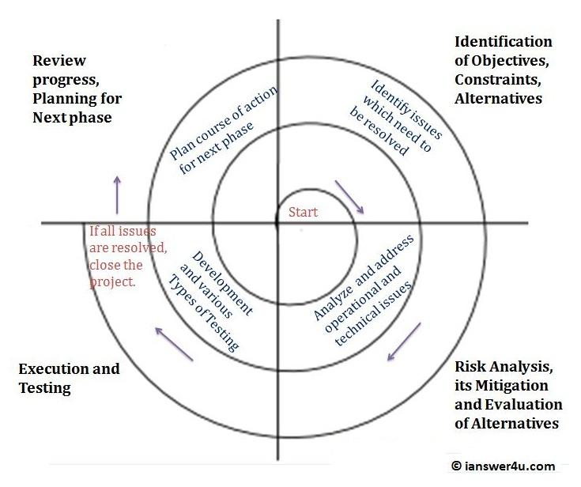
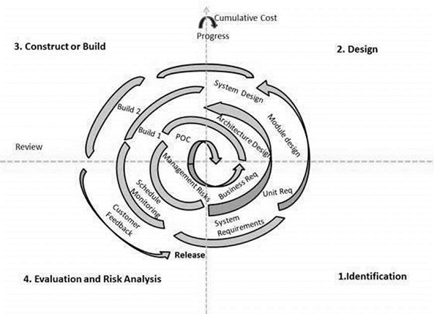
Interesting
There are other versions of the Model:

Slide 59
6. Reflections

Slide 60
Reflections
The Spiral model works well when significant changes are expected, e.g.
Research and Exploration projects
New product lines
Consequential organisational change

Slide 61
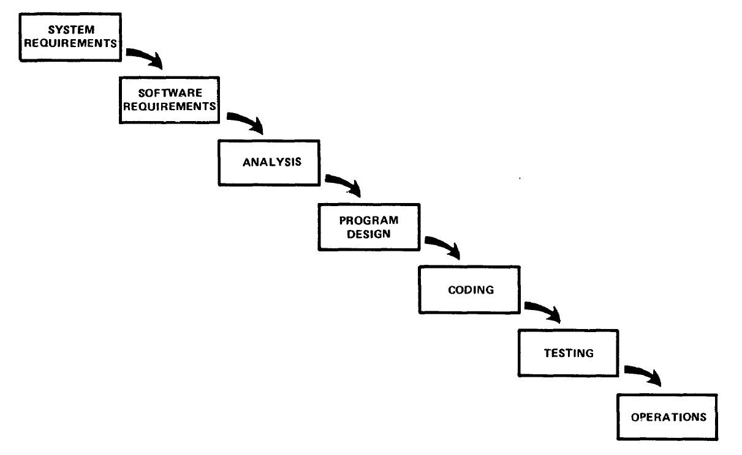
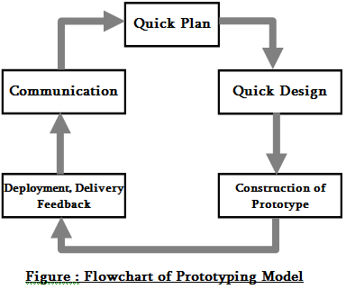
Reflections
The model is a combination of the Waterfall Model and Prototyping Models.

Slide 62
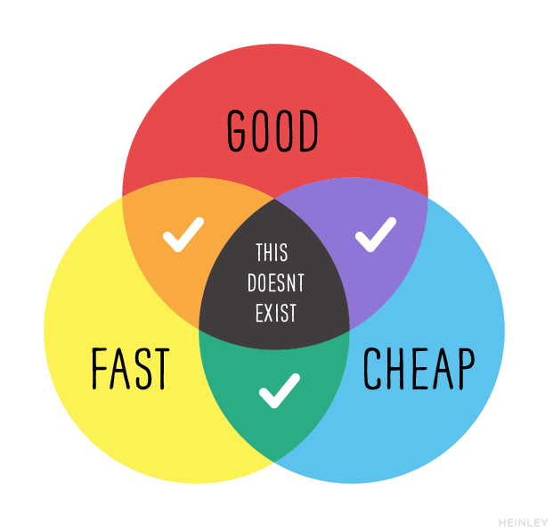
Reflections

Slide 63
7. Review

Slide 64
Review
What did we learn?

Slide 65
8. Summary

Slide 66
Summary

