Slide 1
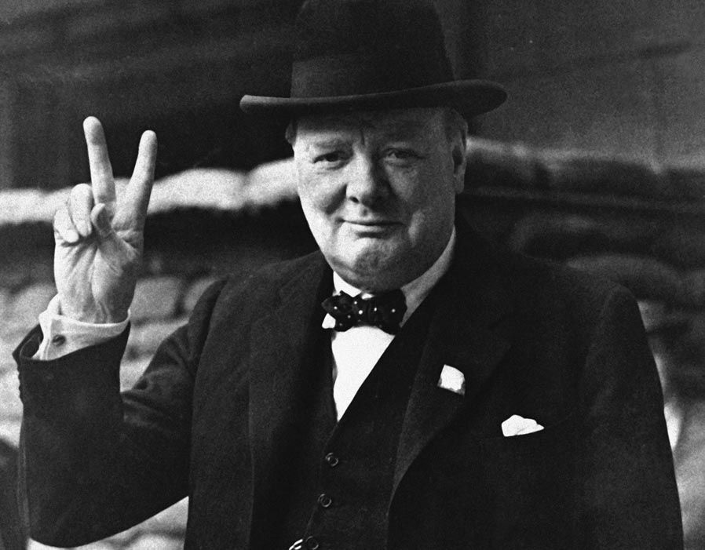
The V Model
The V Model
Damian Gordon
Damian Gordon

Slide 2
Contents
Overview
Details
Advantages
Disadvantages
Interesting
Reflection
Review
Summary

Slide 4
1. Overview

Slide 5
Overview
The “V Model” is a model that represents one method as to how software can be developed.

Slide 6
Timeline of Methodologies
1950s Code & Fix
1960s Design-Code-Test-Maintain
1970s Waterfall Model
1980s Spiral Model
1990s Rapid Application Development, V Model
2000s Agile Methods

Slide 7
Timeline of Methodologies
1950s Code & Fix
1960s Design-Code-Test-Maintain
1970s Waterfall Model
1980s Spiral Model
1990s Rapid Application Development, V Model
2000s Agile Methods

Slide 8
System
Requirements
Software
Requirements
Analysis
Program
Design
Coding
Testing
Operations

Slide 9
System
Requirements
Software
Requirements
Analysis
Program
Design
Coding
Testing
Operations

Slide 10
System
Requirements
Software
Requirements
Analysis
Program
Design
Coding
Testing
Operations

Slide 11
System
Requirements
Acceptance
Testing
Software
Requirements
System
Testing
Analysis
Integration
Testing
Program
Design
Unit
Testing
Coding

Slide 12
System
Requirements
Acceptance
Testing
Software
Requirements
System
Testing
Analysis
Integration
Testing
Program
Design
Unit
Testing
Coding

Slide 13
Reference
Forsberg, K., Mooz, H., 1991, "The Relationship of System Engineering to the Project Cycle", Chattanooga, Tennessee: Proceedings of the National Council for Systems Engineering (NCOSE) Conference, pp. 57–65.

Slide 14
Kevin Forsberg
Born in 1934.
An American engineer, business consultant, and with Harold Mooz co-founder and executive director of The Center for Systems Management

Slide 15
Harold Mooz
Born in 1932.
An American engineer, business consultant, and with Kevin Forsberg co-founder and executive director of The Center for Systems Management

Slide 16
2. Details

Slide 17
Abstract
“A new way of portraying the technical aspect of the project cycle clarifies the role and responsibility of system engineering to a project. This new three dimensional graphic illustrates the end-to-end involvement of system engineering in the project cycle, clarifies the relationship of system engineering and design engineering, and encourages the implementation of concurrent engineering.”

Slide 18
The “Vee” Model
Start with the user needs on the upper right, and ending with a user-validated system on the upper right.

Slide 19
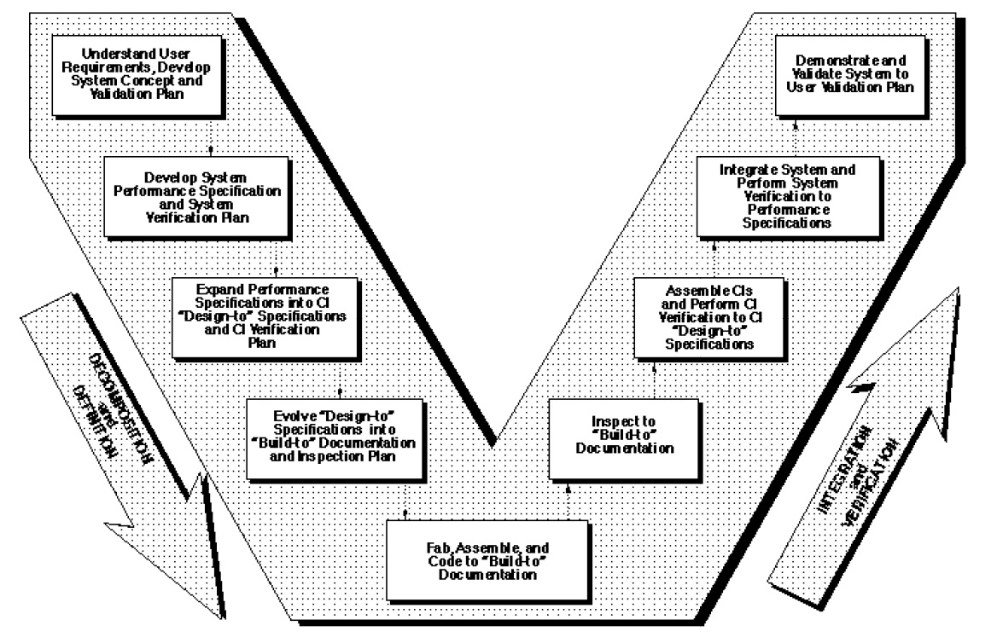

Slide 20
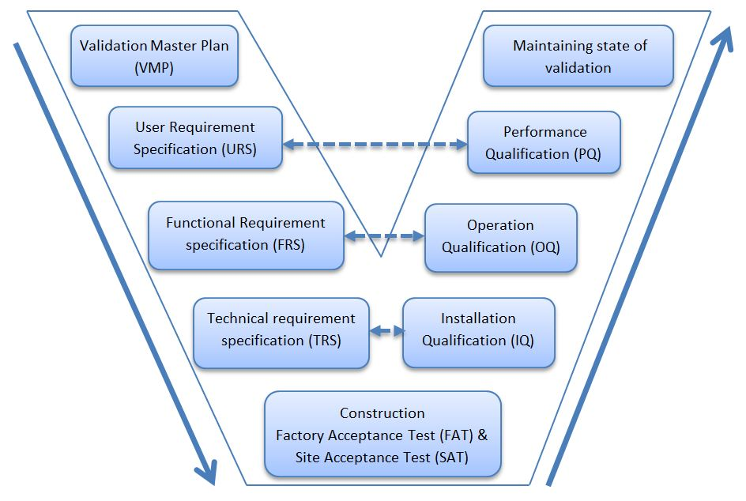

Slide 21
Detailed Discussion of the “Vee” Model
As project development progresses, a series of six baselines are established to systematically manage cohesive system development:

Slide 22
Detailed Discussion of the “Vee” Model
1. The first is the “User Requirements Baseline” established by the System Requirement Document approved and put under Configuration Management prior to the System Requirements Review.

Slide 23
Detailed Discussion of the “Vee” Model
2. The second is the “Concept Baseline” established by the Concept Definition section of the Integrated Program Summary document at the System Requirements Review.

Slide 24
Detailed Discussion of the “Vee” Model
3. The third is the “System Performance Baseline” (or Development Baseline) established by the System Performance Specification at the System Design Review.

Slide 25
Detailed Discussion of the “Vee” Model
4. The fourth is the “‘Design-To’ Baseline” (or Allocated Baseline) established at the series of Preliminary Design Reviews.

Slide 26
Detailed Discussion of the “Vee” Model
5. The fifth is the “‘Build-To’ Baseline” (or preliminary Product Baseline) established at the series of Critical Design Reviews.

Slide 27
Detailed Discussion of the “Vee” Model
6. The sixth is the “‘As-Built’ Baseline” (or Production Baseline) established at the series of Formal Qualification Reviews (FQRs). Each of the baselines is put under formal Configuration Management at the time they are approved.

Slide 28
Detailed Discussion of the “Vee” Model
Incremental Development
If the User Requirements are too vague to permit final definition at Preliminary Design Review, one approach is to develop the project in predetermined incremental releases.
The first release is focused on meeting a minimum set of User Requirements, with subsequent releases providing added functionality and performance. This is a common approach in software development.

Slide 29
Detailed Discussion of the “Vee” Model
Concurrent Engineering
If high iteration with User Requirements is required after the System Design Review (SDR), it is probable that the project has passed early Control Gates prematurely, and it is not sufficiently defined.
One cause of premature advance is that the appropriate technical experts were not involved at early stages, resulting in acceptance of requirements and design concepts which cannot be built, inspected, and/or maintained.

Slide 30
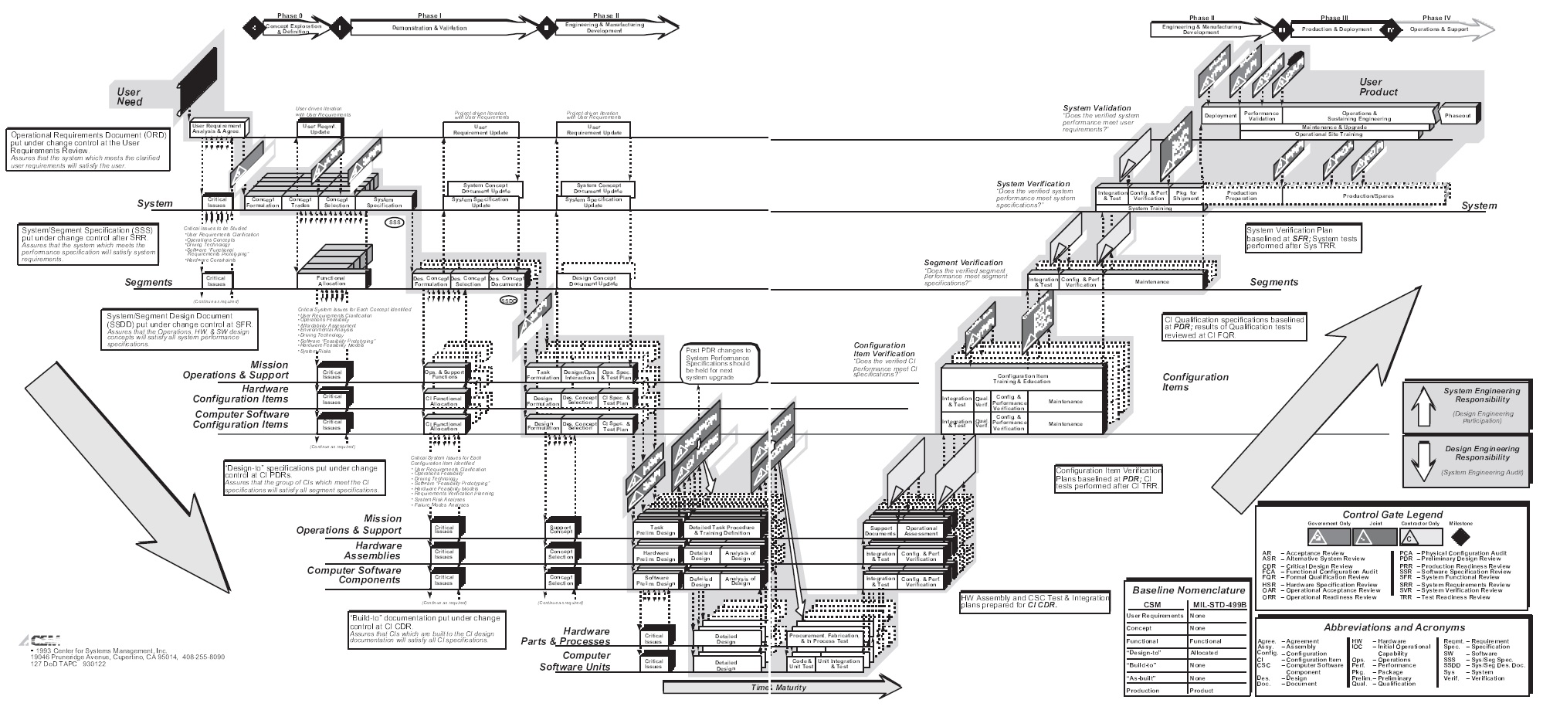

Slide 31
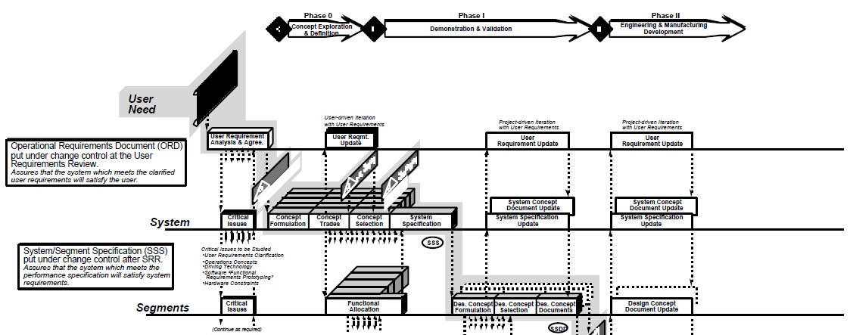

Slide 32
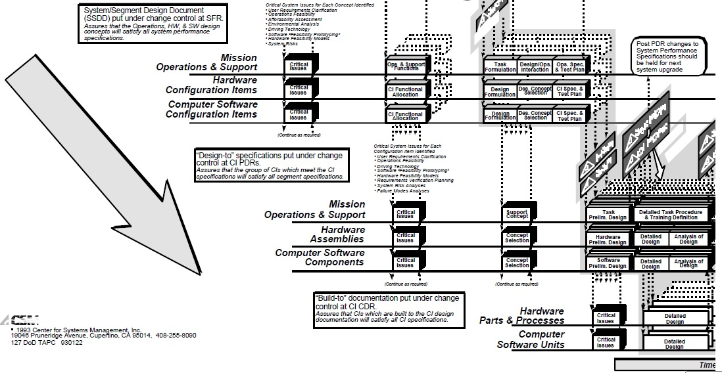

Slide 33
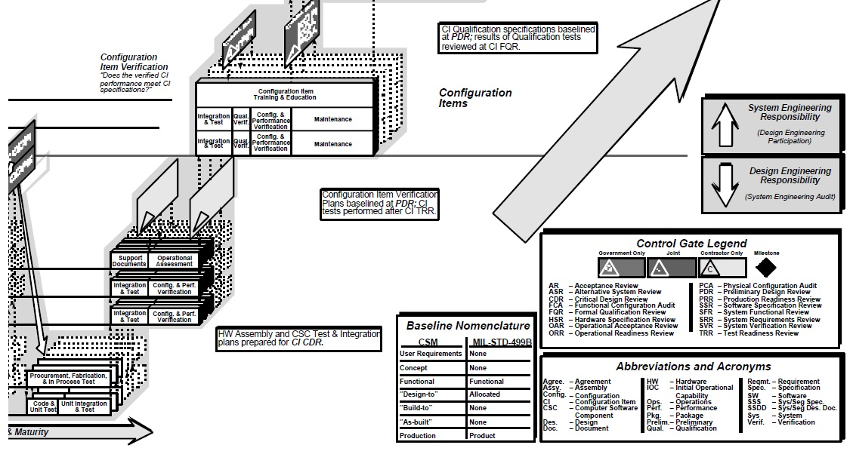

Slide 34
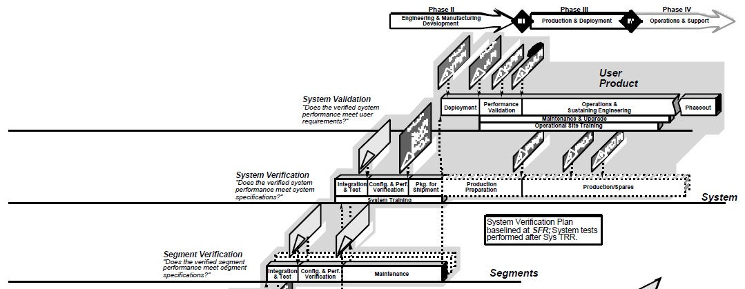

Slide 35
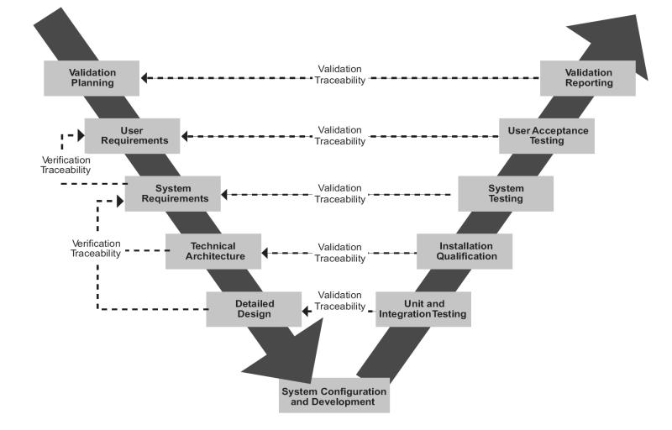

Slide 36
3. Advantages

Slide 37
Advantages
It is easy to understand and use.

Slide 38
Advantages
Testing activities like planning, test designing happens well before coding. This saves a lot of time. Hence higher chance of success over the waterfall model.

Slide 39
Advantages
Proactive defect tracking – that is defects are found at early stage.

Slide 40
Advantages
Avoids the downward flow of the defects.

Slide 41
Advantages
It works well for smaller projects where requirements are very well understood.

Slide 42
4. Disadvantages

Slide 43
Disadvantages
Very rigid and least flexible.

Slide 44
Disadvantages
Software is developed during the implementation phase, so no early prototypes of the software are produced.

Slide 45
Disadvantages
If any changes happen in midway, then the test documents along with requirement documents has to be updated.

Slide 46
Disadvantages
Not a good model for complex and object-oriented projects, or long and ongoing projects.

Slide 47
5. Interesting

Slide 48
Interesting
When to use the V Model:
The V-shaped model should be used for small to medium sized projects where requirements are clearly defined and fixed.
The V-Shaped model should be chosen when ample technical resources are available with needed technical expertise.

Slide 49
Interesting
In common practice, the V model result in a project schedule with:
20–40% of the time invested for the first two phases,
30–40% of the time to coding, and
20–40% to testing and implementation.

Slide 50
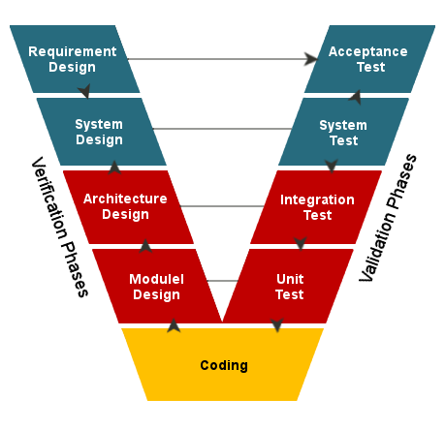
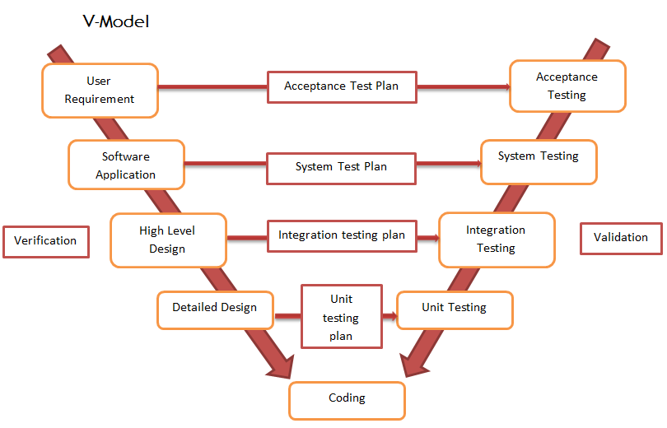
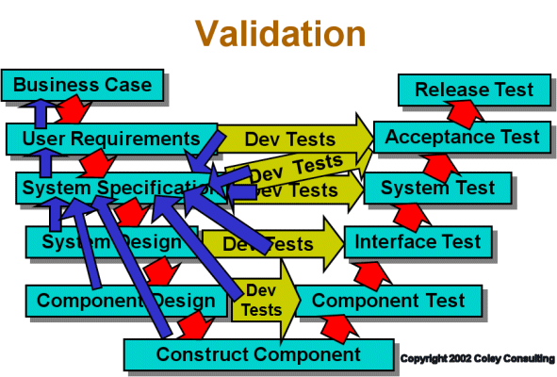
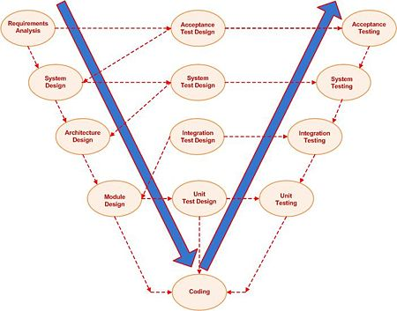
Interesting
There are other versions of the Model:

Slide 51
6. Reflections

Slide 52
Reflections
The V Model works very well with Project Management approaches.

Slide 53
Reflections
The system defined at project start might not be suitable by the end of the project, since the customer will be dealing with change in their industry every business day.

Slide 54
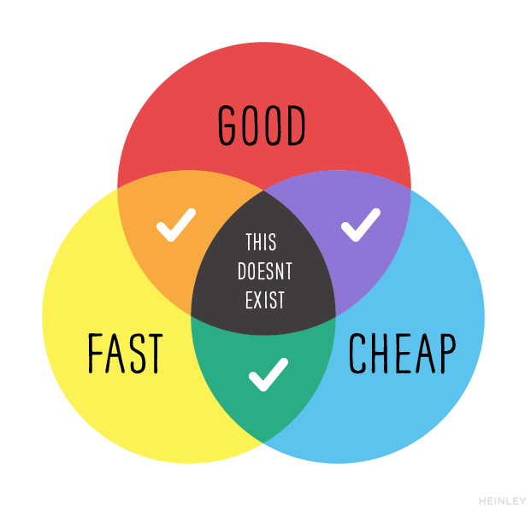
Reflections

Slide 55
7. Review

Slide 56
Review
What did we learn?

Slide 57
8. Summary

Slide 58
Summary

Slide 59
