Slide 1
The Waterfall Model
The Waterfall Model
Damian Gordon
Damian Gordon

Slide 2
Contents
Overview
Details
Advantages
Disadvantages
Interesting
Reflection
Review
Summary

Slide 3
1. Overview

Slide 4
Overview
The “Waterfall Model” is a model that represents one method as to how software can be developed.

Slide 5
System
Requirements
Software
Requirements
Analysis
Program
Design
Coding
Testing
Operations

Slide 6
Timeline of Methodologies
1950s Code & Fix
1960s Design-Code-Test-Maintain
1970s Waterfall Model
1980s Spiral Model
1990s Rapid Application Development
2000s Agile Methods

Slide 7
Timeline of Methodologies
1950s Code & Fix
1960s Design-Code-Test-Maintain
1970s Waterfall Model
1980s Spiral Model
1990s Rapid Application Development
2000s Agile Methods

Slide 8
Reference
Royce, W.W., 1970, "Managing the Development of Large Software Systems", Proceedings of IEEE WESCON 26 (August), pp.1–9.

Slide 9
Winston W. Royce
Born in 1929.
Died in 1995.
An American computer scientist, director at Lockheed Software Technology Center in Austin, Texas, and one of the leaders in software development in the second half of the 20th century.
He was the first person to describe the “Waterfall model” for software development, although Royce did not use the term "waterfall" in that article, nor advocated the waterfall model as a working methodology.

Slide 10
2. Details

Slide 11
Introduction
“I am going to describe my personal views about managing large software developments.
I have had various assignments during the past nine years, mostly concerned with the development of software packages for spacecraft mission planning, commanding and post-flight analysis.
In these assignments I have experienced different degrees of success with respect to arriving at an operational state, on-time, and within costs.
I have become prejudiced by my experiences and I am going to relate some of these prejudices in this presentation.”

Slide 12
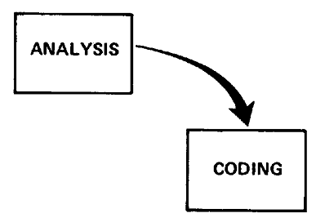
Small Developments
For a small development, you only need the following steps
Typically done for programs for internal use

Slide 13
Large Developments

Slide 14
Large Developments
System Requirements: Identify, select and document functional, scheduling and financial requirements.

Slide 15
Large Developments
Software Requirements: Identify, select and document the software features necessary to satisfy the system requirements.

Slide 16
Large Developments
Analysis: Methodically work through the details of each requirement.

Slide 17
Large Developments
Program Design: Use programming techniques to design software and hardware within the constraints and objectives set in the earlier stages.

Slide 18
Large Developments
Coding: Implement the program as designed in the earlier stages.

Slide 19
Large Developments
Testing: Test the software and record the results.

Slide 20
Large Developments
Operations: Deliver, install and configure the completed software.

Slide 21
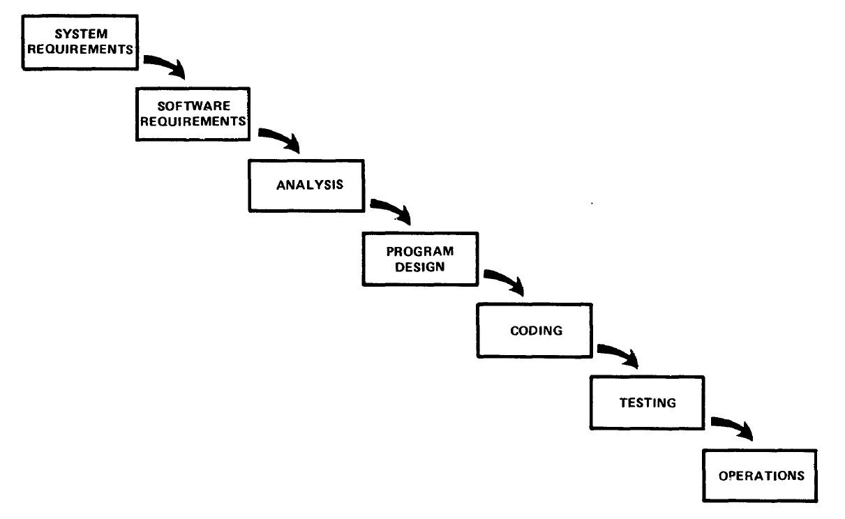
Large Developments

Slide 22
Large Developments
"I believe in this concept,
but the implementation
described above is risky
and invites failure."

Slide 23
Iterative Relationship between Successive Development Phases

Slide 24
Iterative Relationship between Successive Development Phases
Each step progresses and the design is further detailed, there is an iteration with the preceding and succeeding steps but rarely with the more remote steps in the sequence.
The virtue of all of this is that as the design proceeds the change process is scoped down to manageable limits.

Slide 25
Unfortunately the design iterations are never confined to the successive steps

Slide 26
Unfortunately the design iterations are never confined to the successive steps
The testing phase which occurs at the end of the development cycle is the first event for which timing, storage, input/output transfers, etc., are experienced as distinguished from analyzed.
These phenomena are not precisely analyzable.
Yet if these phenomena fail to satisfy the various external constraints, then invariably a major redesign is required.

Slide 27
How do we fix this?

Slide 28
Five Steps
Program Design comes first
Document the Design
Do it twice
Plan, Control and Monitor Testing
Involve the Customer

Slide 29
1. Program Design comes first
A preliminary program design phase has been inserted between the Software Requirements Generation phase and the Analysis phase.

Slide 30
1. Program Design comes first

Slide 31
1. Program Design comes first
The following steps are required:
1) Begin the design process with program designers, not analysts or programmers.
2) Design, define and allocate the data processing modes.
3) Write an overview document that is understandable, informative and current.

Slide 32
2. Document the Design
“How much documentation?"
“Quite a lot"
More than most programmers, analysts, or program designers are willing to do if left to their own devices.
The first rule of managing software development is ruthless enforcement of documentation requirements.

Slide 33
2. Document the Design

Slide 34
3. Do It Twice
Create a pilot study
If the computer program in question is being developed for the first time, arrange matters so that the version finally delivered to the customer for operational deployment is actually the second version insofar as critical design/operations areas are concerned.

Slide 35
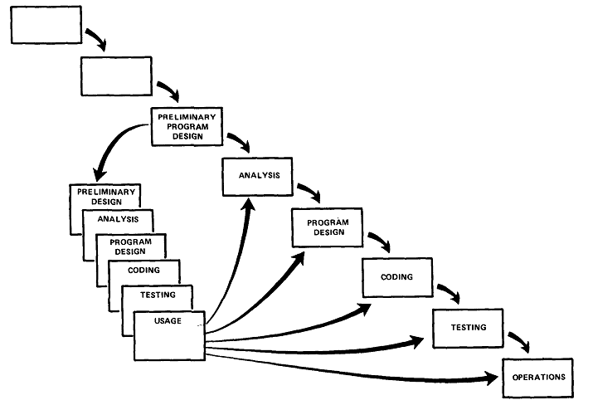
3. Do It Twice

Slide 36
4. Plan, Control and Monitor Testing
Without question the biggest user of project resources, whether it be manpower, computer time, or management judgment, is the test phase. It is the phase of greatest risk in terms of dollars and schedule.

Slide 37
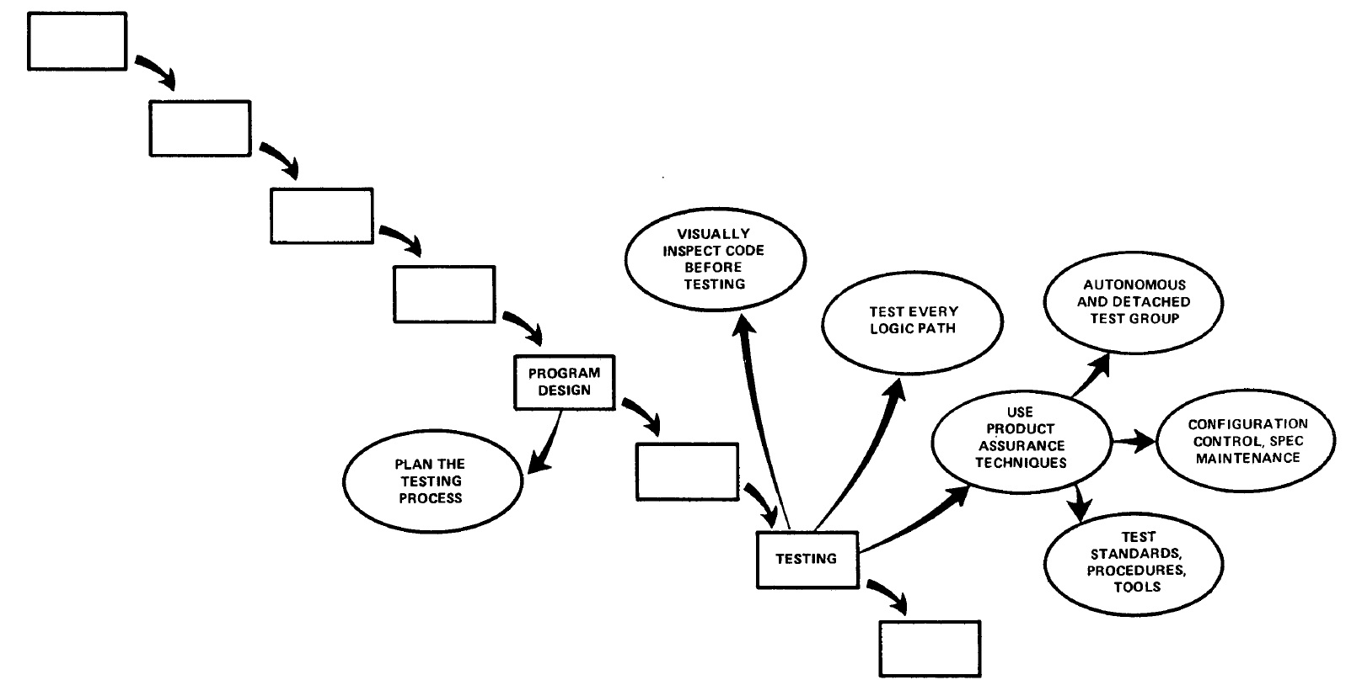
4. Plan, Control and Monitor Testing

Slide 38
4. Plan, Control and Monitor Testing
1) Many parts of the test process are best handled by test specialists who did not necessarily contribute to the original design.
2) Most errors are of an obvious nature that can be easily spotted by visual inspection.
3) Test every logic path in the computer program at least once with some kind of numerical check.
4) After the simple errors (which are in the majority, and which obscure the big mistakes) are removed, then it is time to turn over the software to the test area for checkout purposes.

Slide 39
5. Involve the Customer
For some reason what a software design is going to do is subject to wide interpretation even after previous agreement.
It is important to involve the customer in a formal way so that he has committed himself at earlier points before final delivery.
To give the contractor free rein between requirement definition and operation is inviting trouble.

Slide 40
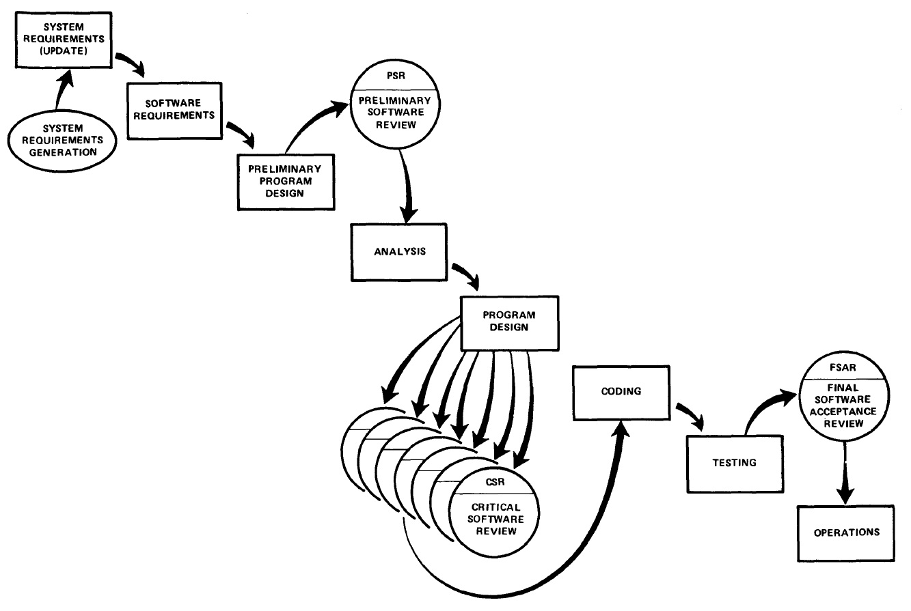
5. Involve the Customer

Slide 41
3. Advantages

Slide 42
Advantages
It is easy to understand and use.

Slide 43
Advantages
It is easy to manage due to the rigidity of the model.

Slide 44
Advantages
The phases are processed and completed one at a time, and the phases do not overlap.

Slide 45
Advantages
It works well for smaller projects where requirements are very well understood.

Slide 46
Advantages
It requires a lot of paperwork as compared to other models.

Slide 47
Advantages
When new team member joins, referenced documents help them to understand the project.

Slide 48
Advantages
There output is generated after each stage, therefore it has high visibility.
The client and project manager gets a feel that there is considerable progress.
Here it is important to note that in any project psychological factors also play an important role.

Slide 49
4. Disadvantages

Slide 50
Disadvantages
Once an application is in the testing stage, it is very difficult to go back and change something that was not well-thought out in the concept stage.

Slide 51
Disadvantages
No working software is produced until late during the life cycle.

Slide 52
Disadvantages
There are high amounts of risk and uncertainty.

Slide 53
Disadvantages
Not a good model for complex and object-oriented projects, or long and ongoing projects.

Slide 54
Disadvantages
Not suitable for the projects where requirements are at a moderate to high risk of changing.

Slide 55
Disadvantages
Takes lot of time to change and update the project documents.

Slide 56
Disadvantages
Going back a phase or two can be a costly affair.

Slide 57
5. Interesting

Slide 58
Interesting
When to use the Waterfall Model:
This model is used only when the requirements are very well known, clear and fixed.
Product definition is stable.
Technology is understood.
There are no ambiguous requirements
Ample resources with required expertise are available freely
The project is short.

Slide 59
Interesting
In common practice, waterfall methodologies result in a project schedule with:
20–40% of the time invested for the first two phases,
30–40% of the time to coding, and
20–40% to testing and implementation.

Slide 60
Interesting
In 1985, the United States Department of Defense captured this approach in DOD-STD-2167A, their standards for working with software development contractors, which stated that:
"the contractor shall implement a software development cycle that includes the following six phases: Preliminary Design, Detailed Design, Coding and Unit Testing, Integration, and Testing".

Slide 61
Interesting
Validation and Verification
Validation – “Does it do what we set out to achieve?” or “Does it do what the customer wants?”
Verification – “Does the current stage do what was agreed in the previous stage?” or “Does what we’ve done so far adhere to regulations, requirements, specifications, or imposed conditions?”

Slide 62
Interesting
Validation
Validation
Verification
Verification
Verification
Validation
Validation

Slide 63
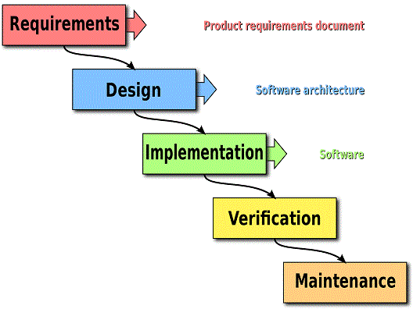
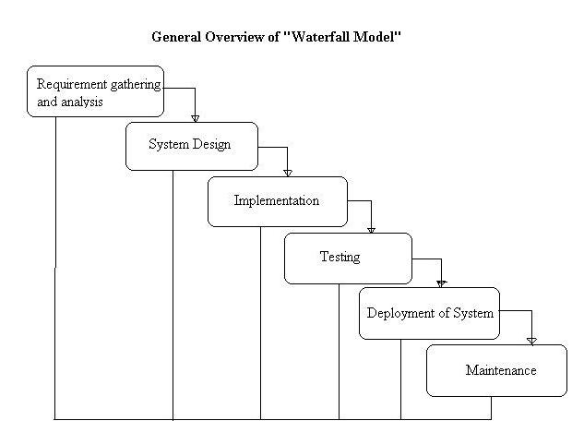
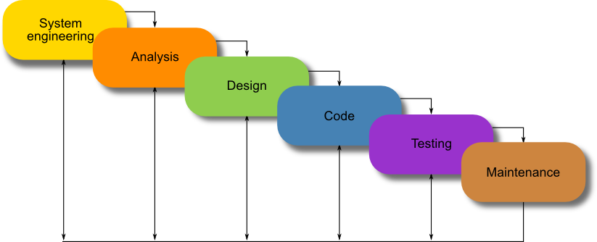
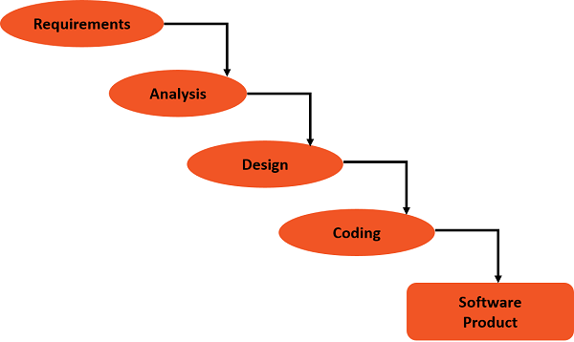
Interesting
There are other versions of the Model:

Slide 64
6. Reflections

Slide 65
Reflections
The Waterfall Model works well with Project Management approaches.

Slide 66
Reflections
The system defined at project start might not be suitable by the end of the project, since the customer will be dealing with change in their industry every business day.

Slide 67
Reflections
Requirements are usually unclear at the start of a project (“I’ll know it when I see it”).

Slide 68
Reflections
Requirements change over time.

Slide 69
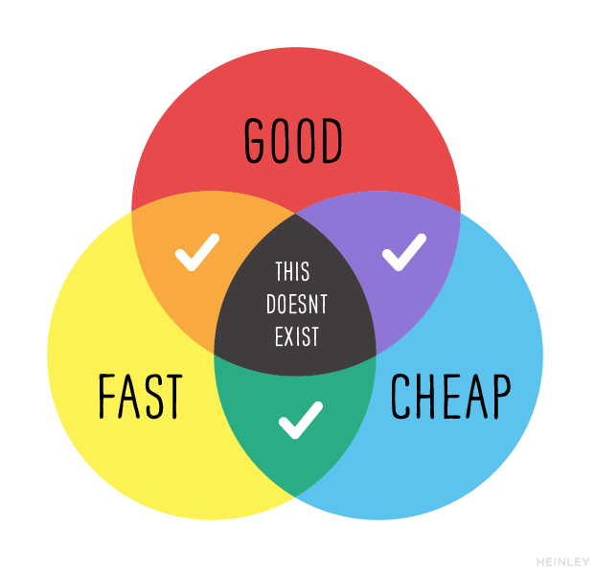
Reflections

Slide 70
7. Review

Slide 71
Review
What did we learn?

Slide 72
8. Summary

Slide 73
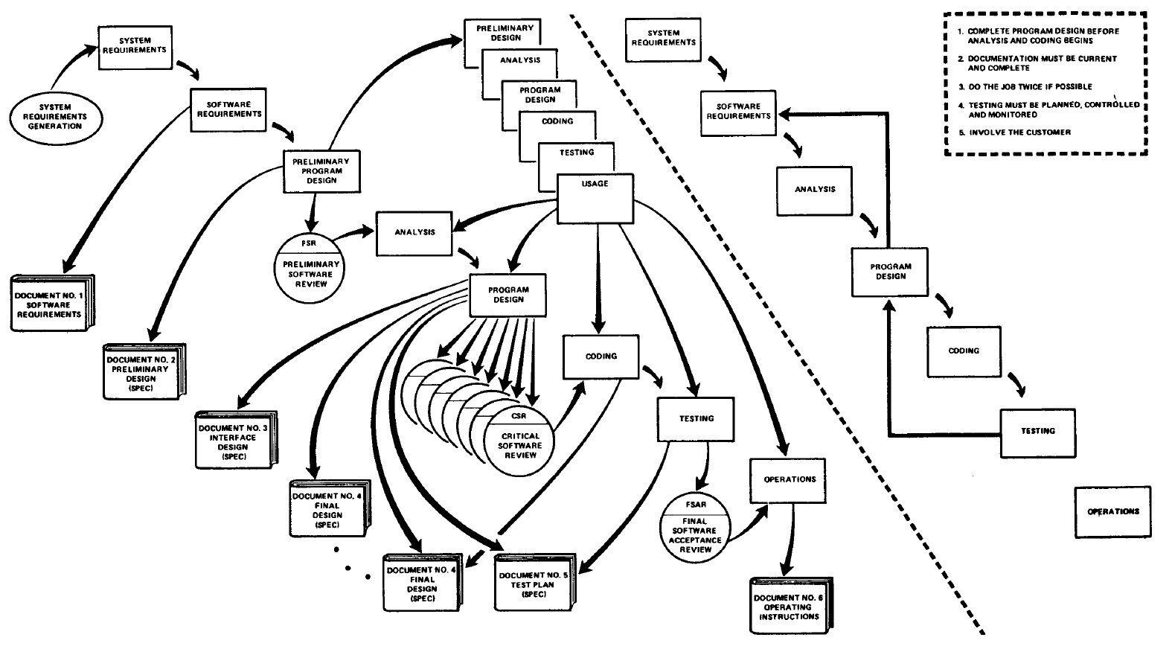
Summary

