Slide 1
The Waterfall Model
The Waterfall Model
Damian Gordon
Damian Gordon

Slide 2
Introduction
“I am going to describe my personal views about managing large software developments.
I have had various assignments during the past nine years, mostly concerned with the development of software packages for spacecraft mission planning, commanding and post-flight analysis.
In these assignments I have experienced different degrees of success with respect to arriving at an operational state, on-time, and within costs.
I have become prejudiced by my experiences and I am going to relate some of these prejudices in this presentation.”

Slide 3
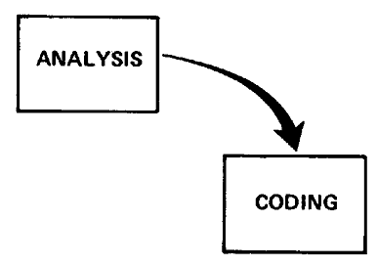
Small Developments
For a small development, you only need the following steps
Typically done for programs for internal use

Slide 4
Large Developments

Slide 5
Large Developments
System Requirements: Identify, select and document functional, scheduling and financial requirements.

Slide 6
Large Developments
Software Requirements: Identify, select and document the software features necessary to satisfy the system requirements.

Slide 7
Large Developments
Analysis: Methodically work through the details of each requirement.

Slide 8
Large Developments
Program Design: Use programming techniques to design software and hardware within the constraints and objectives set in the earlier stages.

Slide 9
Large Developments
Coding: Implement the program as designed in the earlier stages.

Slide 10
Large Developments
Testing: Test the software and record the results.

Slide 11
Large Developments
Operations: Deliver, install and configure the completed software.

Slide 12
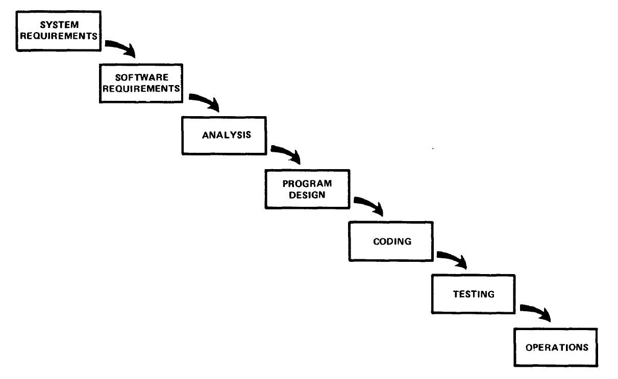
Large Developments

Slide 13
Large Developments
"I believe in this concept,
but the implementation
described above is risky
and invites failure."

Slide 14
Iterative Relationship between Successive Development Phases

Slide 15
Iterative Relationship between Successive Development Phases
Each step progresses and the design is further detailed, there is an iteration with the preceding and succeeding steps but rarely with the more remote steps in the sequence.
The virtue of all of this is that as the design proceeds the change process is scoped down to manageable limits.

Slide 16
Unfortunately the design iterations are never confined to the successive steps

Slide 17
Unfortunately the design iterations are never confined to the successive steps
The testing phase which occurs at the end of the development cycle is the first event for which timing, storage, input/output transfers, etc., are experienced as distinguished from analyzed.
These phenomena are not precisely analyzable.
Yet if these phenomena fail to satisfy the various external constraints, then invariably a major redesign is required.

Slide 18
How do we fix this?

Slide 19
Five Steps
Program Design comes first
Document the Design
Do it twice
Plan, Control and Monitor Testing
Involve the Customer

Slide 20
1. Program Design comes first
A preliminary program design phase has been inserted between the Software Requirements Generation phase and the Analysis phase.

Slide 21
1. Program Design comes first

Slide 22
1. Program Design comes first
The following steps are required:
1) Begin the design process with program designers, not analysts or programmers.
2) Design, define and allocate the data processing modes.
3) Write an overview document that is understandable, informative and current.

Slide 23
2. Document the Design
“How much documentation?"
“Quite a lot"
More than most programmers, analysts, or program designers are willing to do if left to their own devices.
The first rule of managing software development is ruthless enforcement of documentation requirements.

Slide 24
2. Document the Design

Slide 25
3. Do It Twice
Create a pilot study
If the computer program in question is being developed for the first time, arrange matters so that the version finally delivered to the customer for operational deployment is actually the second version insofar as critical design/operations areas are concerned.

Slide 26
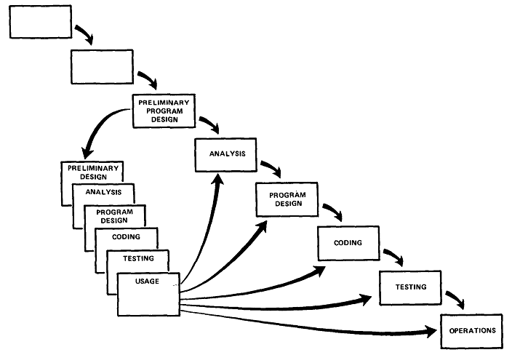
3. Do It Twice

Slide 27
4. Plan, Control and Monitor Testing
Without question the biggest user of project resources, whether it be manpower, computer time, or management judgment, is the test phase. It is the phase of greatest risk in terms of dollars and schedule.

Slide 28
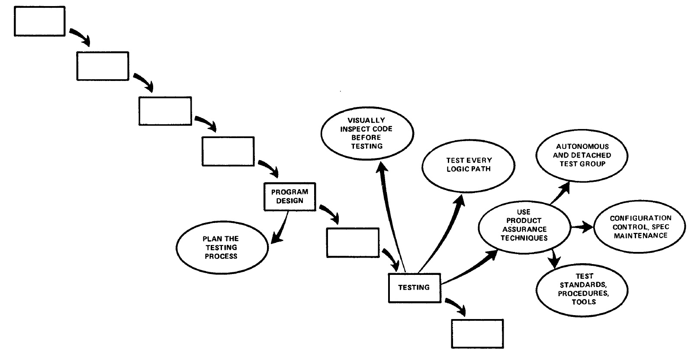
4. Plan, Control and Monitor Testing

Slide 29
4. Plan, Control and Monitor Testing
1) Many parts of the test process are best handled by test specialists who did not necessarily contribute to the original design.
2) Most errors are of an obvious nature that can be easily spotted by visual inspection.
3) Test every logic path in the computer program at least once with some kind of numerical check.
4) After the simple errors (which are in the majority, and which obscure the big mistakes) are removed, then it is time to turn over the software to the test area for checkout purposes.

Slide 30
5. Involve the Customer
For some reason what a software design is going to do is subject to wide interpretation even after previous agreement.
It is important to involve the customer in a formal way so that he has committed himself at earlier points before final delivery.
To give the contractor free rein between requirement definition and operation is inviting trouble.

Slide 31
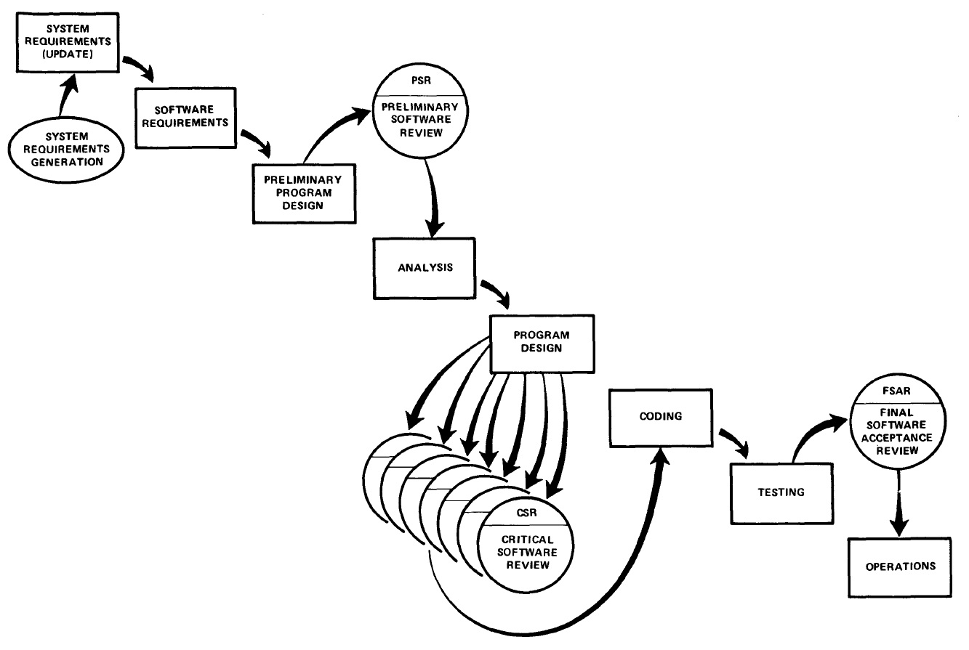
5. Involve the Customer

Slide 32
Rapid Application Development
Rapid
Application
Development
Damian Gordon
Damian Gordon

Slide 33
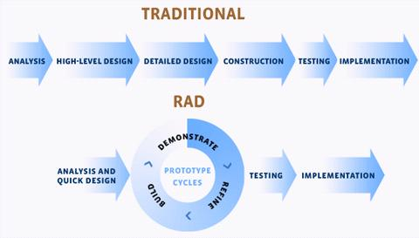
RAD

Slide 34
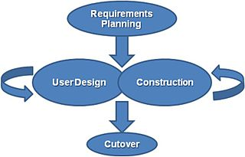
RAD
Rapid Application Development is a lightweight approach to development. It is divided into four phases:
1. Requirements Planning Phase
2. User Design Phase
3. Construction Phase
4. Cutover Phase

Slide 35
RAD
1. Requirements Planning Phase
Also called “Joint Requirements Planning (JRP) Phase”
Combines the Planning and Analysis phases from the Waterfall Model
End-users and IT staff agree on business needs, project scope, constraints, and system requirements
This phase ends when the team agree on the key issues and obtain management authorization to continue

Slide 36
RAD
2. User Design Phase
End-users and IT staff jointly develop the system processes, inputs, and outputs.
They use a combination of Joint Application Design (JAD) and CASE tools.
This needs to be a continuous interactive process that allows End-users to understand, modify, and eventually approve a working model of the system that meets their needs.

Slide 37
RAD
3. Construction Phase
Similar to the Development phase in the Waterfall model, but End-users continue to participate and can still suggest changes or improvements as actual screens or reports are developed.
The key tasks in this phase are programming and application development, coding, unit-integration and system testing.

Slide 38
RAD
4. Cutover Phase
Similar to the Installation, Testing and Maintenance phases of the Waterfall model, including data conversion, testing, changeover to the new system, and user training.
Compared with traditional methods, the entire process is compressed, and as a result, the new system is built, delivered, and placed in operation much sooner

Slide 39
RAD

Slide 40
RAD
Tools
Using CASE tools provides automation support for systems development through features such as code generation and automatic consistency checking.
CASE tools that generate prototypes can be used to support the iterative development approach, allowing end users to see the application evolve as it is being built.

Slide 41
RAD
Methodology
The most effective family of techniques must be formalised and used to deliver the system.
A complete list of tasks is provided to ensure that no essential activity is overlooked, while techniques are fully documented to ensure that a task is performed in the proper way.

Slide 42
RAD
People
The best people must be well-trained in both the methodology and the tools.
Small teams that work consistently well together should be grouped together on assignments.

Slide 43
RAD
Management
The project must be managed for speed through the use of techniques such as facilitated Joint Requirements Planning (JRP) and Joint Application Design (JAD) workshops to extract users' requirements quickly.
Timebox Management is used in Rapid Construction to iteratively deliver the system to the users.

Slide 44
Activity Diagram

Slide 45
Activity Diagram
Process models show the overall process and the processes that are supported by the system.

Slide 46
Activity Diagram
We’ll use UML Activity Diagrams to represent process flows.

Slide 47
Activity Diagram
Start
Stop

Slide 48
Activity Diagram
Start
The Start Node is also called the Initial Note.
Stop
The Stop Node is also called the Final Note.

Slide 49
Activity Diagram
Condition

Slide 50
Activity Diagram
Condition
The condition defines a guard which must evaluate to true in order to traverse the node.

Slide 51
Activity Diagram
Action

Slide 52
Activity Diagram
Action
An action may be physical, such as Inspect Forms, or electronic, such as Display Student Screen.

Slide 53
Activity Diagram
Decision

Slide 54
Activity Diagram
Decision
The flows leaving a decision will normally include conditions

Slide 55
Activity Diagram
Fork
Join

Slide 56
Activity Diagram
Fork
This denotes the beginning of parallel activity.
Join
All flows going into the join must reach it before processing can continue.

Slide 57
Activity Diagram
Join
Start
Action
Fork
Stop
Decision
Condition

Slide 58
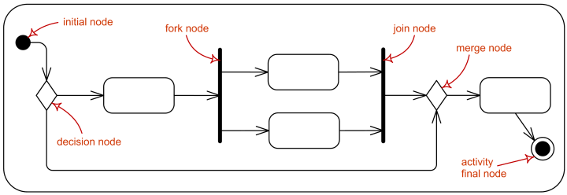
Activity Diagram

Slide 59
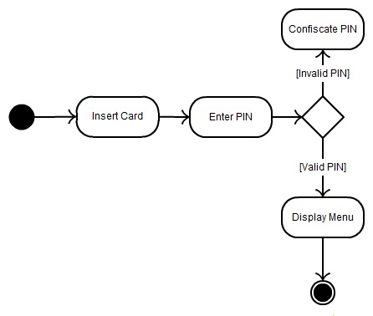
Activity Diagram

Slide 60
Activity Diagram
To enrol in college:
"Fill out enrolment forms", if they are filled out incorrectly, then if there is help available, "Obtain Help", but if there is no help available, retry to "Fill out enrolment forms". If it's a trivial problem or the form are filled out correctly, proceed to "Enrol in University. Once you've enrolled, two things can happen in parallel; (1) you can "Attend University Overview Presentation", and (2) you can "Enrol in Seminar(s), an "Make initial Tuition Payments".

Slide 61
Activity Diagram
Fill Out Enrollment Forms
IF the forms are filled out incorrectly
THEN IF it’s a big problem
THEN IF there is help available
THEN “Obtain Help”
ELSE Return to “Fill Out Enrollment Forms”
ELSE it’s a trivial problem so “Enrol in University”
ELSE “Enrol in University”
Happening in Parallel (Concurrently):
Attend university
Enrol in Seminar(s) → Make Initial Tuition Payment

Slide 62
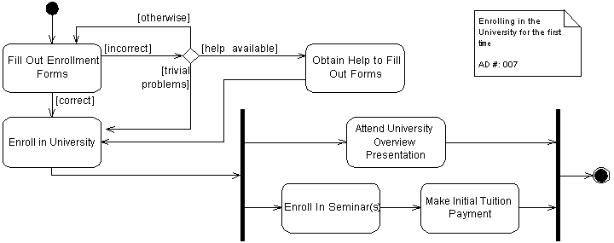
Activity Diagram

Slide 63
Activity Diagram

Slide 64
Activity Diagram
To buy a ticket:
"Show Your Ticket at the Check-In Counter" then "Verify that Ticket". If the Ticket has a problem, "Refer the Passenger to the Customer Services" and exit. Otherwise “Check-in the Luggage”. When "Accepting the Luggage", check if it is “Subject to a Fee”, if it is “Pay Fees”, otherwise don't. In either case “Issue a Boarding Pass” and exit.

Slide 65
Activity Diagram
Show Your Ticket at the Check-In Counter;
Verify the Ticket;
IF the Ticket is NOT OK
THEN Refer to CUSTOMER SERVICES; EXIT;
END IF;
Check in Luggage;
Accept Luggage;
IF Luggage is Subject to Fee
THEN Pay Fee;
END IF;
Issue Boarding Pass;

Slide 66
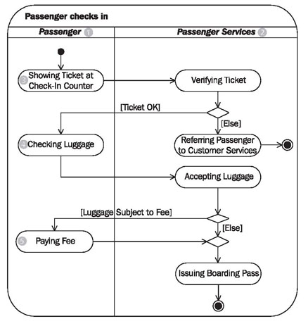
Activity Diagram

Slide 67
Activity Diagram

Slide 68
Use Case Diagram

Slide 69
Use Case Diagram
Actor

Slide 70
Use Case Diagram
Actor
Can represent:
Human
Peripheral device (hardware)
External system or subsystem
Time or time-based event

Slide 71
Use Case Diagram
Use Cases

Slide 72
Use Case Diagram
Use Cases
A sequence of actions that provide something of measurable value to an actor.

Slide 73
Use Case Diagram
Associations

Slide 74
Use Case Diagram
Associations
An association exists whenever an actor is involved with an interaction described by a use case.

Slide 75
Use Case Diagram
System
Boundary

Slide 76
Use Case Diagram
System
Boundary
Indicates the scope of the system, anything within the box represents functionality that is in scope and anything outside the box is not.
Optional

Slide 77
Use Case Diagram
Packages

Slide 78
Use Case Diagram
Packages
Packages allow you to organize use cases into groups. When a Use Case becomes to complex, it’s better to divide it into packages.
Optional

Slide 79
Use Case Diagram
System
Boundary
Actor
Use Cases
Packages
Associations

Slide 80
Use Case Diagram
Actor
Use Case
Association
System
Boundary
Package

Slide 81
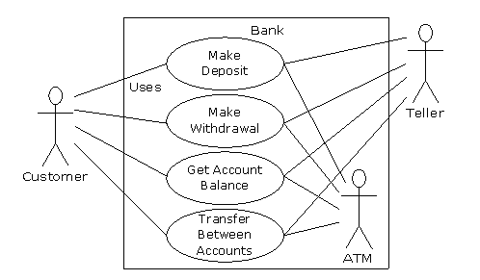
Use Case Diagram

Slide 82
Use Case Diagram
You see a "Man with Chainsaw“ walking down the road.
You think “I wonder is that a Halloween costume (if so, it’s SCARY). Maybe there a defending against Zombies (if so, it’s SCARY and VIOLENT), or maybe they are a Psycho Killer (if so, it’s SCARY and VIOLENT again)”
Then you think “Wait, maybe it’s their OCCUPATION, maybe they’re a Lumberjack or a Juggler”.

Slide 83
Use Case Diagram
A "Man with Chainsaw" is either:
- Wearing a SCARY Halloween costume
- a VIOLENT and SCARY Zombie Defender
- a VIOLENT and SCARY Psycho Killer
- has an OCCUPATION of Lumberjack
- has an OCCUPATION of Juggler

Slide 84
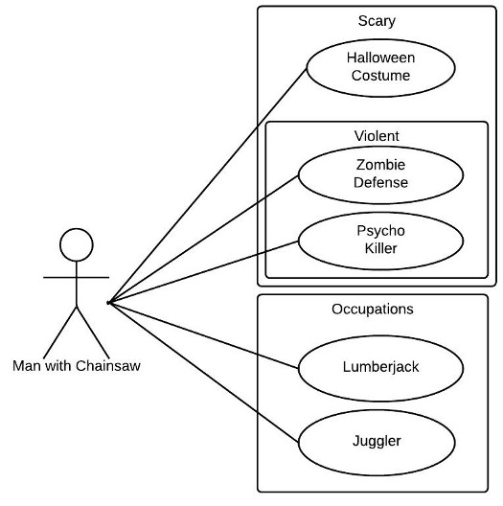
Use Case Diagram

Slide 85
Use Case Diagram

Slide 86
Use Case Diagram
The Airport "Passenger Service" system presents the PASSENGER with the following menu options:
(1) Check-In
(2) Automated Check-In
(3) Express Check-In
(4) Boarding
If they select (1) they get the help of a CHECK-IN REPRESENTATIVE.
Both the CUSTOMS OF THE DESTINATION AIRPORT and the BAGGAGE TRANSPORTATION will be "Requesting a Passenger List".

Slide 87
Use Case Diagram
The PASSENGER actor can use the "Passenger Service“ system to choose between:
(1) Check-In (with the help of a CHECK-IN REPRESENTATIVE actor)
(2) Automated Check-In
(3) Express Check-In
(4) Boarding
Both the CUSTOMS OF THE DESTINATION AIRPORT actor and the BAGGAGE TRANSPORTATION actor will be "Requesting a Passenger List“ from the "Passenger Service“ system.

Slide 88
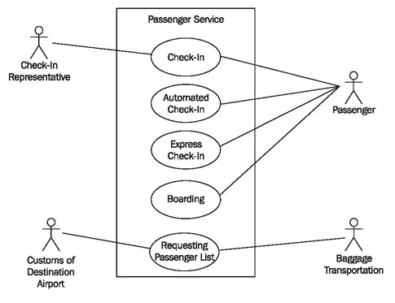
Use Case Diagram

Slide 89
Use Case Diagram

Slide 90
Use Case Diagram (advanced features)

Slide 91
Use Case Diagram
Generalization
A parent use case (or actor) may be specialized into one or more child use cases (or actors) that represent more specific forms of the parent.

Slide 92
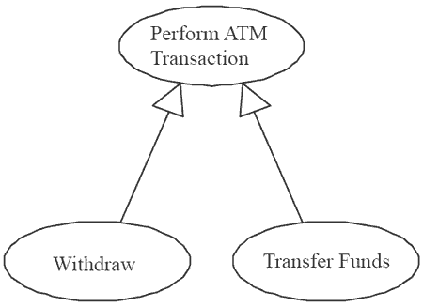
Use Case Diagram
Generalization

Slide 93
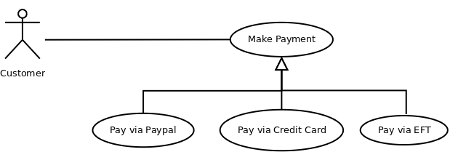
Use Case Diagram
Generalization

Slide 94
Use Case Diagram
<<include>>
The inclusion of the functionality of one use case within another. For example, if I am taking a car journey, then the Use Case “Drive Car” is definitely required.
<<extend>>
The extension of the use case to include optional functionality. For example, if I am taking a car journey, then the Use Case “Fill Petrol Tank” may be required.

Slide 95
Use Case Diagram
System
Boundary
Actor
Use Cases
Packages
Association
<<include>>
Generalization
<<extend>>

Slide 96
Use Case Diagram
include
Actor
<<include>>
Use Case
extend
<<extend>>
Association
Package
Generalization
System Boundary

Slide 97
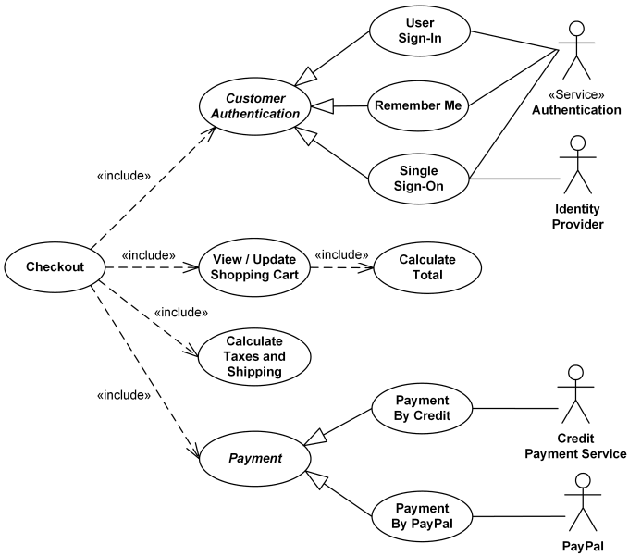
Use Case Diagram

Slide 98
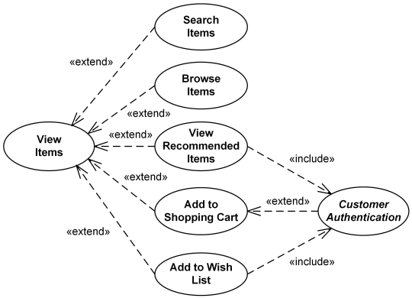
Use Case Diagram

Slide 99
Use Case Diagram
When using the ONLINE SHOPPING system, a WEB CUSTOMER can either be an already REGISTERED CUSTOMER or a NEW CUSTOMER.
A REGISTERED CUSTOMER can "View Items" and "Make a Purchase". A NEW CUSTOMER can also "View Items", but they cannot yet "Make a Purchase" as they have to add their name to the "Client Register".
"Make a Purchase" is made up of several processes, two of which must be: "View Items" and "Checkout".
"View Items" requires two external processes, both an "Authentication" process and an "Identity Provider“ process. "Checkout" requires three external processes, an "Authentication" process, an "Identity Provider“ process, and a "Paypal" process. "Client Register" requires the "Authentication" process.

Slide 100
Use Case Diagram
There is a general WEB CUSTOMER actor, and two instances of it, the REGISTERED CUSTOMER actor and the NEW CUSTOMER actor.
When using the ONLINE SHOPPING system, a REGISTERED CUSTOMER can "View Items" and "Make a Purchase".
When using the ONLINE SHOPPING system, a NEW CUSTOMER can also "View Items", but they cannot yet "Make a Purchase" as they have to add their name to the "Client Register".
"Make a Purchase" is a Use Case that has to include two other use cases: "View Items" and "Checkout".
"View Items" requires two external actors, both an "Authentication" actor and an "Identity Provider“ actor. "Checkout" requires three external actors, an "Authentication" actor, an "Identity Provider“ actor, and a "Paypal" actor. "Client Register" requires the "Authentication" actor.

Slide 101
Use Case Diagram

Slide 102
Use Case Diagram

Slide 103
Use Case Diagram
When using the BANK SYSTEM, the first thing a CUSTOMER has to do is "Open an Account" with the help of a BANK EMPLOYEE. Once their account is open, they can either "Deposit Funds" or "Withdraw Funds", both of which will "Update the Balance".
If the Amount in the Account exceeds £10,000 because of a "Deposit Funds" action, a bonus is added to the balance. Also if the Account is over 55 years, the Balance gets a bonus added.
As well as a CUSTOMER actor, there is a FOREIGN EXCHANGE CUSTOMER actor, who can do everything a CUSTOMER actor can do, as well as bring able to "Convert Currency".

Slide 104
Use Case Diagram
In the BANK SYSTEM, there is a CUSTOMER actor who can do the following:
(1) "Open an Account" (with the help of a BANK EMPLOYEE actor)
(2) "Deposit Funds“, which will include "Update the Balance“.
(3) "Withdraw Funds", which will “include Update the Balance".
The "Deposit Funds“ will check if the balance exceeds £10,000, and based on that CONDITION, a “Calculate Bonus” will occur. Also if the Account is over 55 years , a “Calculate Bonus” will occur.
As well as a regular CUSTOMER, there is a FOREIGN EXCHANGE CUSTOMER, who can do everything a CUSTOMER can do, as well as bring able to "Convert Currency".

Slide 105
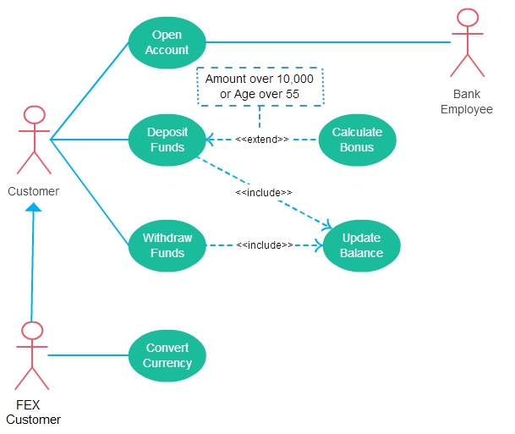
Use Case Diagram

Slide 106
Use Case Diagram
BANK
SYSTEM

Slide 107
Intentional Attacks

Slide 108
Intentional Attacks
Denial-of-Service (DoS) Attack
Wiretapping
Viruses
Worms
Trojans

Slide 109
Denial-of-Service (DoS) Attack

Slide 110
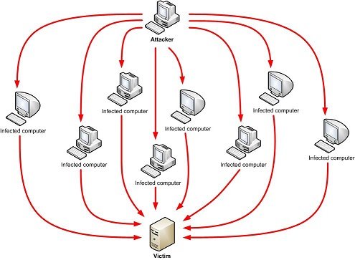
Denial-of-Service (DoS) Attack
Makes the “victim” computer unavailable to its users. Typically used on computers that act as Web Servers.

Slide 111
Denial-of-Service (DoS) Attack
Works by making the “victim” computer perform a task over and over again, thus preventing it from doing other jobs.
For example, if the computer is supposed to take orders from customers, and the first step is for the “victim” computer to identify itself to the customer computer, a DoS attack might keep making the “victim” computer identify itself and therefore unable to do other work.

Slide 112
Denial-of-Service (DoS) Attack
A Distributed Denial-of-Service (DDoS) is where the attack source is more than one, often thousands of, unique IP addresses.
It is like to a group of people crowding the entry door to a shop, and not letting legitimate customers enter into the shop or business, disrupting normal operations.

Slide 113
Denial-of-Service (DoS) Attack
How does it work?
There are a variety of approaches that can work, we’ll look at a HTTP POST DoS attack.

Slide 114
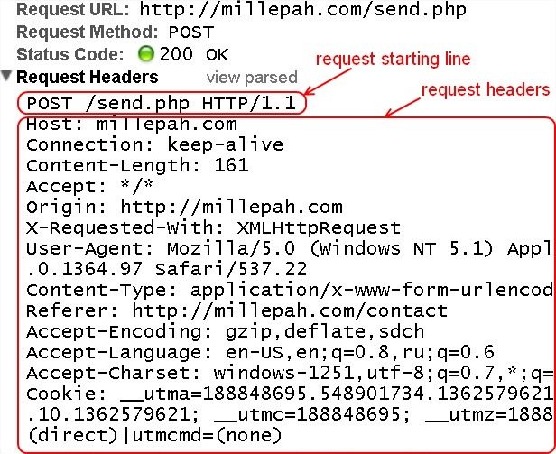
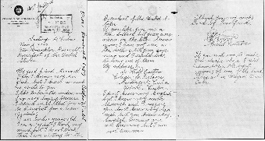
Denial-of-Service (DoS) Attack
HTTP
POST
Attack
How does it work?
There are a variety of approaches that can work, we’ll look at a HTTP POST DoS attack.
<HTTP Message>
HEAD
BODY

Slide 115
Denial-of-Service (DoS) Attack
HTTP
POST
Attack
A legitimate HTTP POST header, which includes a 'Content-Length' field to specify the size of the message body to follow. However, the attacker then proceeds to send the actual message body at an extremely slow rate (e.g. 1 byte/110 seconds).

Slide 116
Denial-of-Service (DoS) Attack
HTTP
POST
Attack
Due to the entire message being complete, the target server will attempt to obey the 'Content-Length' field in the header, and wait for the entire body of the message to be transmitted, which can take a very long time.

Slide 117
Denial-of-Service (DoS) Attack
HTTP
POST
Attack
The attacker establishes hundreds or even thousands of such connections, until all resources for incoming connections on the server (the victim) are used up, hence making any further (including legitimate) connections impossible until all data has been sent.

Slide 118
DoS Attack Case Study
Bollywood versus Anonymous

Slide 119
DoS Attack Case Study
Bollywood versus Anonymous
Bollywood is the nickname for the Hindi language film industry, based in Mumbai, the capital of Maharashtra in India. Bollywood is also one of the largest centres of film production in the world, and is more formally referred to as Hindi cinema.

Slide 120
DoS Attack Case Study
Bollywood versus Anonymous
Anonymous are a loosely associated international network of activist and hacktivist groups. The group became known for a series of well-publicized publicity stunts and Denial-of-Service (DoS) attacks on government, religious, and corporate websites.

Slide 121
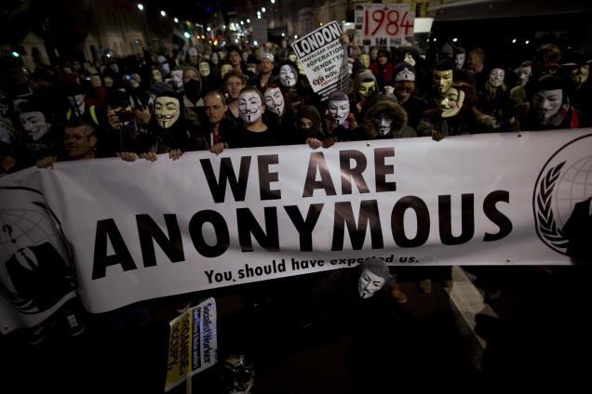
DoS Attack Case Study
Bollywood versus Anonymous
Anonymous are a loosely associated international network of activist and hacktivist groups. The group became known for a series of well-publicized publicity stunts and Denial-of-Service (DoS) attacks on government, religious, and corporate websites.

Slide 122
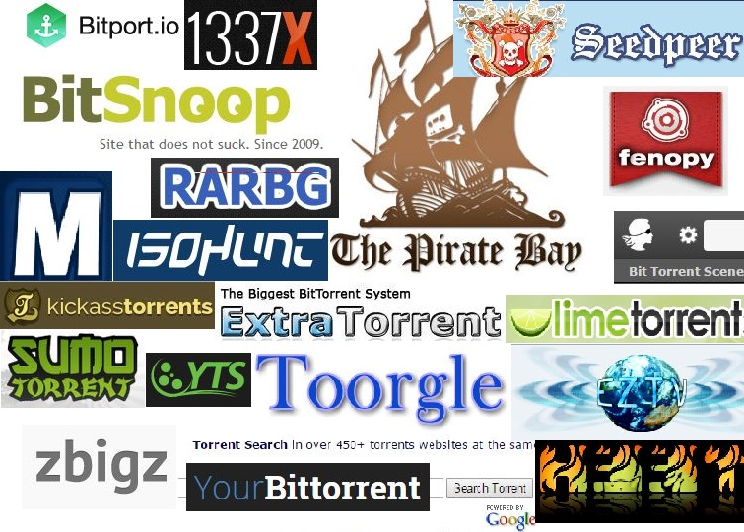
DoS Attack Case Study
Bollywood versus Anonymous
Bollywood was unhappy with the torrent sites:

Slide 123
DoS Attack Case Study
Bollywood versus Anonymous
In 2010, several Bollywood companies hired Aiplex Software to launch DDoS attacks on websites that did not respond to takedown notices.

Slide 124
DoS Attack Case Study
Bollywood versus Anonymous
Piracy activists then created Operation Payback in September 2010 in retaliation

Slide 125
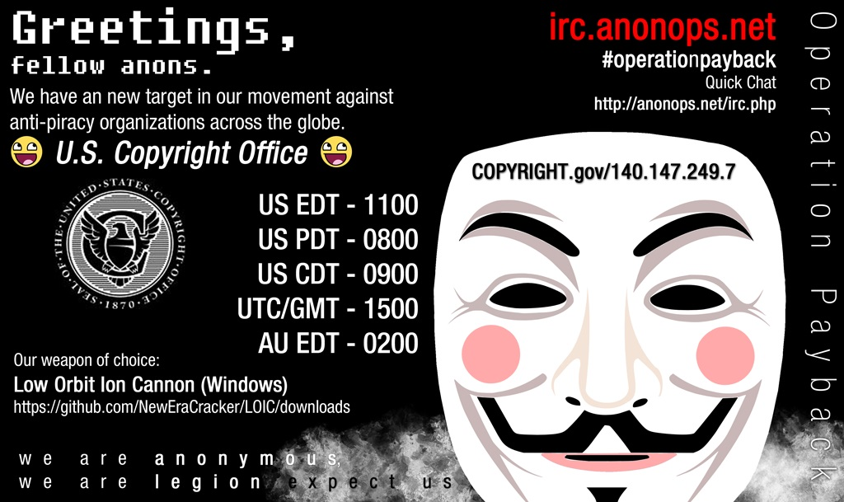

Slide 126
DoS Attack Case Study
Bollywood versus Anonymous
The original plan was to attack Aiplex Software directly, but upon finding some hours before the planned DDoS that another individual had taken down the firm's website on their own, Operation Payback moved to launching attacks against the websites of copyright stringent organisations Motion Picture Association of America (MPAA) and International Federation of the Phonographic Industry, giving the two websites a combined total downtime of 30 hours.

Slide 127
DoS Attack Case Study
Bollywood versus Anonymous
In the following two days, Operation Payback attacked a multitude of sites affiliated with the MPAA, the Recording Industry Association of America (RIAA), and British Phonographic Industry. Law firms such as ACS:Law, Davenport Lyons and Dunlap, Grubb & Weaver (of the US Copyright Group) were also attacked.

Slide 128
Wiretapping

Slide 129
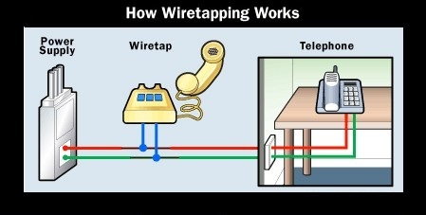
Wiretapping
Wiretapping has been around since the 1890s, it’s simply a matter of gaining access to the transmission media and using a device to intercept the signals.

Slide 130
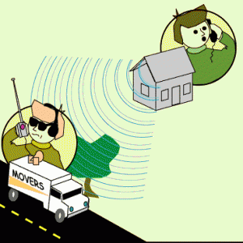
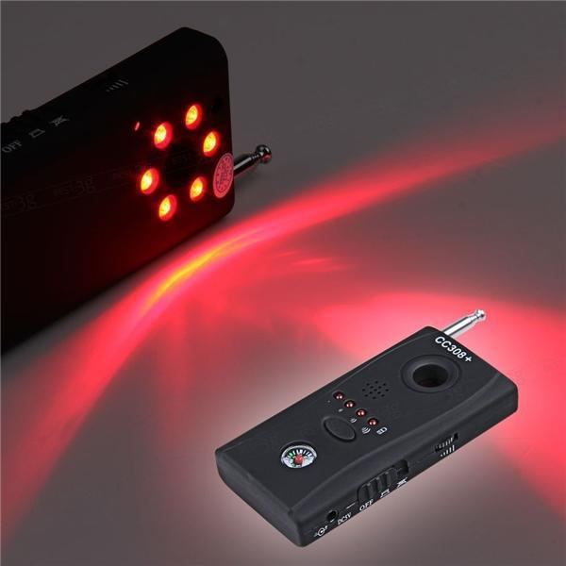
Wiretapping
Wireless wiretapping works in the exact same way, except that there is no need to have physical contact with the transmission media.
This is why we should encrypt wireless transmissions.

Slide 131
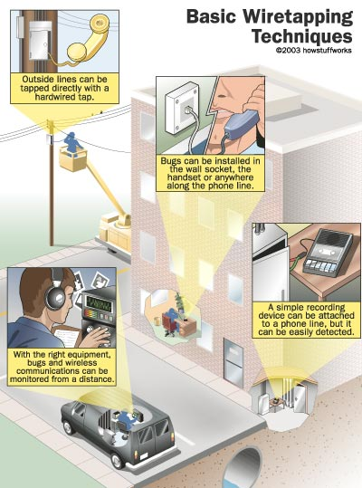
Wiretapping

Slide 132
Wiretapping
There are two forms of wiretapping:
Passive Wiretapping is where you are recording the data transmitted, but not interfering with it.
Active Wiretapping is where you are recording the data and also modifying it before it is sent onto the receiver.

Slide 133
Wiretapping Case Study
USA Patriot Act
The USA PATRIOT Act
Title II: Enhanced Surveillance Procedures

Slide 134
Wiretapping Case Study
USA Patriot Act
The USA PATRIOT Act
Title II: Enhanced Surveillance Procedures
Section 209 made it easier for authorities to gain access to voicemail as they no longer must apply for a wiretap order, and instead just apply for a normal search warrant.
The FBI can secretly conduct a physical search or wiretap on U.S. citizens to obtain evidence of crime without proving probable cause, as the Fourth Amendment explicitly requires.

Slide 135
Wiretapping Case Study
What it doesn’t cover
USA Patriot Act
The USA PATRIOT Act
On February 9, 2016, the FBI asked Apple Inc. to create a new version of the phone's iOS operating system that could be installed and run in the phone's random access memory to disable certain security features that Apple refers to as "GovtOS“, the FBI had recovered an Apple iPhone 5C owned by the San Bernardino County, California government, that had been issued to its employee, Syed Rizwan Farook, one of the shooters involved in the December 2015 San Bernardino attack. The attack killed 14 people and seriously injured 22.

Slide 136
Wiretapping Case Study
What it doesn’t cover
USA Patriot Act
The USA PATRIOT Act
Apple declined due to its policy to never undermine the security features of its products. The FBI responded by successfully applying to a United States magistrate judge, Sherri Pym, to issue a court order, mandating Apple to create and provide the requested software. The order was not a subpoena, but rather was issued under the All Writs Act of 1789.

Slide 137
Wiretapping Case Study
What it doesn’t cover
USA Patriot Act
The USA PATRIOT Act
On February 16, 2016, Apple chief executive officer Tim Cook released an online statement to Apple customers, explaining the company's motives for opposing the court order. He also stated that while they respect the FBI, the request they made threatens data security by establishing a precedent that the U.S. government could use to force any technology company to create software that could undermine the security of its products.

Slide 138
Wiretapping Case Study
What it doesn’t cover
USA Patriot Act
The USA PATRIOT Act
On March 28, 2016, the FBI said it had unlocked the iPhone with the third party's help, and an anonymous official said that the hack's applications were limited; the Department of Justice vacated the case.

Slide 139
Wiretapping Case Study
What it doesn’t cover
USA Patriot Act
For more detail:
In September 2015, Apple released a white paper detailing the security measures in its iOS 9 operating system.
The iPhone 5C model can be protected by a four-digit PIN code. After more than ten incorrect attempts to unlock the phone with the wrong PIN, the contents of the phone will erase the AES encryption key that protects its stored data.
https://www.apple.com/business/docs/iOS_Security_Guide.pdf

Slide 140
Viruses

Slide 141
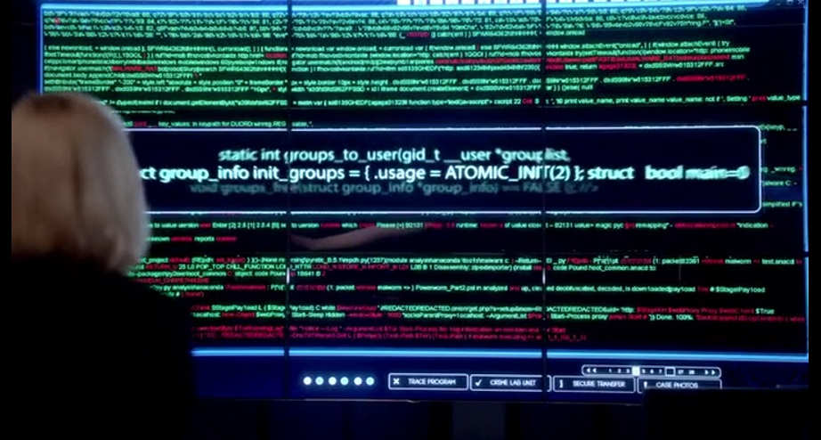
Viruses
A Computer Virus is a program that alters the way a computer works without permission of the user. It is typically self-executing and self-replicating.

Slide 142
Viruses
A Virus is typically written for a specific operating system, so a virus that works on Windows usually won’t work on Linux.
Virus writers exploit vulnerabilities in a specific operating systems.

Slide 143
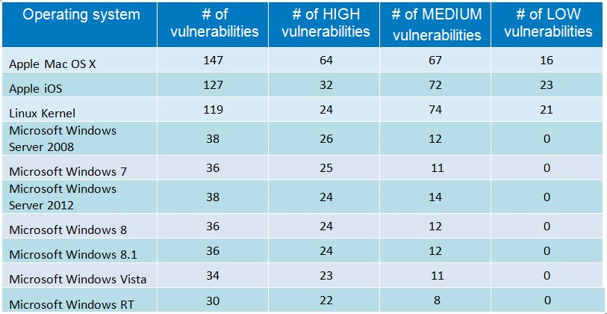
Viruses
Most vulnerable operating systems and applications in 2014

Slide 144
Types of Viruses
Boot Sector Virus
File Infector Virus
Macro Virus
Multipartite Virus
Polymorphic Virus

Slide 145
Types of Viruses
Boot Sector Virus: Infects the boot sector. There are two types of boot sector viruses:
Master Boot Record (MBR): A MBR can contain code that locates and invokes its volume record.
Volume Boot Record (VBR): A VBR can contain code that loads and invokes the operating system.

Slide 146
Types of Viruses
File Infector Virus: Perhaps the most common type of virus, the file infector takes root in a host file. This type of virus may end up deleting the file that was originally infected, or it may rewrite it or replace it with something else.
Usually infects .COM and .EXE files.

Slide 147
Types of Viruses
Macro Virus: This is a virus that can be hidden in data files, like Word documents and Spreadsheets.
Disable macros on files that you don’t trust.

Slide 148
Types of Viruses
Multipartite Virus: A virus of this type may spread in multiple ways, and it may take different actions on an infected computer depending on variables, such as the operating system installed or the existence of certain files.
Can infect boot sector and files.

Slide 149
Types of Viruses
Polymorphic Virus: A polymorphic Virus can mutate over time or after every contaminated file and changes the code that is used to deliver the payload.

Slide 150
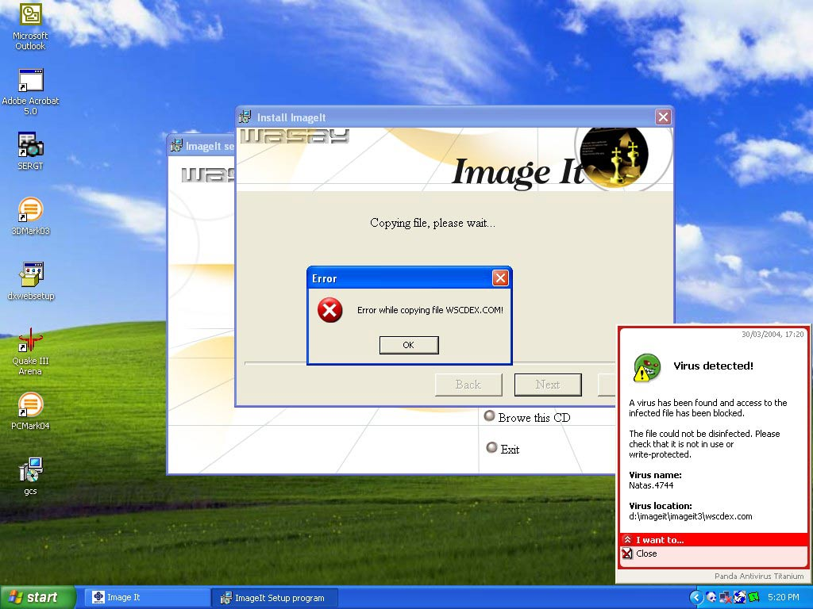
Virus Case Study
Natas Virus
The Natas Virus

Slide 151
Virus Case Study
Natas Virus
The Natas Virus
Natas is a memory-resident stealth virus which is highly polymorphic, that affects master boot records, boot sectors of diskettes, files .COM and also .exe programs.

Slide 152
Virus Case Study
Natas Virus
The Natas Virus
Natas (Satan spelled backwards) is a computer virus written by James Gentile, a then 18-year-old hacker from San Diego, California who went by the alias of "Little Loc" and later "Priest".
The virus was made for a Mexican politician who wanted to win the Mexican elections by affecting all the Mexican Federal Electoral Institute (IFE) computers with a floppy disk.

Slide 153
Virus Case Study
Natas Virus
The Natas Virus
The virus first appeared in Mexico City in May 1992, spread by a consultant using infected floppy disks. The virus became widespread in Mexico and the southwest United States.
The virus also made its way to the other side of the USA, infecting computers at the United States Secret Service knocking their network offline for approximately three days.

Slide 154
Virus Case Study
Natas Virus
The Natas Virus
When a file infected with Natas is executed, it becomes memory resident, taking up 5,664 bytes in memory and infects the master boot record and COMMAND.COM. The virus infects files when they are executed, opened or copied, appending its 4,746 bytes to .COM, .EXE and .OVL files.

Slide 155
Worms

Slide 156
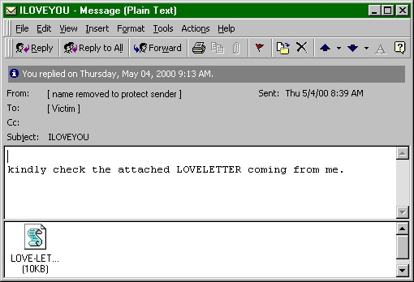
Worms
A computer worm is program that replicates itself in order to spread to other computers (often using a computer network). Unlike a computer virus, it does not need to attach itself to an existing program

Slide 157
Worms
Worms usually slow down processor time, and take up memory space, they also typically take up network bandwidth.
Some worms that have been created are designed only to spread, and do not attempt to change the systems they pass through. However, as the Morris worm and Mydoom showed, even these worms can cause major disruption by increasing network traffic.

Slide 158
Helpful Worms
Since the start of computer networks there have been attempts to create useful worms, for example, the Nachi family of worms tried to download and install patches from Microsoft's website to fix vulnerabilities in the host system—by exploiting those same vulnerabilities.

Slide 159
Helpful Worms
In practice, although this may have made these systems more secure, it generated considerable network traffic, rebooted the machine in the course of patching it, and did its work without the consent of the computer's owner.
Several worms, like XSS worms, have been written to research how worms spread. For example, the effects of changes in social activity or user behaviour.

Slide 160
Worm Case Study
“I love you” worm
The ILOVEYOU Worm

Slide 161
Worm Case Study
“I love you” worm
The ILOVEYOU Worm
ILOVEYOU, sometimes referred to as Love Letter, was a computer worm that attacked tens of millions of Windows personal computers on and after May 4th, 2000.
it started spreading as an email message with the subject line "ILOVEYOU" and the attachment "LOVE-LETTER-FOR-YOU.txt.vbs“

Slide 162
Worm Case Study
“I love you” worm
The ILOVEYOU Worm
The worm did damage on the local machine, overwriting random types of files (including Office files, image files, and audio files; however after overwriting MP3 files the virus would hide the file), and sent a copy of itself to all addresses in the Windows Address Book used by Microsoft Outlook.

Slide 163
Worm Case Study
“I love you” worm
The ILOVEYOU Worm
The worm originated in the Philippines, thereafter across the world, moving first to Hong Kong, then to Europe, and finally the United States, as employees began their workday that Friday morning. The outbreak was later estimated to have caused US $5.5-8.7 billion in damages worldwide, and estimated to cost the US $15 billion to remove the worm.

Slide 164
Trojans

Slide 165
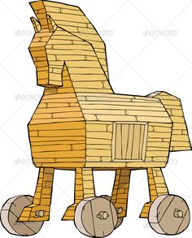
Trojans
A Trojan is a malicious program that misrepresents itself to appear useful, routine, or interesting in order to persuade a victim to install it.

Slide 166
Trojans
Trojans are generally spread by some form of social engineering, for example where a user is duped into executing an e-mail attachment disguised to be unsuspicious, (e.g., a routine form to be filled in), or by downloading.
Unlike computer viruses and worms, Trojans generally do not attempt to inject themselves into other files or otherwise propagate themselves.

Slide 167
Trojans
Types of things Trojans do:
Destructive Behaviour
Use of Resources, or Identity
Money, Theft, or Ransom
Data Theft
Spying, Surveillance, or Stalking

Slide 168
Trojans
Destructive Behaviour
Crashing the computer or device.
Modification or deletion of files.
Data corruption.
Formatting disks, destroying all contents.
Spread malware across the network.
Spy on user activities and access sensitive information.

Slide 169
Trojans
Use of Resources, or Identity
Use of the machine as part of a botnet (e.g. to perform automated spamming)
Using computer resources for mining cryptocurrencies
Using the infected computer as proxy for illegal activities and/or attacks on other computers.
Infecting other connected devices on the network.

Slide 170
Trojans
Money, Theft, or Ransom
Electronic money theft
Installing ransomware such as CryptoLocker

Slide 171
Trojans
Data Theft
Data theft, including for industrial espionage
User passwords or payment card information
User personally identifiable information
Trade secrets

Slide 172
Trojans
Spying, Surveillance, or Stalking
Keystroke logging
Watching the user's screen
Viewing the user's webcam
Controlling the computer system remotely

Slide 173
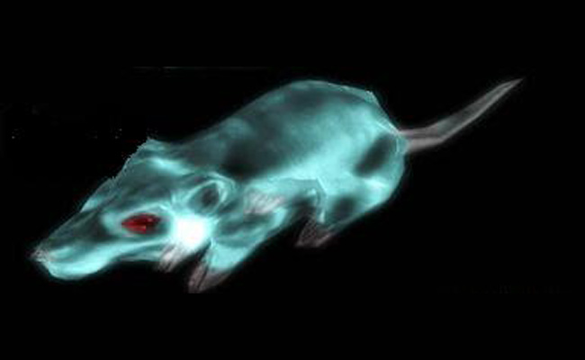
Trojan Case Study
Gh0st RAT
Trojan
The Gh0st RAT Trojan

Slide 174
Trojan Case Study
Gh0st RAT
Trojan
The Gh0st RAT Trojan
Gh0st RAT is a Trojan horse for the Windows platform that was used to hack into some of the most sensitive computer networks on Earth. It is a cyber spying computer program. The "Rat" part of the name refers to the software's ability to operate as a "Remote Administration Tool".

Slide 175
Trojan Case Study
Gh0st RAT
Trojan
The Gh0st RAT Trojan
It can:
Take full control of the remote screen.
Provide real time as well as offline keystroke logging.
Provide live feed of webcam, and microphone.
Download remote binaries on the infected remote host.
Take control of remote shutdown and reboot of host.
Disable infected computer remote keyboard input.
Enter into shell of remote infected host with full control.
Provide a list of all the active processes.

Slide 176
Trojan Case Study
Gh0st RAT
Trojan
The Gh0st RAT Trojan
Gh0st Rat was originally made by the C.Rufus Security Team in 2005. Just as with other well-featured “off-the-shelf” trojans like Poison Ivy, Hupigon and DarkComet it has been used by all sorts of people – from script kiddies to resourceful targeted attack actors.

Slide 177
Trojan Case Study
Gh0st RAT
Trojan
The Gh0st RAT Trojan
In less than two years (2007-2009) Gh0st Rat infiltrated at least 1,295 computers in 103 countries, including many belonging to embassies, foreign ministries and other government offices, as well as the Dalai Lama’s Tibetan exile centres in India, Brussels, London and New York.

Slide 178
Storyboarding

Slide 179
Storyboarding
“Storyboards are visual organizers, typically a series of illustrations displayed in sequence for the purpose of pre-visualizing a video, web-based training, or interactive media sequence.”
http://www.instructionaldesign.org/storyboarding.html

Slide 180
Storyboarding: Types
Passive
Sketches, pictures, screenshots
PowerPoint or example outputs
Active
Slideshows, simple animations
“Demo mode” of typical behaviour of system
Interactive
Interactive tools
Requires user participation

Slide 181
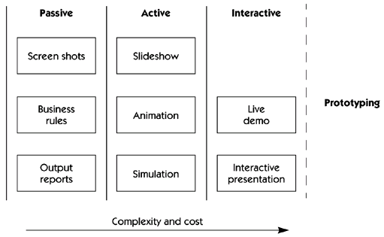
Storyboarding: Types

Slide 182
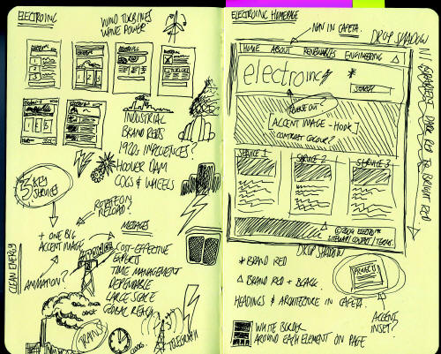
Storyboarding: Features

Slide 183
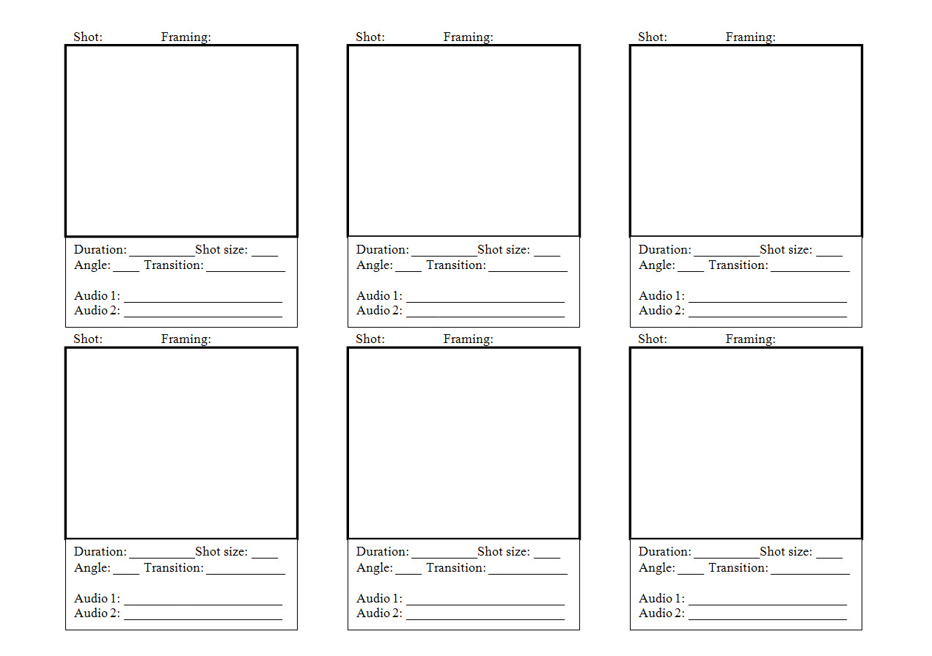
Storyboarding: Features

Slide 184
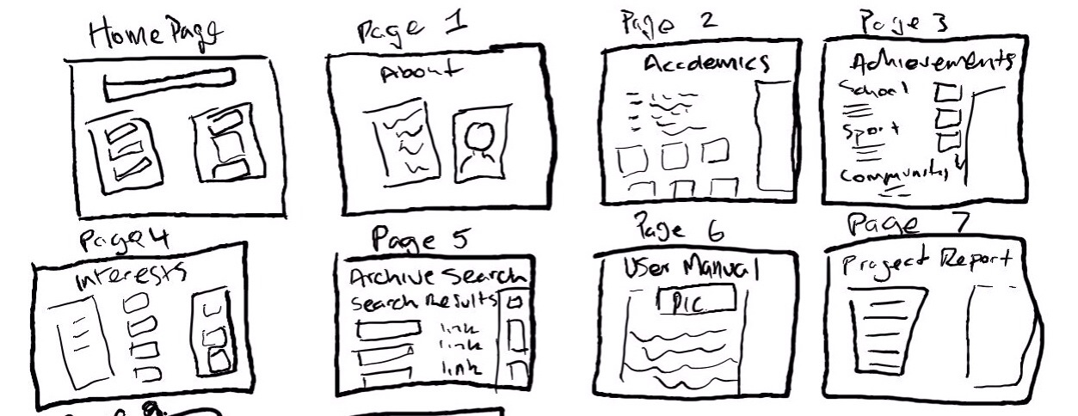
Storyboarding: Features

Slide 185
Personas

Slide 186
Personas
A persona is a fictional character that can be used to represent a collection of some of the kinds of people who could potentially be using a particular design.

Slide 187
Personas
Typically in user-centred design the designers will use several personas to test the viability of a design. The personas allow the designers to consider the range of stakeholders that might be using their designs, and allows the designer to look at their designs from these stakeholders’ perspectives.

Slide 188
Personas
The need for personas was initially identified in the mid-1990s in the marketing sector, followed quickly by the software sector, and then quickly spreading to a range of design disciplines.

Slide 189
Personas
Benefits that have been suggested for personas include a suggestion that for designers working in groups, they are given a common, consistent understanding of the dimensions of diversity and can communicate and brainstorm more effectively about diversity to each other. It also allows the designers to focus on the users of their design and encourages the designers to learn more about those users and understand how they will use the design.

Slide 190
Personas
Some researchers have criticised the use of personas by indicating that for evaluating a design, the use of real customers who will be using the design is more realistic and preferable to the use of personas which are fictional characters. There is no doubt that using a wide range of real customers is one of the strongest forms of evaluation, but there are many cases where this is not possible, and personas are an effective alternative.

Slide 191
Personas
Some scientific studies (e.g. Frank Long, 2009, “Real or Imaginary: The effectiveness of using personas in product design”) on the use of personas have shown that personas can result in more usable designs, more user-centred discussions, and more effective communication in design teams.

Slide 192
User Stories

Slide 193
User Stories
A user story is one or more sentences in the everyday language that captures what a user does or needs to do as part of their job function.
As a user, I want to search for my customers by their first and last names.
As a non-administrative user, I want to modify my own schedules but not the schedules of other users.

Slide 194
User Stories
User stories are often written from the perspective of an end user or user of a system.
They are often recorded on index cards, on Post-it notes, or in project management software.

Slide 195
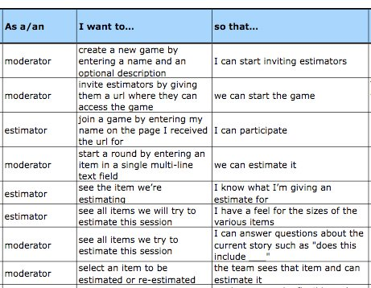
User Stories
User Story template:

