Slide 1
Evaluation of Content
Damian Gordon

Slide 2
Other Evaluation Approaches

Slide 3
Financial Evaluation
Cost-Benefit Analysis
Cost-Benefit Analysis should really be called Benefit-Cost Analysis, as it describes the ratio between Benefits and Costs.
Cost-Benefit Analysis = Ratio (Benefits : Costs)

Slide 4
Financial Evaluation
Return on Investment
Return on Investment is calculated by first determining the Net Profit (with is Benefits minus Costs), dividing that by the costs, and multiplying the result by 100.
Return on Investment = (Benefits – Costs) * 100
------------
Costs

Slide 5
Personas

Slide 6
Personas

Slide 7
Activity Theory

Slide 8
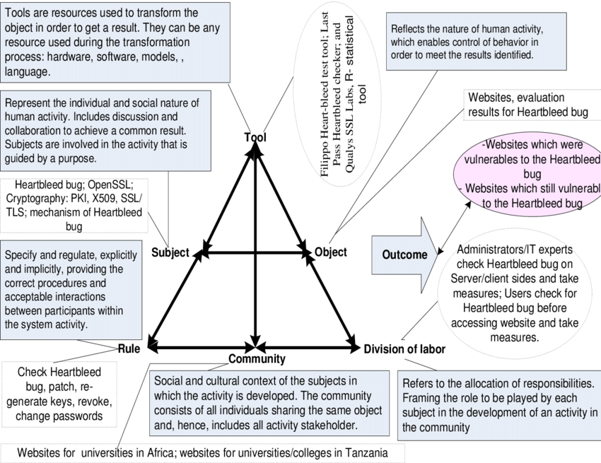

Slide 9
Teaching Observation

