Slide 1
Biographies

Slide 2
Thomas Kuhn
Born: July 18, 1922
Died: June 17, 1996
Born in Cincinnati, Ohio
Wrote extensively on the history of science

Slide 3
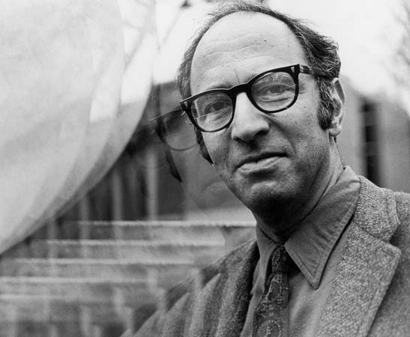
Thomas Kuhn
Born: July 18, 1922
Died: June 17, 1996
Born in Cincinnati, Ohio
Wrote extensively on the history of science

Slide 4
Thomas Kuhn
Born: July 18, 1922
Died: June 17, 1996
Born in Cincinnati, Ohio
Wrote extensively on the history of science

Slide 5
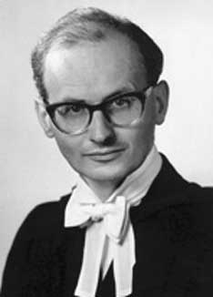
Imre Lakatos
Born: Nov 9, 1922
Died: Feb 2, 1974
Born in Debrecen, Hungary
Philosopher of mathematics and science

Slide 6
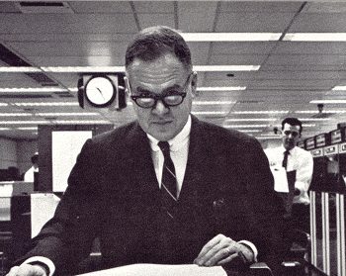
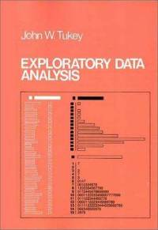
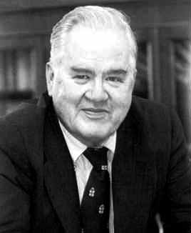
John Tukey
Born June 16, 1915
Died July 26, 2000
Born in New Bedford, Massachusetts
He introduced the box plot in his 1977 book,"Exploratory Data Analysis"
Also the Cooley–Tukey FFT algorithm and jackknife estimation

Slide 7
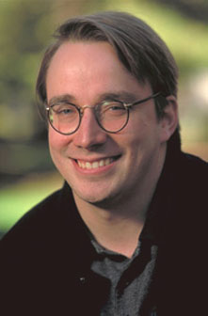
Linus Benedict Torvalds
Born: December 28, 1969 (age 45)
Born in Helsinki, Finland
Chief developer on the Linux kernel
Created the revision control system Git
2014 IEEE Computer Society Computer Pioneer Award

Slide 8
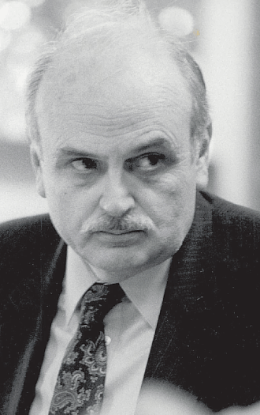
Edgar Frank "Ted" Codd
Database
Pioneers
Edgar Frank "Ted" Codd
Biography
Born on the Isle of Portland, England in 1923, and died in 2003 of heart failure at aged 79 years old. He served as an RAF pilot during WW2.
Achievements
He started working for IBM in 1965 and made extraordinary contributions to the design of databases by creating the Relational Model for database management in 1970. He also helped develop Boyce-Codd Normal Form to address anomalies not dealt with by Third Normal Form with Ray Boyce. Additionally he demonstrated that relational algebra and relational calculus are equivalent in expressive power (called Codd’s Theorem)
Papers
Codd, E.F. (1970) "A Relational Model of Data for Large Shared Data Banks“ Comms of the ACM 13 (6), pp. 377–38.
Database
Pioneers

Slide 9
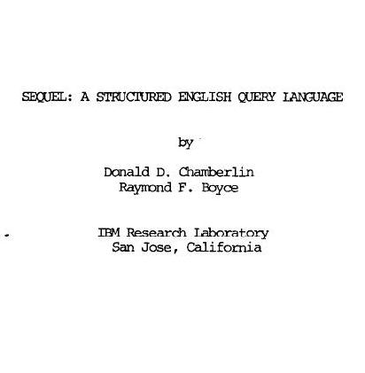
Raymond “Ray” Boyce
Database
Pioneers
Raymond “Ray” Boyce
Biography
Born in New York, America in 1947, and died in 1974 of a brain aneurysm at aged 27 years old.
Achievements
He started working for IBM in 1972 and made extraordinary contributions to the design and development of databases in two years. He helped develop Boyce-Codd Normal Form to address anomalies not dealt with by Third Normal Form with Ted Codd. He also co-developed the Structured Query Language (SQL) with Don Chamberlin in that time.
Papers
Chamberlin, D.D., Boyce, R.F. (1974) “SEQUEL: A Structured English Query Language”, Proc. ACM SIGMOD Workshop on Data Description, Access and Control, pp. 249-264.
Database
Pioneers

Slide 10
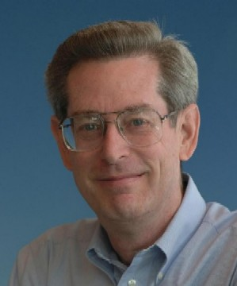
Donald D. Chamberlin
Database
Pioneers
Donald D. Chamberlin
Biography
Born in San Jose, California, America in 1944. Retired in 2009.
Achievements
He started working for IBM in the early 1970s and made significant contributions to the development of databases. He co-developed the Structured Query Language (SQL) with Ray Boyce for System R, IBM’s relational database, that showed the power of transaction processing. He also made significant contributions to the development of XQuery, a query language for collections of XML data.
Papers
Chamberlin, D.D., Boyce, R.F. (1974) “SEQUEL: A Structured English Query Language”, Proc. ACM SIGMOD Workshop on Data Description, Access and Control, pp. 249-264.
Database
Pioneers
Database
Pioneers

Slide 11
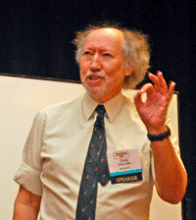
Christopher “Chris” J. Date
Database
Pioneers
Christopher “Chris” J. Date
Biography
Born in Watford, England in 1941.
Achievements
He started working for IBM in 1967 and made significant contributions to the design of databases. He contributed to the design of DB2 and SQL/DS, and has championed and extended Ted Codd’s work on the Relational Model. He is the author of An Introduction to Database Systems which is considered a seminal work in the field of databases, and with Hugh Darwen is the author of Databases, Types, and the Relational Model, more commonly referred to as The Third Manifesto, which looks at the future of databases.
Books
An Introduction to Database Systems
Databases, Types, and the Relational Model, The Third Manifesto (with Hugh Darwen)
Database
Pioneers

Slide 12
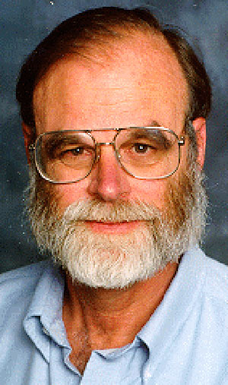
James "Jim" Gray
Database
Pioneers
James "Jim" Gray
Biography
Born in San Francisco, California in 1944, and disappeared in 2007, aged 63, when during a short solo sailing trip near San Francisco, his 40-foot yacht, Tenacious, went missing.
Achievements
He worked for several computer companies including: IBM, DEC, and Microsoft. During his time with IBM he worked on System R, and is responsible for several fundamental database achievements, including granular database locking, two-tier transaction commit, the "five-minute rule", and the data cube operator for data warehousing applications. His book Transaction Processing is considered a seminal work.
Books
Transaction Processing: Concepts and Techniques (with Andreas Reuter)
Database
Pioneers
Database
Pioneers

Slide 13
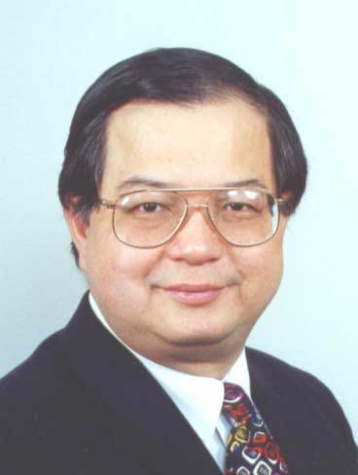
Peter Pin-Shan Chen
Database
Pioneers
Peter Pin-Shan Chen
Biography
Born in Taichung, Taiwan.
Achievements
From 1974 to 1978 he worked as Assistant Professor at MIT Sloan School of Management, and during that time, in 1976 he authored a paper outlining Entity-Relationship Modelling (ERM), a conceptual approach to the representation of data. Although he did not invent ERM, it was already being used (e.g. A.P.G Brown, 1975, “Modelling a Real-World System and Designing a Schema to Represent It”), but he did formalise and champion its use. In 1998, he was inducted as a Fellow of the ACM.
Papers
Chen, P., (1976) "The Entity-Relationship Model--Toward a Unified View of Data", ACM Trans on Database Systems 1/1/1976 ACM-Press ISSN 0362-5915, pp. 9–36
Database
Pioneers

Slide 14
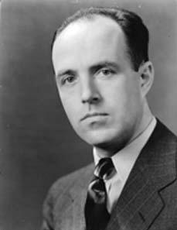
Charles "Charlie" Bachman
Database
Pioneers
Charles "Charlie" Bachman
Biography
Born in Manhattan, Kansas in 1924, and retired in 1996. During World War II he spent two years in the Southwest Pacific Theater.
Achievements
While working for General Electric Charles Bachman spent 1960 to 1964 developing one of the very first Database Management Systems, the Integrated Data Store (IDS) which also resulted in Bachman’s development of the Network Data Model and the Bachman Diagram. He received the ACM Turing Award in 1973 for "his outstanding contributions to database technology".
Papers
Bachman, C., 1969, "Data Structure Diagrams" in DataBase: A Quarterly Newsletter of SIGBDP. vol. 1, no. 2, Summer 1969.
Database
Pioneers

Slide 15
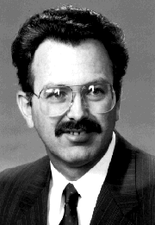
Cecil Wayne Ratliff
Database
Pioneers
Cecil Wayne Ratliff
Biography
Born in Trenton, Ohio in 1946, and retired in 1996. During World War II he spent two years in the Southwest Pacific Theater.
Achievements
Ratlif was a member of the NASA Viking program flight team when the Viking spacecraft landed on Mars in 1976, and wrote the data management system, MFILE, for the Viking lander support software. Following this in 1978 he wrote Vulcan, a database program in assembly language for the Jet Propulsion Laboratory (JPL). This program was renamed dBase in 1980 and became the first widely used database system for microcomputers.
Books
Wayne Ratliff, C., Heimendinger, L., 1992, "Using dBASE IV", Prentice Hall
Database
Pioneers

Slide 16
Timelines

Slide 17
Scientific
Method
280BC Libraries with Index
1000 Collaborative Encyclopedia
1410 Cross-referenced Encyclopedia
1550 Invention of the Fact
1590 Controlled Experiments
1609 Scopes and Laboratories
1687 Hypothesis/Prediction
1650 Societies of Experts
1665 Necessary Repeatability
1752 Peer Review Referee
1780 Journal Network
1920 Falsifiable Testability
1926 Randomized Design
1937 Controlled Placebo
1950 Double Bind Refinement
1946 Computer simulations
1974 Meta-analysis

Slide 18
1992
V0.01
1993
Slackware
1994
SUSE
1996
V2
2000
Knoppix
2002
Gentoo
2004
Ubuntu
2006
Alpine
2008
Musix
2011
Mageia
1993
Debian
1994
V1
1995
Red Hat
2002
Arch
2003
Fedora
2004
CentOS
2006
Oracle
2008
Android
2011
V3

Slide 19
Pictures of animals

Slide 20

During the late nineteenth century, the public was especially interested in animal intelligence due in a large part to Charles Darwin’s, and Francis Galton’s, then-recent publications.

Slide 21

Clever Hans
Hans was a horse owned by Wilhelm von Osten, who said he had taught Hans to add, subtract, multiply, divide, work with fractions, tell time, keep track of the calendar, differentiate musical tones, and read, spell, and understand German.

Slide 22
Poems

Slide 23
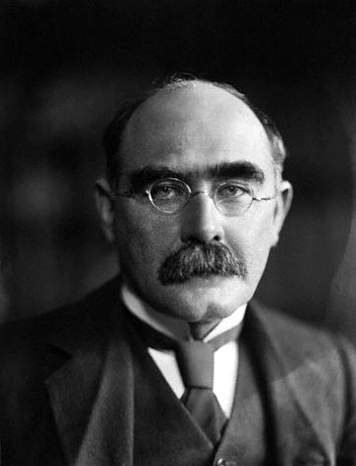
"I Keep Six Honest Serving Men ..."
I keep six honest serving-men
(They taught me all I knew);
Their names are What and Why and When
And How and Where and Who.
I send them over land and sea,
I send them east and west;
But after they have worked for me,
I give them all a rest.
I let them rest from nine till five,
For I am busy then,
As well as breakfast, lunch, and tea,
For they are hungry men.
But different folk have different views;
I know a person small-
She keeps ten million serving-men,
Who get no rest at all!
She sends'em abroad on her own affairs,
From the second she opens her eyes-
One million Hows, two million Wheres,
And seven million Whys!
- Rudyard Kipling

Slide 24
Tell a story

Slide 25
A Typical Day

Slide 26
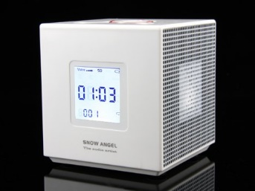
A Typical Day
Wake up

Slide 27

A Typical Day
Wake up

Slide 28
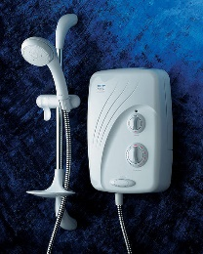
A Typical Day
Wake up
Shower

Slide 29
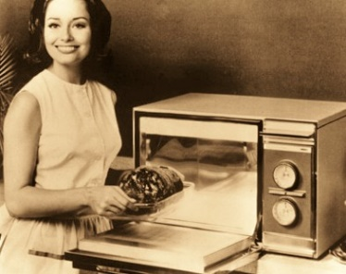
A Typical Day
Wake up
Shower
Microwave

Slide 30
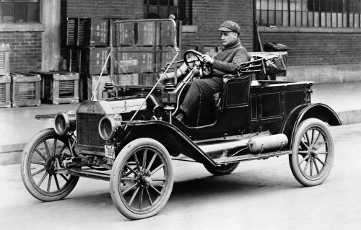
A Typical Day
Wake up
Shower
Microwave
Car

Slide 31
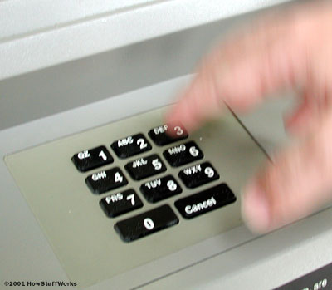
A Typical Day
Wake up
Shower
Microwave
Car
ATM

Slide 32

A Typical Day
Wake up
Shower
Microwave
Car
ATM
Work

Slide 33

A Typical Day
Wake up
Shower
Microwave
Car
ATM
Work

Slide 34
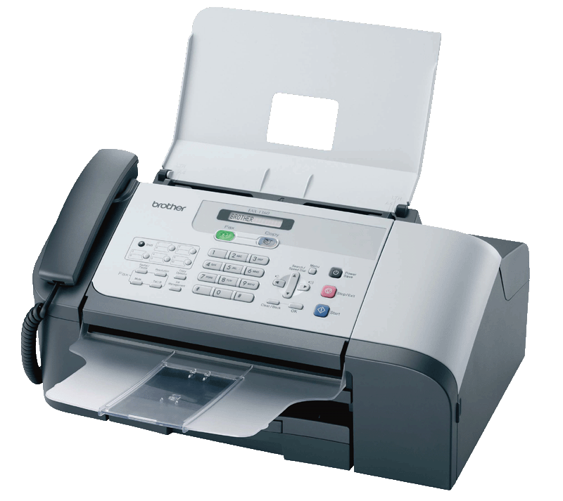
A Typical Day
Wake up
Shower
Microwave
Car
ATM
Work

Slide 35
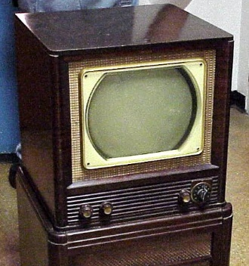
A Typical Day
Wake up
Shower
Microwave
Car
ATM
Work
Home

Slide 36

A Typical Day
Wake up
Shower
Microwave
Car
ATM
Work
Home

Slide 37

A Typical Day
Wake up
Shower
Microwave
Car
ATM
Work
Home

Slide 38
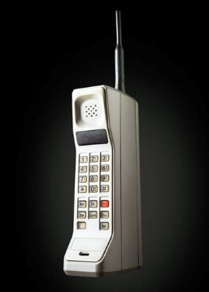
A Typical Day
Wake up
Shower
Microwave
Car
ATM
Work
Home

Slide 39
Nice Pictures

Slide 40
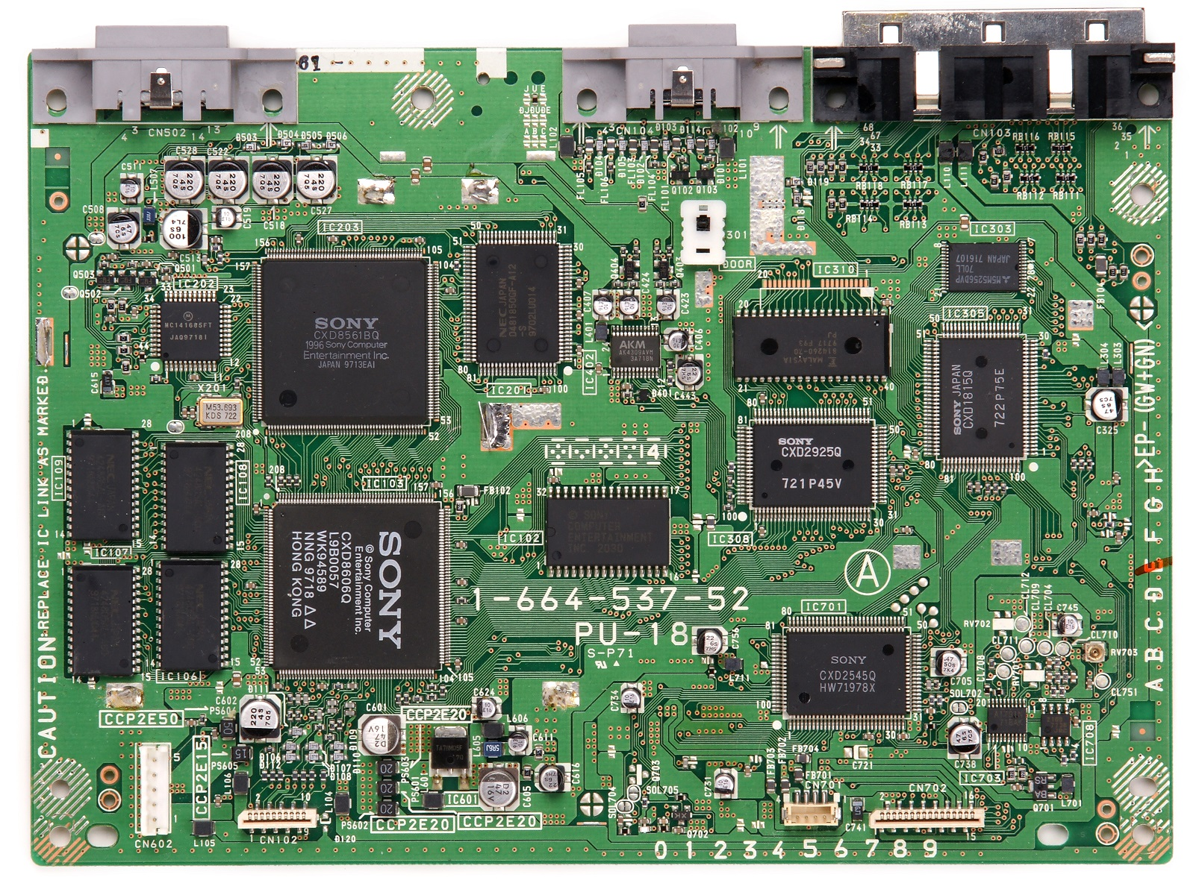

Slide 41
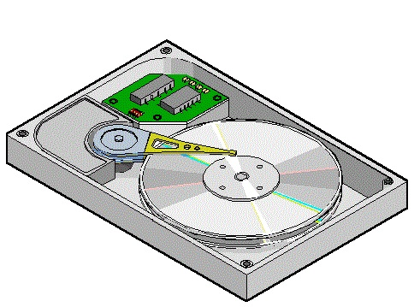
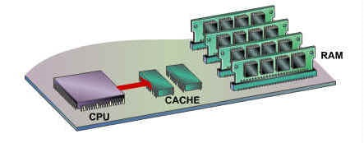
Memory Management
HARD DISK
(SECONDARY
MEMORY)
CACHE 1
(MAIN
MEMORY)
2

Slide 42
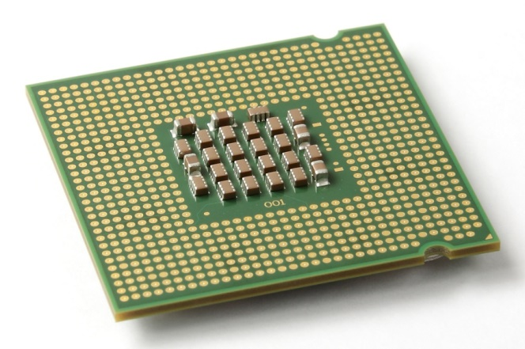
CPU

Slide 43
CPU
Cache 1

Slide 44
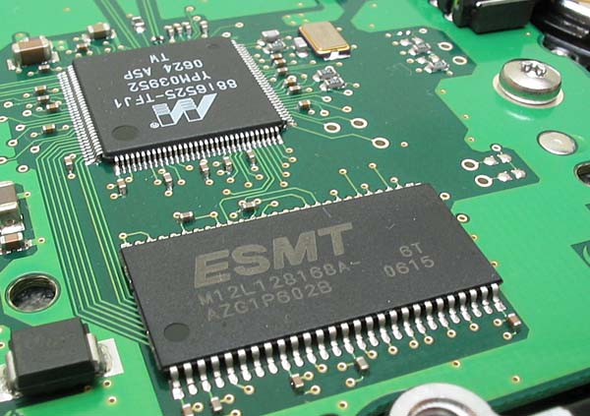
Cache

Slide 45
Cache
CPU

Slide 46
Cache
CPU
Cache 2

Slide 47
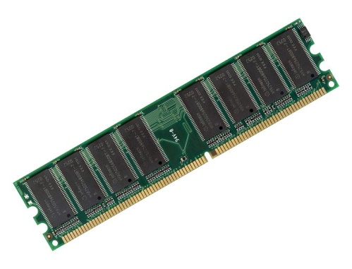
Main Memory
(RAM)

Slide 48
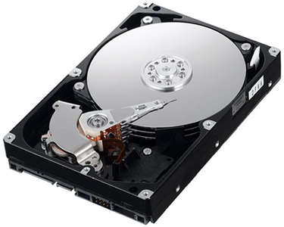
Secondary Memory
(Hard Disk)

Slide 49
Memory Management
HARD DISK
(SECONDARY
MEMORY)
CACHE 1
(MAIN
MEMORY)
2

Slide 50
Memory Management
Approximate number of clock cycles to access
the various elements of the memory hierarchy.
HARD DISK
(SECONDARY
MEMORY)
CACHE 1
(MAIN
MEMORY)
2
10¹

Slide 51
Memory Management
Approximate number of clock cycles to access
the various elements of the memory hierarchy.
HARD DISK
(SECONDARY
MEMORY)
CACHE 1
(MAIN
MEMORY)
2
10¹
10³

Slide 52
Memory Management
Approximate number of clock cycles to access
the various elements of the memory hierarchy.
HARD DISK
(SECONDARY
MEMORY)
CACHE 1
(MAIN
MEMORY)
2
10¹
10³
10⁷

Slide 53
Animations

Slide 54
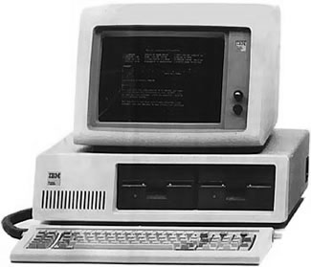
Computer Networks
When we hook up computers together using data communication facilities, we call this a computer network.

Slide 55
Computer Networks
When we hook up computers together using data communication facilities, we call this a computer network.

Slide 56
Computer Networks
When we hook up computers together using data communication facilities, we call this a computer network.

Slide 57
Computer Networks
When we hook up computers together using data communication facilities, we call this a computer network.

Slide 58
Ring Topology

Slide 59
Ring Topology
Host
1
Host
2
Host
6
Host
3
Host
5
Host
4

Slide 60
Ring Topology
Host
1
Host
2
Host
6
Host
3
Host
5
Host
4

Slide 61
Tree
Topology
Host
1
Host
2
End point
Controller
Host
3
Host
4
Head end
Controller
End point
Controller
Host
5
Host
6
End point
Controller

Slide 62
Tree
Topology
Host
1
Host
2
End point
Controller
Host
3
Host
4
Head end
Controller
End point
Controller
Host
5
Host
6
End point
Controller

Slide 63
Tree
Topology
Host
1
Host
2
End point
Controller
Host
3
Host
4
Head end
Controller
End point
Controller
Host
5
Host
6
End point
Controller

Slide 64

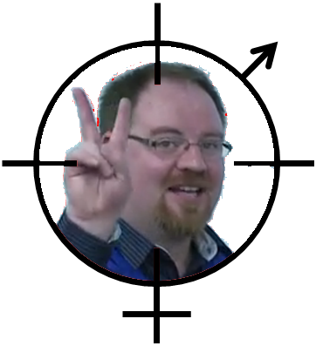
Target
GPS ON
GAME STARTING 3 2 1

Slide 65



Proportion of all Apps downloaded US/China
November 2011
January 2011
November 2011

