Slide 1
User Stories
Damian Gordon

Slide 2
User Stories
A user story is one or more sentences in the everyday language that captures what a user does or needs to do as part of their job function.
As a user, I want to search for my customers by their first and last names.
As a non-administrative user, I want to modify my own schedules but not the schedules of other users.

Slide 3
User Stories
User stories are often written from the perspective of an end user or user of a system.
They are often recorded on index cards, on Post-it notes, or in project management software.

Slide 4
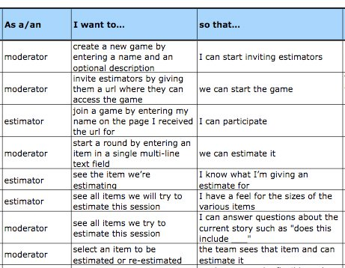
User Stories
User Story template:

