Slide 1
Goal-Directed and Practice-Based Personas
Ciarán O’Leary
10th March 2020

Slide 2
Design
Everyone designs who devises courses of action aimed at changing existing situations into preferred ones. The intellectual activity that produces material artifacts is no different fundamentally from the one that prescribes remedies for a sick patient or the one that devises a new sales plan for a company or a social welfare policy for a state. Design, so construed, is the core of all professional training; it is the principal mark that distinguishes the professions from the sciences. Schools of engineering, as well as schools of architecture, business, education, law, and medicine, are all centrally concerned with the process of design.
- Herbert Simon, 1969, The Sciences of the Artificial
Product
Service
Assemblage
Expert
Non-Expert
Failed Use
Non-Use
Faithful Use
Appropriation

Slide 3
Who’s at Fault?
Joan, a 45 year old Garda bought a new tablet but is unable to connect it to her home Wifi network.
Gerry, a 20 year old student accidentally bought the wrong ticket for the London tube while visiting the city during the recent world cup, paying almost double what he should have paid.
Laura, a lecturer, was going to set up a discussion forum for her students in Blackboard but found herself going around in circles with the system, got frustrated and gave up
Jim, a lecturer, gets plenty of feedback from his students but never fills in the quality assurance forms which reflect this feedback.
Phillipa, a student, has stopped attending classes which she considered to be boring and a waste of her time.
Jack, a student, was delighted with the high points he got in the leaving cert and started studying Law which he quickly found he was useless at.
Jamie submitted his assignment late (12:01am) because he couldn’t figure out the SafeAssign system when he logged in at 11:50pm.
Josh is struggling with his course because he can’t interpret the diagrams his lecturer requires them to study, since he is unable to see.
Control
Outside Designer Control
Change the design
Designer Error?
User Error?
Change the User
Innovate
Blame / Frustration

Slide 4
If we assume Designer Error…
Why do designers make errors?
Not creative enough?
Don’t understand the problem well enough?
Don’t understand the users well enough?
What do we need to know about the users?
The problem they’re trying to solve
Their goals
Their abilities
Their aptitudes
Their attitudes
Their motivations
Their environment
Their practices
Their relationships
How can we learn this about users?
Checklists of human factors?
Participatory design?
User models?
If you want to create a product that satisfies a broad audience of users, logic will tell you to make it as broad in its functionality as possible to accommodate the most people. Logic is wrong. You will have far greater success by designing for a single person.
Alan Cooper (2007)
The writer Kurt Vonnegut once said that he wrote books trying to please one person: his sister. By focusing on one potential reader, Vonnegut was able to create books that appealed to many.
Declan Mannion (2009)
Who is that user?
Me?
A real user?
A synthesised user?

Slide 5
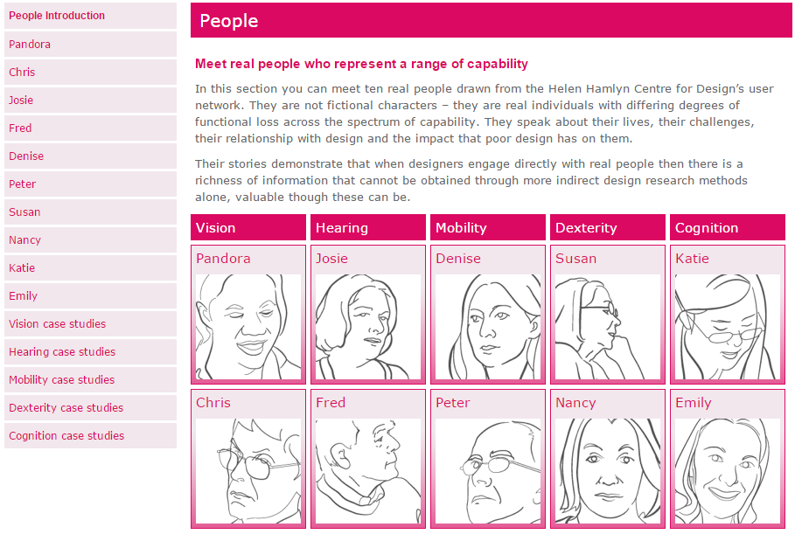
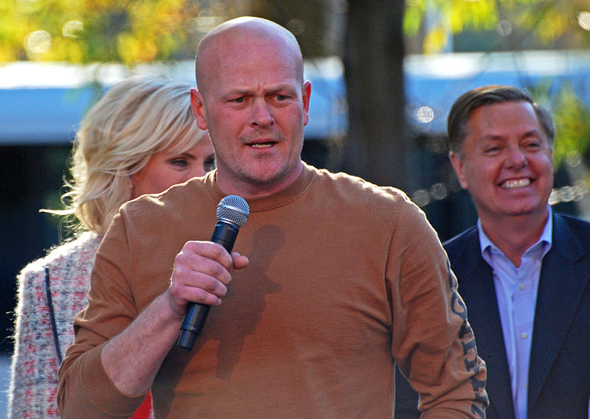
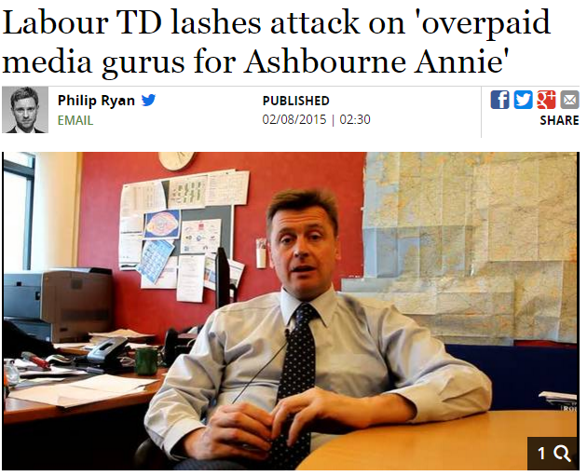
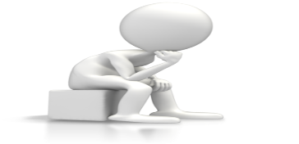
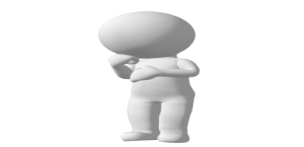
Who is that user?
CJ
Terry
Phil
Transformed research approach using social media
Reinforced teaching practice with presentation tools
Developed flexible working day through use of remote online access
Enhanced communication with students by accessing email on phone
Transformed assessment by collaboration with online communities

Slide 6
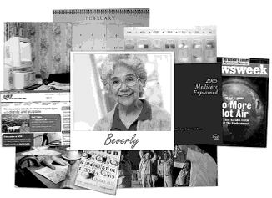
Personas
User archetypes
Grounded in data
Developed as characters (empathetic)
Perform in scenarios (active)
Reduce the user space (the primary persona)
Used for communication (accessible)
Used for design (operable)
Beverly (Cooper et al., 2007, p. 103)
People routinely engage with fictional characters in novels, movies, and television programs, often fiercely. They shout advice to fictional characters and argue over what they have done off-screen or after the novel ends. Particularly in ongoing television dramas or situation comedies, characters come to resemble normal people to some extent.
- Pruitt & Grudin, 2003, p. 6
"Character is plot, plot is character."
- F. Scott Fitzgerald

Slide 7
Developing Goal Directed Personas
Identify behavioural variables
Map interview subjects to behavioural variables
Identify significant behaviour patterns
Synthesise characteristics and relevant goals
Check for completeness and redundancy
Expand description of attributes and behaviours
Designate persona types
To be primary, a persona is someone who must be satisfied but who cannot be satisfied with an interface designed for any other persona.
- Cooper, 1999, p. 137
Goal Directed Design
Goals are stable and permanent, but tasks are fluid, changeable, and often unnecessary in computerized systems. As we develop scenarios, we need to seek out and eliminate tasks whose only justification is historical. Effective scenarios need to be complete in breadth more than in depth. In other words, it is more important that the scenario is described from start to finish than that it cover each step in exhaustive detail.
- Cooper, 1999, p. 180

Slide 8
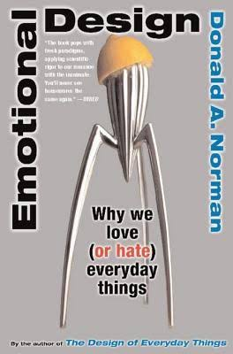
Goals
Experience goals help describe how a persona wants to feel while using a product. These goals provide focus for a product’s visual and aural characteristics, its interactive feel—such as animated transitions and the snap ratio of a physical button—and its industrial design by providing insights into persona motivations that express themselves at the visceral level. For example: Feel smart or in control. Have fun. Feel cool or hip or relaxed. Remain focused and alert.
End goals describe what a persona wants or needs to accomplish. A product or service can help accomplish such goals directly or indirectly. These goals are the focus of a product’s interaction design, information architecture, and the more functional aspects of industrial design. Because of the influence of behavioral processing on both visceral and reflective responses, end goals should be among the most significant factors in determining the overall product experience.
Life goals describe a persona’s long-term desires, motivations, and self-image attributes, which cause the persona to connect with a product. These goals form the focus for a product’s overall design, strategy, and branding.
Robert Reimann (2005), Personas, Goals, and Emotional Design,
http://www.uxmatters.com/mt/archives/2005/11/personas-goals-and-emotional-design.php#sthash.7nm4OMa3.dpuf

Slide 9
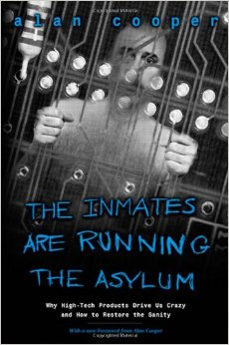
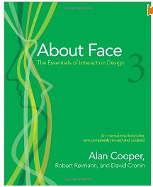
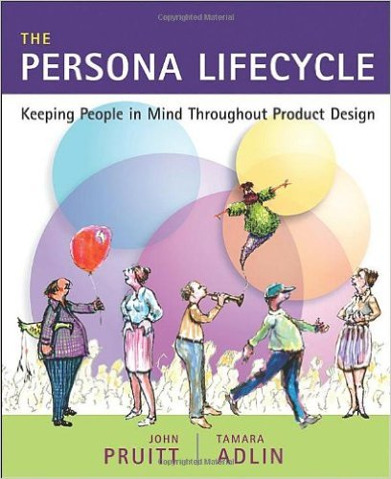
Personas, For and Against
Personas invoke this powerful human capability and bring it to the design process. Well-crafted Personas are generative: Once fully engaged with them, you can almost effortlessly project them into new situations.
- Pruitt & Grudin, 2003, p. 6
Rather than create distancing caricatures, tell stories. Don’t deny the need to do in-person research with real people. Look for ways to represent what you’ve learned in a way that maintains the messiness of actual human beings. And understand that no tool, no method, and no shortcut, can substitute for real, in-person interactions. People are too wonderfully complicated, to be reduced to plastic toys.
- Portigal, 2008, p. 5

Slide 10
Creator: Henry Ballinger McFarlane, DT228/1

Slide 11
Practice-Based Personas
Not goals, but practices
Personas for breadth of coverage, not focus of design
Practice
“A routinized type of behaviour which consists of several elements interconnected to one other: forms of bodily activities, forms of mental activities, things and their use, a background knowledge in the form of understanding, know-how, states of emotions and motivational knowledge”
A. Reckwitz, “Toward a Theory of Social Practices A development in culturalist theorizing,” Eur. J. Soc. Theory, vol. 5, no. 2, pp. 243–263, 2002.
Persuasive Technology
Fogg (2003, 2009)
Technology in practice /
Sociomaterial practices
Orlikowski and Scott (2007, 2014)
Everyday Designer
Wakkaray
(2005, 2007, 2009)

Slide 12
Persuasive Technology (Fogg)
An attempt to change attitudes, or behaviours, or both (without using coercion, or deception, or both)
Persuasive technology focuses on behaviour or attitude change through human computer interaction
Types of persuasive technology tools: Reduction, Tunnelling, Tailoring, Suggestion, Self-monitoring, Observation, Conditioning
A design team must select a channel that is familiar to the target user. I’ve watched teams expect their audience to learn a new channel (such as texting or social networking) and simultaneously adopt a new behaviour. This approach almost never works. I have come to believe that most people can change only one behaviour at a time. And the reality is that adopting a new technology is a behaviour change.

Slide 13
Persuasive Technology
Reduction
Suggestion
Using computing technology to reduce complex behaviour to simple tasks increases the benefit / cost ration of the behaviour and influences users to perform the behaviour
A computing technology will have greater persuasive power if it offers suggestions at opportune moments
Tunnelling
Self-monitoring
Using computing technology to guide users through a process or experience provides opportunities to persuade along the way
Applying computing technology to eliminate the tedium of tracking performance or status helps people to achieve pre-determined goals or outcomes

Slide 14
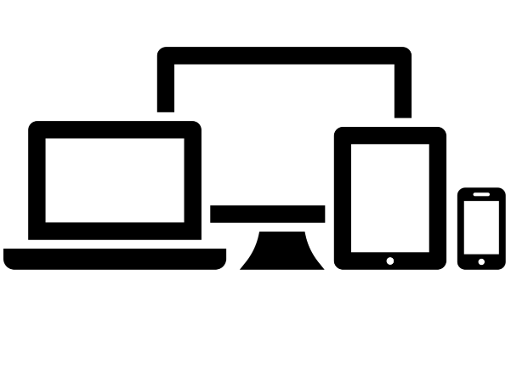
Influential Technology
Channel

Slide 15
Classroom projector and computer as presentation facilitators
Classroom response systems as student engagement devices
Cloud space as a collaborative platform
Cloud space as backup and storage
EGB as a student record generator
Email as a collaborative space
Email as a communication medium
Email as a permanent voice
Email as a personal assistant
Home computer as an extension of the office
Institutional records as valuable data sources
Laptop and office computer as coordinating pair
Laptop computer as personal assistant
Microsoft Excel as a student data analyst
Microsoft Word as an authoring tool
Office computer as daily assistant
Online calendar as an organisation device
Phone as a multi-media tool
Phone as a permanent companion
PowerPoint as a creation, editing and presentation device
Rich media tool as student engagement devices
Social Media as an engagement platform
USB devices as connectors
VLE as a creative environment
VLE as a dissemination, storage and collection facility
VLE as a knowledgeable informant
VPN as an Institutional connector
Web as a creation platform
Web as a publication platform
Web as a source for information or resources
Assessing Students
Authoring Examination Papers
Authoring Learning Materials
Authoring Research Papers
Being Always On
Collaborating Face-to-Face with Colleagues
Collaborating Online with Colleagues
Designing and Preparing Module Delivery
Disseminating Learning Materials to Students
Enabling Collaborative Learning
Enabling Student Reflection upon Learning
Engaging and Motivating Students
Engaging with the Programme Team
Enhancing Teaching, Learning and Assessment
Interacting Directly with Students
Learning from Colleagues
Making Decisions about the Use of Technology
Organising In-Class Activities
Organising Office
Organising Self
Providing Feedback to Students
Reflecting on Student Performance
Working from Home
Notes:
Technology channels are consistent (same across all people performing them), predictable (has a frequency or time dimension to it that can be latched onto) and constitutve (constitutive of current practice, ensuring that it will continue to be performed – it’s sembedded and established)

Slide 16
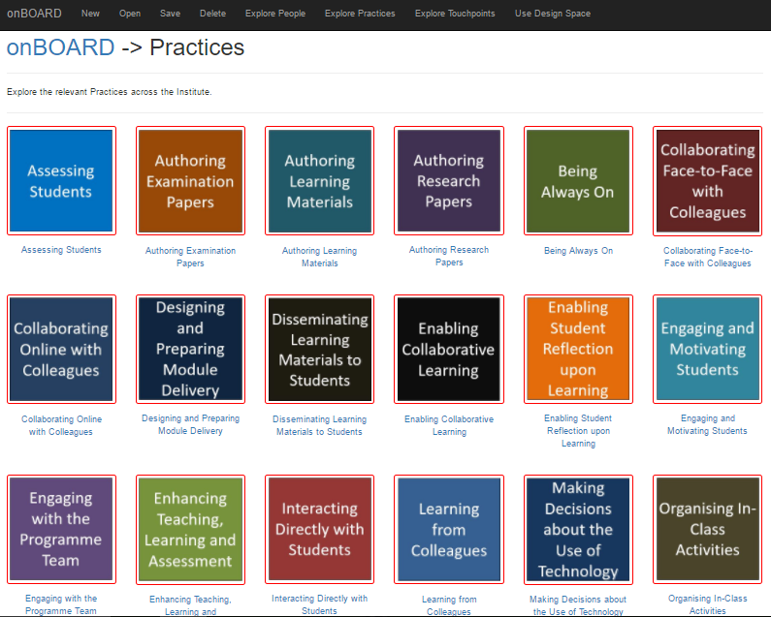
Step 1: Explore Academic Practices

Slide 17
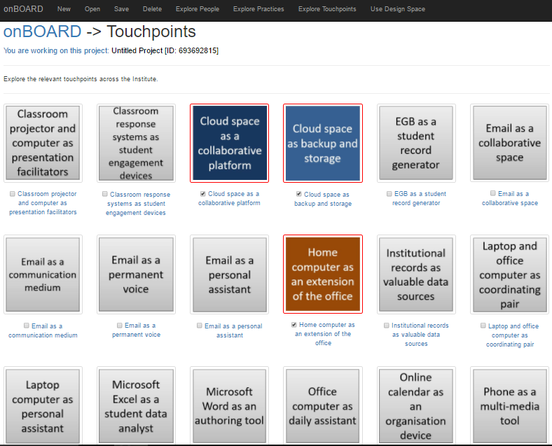
Step 2: Select suite of familiar technology performance channels

Slide 18
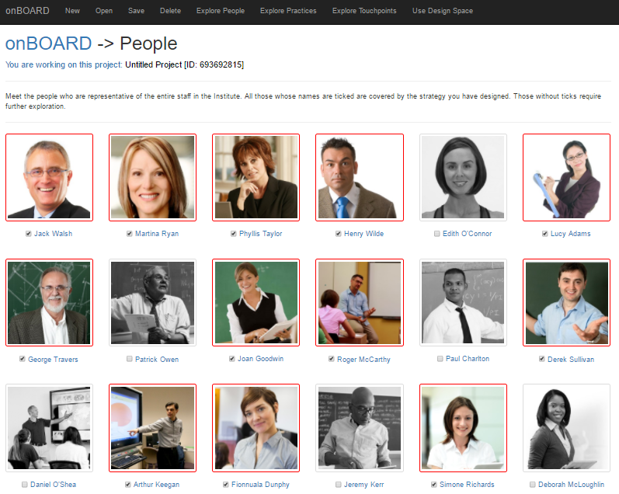
Step 3: Determine audience coverage, and add channels as required

Slide 19
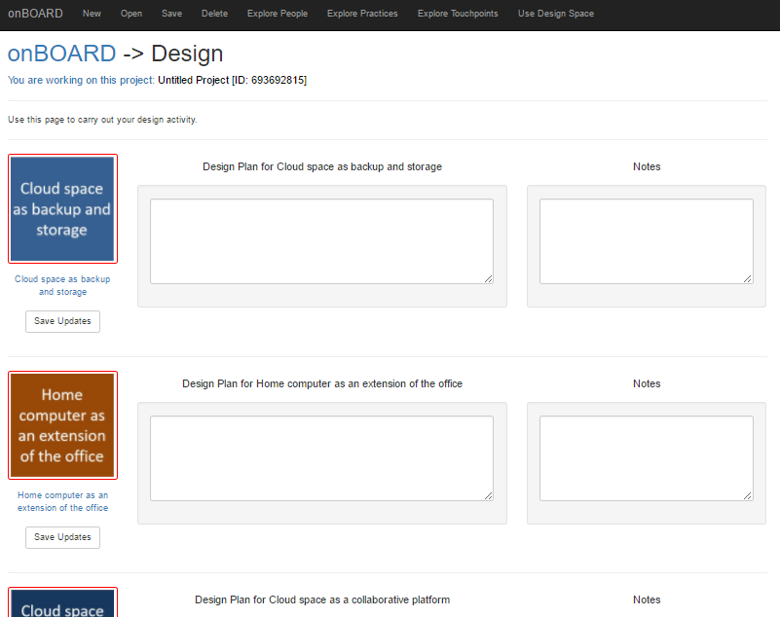
Step 4: Design
The designer implements a persuasive technology solution making use of a range of familiar technology performance channels, informed by appropriate patterns
Fogg (2003)
Reduction, Tunnelling, Tailoring, Suggestion, Self-monitoring, Observation, Conditioning
Oinas-Kukkonen and Harjumaa (2008)
Reduction
Tunneling
Tailoring
Personalization
Self-monitoring
Simulation
Rehearsal
Praise
Rewards
Reminders
Suggestion
Similarity
Liking
Social role
Trustworthiness
Expertise
Surface credibility
Real-world feel
Authority
Third-party
Verifiability
Social learning
Social comparison
Normative influence
Social facilitation
Cooperation
Competition
Recognition

