Slide 1
Instructional Design and e-Authoring
Writing Learning Outcomes
Damian Gordon, Edel Gallagher
Instructional Design and e-Authoring

Slide 2
Learning Outcomes
We’ve seen some of these already:
Instructional Design and e-Authoring

Slide 3
Learning Outcomes
On successful completion of this module the learner will be able to:
Design a small-scale pedagogically sound and accessible eLearning resource/activity, informed by relevant theories and using appropriate technologies.
Develop a storyboard to plan for a user-friendly, technically robust and pedagogically effective eLearning resource/activity.
Justify decisions relating to the selection, design and use of elearning technologies taking into account the impact of the learning context.
Instructional Design and e-Authoring

Slide 4
Learning Outcomes
On successful completion of this module the learner will be able to:
Apply principles of learning orientations to an identified eLearning situation within their own working context.
Critically discuss the pedagogical value of specific eLearning materials in a range of different contexts
Critically discuss the usability of specific eLearning materials in a range of different contexts.
Demonstrate positive and constructive contribution to group work.
Instructional Design and e-Authoring

Slide 5
Learning Outcomes
How to write Learning outcomes:
We typically write 3-7 learning outcomes
We begin with a verb (one of Bloom’s)
Limit the length of each learning outcome to about 400 characters
Exclude special characters (e.g., accents, umlats, ampersands, etc.)
Exclude special formatting (e.g., dashes, numbering, etc.)
Instructional Design and e-Authoring

Slide 6
Benjamin S. Bloom
Born: Feb 21, 1913
Died: Sept 13, 1999
Born in Lansford, Pennsylvania.
Educational psychologist
Editor of “Taxonomy of Educational Objectives, Handbook 1: Cognitive Domain” (1956)

Slide 7
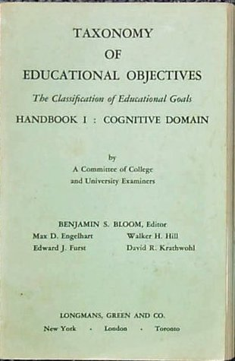
Bloom’s Taxonomy
In 1956 Bloom helped developed a taxonomy of cognitive objectives in “Taxonomy of Educational Objectives, Handbook 1”
As a means of expressing qualitatively different kinds of thinking
Instructional Design and e-Authoring

Slide 8
Bloom’s Taxonomy
It’s been adapted for classroom use as a planning tool and is one of the most universally applied models
Provides a way of organizing thinking skills into six levels, from basic to the more complex levels of thinking
Instructional Design and e-Authoring

Slide 9
Bloom’s Taxonomy
Evaluation
Synthesis
Analysis
Application
Comprehension
Knowledge
Higher-order thinking
Instructional Design and e-Authoring

Slide 10
Bloom’s Taxonomy
Evaluation: compare and discriminate between ideas, assess value of theories, presentations make choices based on reasoned argument, verify value of evidence, recognize subjectivity
Instructional Design and e-Authoring

Slide 11
Bloom’s Taxonomy
Synthesis: use old ideas to create new ones, generalize from given facts, relate knowledge from several areas, predict, draw conclusions
Instructional Design and e-Authoring

Slide 12
Bloom’s Taxonomy
Analysis: seeing patterns, organization of parts, recognition of hidden meanings, identification of components
Instructional Design and e-Authoring

Slide 13
Bloom’s Taxonomy
Application: use information use methods, concepts, theories in new situations, solve problems using required skills or knowledge
Instructional Design and e-Authoring

Slide 14
Bloom’s Taxonomy
Comprehension: understanding information, grasp meaning, translate knowledge into new context
Instructional Design and e-Authoring

Slide 15
Bloom’s Taxonomy
Knowledge: observation and recall of information, knowledge of dates, events, places knowledge of major ideas
Instructional Design and e-Authoring

Slide 16
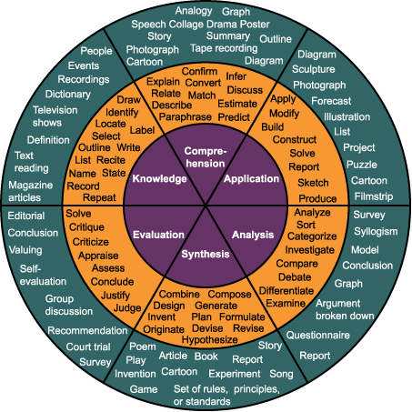
Bloom’s Taxonomy
Instructional Design and e-Authoring

Slide 17
Bloom’s Taxonomy
Evaluation: appraise, argue, assess, attach, choose, compare, defend estimate, judge, predict, rate, score, select, support, value
Instructional Design and e-Authoring

Slide 18
Bloom’s Taxonomy
Synthesis: arrange, assemble, collect, compose, construct, create, design, develop, formulate, manage, organize, plan, prepare
Instructional Design and e-Authoring

Slide 19
Bloom’s Taxonomy
Analysis: analyze, appraise, calculate, categorize, compare, contrast, criticize, differentiate, discriminate, distinguish, examine
Instructional Design and e-Authoring

Slide 20
Bloom’s Taxonomy
Application: apply, choose, demonstrate, dramatize, employ, illustrate, interpret, operate, practice, schedule, sketch, solve, use
Instructional Design and e-Authoring

Slide 21
Bloom’s Taxonomy
Comprehension: classify, describe, discuss, explain, express, identify, indicate, locate, recognize, report, restate, review
Instructional Design and e-Authoring

Slide 22
Bloom’s Taxonomy
Knowledge: arrange, define, duplicate, label, list, memorize, name, order, recognize, relate, recall, repeat, reproduce, state
Instructional Design and e-Authoring

Slide 23
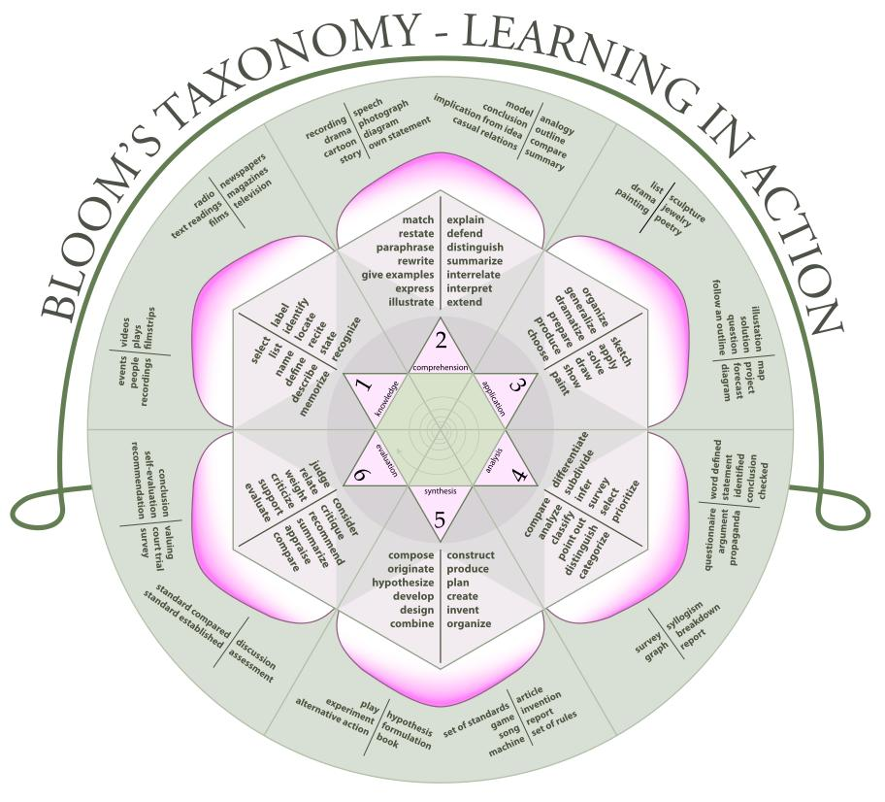

Slide 24
Evaluation
Synthesis
Analysis
Application
Comprehension
Knowledge

Slide 25
Evaluation
Analysis
Synthesis
Application
Comprehension
Knowledge

