Slide 1
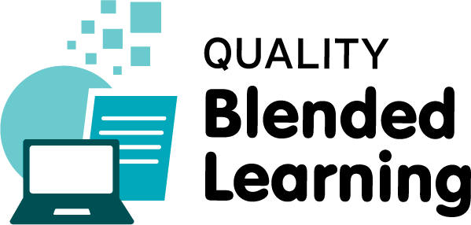
Instructional Design and eAuthoring
Copyright and Creative Commons
Damian Gordon
Lecturer in Computer Science
To Design, Develop, and Evaluate Quality Blended Learning

Slide 2
Copyright ©
Copyright is a legal right that grants the creator of an original work exclusive rights for its use and distribution.
This is usually only for a limited time. The exclusive rights are not absolute but limited by limitations and exceptions to copyright law, including fair use.
To Design, Develop, and Evaluate Quality Blended Learning

Slide 3
Copyright ©
A major limitation on copyright is that copyright protects only the original expression of ideas, and not the underlying ideas themselves.
To Design, Develop, and Evaluate Quality Blended Learning

Slide 4
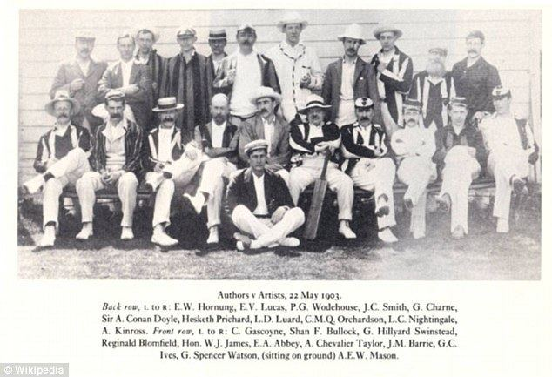

Slide 6
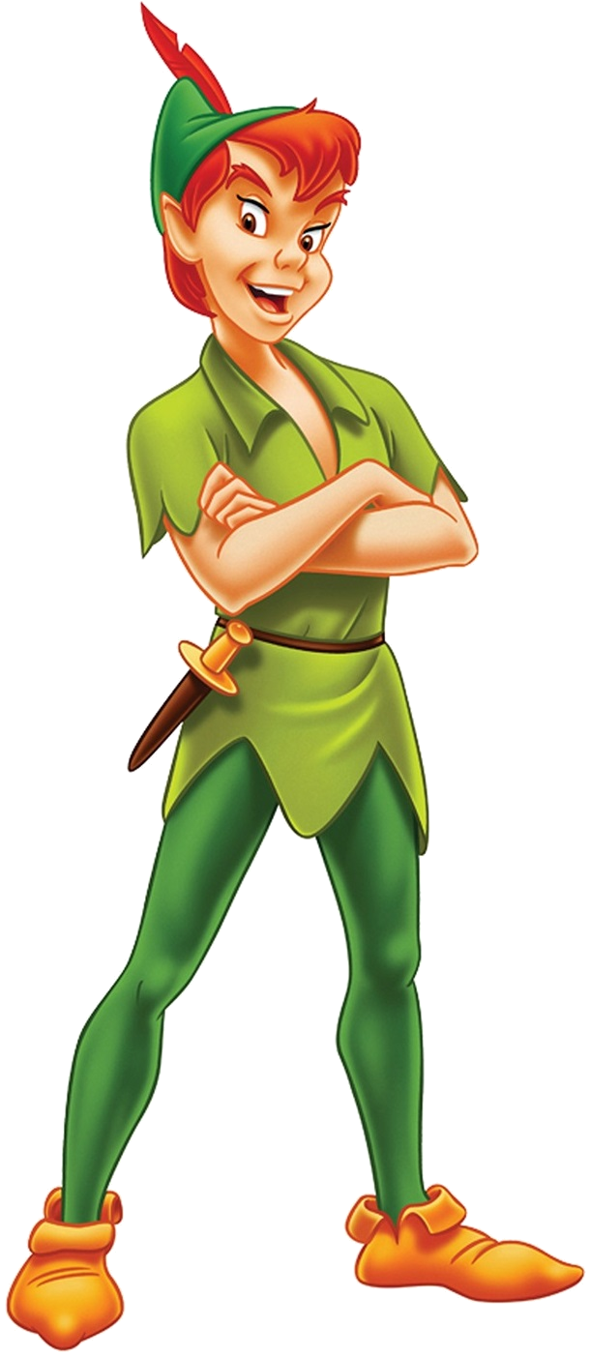

Slide 7
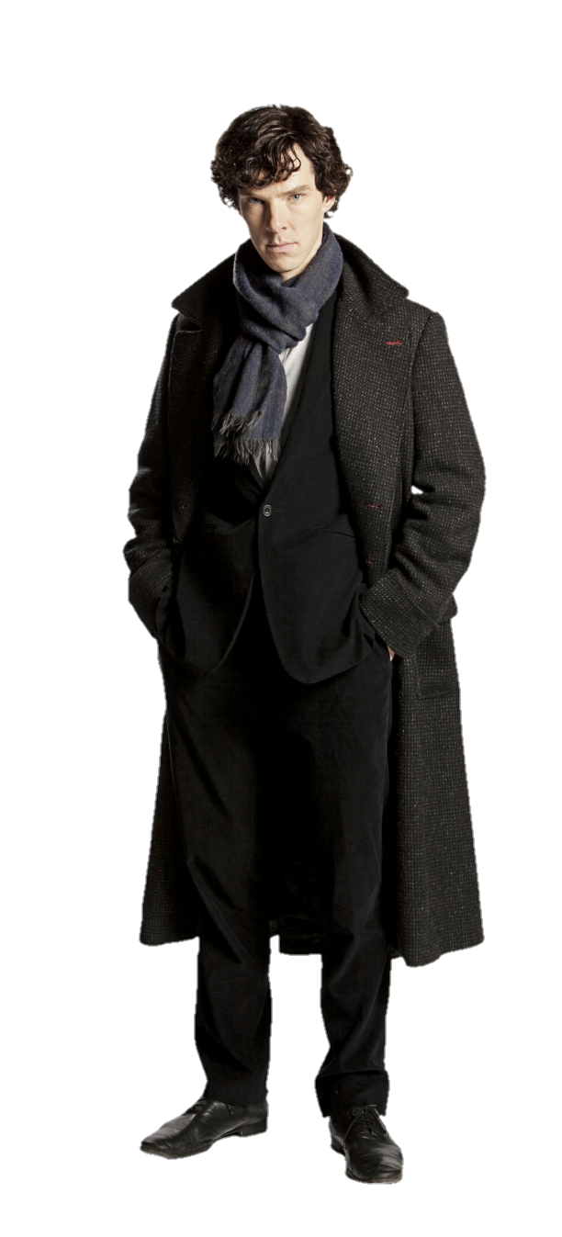

Slide 8
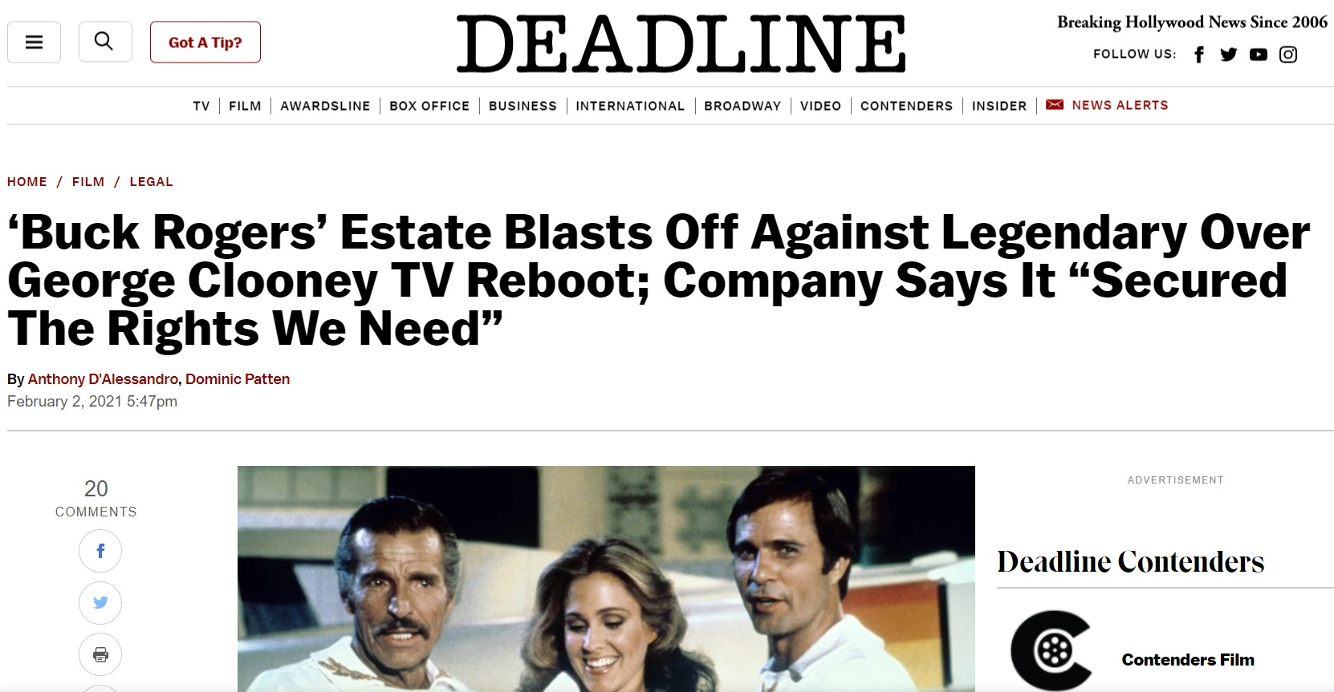
Buck Rogers
Feb 2nd 2021
https://deadline.com/2021/02/buck-rogers-estate-lawsuit-threat-legendary-entertainment-george-clooney-skydance-1234685992/
To Design, Develop, and Evaluate Quality Blended Learning

Slide 9
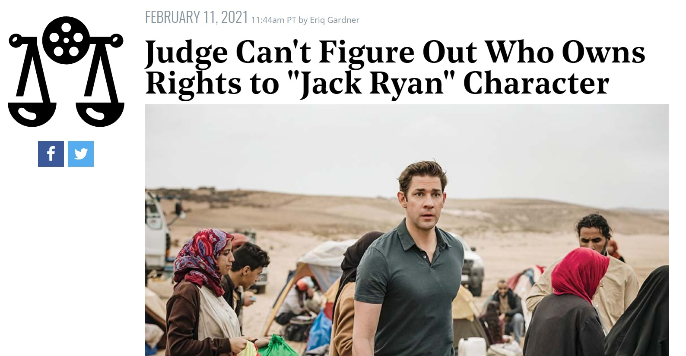
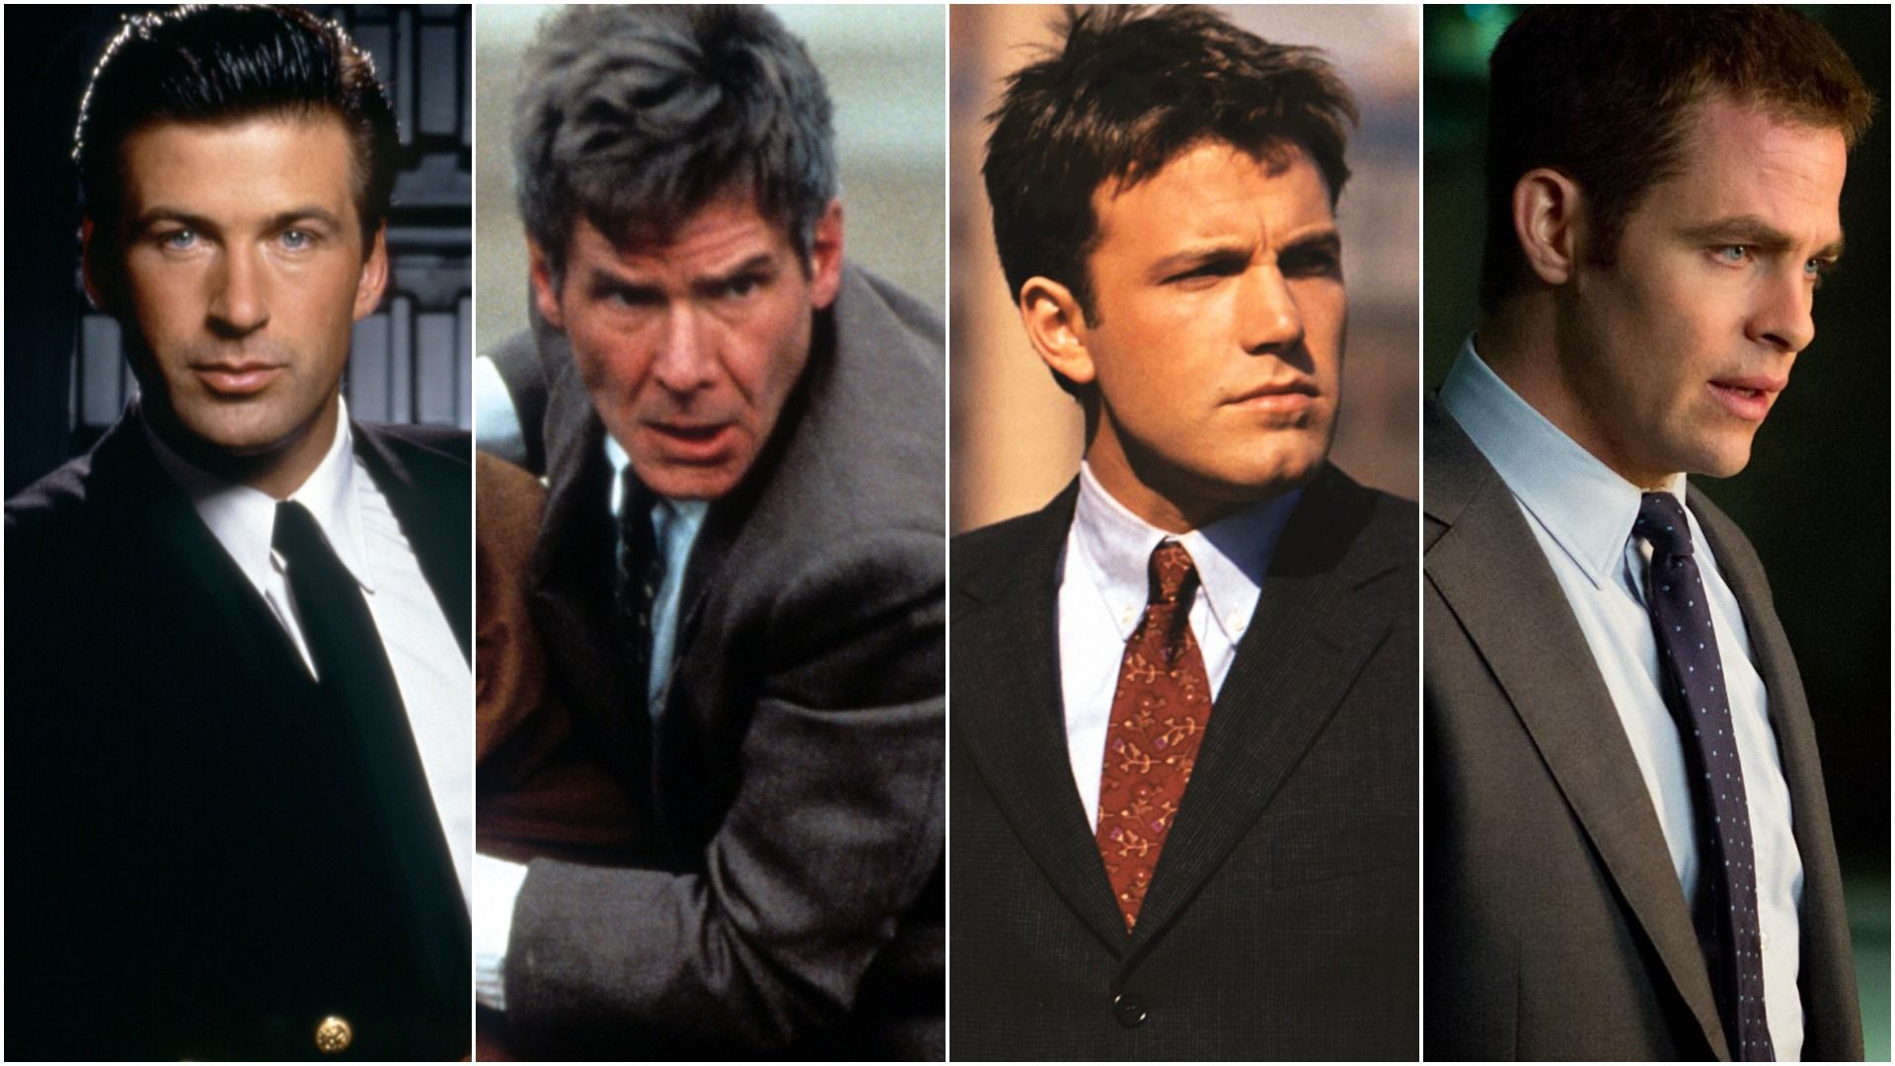
Tom Clancy’s Jack Ryan
Feb 11th 2021
https://www.hollywoodreporter.com/thr-esq/judge-cant-figure-out-who-owns-rights-to-jack-ryan-character
To Design, Develop, and Evaluate Quality Blended Learning

Slide 10
Copyright Law
Usually has educational provisions:
  flexible fair dealing - non-commercial uses for purposes of giving educational instruction
  communications in and to the classroom
  communications of free-to-air broadcasts eg webcasts and podcasts
To Design, Develop, and Evaluate Quality Blended Learning

Slide 11
Copyright Law
There are normally six rules:
Use must be for purposes of giving educational instruction
Use must be non-commercial
Must be a “special case”
Must not conflict with “normal exploitation” of copyright material by copyright owner
Use must not “unreasonably prejudice” copyright owner
Must not remove/disable an Access Technological Protection Measure
To Design, Develop, and Evaluate Quality Blended Learning

Slide 12
Copyright in Ireland
To Design, Develop, and Evaluate Quality Blended Learning

Slide 13
Copyright in Ireland
Generally, applies to works which are:
  Original,
  Literary,
  Dramatic,
  Musical,
  Artistic.
(Section 17(2)(a) CRRA)
To Design, Develop, and Evaluate Quality Blended Learning

Slide 14
Copyright in Ireland
Generally, applies to works which are:
  Original,
  Literary,
  Dramatic,
  Musical,
  Artistic.
(Section 17(2)(a) CRRA)
• Sound recordings, films, broadcast material
• Typographical setting of published works
• Table or compilation
• Computer programs
• Designs for computer programs
• Databases
• Dance, mime works
• Teaching and learning materials
To Design, Develop, and Evaluate Quality Blended Learning

Slide 15
Copyright
Is it OK to show a YouTube video in class?
To Design, Develop, and Evaluate Quality Blended Learning

Slide 16
Copyright
YES
Fair dealing?
Use of the performer’s official channel
Quoting from a work?
Would be better if I acknowledged the author, copyright holder, source of work
NO
If I embedded the video into my slides/content (especially if I make this available online e.g. via webcourses)
If I embed from unapproved channel
If I extracted clips from the video and circulated them later via email
To Design, Develop, and Evaluate Quality Blended Learning

Slide 17
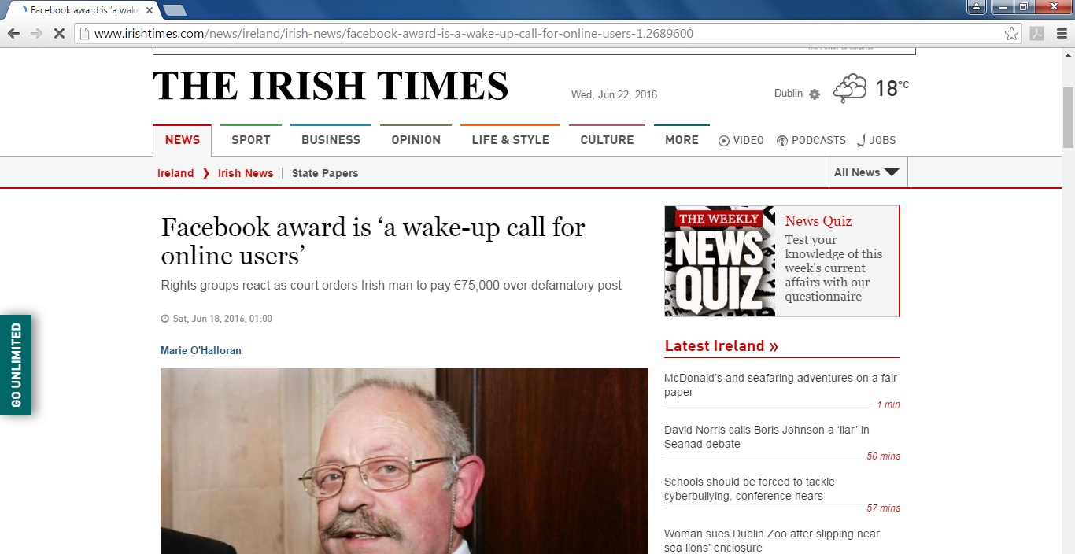
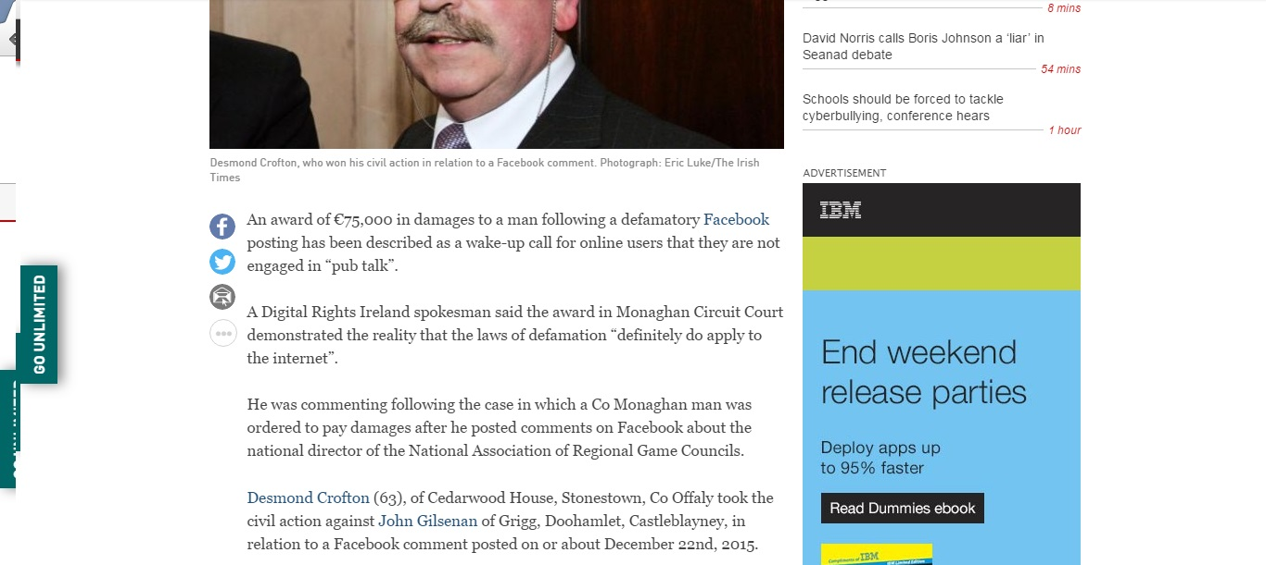

Slide 18
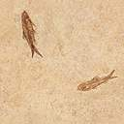
DAMIAN’S TIMES Wed. 6 Jun 2021

Slide 19
DAMIAN’S TIMES Wed. 6 Jun 2021

Slide 20
DAMIAN’S TIMES Wed. 6 Jun 2021

Slide 21
DAMIAN’S TIMES Wed. 6 Jun 2021
http://www.irishtimes.com/news/ireland/irish-news/facebook-award-is-a-wake-up-call-for-online-users-1.2689600

Slide 22
2012: The year Irish newspapers tried to destroy the web
To Design, Develop, and Evaluate Quality Blended Learning

Slide 23
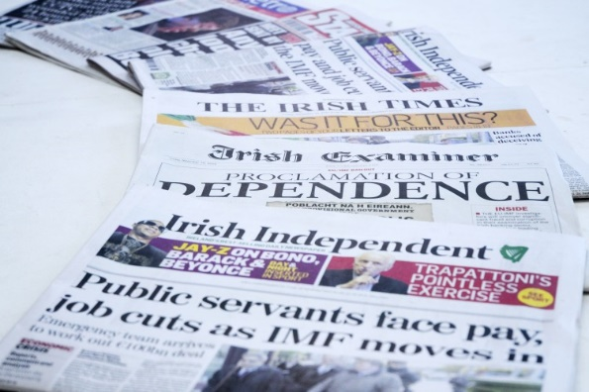

National Newspapers of Ireland /
Newspaper Licensing Ireland
Irish Independent
Irish Examiner
The Irish Time
Irish Daily Star
Evening Herald
The Sunday Independent
Sunday World
The Sunday Business Post
Irish Mail on Sunday
Irish Farmers Journal
Irish Daily Mail
Irish Daily Mirror
Irish Sun
Irish Sunday Mirror
The Sunday Times
Irish Sun Sunday
To Design, Develop, and Evaluate Quality Blended Learning

Slide 24
The Bill
# of Links | Cost
1-5 | €300.00
6-10 | €500.00
11-15 | €700.00
16-25 | €950.00
26-50 | €1,350.00
50+ | Negotiable
To Design, Develop, and Evaluate Quality Blended Learning

Slide 25

The Threat
They told Women’s Aid “a licence is required to link directly to an online article even without uploading any of the content directly onto your own website.”
To Design, Develop, and Evaluate Quality Blended Learning

Slide 26
The Coverage
This story was covered:
  in the New York Observer,
  on Techcrunch,
  on Techdirt
  on Broadsheet.ie.
But, apparently, it wasn’t a story that Irish newspapers felt was newsworthy.
To Design, Develop, and Evaluate Quality Blended Learning

Slide 27

The Response
The Copyright Review Committee of the Department of Justice and Equality reply to NLI pointed out that the terms and conditions of the NLI's member newspaper websites in many cases explicitly grant permission to produce weblinks to articles and that some NLI member websites included up to 300 sharing buttons that permit and encourage easy creation of weblinks for use on social media.
To Design, Develop, and Evaluate Quality Blended Learning

Slide 29
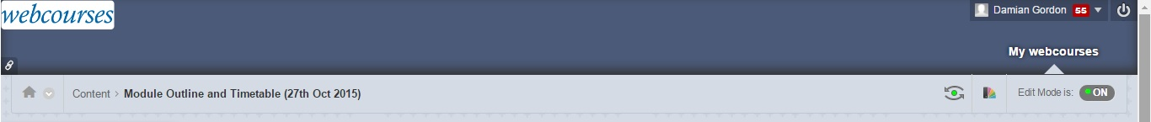
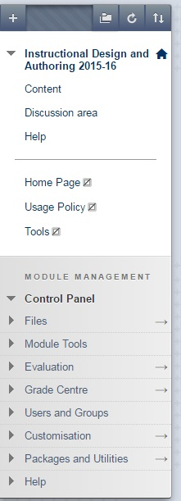

Slide 30
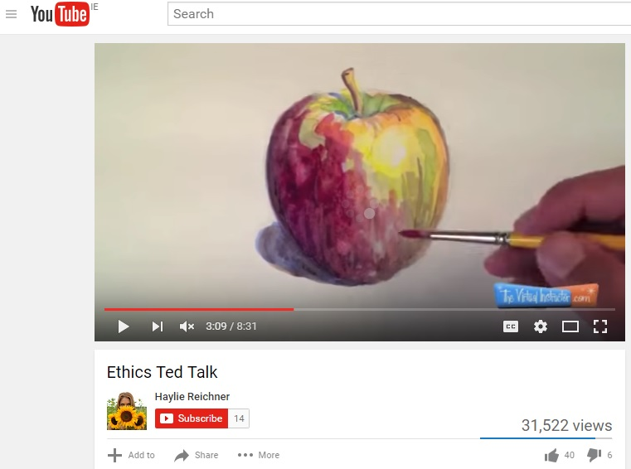

Slide 31
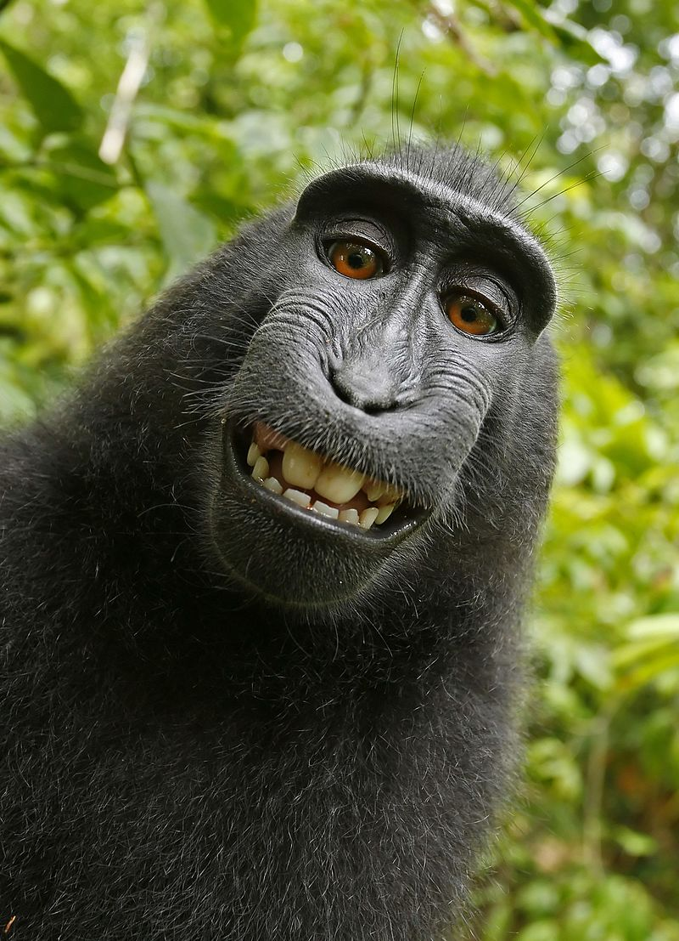
Monkey Selfie Copyright Dispute

Slide 33
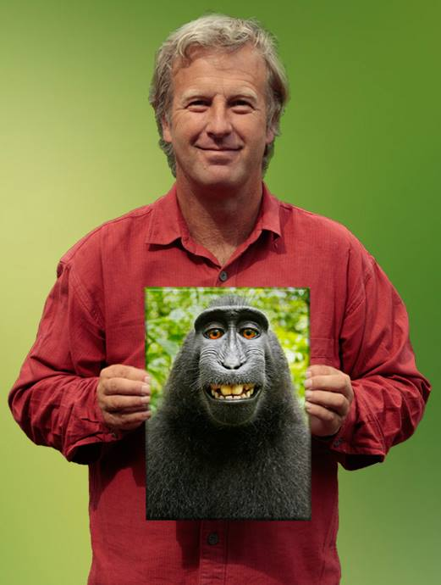
David J. Slater

Slide 34
Monkey selfie copyright dispute
Since 2008, British nature photographer David Slater had travelled to Indonesia to take photographs of the critically endangered Celebes crested macaques.

Slide 35
Monkey selfie copyright dispute
In 2011 he licensed several images to the Caters News Agency who released them, along with a written promotional press release with quotes from Slater, for publication in the British media.

Slide 36
Monkey selfie copyright dispute
On 4 July 2011 several publications including the Daily Mail, The Telegraph, and The Guardian picked up the story and published the pictures along with articles that quoted Slater as describing the photographs as self-portraits taken by the monkeys.

Slide 37
Monkey selfie copyright dispute
On 9 July 2011, an editor on Wikimedia Commons, a site that only accepts media available under a free content license, in the public domain, or otherwise ineligible for copyright, uploaded the selfie photographs from The Daily Mail.
The uploader asserted that the photographs were in the public domain as "the work of a non-human animal, it has no human author in whom copyright is vested".

Slide 38
Monkey selfie copyright dispute
Slater asked Wikimedia Commons to take down the pictures, which they did, but after a lot of internal discussion agreed that the monkey took the picture and they can’t hold copyright.

Slide 39
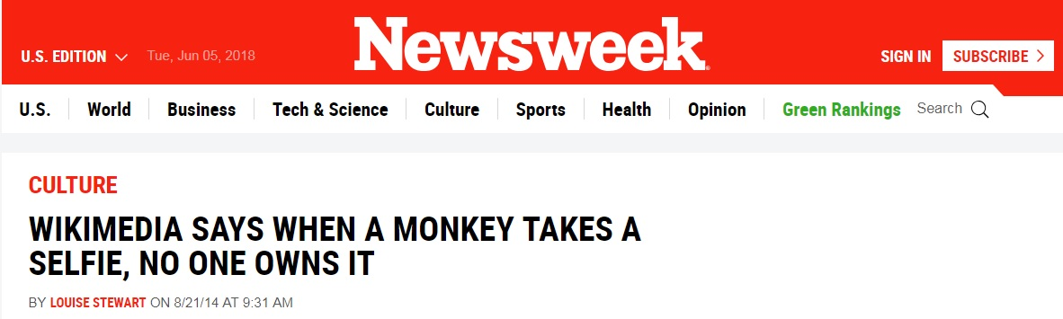
Monkey selfie copyright dispute
Slater asked Wikimedia Commons to take down the pictures, which they did, but after a lot of internal discussion agreed that the monkey took the picture and they can’t hold copyright.

Slide 40
Monkey selfie copyright dispute
Slater countered by saying "I put my camera on a tripod with a very wide angle lens, settings configured such as predictive autofocus, motorwind, even a flashgun, to give me a chance of a facial close up if they were to approach again for a play ... I had one hand on the tripod when this was going on, but I was being prodded and poked by would be groomers and a few playful juveniles who nibbled at my arms"

Slide 41

Monkey selfie copyright dispute
On 21 August 2014 the United States Copyright Office ruled that the picture can't be copyrighted, ruling that "only works created by a human can be copyrighted under United States law, which excludes photographs and artwork created by animals or by machines without human intervention" and that "Because copyright law is limited to 'original intellectual conceptions of the author,' the [copyright] office will refuse to register a claim if it determines that a human being did not create the work. The Office will not register works produced by nature, animals, or plants."

Slide 42
Monkey selfie copyright dispute
American and British intellectual property lawyers generally agree that because the creator of the photograph is an animal and not a person, there is no copyright on the photograph, regardless of who owns the equipment with which the photograph was create

Slide 43
Monkey selfie copyright dispute
However, British lawyer Serena Tierney stated "If he checked the angle of the shot, set up the equipment to produce a picture with specific light and shade effects, set the exposure or used filters or other special settings, light and that everything required is in the shot, and all the monkey contributed was to press the button, then he would seem to have a passable claim that copyright subsists in the photo in the UK and that he is the author and so first owner."

Slide 44

Monkey selfie copyright dispute
The photographs appeared in a book titled "Wildlife Personalities" that Slater had published via Blurb, Inc.
On 22 September 2015, People for the Ethical Treatment of Animals (PETA) filed a lawsuit against Slater and Blurb in the United States District Court for the Northern District of California to request that the monkey, whom they named Naruto, be assigned copyright and that PETA be appointed to administer proceeds from the photos for the benefit of Naruto and other crested macaques in the reserve on Sulawesi.

Slide 45
Monkey selfie copyright dispute
Slater told BBC News that he had suffered financial loss as a result of the pictures being available on Wikimedia Commons, "I made £2,000 [for that picture] in the first year after it was taken. After it went on Wikipedia all interest in buying it went. It's hard to put a figure on it but I reckon I've lost £10,000 or more in income. It's killing my business.“
By July 2017, Slater was reported to be broke and unable to pay his attorney.

Slide 46
Monkey selfie copyright dispute
Slater was unable to travel to the July 2017 court hearing in the United States for lack of funds and said he was considering alternative careers as a dog walker or tennis coach.

Slide 47

Creative Commons
To Design, Develop, and Evaluate Quality Blended Learning

Slide 48
Creative Commons
To help avoid copyright pitfalls an American non-profit organization called Creative Commons (CC) was set up in 2001 by Harvard scholar Lawrence Lessig to expand “the range of creative works available for others to build upon legally and to share”.
To Design, Develop, and Evaluate Quality Blended Learning

Slide 49
Creative Commons
To achieve this the organisation have created a number of standard, free legal permissions (called Creative Commons licenses) that describe which rights the creator wants to reserve and which they are willing to waive for the benefit of other creators.
To Design, Develop, and Evaluate Quality Blended Learning

Slide 50
Creative Commons
Creative Commons licenses are not designed to replace copyright, but they can replace individual negotiations for specific rights between copyright owner and licensees, which are necessary under an "all rights reserved" copyright management. By 2015 over one billion works were licensed under the various Creative Commons licenses.
To Design, Develop, and Evaluate Quality Blended Learning

Slide 51
Creative Commons
Organisations like Google Images, flickr, YouTube, vimeo, SoundCloud, and Wikipedia use Creative Commons licenses, so when you upload content to them, you are asked which licence you wish to attach to that content. A useful website to search for content that has Creative Commons licenses is: https://search.creativecommons.org
To Design, Develop, and Evaluate Quality Blended Learning

Slide 52
Creative Commons
Creative Commons (CC) is an American non-profit organization devoted to expanding the range of creative works available for others to build upon legally and to share.
To Design, Develop, and Evaluate Quality Blended Learning

Slide 53
Creative Commons
The organization has released several copyright-licenses known as Creative Commons licenses free of charge to the public. These licenses allow creators to communicate which rights they reserve, and which rights they waive for the benefit of recipients or other creators. An easy-to-understand one-page explanation of rights, with associated visual symbols, explains the specifics of each Creative Commons license.
To Design, Develop, and Evaluate Quality Blended Learning

Slide 54
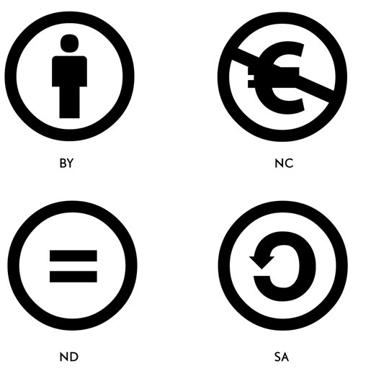
Creative Commons: licence elements
To Design, Develop, and Evaluate Quality Blended Learning

Slide 55

Creative Commons: licence elements
ATTRIBUTION
This means that others must credit you as the original creator of the work. All Creative Commons licences require users to provide attribution.
To Design, Develop, and Evaluate Quality Blended Learning

Slide 56

Creative Commons: licence elements
NON-COMMERCIAL
This means that others may not share, adapt or reuse use your work if their use is primarily intended for commercial advantage or monetary compensation.
To Design, Develop, and Evaluate Quality Blended Learning

Slide 57

Creative Commons: licence elements
NODERIVATIVES
This means that others can share your work, but they must not change it. Note that users still have the range of Fair Dealing rights granted to them under the Copyright Act 1994.
To Design, Develop, and Evaluate Quality Blended Learning

Slide 58

Creative Commons: licence elements
SHAREALIKE
This means that those who adapt or remix your work must use the same Creative Commons licence on any derivative works.
To Design, Develop, and Evaluate Quality Blended Learning

Slide 59

Creative Commons: licences
ATTRIBUTION
This licence lets others distribute, remix, tweak, and build upon your work, even commercially, as long as they credit you for the original creation.
To Design, Develop, and Evaluate Quality Blended Learning

Slide 60

Creative Commons: licences
ATTRIBUTION-NONCOMMERCIAL
This licence lets others remix, tweak, and build upon your work non-commercially with credit to you (their new works must also be non-commercial).
To Design, Develop, and Evaluate Quality Blended Learning

Slide 61

Creative Commons: licences
ATTRIBUTION-SHAREALIKE
This licence lets others remix, tweak, and build upon your work even for commercial purposes, as long as they credit you and license their new creations under the identical terms.
To Design, Develop, and Evaluate Quality Blended Learning

Slide 62

Creative Commons: licences
ATTRIBUTION-NONCOMMERCIAL-SHAREALIKE
This licence lets others remix, tweak, and build upon your work non-commercially, as long as they credit you and license their new creations under the identical terms.
To Design, Develop, and Evaluate Quality Blended Learning

Slide 63

Creative Commons: licences
ATTRIBUTION-NO DERIVATIVES
This licence allows for redistribution, commercial and non-commercial, as long as it is passed along unchanged and in whole, with credit to you.
To Design, Develop, and Evaluate Quality Blended Learning

Slide 64

Creative Commons: licences
ATTRIBUTION-NONCOMMERCIAL-NO DERIVATIVES
This licence is the most restrictive of our six main licences, only allowing others to download your works and share them with others as long as they credit you, but they can’t change them in any way or use them commercially.
To Design, Develop, and Evaluate Quality Blended Learning

Slide 65

Creative Commons: licence elements
CC Zero
CC0 means you are relinquishing copyright and releasing material into the public domain.
To Design, Develop, and Evaluate Quality Blended Learning

Slide 66
Creative Commons: Sites
Some sites with creative commons sections are:
  Flickr: Flickr is a video and image hosting site.
  Google: Google text search.
  Google Images: Google image search.
  Jamendo: Jamendo is a music hosting site.
  Wikimedia Commons: includes text, images, audio and video.
To Design, Develop, and Evaluate Quality Blended Learning

Slide 67
Creative Commons: Sites
Some sites with creative commons sections are:
  YouTube: YouTube is a video hosting site.
  Pixabay: Pixabay is image and video hosting site.
  ccMixter: ccMixter is a music hosting site.
  SoundCloud: SoundCloud is a music hosting site.
To Design, Develop, and Evaluate Quality Blended Learning

Slide 68
Creative Commons: Sites
Some of these sites have direct links including:
Google Images
SoundCloud
YouTube
Flickr
To Design, Develop, and Evaluate Quality Blended Learning

Slide 69
Creative Commons: Sites
Some creative commons search tools are:
https://search.creativecommons.org
https://labs.tineye.com/multicolr/
To Design, Develop, and Evaluate Quality Blended Learning

Slide 70


