Slide 1
How to use the PowerPoint slides on my website
Damian Gordon

Slide 2
Using my slides
The PowerPoint files on my website are for me, to help me present in a clear way the necessary information you need to know.
They help me remember what the key points are that I need to mention in class.
As such they are presentation slides, not lecture notes.

Slide 3
What’s the difference?
Presentation slides are for me, lecture notes are for you.
For example, if I am presenting a list of 10 items, if I were writing lecture notes for you I’d write them all on one slide, but as I am writing presentation slides then I am going to be explaining them one at a time, so I am going to put each item on a separate slide for clarity.

Slide 4
For Example
FOR EXAMPLE:
If I was writing Lecture Notes they might look like the next slide

Slide 5
List
List1
List2
List3
List4
List5
List6
List7
List8
List9
List10

Slide 6
For Example
FOR EXAMPLE:
Whereas this list becomes the following set of slides for a presentation

Slide 7
List
List1

Slide 8
List
List1
List2

Slide 9
List
List1
List2
List3

Slide 10
List
List1
List2
List3
List4

Slide 11
List
List1
List2
List3
List4
List5

Slide 12
List
List1
List2
List3
List4
List5
List6

Slide 13
List
List1
List2
List3
List4
List5
List6
List7

Slide 14
List
List1
List2
List3
List4
List5
List6
List7
List8

Slide 15
List
List1
List2
List3
List4
List5
List6
List7
List8
List9

Slide 16
List
List1
List2
List3
List4
List5
List6
List7
List8
List9
List10

Slide 17
For Example
END OF EXAMPLE

Slide 18
So what?
Why does this matter?

Slide 19
So what?
Why does this matter?
The only difference is that if you are printing the slides out as they are, it’s an awful waste of paper and money, there is a better way...

Slide 20
A better way...
Save my slides as file type “Outline/RTF” under “Other Formats”:

Slide 21
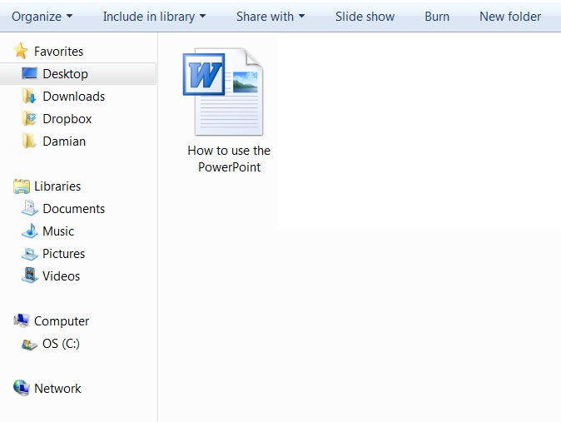
A better way...
And you’ll find a Word document that you can manipulate:

Slide 22
A better way...
You’ll find the text is too big:

Slide 23
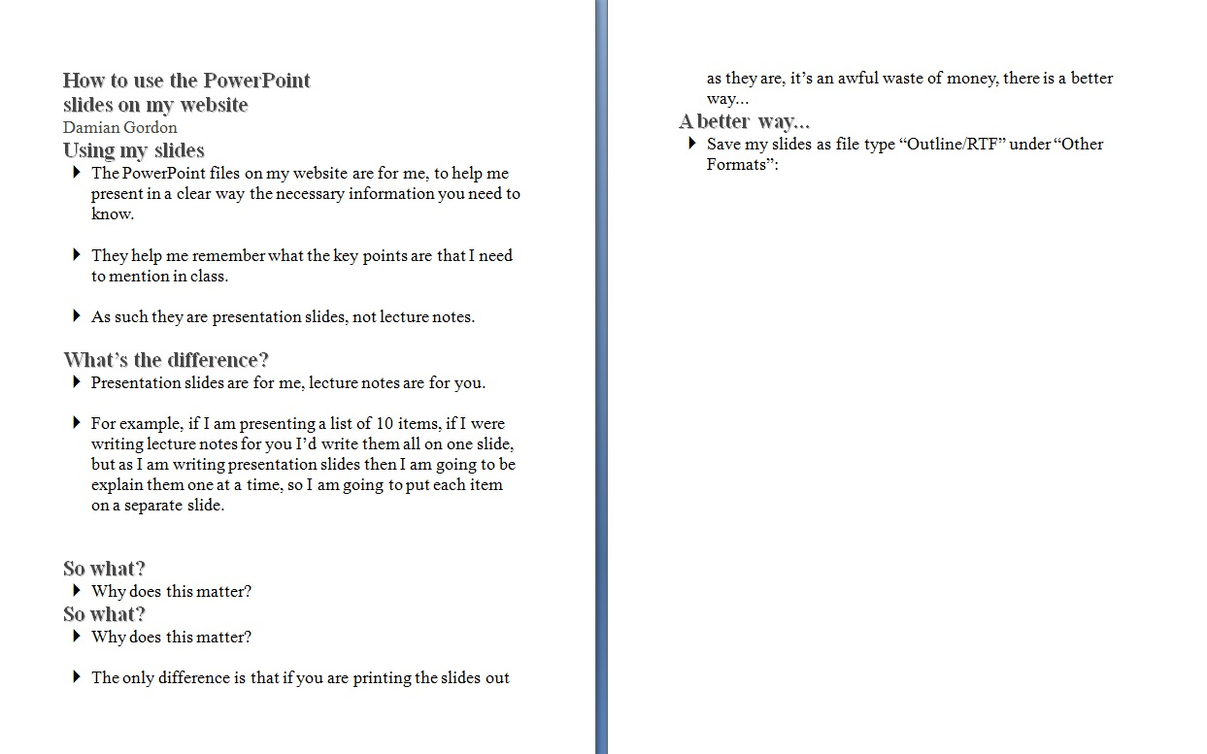
A better way...
So you should reduce the text size:

Slide 24
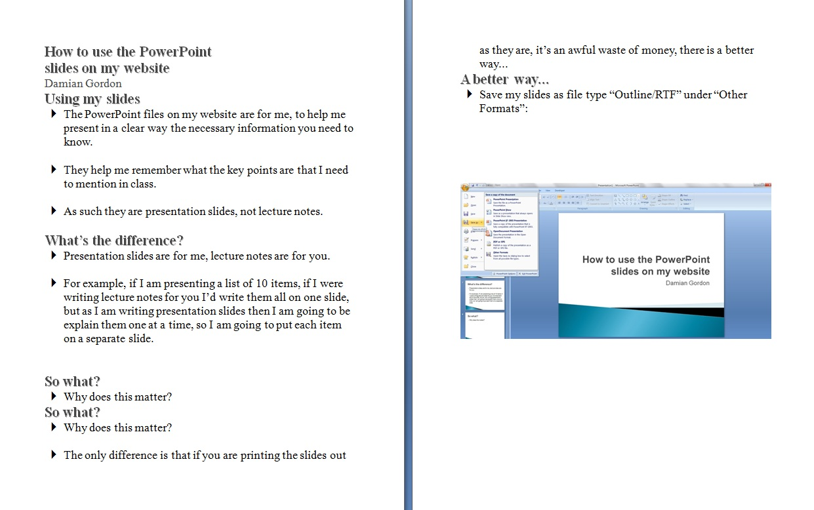
A better way...
Add in any diagrams from the PowerPoint (a lot of the images in my slides are just for “setting the mood” so there’s no need to include them):

Slide 25
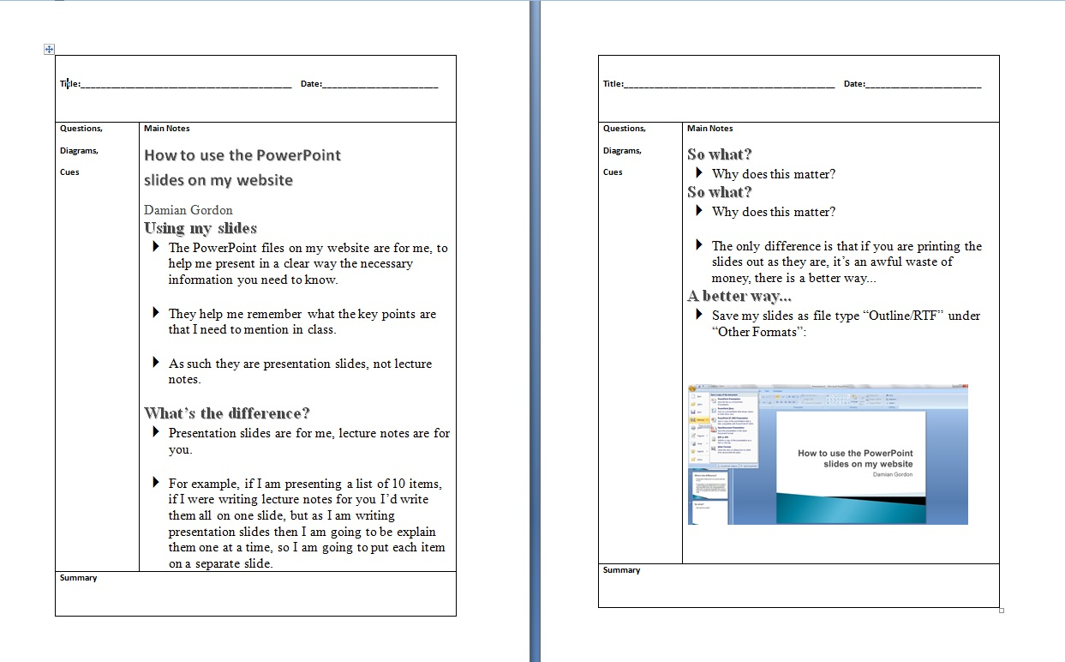
A better way...
And put the notes in the Cornell Note format (you’ll find a template on the same page as this presentation):

Slide 26
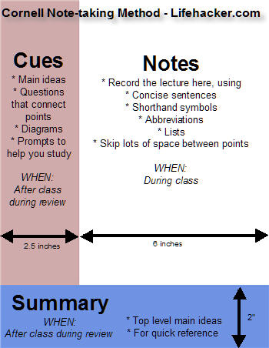
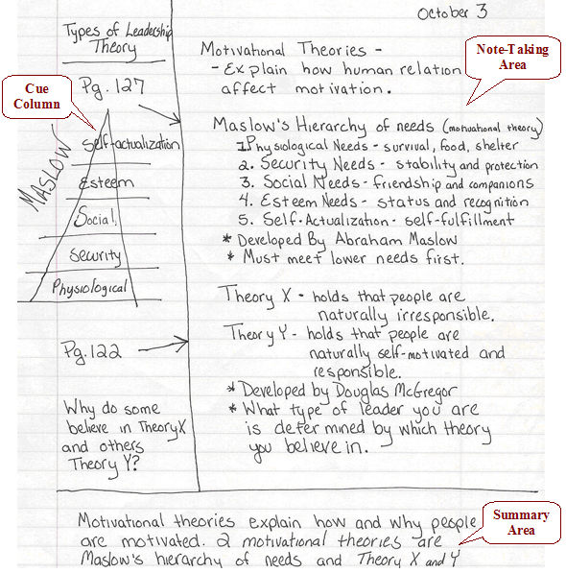
Cornell Notetaking

Slide 27
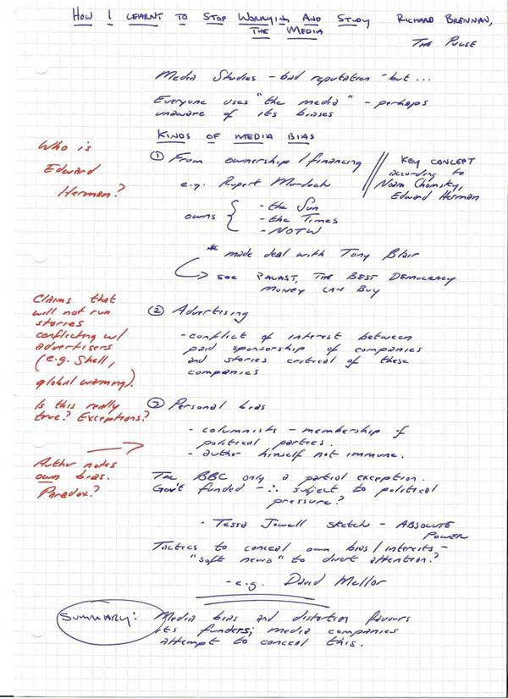
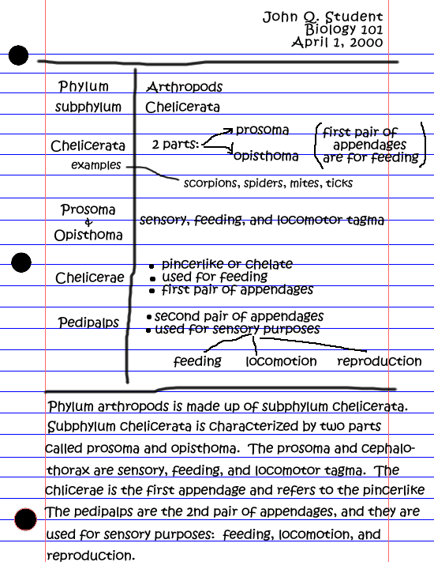
Cornell Notetaking

Slide 28
Why?
Because I want you to interact with the text of my presentations, It’s too easy to print slides out and do nothing with them.
Because Cornell Notetaking is a very effective note-taking technique.

Slide 29
Why?
Because this is a good example of “Directed-Activities-Related-to-Texts” or “DARTs”
Also change the font of the text from time-to-time, it’ll help you remember it.¹
¹Diemand-Yauman C, Oppenheimer DM, Vaughan EB. "Fortune favors the bold (and the Italicized): effects of disfluency on educational outcomes." Cognition. 2011 Jan;118(1):111-5.

Slide 30
Final Note
REMEMBER: The PowerPoint files on my website are for me, to help me present in a clear way the necessary information you need to know
So I reserve the right to remove any or all of my notes off the web at any time, so don’t wait until the night before the exams to download my notes, you should be using them over the whole of the term.

