Slide 1
Video Editing Tools
Damian Gordon

Slide 2
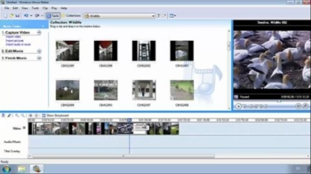
Windows Movie Maker
https://support.microsoft.com/en-ie/help/14220/windows-movie-maker-download

Slide 3
http://www.virtualdub.org/

Slide 4
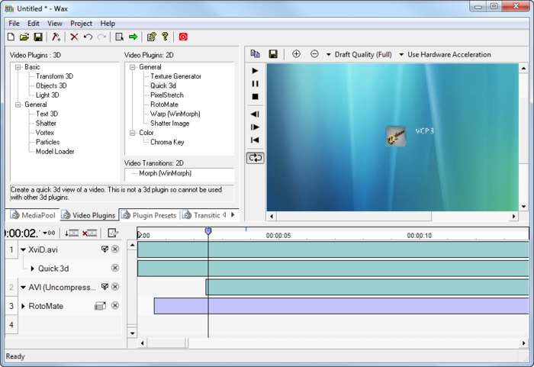
Wax
http://www.debugmode.com/wax/

Slide 5
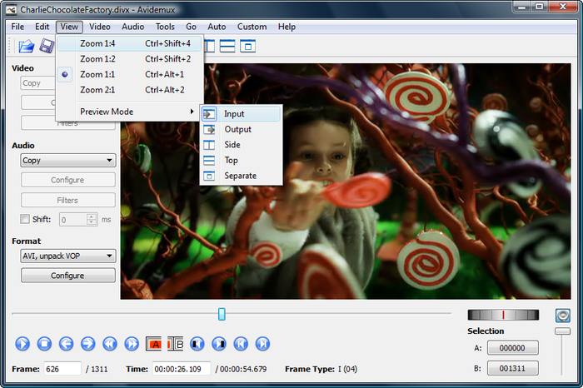
Avidemux
http://fixounet.free.fr/avidemux/

Slide 6
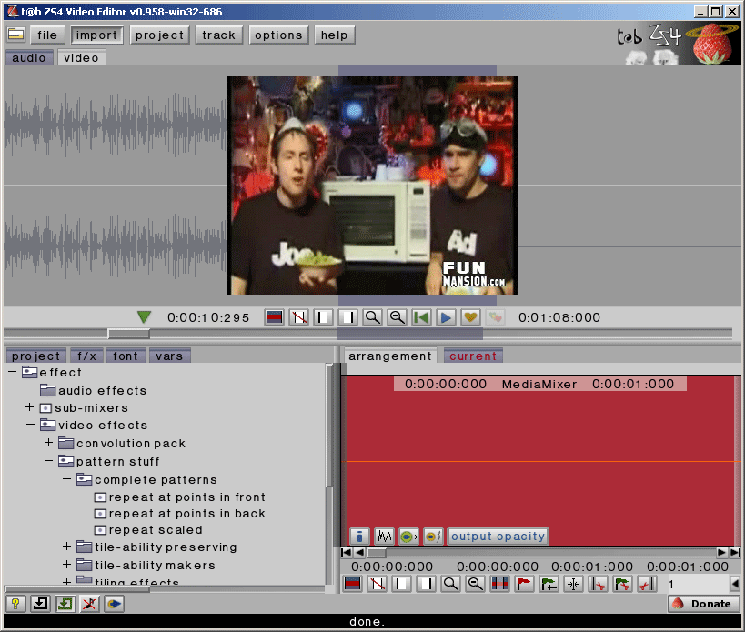
ZS4 Video Editor
http://download.cnet.com/ZS4-Video-Editor/3000-13631_4-10043774.html

Slide 7
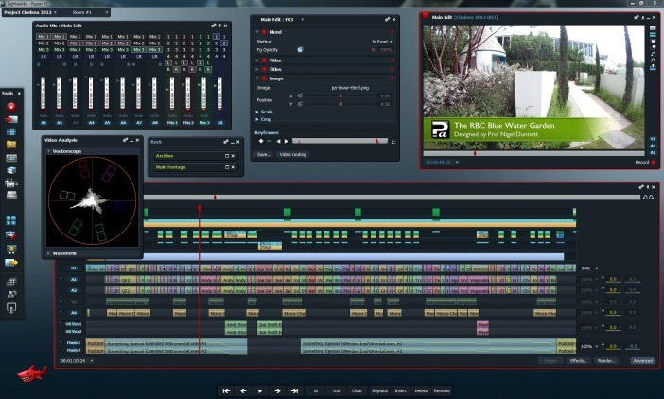
Lightworks
https://www.lwks.com/

Slide 8
THE END.

