Slide 1
Prototyping and Wireframe Tools
Damian Gordon

Slide 2
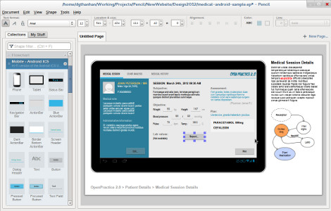
The Pencil Project
http://pencil.evolus.vn/

Slide 3
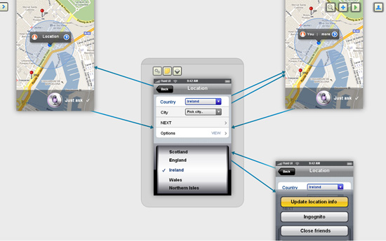
https://www.fluidui.com/

Slide 4
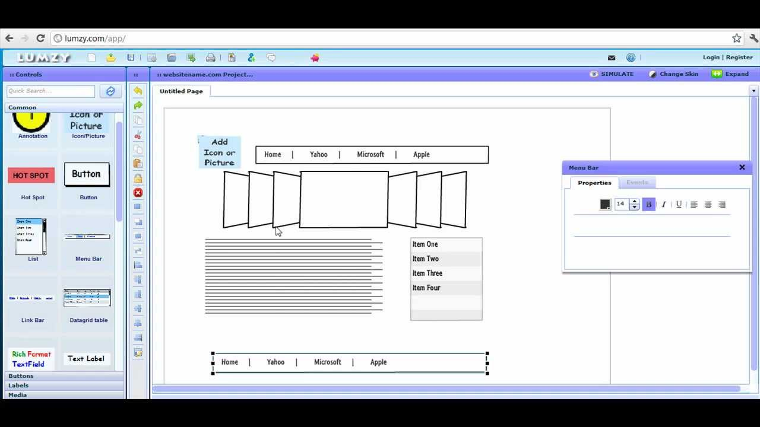
http://lumzy.com/app/

Slide 5
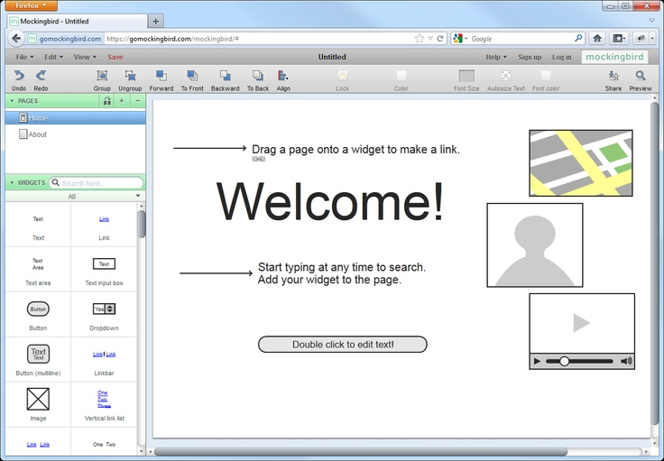
Mockingbird
https://gomockingbird.com/mockingbird

Slide 6
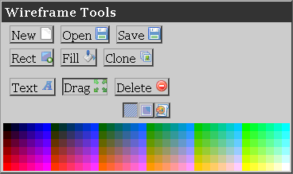
Web Site Wireframe Tool
http://wireframe.talltree.us/default.asp

Slide 7
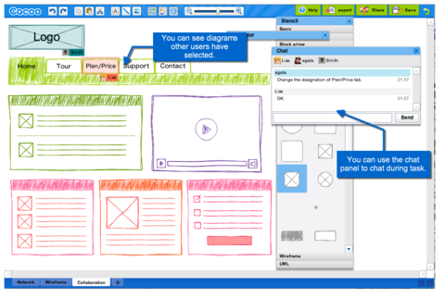
https://cacoo.com/

Slide 8
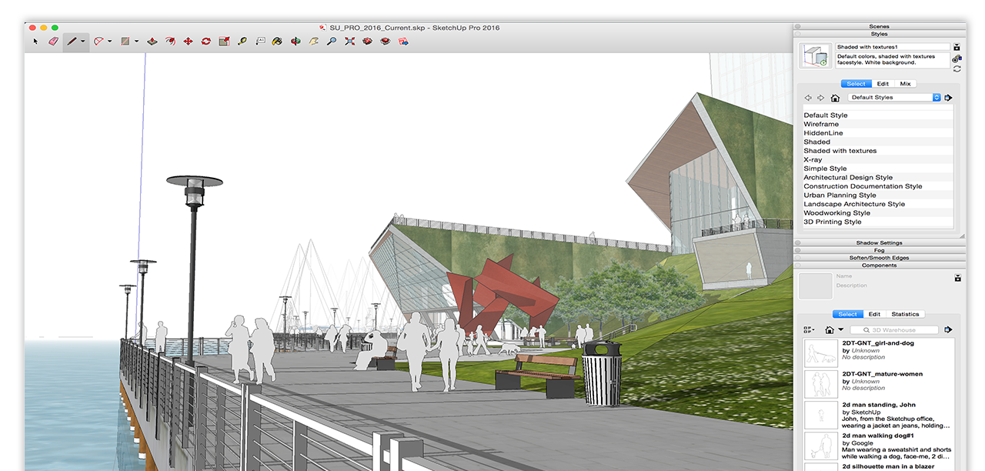
http://www.sketchup.com/

Slide 9
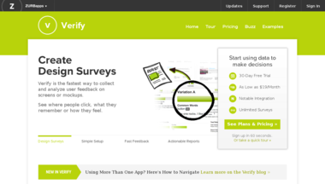
http://verifyapp.com/

Slide 10
THE END.

