Slide 1
Some Multimedia Design Tools
Damian Gordon

Slide 2
http://www.designcomics.org/

Slide 3
https://www.powtoon.com

Slide 4
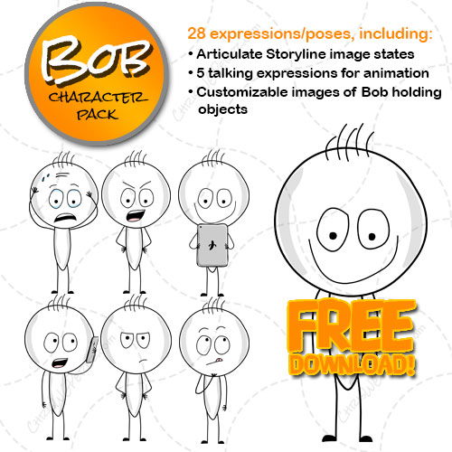
Bob Character Pack
http://chriswgperez.com/downloads/bob-character-pack/

Slide 5
https://tellagami.com/

Slide 6
http://www.voki.com/

Slide 7
http://doppelme.com/

Slide 8
http://animoto.com/

Slide 9
https://goanimate.com/

Slide 10
http://www.makebeliefscomix.com/

Slide 11
https://www.iconfinder.com

Slide 12
http://www.freesound.org/browse/

Slide 13
https://dabuttonfactory.com/

Slide 14
http://www.texturelovers.com/

Slide 15
70+ Handwritten Fonts and Showcases
http://www.tripwiremagazine.com/2009/09/70-seriously-useful-handwritten-fonts-and-inspirational-showcases.html

Slide 16
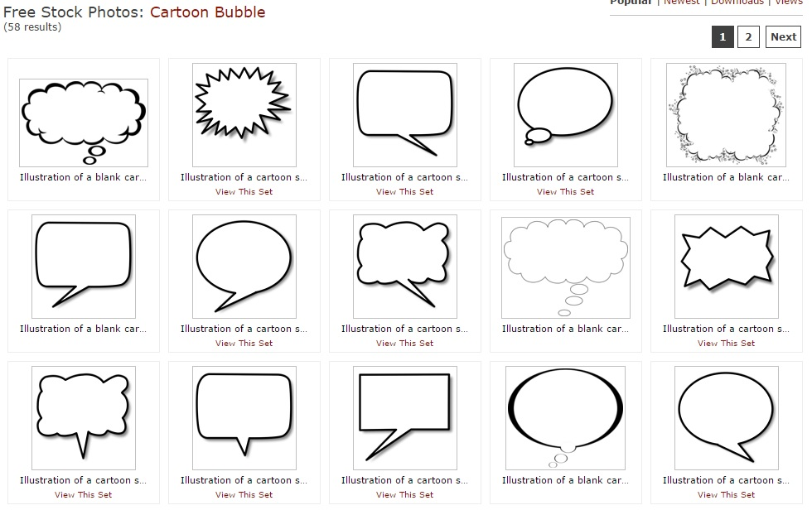
Cartoon Speech Bubbles
http://www.freestockphotos.biz/stockphoto/1008

Slide 17
THE END.

