Slide 1
Some Creative Commons Sites
Damian Gordon

Slide 2
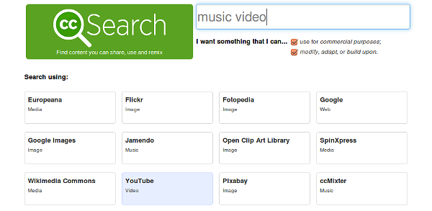
https://search.creativecommons.org/

Slide 3
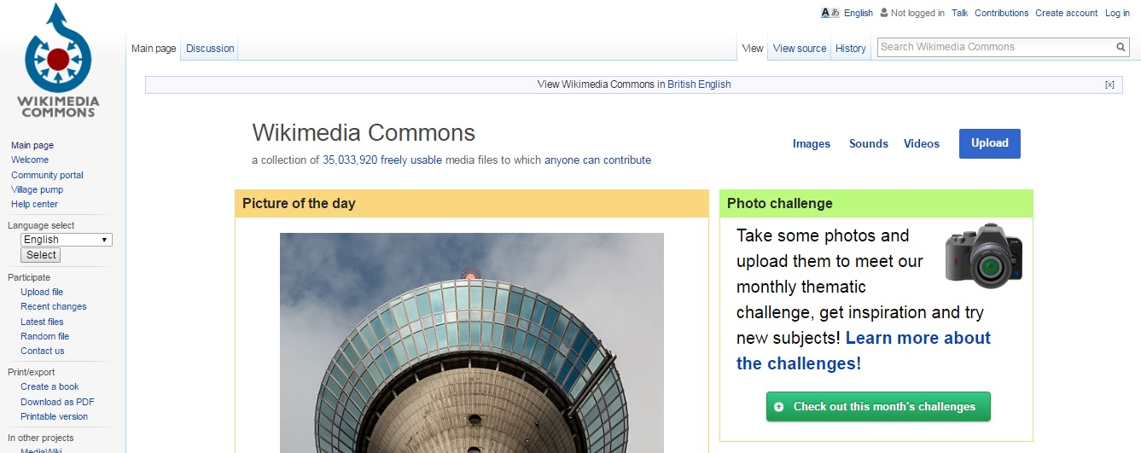
https://commons.wikimedia.org/wiki/Main_Page

Slide 4
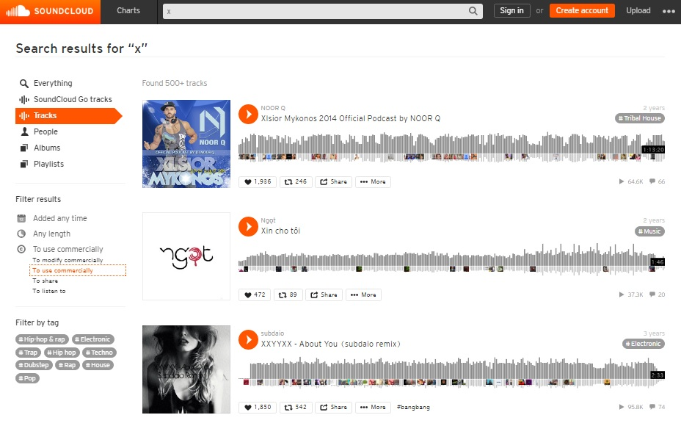
https://soundcloud.com/

Slide 5
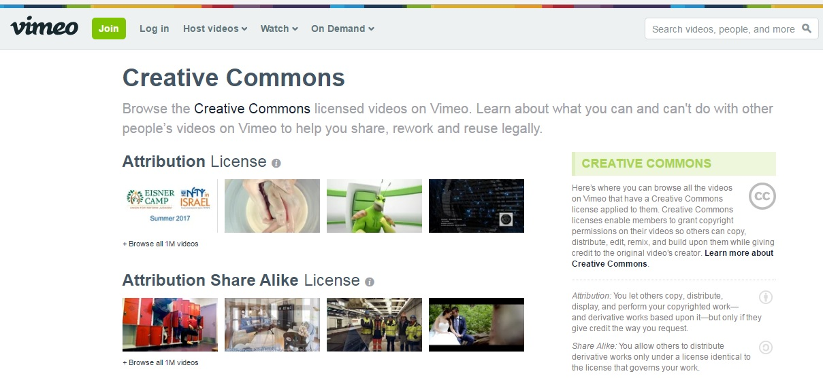
https://vimeo.com/creativecommons

Slide 6
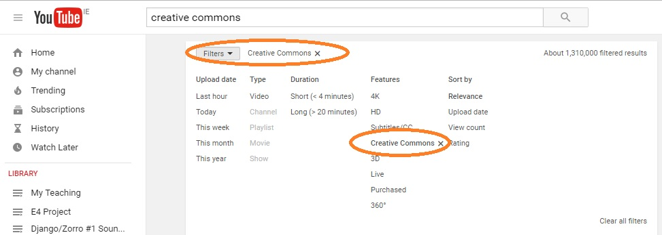
YouTube

Slide 7
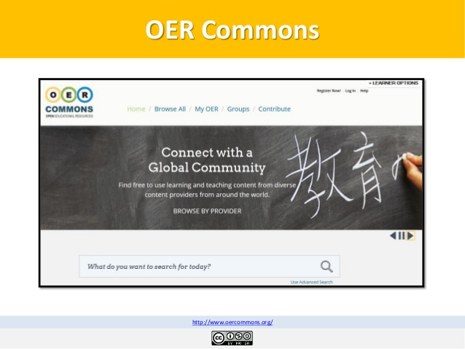
https://www.oercommons.org/

Slide 8
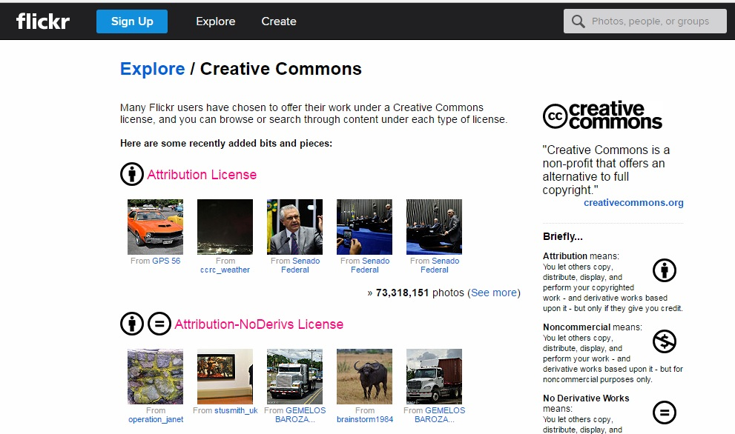
https://www.flickr.com/creativecommons/

Slide 9
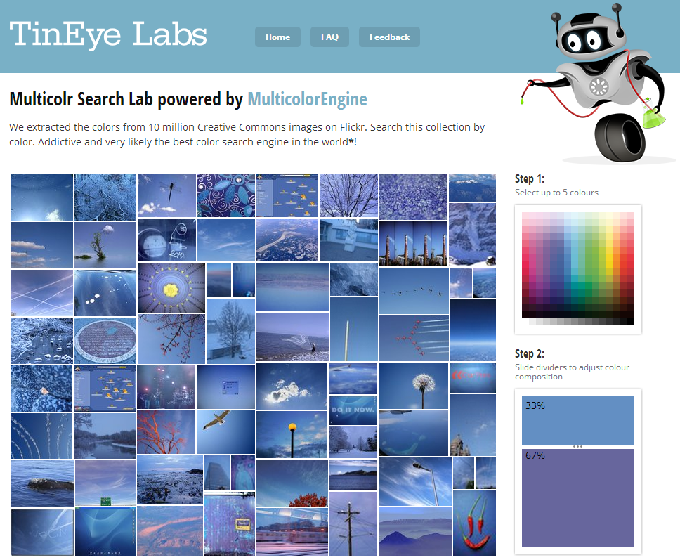
TinEye Labs: Search by Colour
http://labs.tineye.com/multicolr/

Slide 10
THE END.

