Slide 1
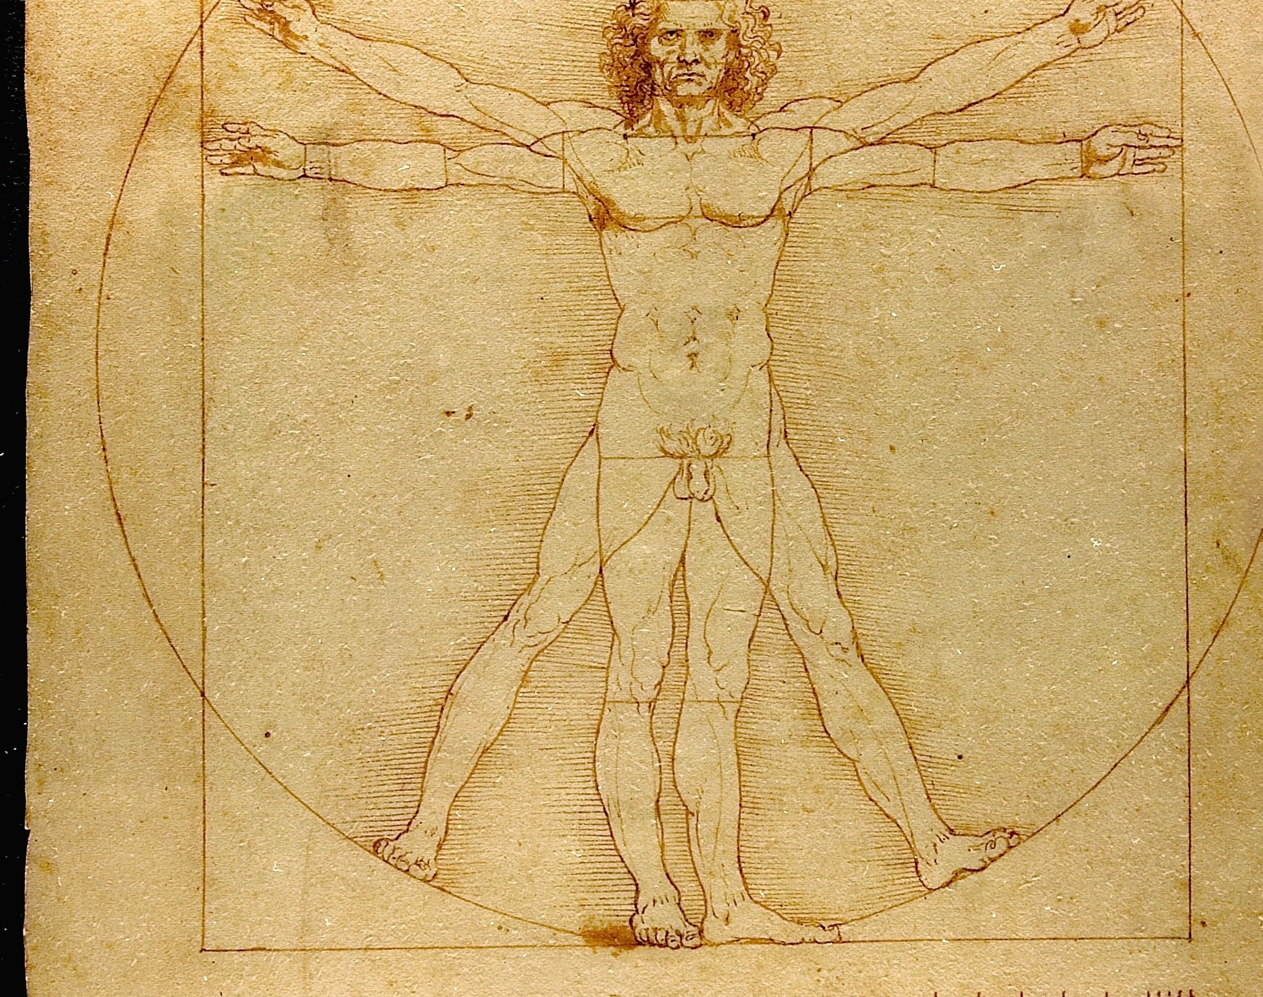
Leonardo Da Vinci
Damian Gordon

Slide 2
1st Art - Architecture
2nd Art - Sculpture
3rd Art - Painting and Drawing
4th Art - Music
5th Art - Literature and Poetry
6th Art - Dance, Mime, theatre, opera & circus
7th Art - Cinema
8th Art - Radio, TV, and photography
9th Art - Comics
10th Art - Video games and digital Art
The 10 Arts

Slide 3
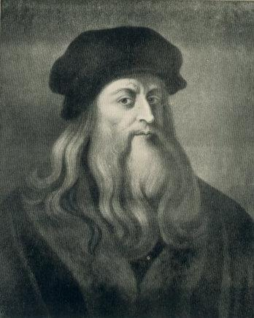
Leonardo da Vinci
1452 - 1519

Slide 4
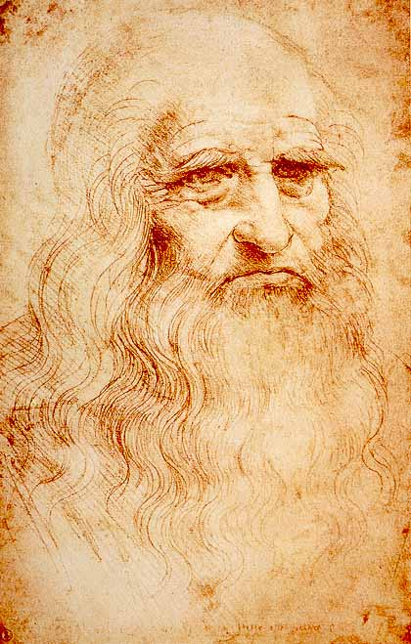

Slide 5
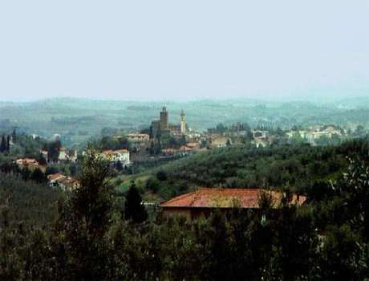
Born in Vinci, Tuscany, Italy (15th Apr. 1452)

Slide 6
Childhood
Mother – Catarina, father – Ser Piero, a public notary
Went to school there, studied geometry and Latin
He lived there until he was 14
Then moved to Florence where he began an apprenticeship in the workshop of Verrocchio.

Slide 7
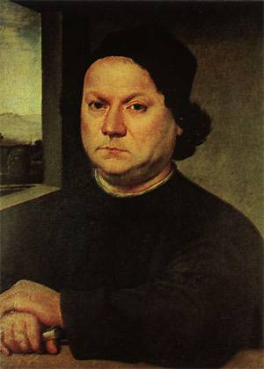
Andrea del Verrocchio
Started an apprenticeship in the workshop of Andrea del Verrocchio 1466 (sculptor, painter, goldsmith, bronze caster and more)
the mixing of colors and then he painted simple parts of paintings, taught himself to paint in oils at this time
In June 1472 - listed in the red book of painters from Florence, end of apprenticeship.

Slide 8
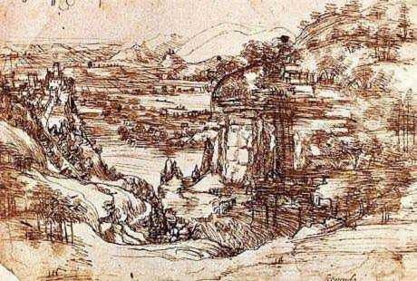
First Work
Leonardo da Vinci’s first known and dated work (5th of August 1473)
"the perspective of disappearance".

Slide 9
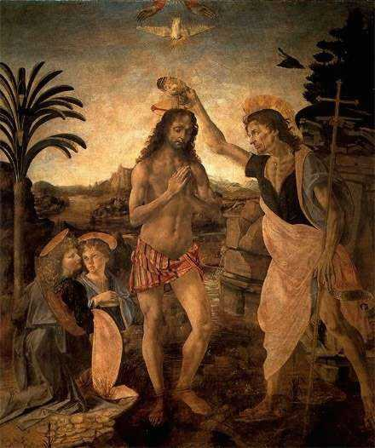
"Baptism of Christ", 1472-1475, assisted his master Verrocchio

Slide 10
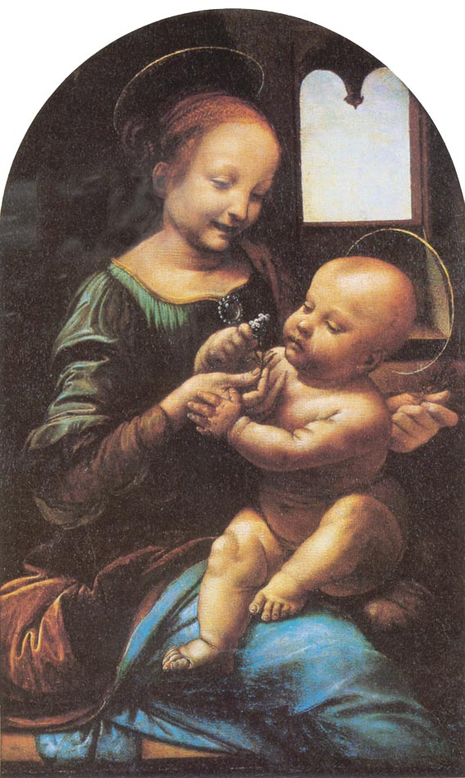
The Benois Madonna, 1478

Slide 11
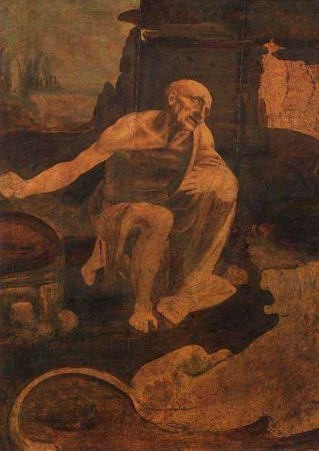
St.Jermoe, 1481
Never finished
Now in the Vatican

Slide 12
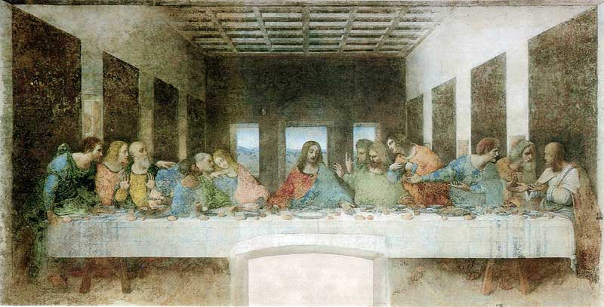
Milan (1482-1499)
“The Last Supper”
Many unfinished works

Slide 13
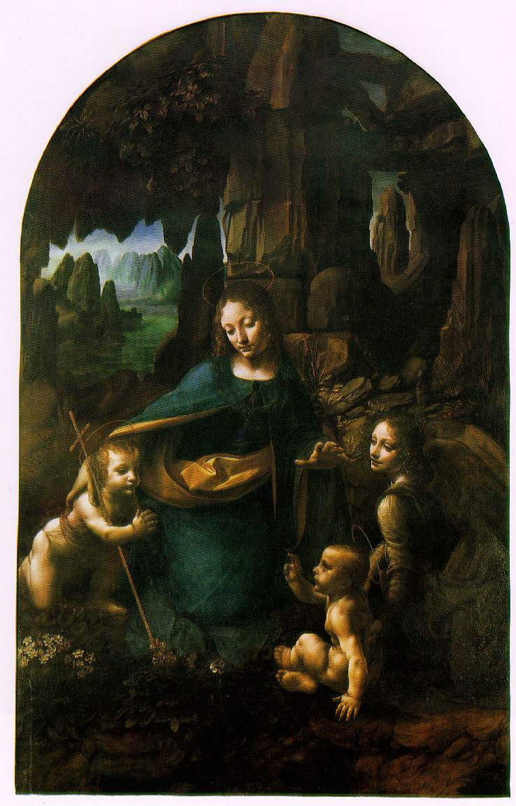
“The virgin of the Rocks”
1483 - 86

Slide 14
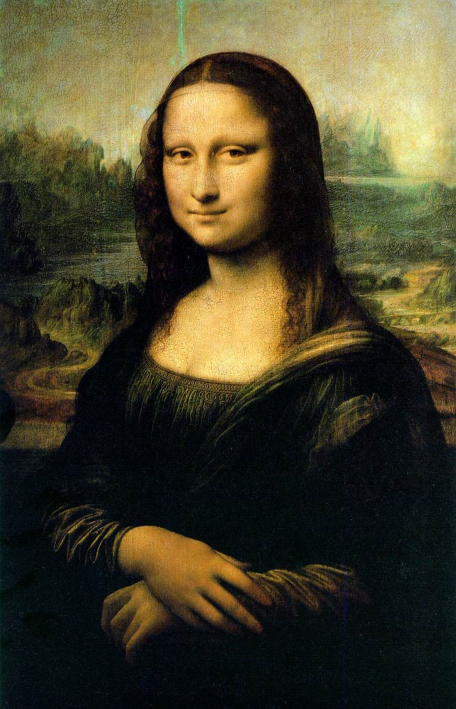
“Mona Lisa” (1503-1507)
Sfumato (smoky effect)

Slide 15
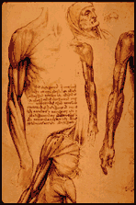
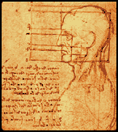
Leonardo the Scientist
Studied many topics such as anatomy, zoology, botany, geology, optics, aerodynamics and hydrodynamics among others
He was fascinated by the study of physiognomy, the “science” of evaluating a person’s character by his or her facial features

Slide 16
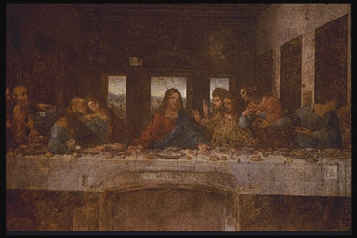

Leonardo the Artist
Leonardo’s desire to paint things realistically was bold and fresh, and eventually became the standard for painters who followed in the 16th century
Went beyond his teaching by making a scientific study of light and shadow in nature
Objects were not comprised of outlines, but were actually 3-D bodies defined by light and shadow
Known as chiaroscuro, this technique gave his paintings the soft, lifelike quality that made older paintings look “cartoony” and flat
The Last Supper
The Virgin of the Rocks

Slide 17
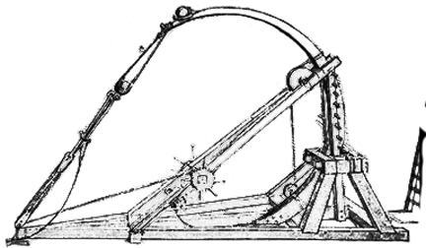
Leonardo the Inventor
Adapted drawing skills to the more lucrative fields of architecture, military engineering, canal building and weapons design
Leonardo wanted to create "new machines" for a "new world“
Based on the gear, he came up with loads of different ideas, including the bicycle, a helicopter, an “auto-mobile”, and many military weapons
Leonardo’s first idea for a catapult

Slide 18
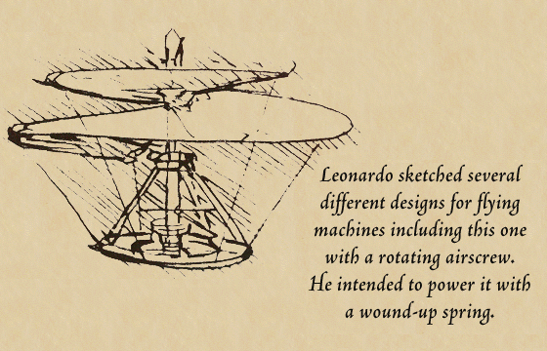

Leonardo’s Helicopter

Slide 19
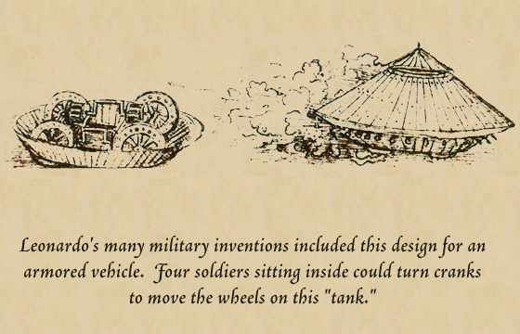

The First Tank

Slide 20
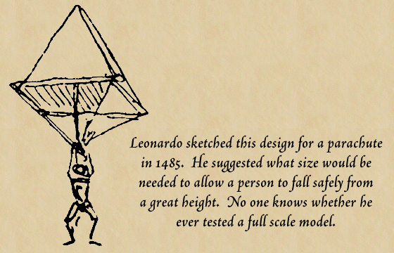
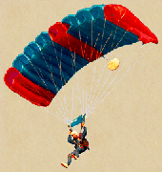
“Leo-chute”

Slide 21
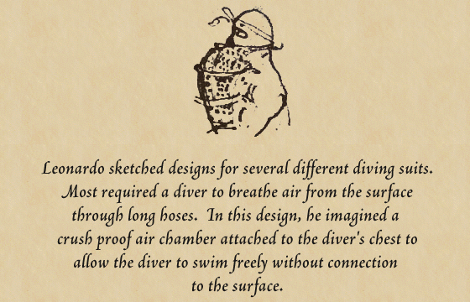
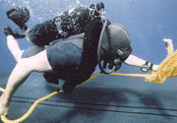
Diving During the Renaissance?

Slide 22
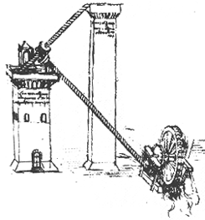
The Water Lift
This invention consists of a water wheel, two screws and two towers
As the water wheel turns, the screws turn, pushing the water up to the highest tower
The tall tower acts as a reservoir for gravity fed water pipes

Slide 23
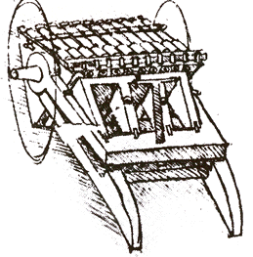
The Machine Gun
This machine actually consisted of three sets of machine guns, set on a rotating drum
When the first set is fired, the force of the explosion would pivot the guns down, bringing the next set of guns to the top, ready to be fired.

Slide 24
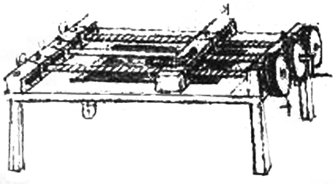
The Thread Cutter
This machine cuts the threads of screws
A bar, the one to have the thread cut into it, would be laid in between the two screws.
As the cranks on the end of the table were turned, the cutting blade would be carried down the two screws, creating an even groove to be used for screws, bolts, etc.

Slide 25

Right to Left
Leonardo wrote in Italian using a special kind of shorthand that he invented himself
He usually used “mirror writing,” starting at the right side of the page and moving to the left
Only when he was writing something intended for other people did he write in the normal direction
Leonardo’s Signature in a notebook

Slide 26
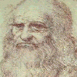
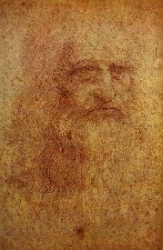
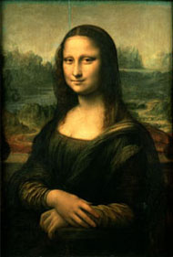
Mystery of the Mona Lisa
He recorded in his notebooks the records of model sittings; but records of the Mona Lisa model sitting are nowhere to be found
Theories are that Leonardo painted himself, and this theory is supported by analyzing the facial features of Leonardo’s face and that of the famous painting
If the features of the face were placed on top of each other, and flipped, they would align perfectly

Slide 27

Leonardo’s Notebooks

Slide 28
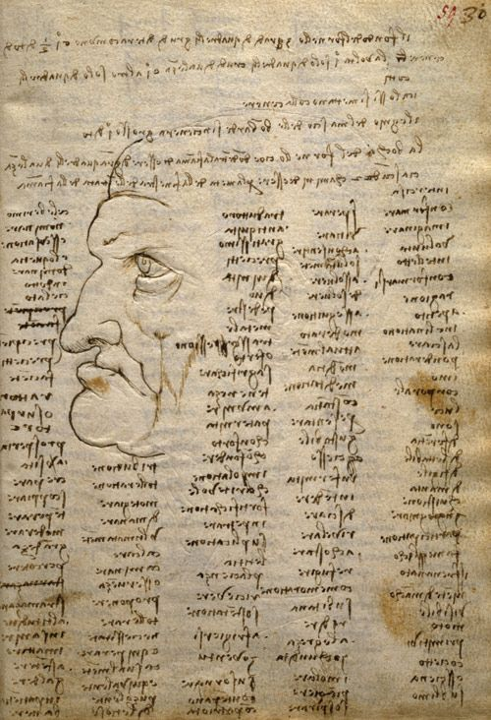
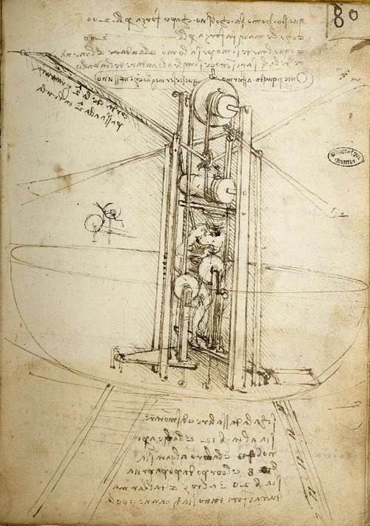

Slide 29
Leonardo’s Notebooks
Leonardo's notebooks may have started out as just a way for him to improve the quality of his paintings.
  He studied anatomy to portray the human body accurately.
  He studied plants and rocks to make them authentic for his paintings.
  Somewhere along the line, however, the books became more than that. They became a record of his life-long fascination with nature and his genius for invention.

Slide 30
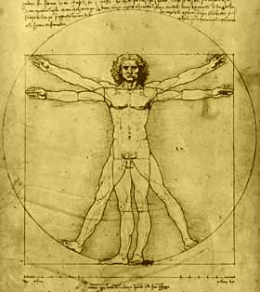
Leonardo’s Notebooks
Presently there are ten known codices containing Leonardo's sketches and notes.

Slide 31
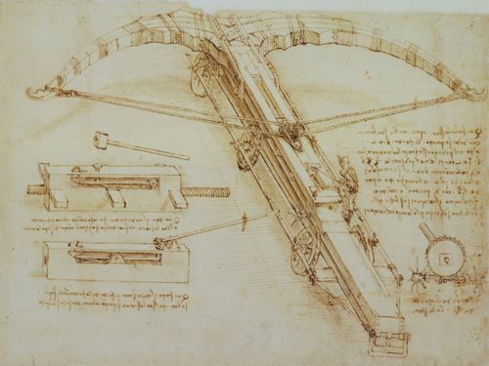
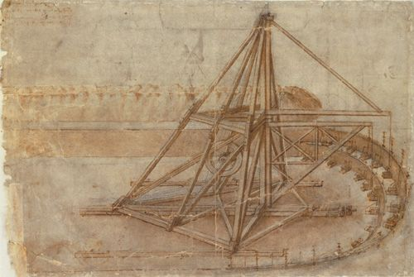
Codex Atlanticus
This notebook concerns mathematics, geometry, astronomy, botany, zoology and the military arts. It is held by the Biblioteca Ambrosianain in Milan, Italy.

Slide 32
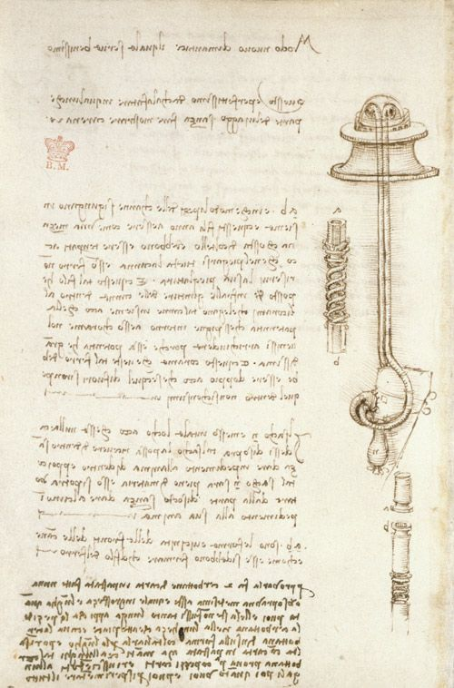
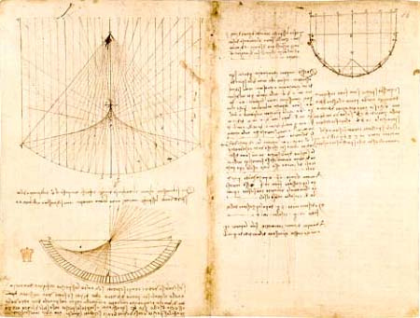
Codex Arundel
This book resides in the British Library in London and is one of the ones created by the cutting and pasting of pages from other works. Most of the material deals with the study of geometry, weights and architecture.

Slide 33
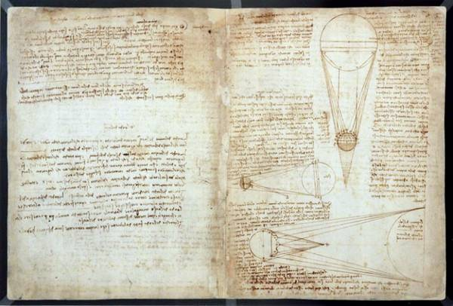
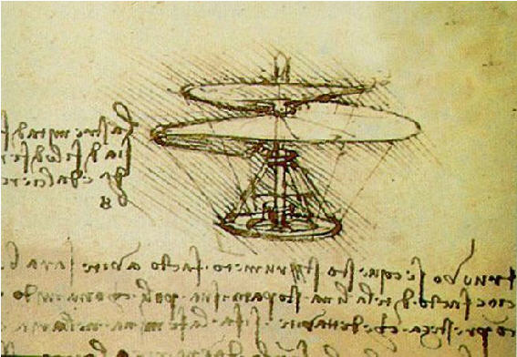
Codices of the Institute of France
These are twelve documents (referred to as A-M) of varying sizes that cover a variety of areas including hydraulics, military art, optics, geometry and bird flight. One of Leonardo's most well known-designs, a primitive helicopter, is included in manuscript B.

Slide 34
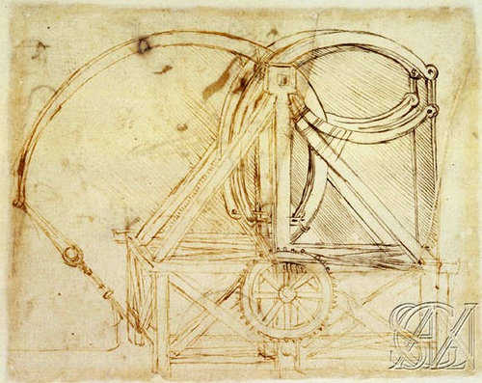
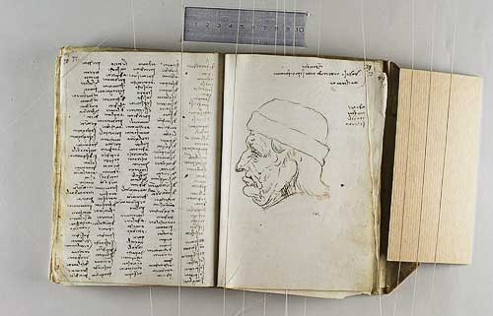
Codex Trivulzianus
This notebook originally contained 62 sheets, but today only 55 remain.
It documents Leonardo's attempts to improve his modest literary education, through long lists of learned words copied from authoritative lexical and grammatical sources. The manuscript also contains studies of military and religious architecture.

Slide 35
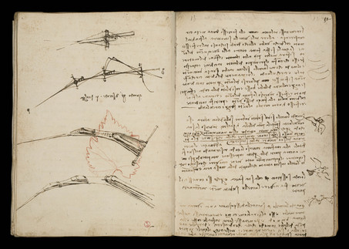
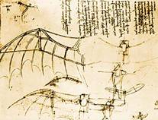
Codex "On the Flight of Birds"
This short work of only 17 pages is a very careful study Leonardo did in 1505 on the mechanics of flight and the movement of air.

Slide 36
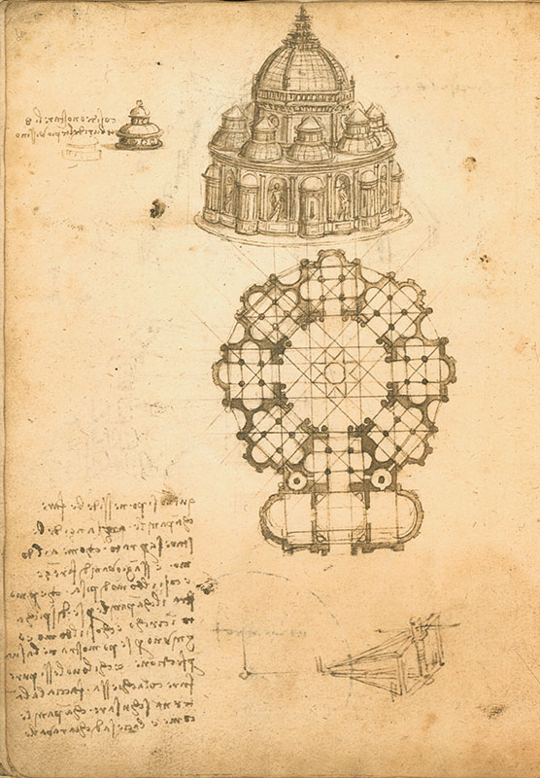
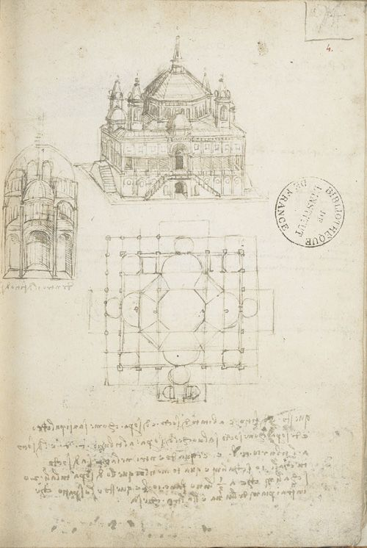
Codex Ashburnham
This is actually composed of two documents held by the Institute of France. It primarily consists of pictorial studies.

Slide 37
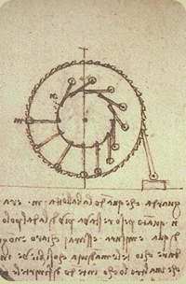
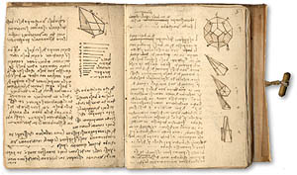
Codex Forster
These are three different documents held at the Victoria and Albert Museum in London. They are composed of studies about geometry, weights and hydraulic machines.

Slide 38
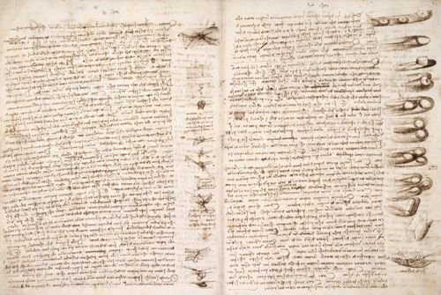
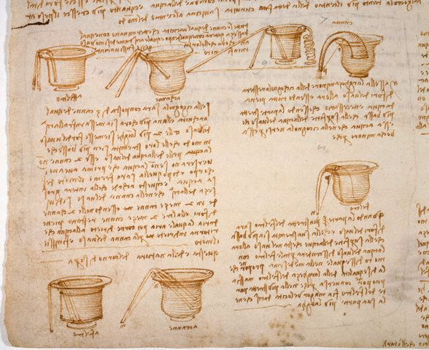
Codex Leicester
This manuscript was in the news when it was purchased by Bill Gates in 1995 for $30.8 million. It contains 64 pages mostly dedicated to Leonardo's theories on astronomy, the properties of water, rocks and fossils, air and celestial light.

Slide 39
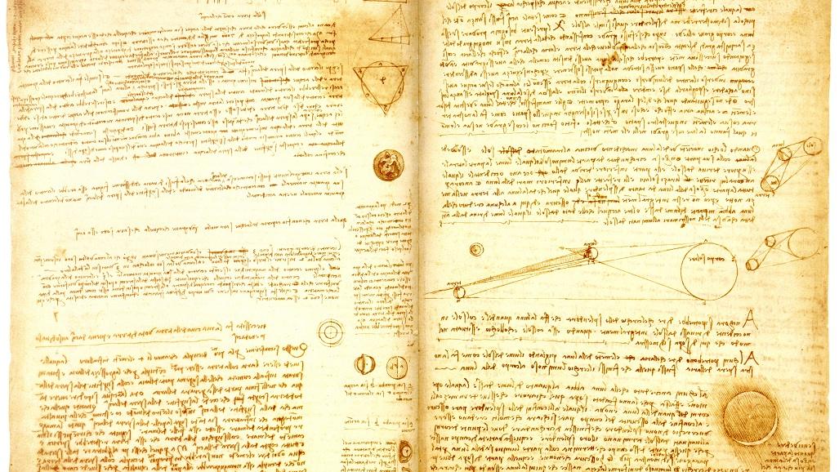

Slide 40
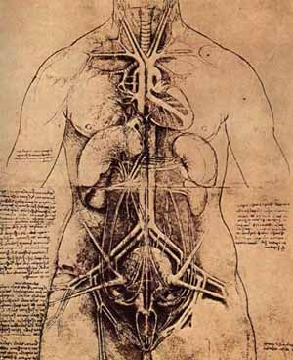
Windsor Royal Documents
These pages are part of the royal collection at Windsor Castle. The subjects include anatomy and geography, horse studies, drawings, caricatures and a series of maps.

Slide 41
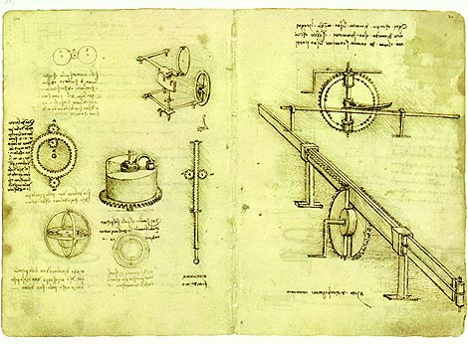
The Madrid Codices
These manuscripts were found in the archives of the National Library of Madrid. There are two volumes bound in red morocco leather and contain 197 pages on geometry and mechanics.

Slide 42






