Slide 1
Game Development
Damian Gordon

Slide 2
1st Art - Architecture
2nd Art - Sculpture
3rd Art - Painting and Drawing
4th Art - Music
5th Art - Literature and Poetry
6th Art - Dance, Mime, theatre, opera & circus
7th Art - Cinema
8th Art - Radio, TV, and photography
9th Art - Comics
10th Art - Video games and digital Art
The 10 Arts

Slide 3
What is Game Development?
The process of designing, developing, and releasing games.
Includes art, code, sound, and storytelling.

Slide 4
Game Development Workflow
Concept
Design
Development
Testing
Release
Maintenance

Slide 5
Game Concept
Genre
Defines the type and style of gameplay.
Story
Sets the context and motivation for the player.
Platform
Impacts game design, controls, and performance:
Target audience
Who are you making the game for?

Slide 6
Game Concept: Genre
Action – fast-paced combat and movement
Adventure – exploration and storytelling
Puzzle – logic, problem-solving
Role-Playing Games (RPGs) – character growth, quests
Strategy – planning, tactics (turn-based or real-time)
Platformer – jumping/navigation (e.g., Mario)

Slide 7
Game Concept: Story
Setting (e.g., sci-fi, medieval, post-apocalyptic)
Plot (what’s happening and why)
Characters (player character and NPCs)
Conflict (what needs to be resolved)
Good story adds emotional depth and immersion.

Slide 8
Game Concept: Platform
PC – high graphics capability, flexible input
Consoles (PS5, Xbox, Switch) – controller-focused, standard hardware
Mobile – touch controls, short sessions
Web – browser-based, lightweight
VR/AR – immersive environments, motion input

Slide 9
Popular Game Engines
Unity, Unreal Engine, Godot.

Slide 10
Programming Languages
C#, C++, Python, GDScript, Lua

Slide 11
Physics & Collision Detection
Rigidbody components simulate realistic motion and forces

Slide 12
Physics & Collision Detection
Hitboxes define the areas for detecting collisions

Slide 13
Physics & Collision Detection
Physics engines handle gravity, bouncing, and other interactions between objects.

Slide 14
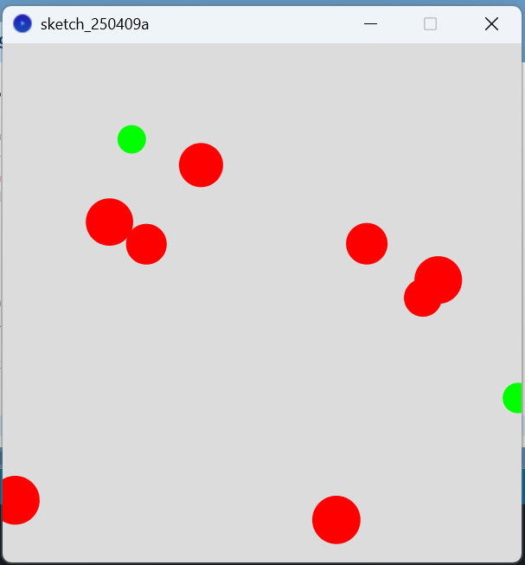
Physics & Collision Detection
Falling Balls

Slide 15
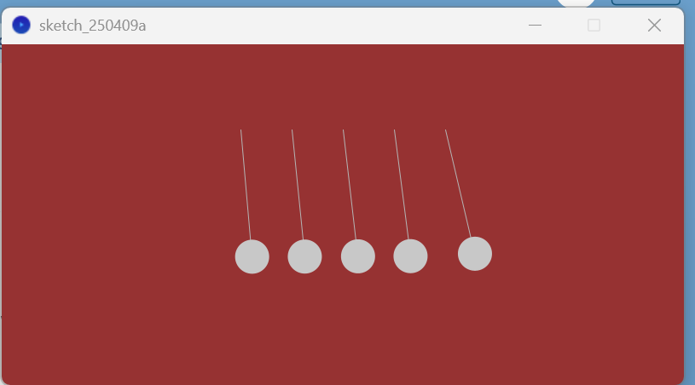
Physics & Collision Detection
Newton’s Cradle

Slide 16
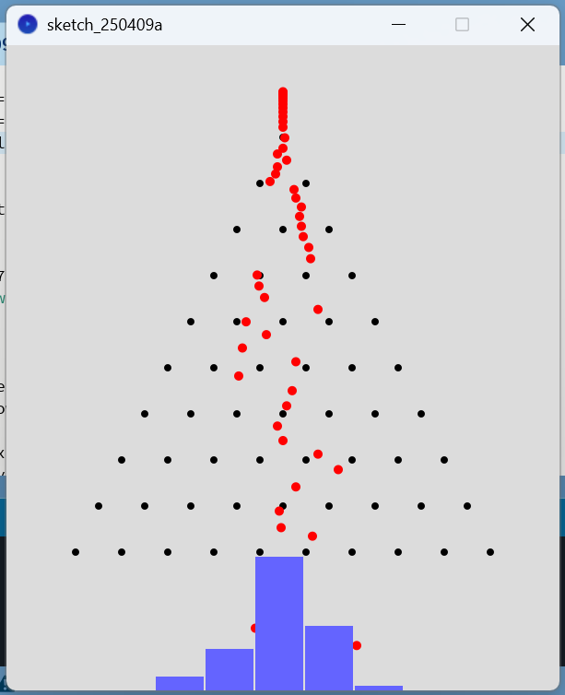
Physics & Collision Detection
Galton Box

Slide 17
Two Sample Games

Slide 18
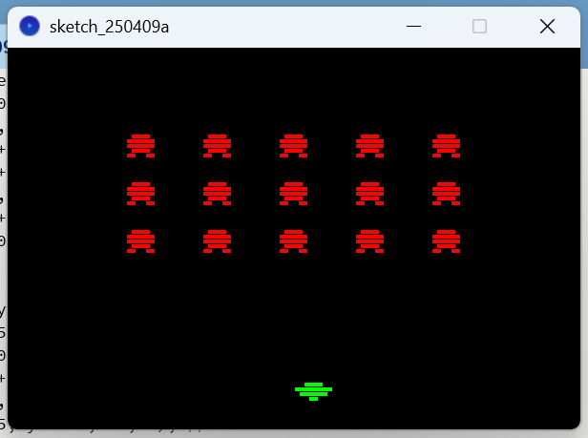
Space Invaders

Slide 19
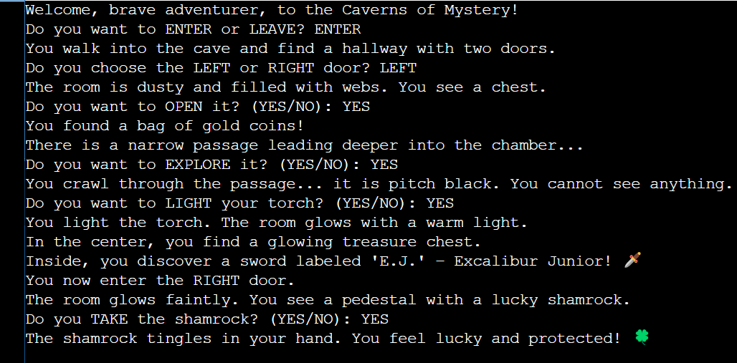
Shamrock Text Adventure

Slide 20
Assignment #2

Slide 21
Assignment #2
It’s Lab #6.

