Slide 1

Creative Coding
Module
Damian Gordon

Slide 2
Contents
Module Overview
Indicative Syllabus
Learning Outcomes
Assessments
Reading List

Slide 3
Module Overview (1 of 2)
This one-semester module is designed for first-year undergraduate students who have a basic understanding of programming, that explores the world of creative coding.
Creative coding is using code, algorithms and maths in a creative and fun way to make art.
The course will use Processing or similar programming environment. Processing currently works with Python, Java and Javascript.

Slide 4
Module Overview (2 of 2)
This module reinforces the skills and knowledge learned on the programming, maths and computational thinking modules.
It also introduces students to the creative potential of computer science through applications in graphics and sound and provides them with a highly motivating domain in which to develop their computer science skills.

Slide 5
Indicative Syllabus (1 of 3)
Drawing functions – co-ordinates, line, ellipse, point, rect, triangle, RGB & HSB colors, animation, setup & draw functions, using the mouse.
Variables & operations, moving objects around the screen, drawing patterns using variables & operations
Trigonometry & the unit circle, drawing spirals

Slide 6
Indicative Syllabus (2 of 3)
Conditions & Boolean operations. Inside & outside of boxes and circles
Drawing with loops. Patterns in shapes and colors
Arrays, min, max, average, iteration and graphing data
Loading CSV files, using an ArrayList

Slide 7
Indicative Syllabus (3 of 3)
Audio, time domain, frequency domain, average amplitude. Mapping audio to colors and shapes
Particle Systems – Classes, snow, fireworks
Cellular automata. The Game of Life

Slide 8
Learning Outcomes (1 of 4)
1. Exhibit mastery in programming, particularly in the context of creative coding, and leverage this expertise in other programming languages and domains.
2. Use and manipulate data in various formats including images, sound and video.

Slide 9
Learning Outcomes (2 of 4)
3. Apply software development best practices, including code documentation, version control, and peer review, ensuring readiness for roles in software development and related fields.
4. Exhibit strong debugging and troubleshooting skills, allowing them to identify and resolve issues in code efficiently.

Slide 10
Learning Outcomes (3 of 4)
5. Integrate computer science concepts into diverse domains, including art, design, and mathematics, making them adept at applying programming skills in real-world scenarios across different fields.
6. Cultivate adaptability and a commitment to lifelong learning, ensuring they remain competitive and versatile throughout their careers in computer science and programming

Slide 11
Learning Outcomes (4 of 4)
7. Apply creative thinking and innovative approaches to problem-solving, demonstrating the capacity to devise unique and imaginative solutions to real world challenges using computer science.
8. Collaborate effectively within a team, showcasing strong interpersonal and communication skills, and demonstrating the ability to contribute positively to group projects. Engage with creative and opensource communities

Slide 12
Assessments
Module is 100% CA, no exam.

Slide 13
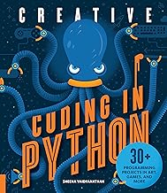
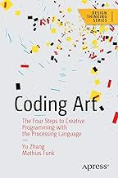
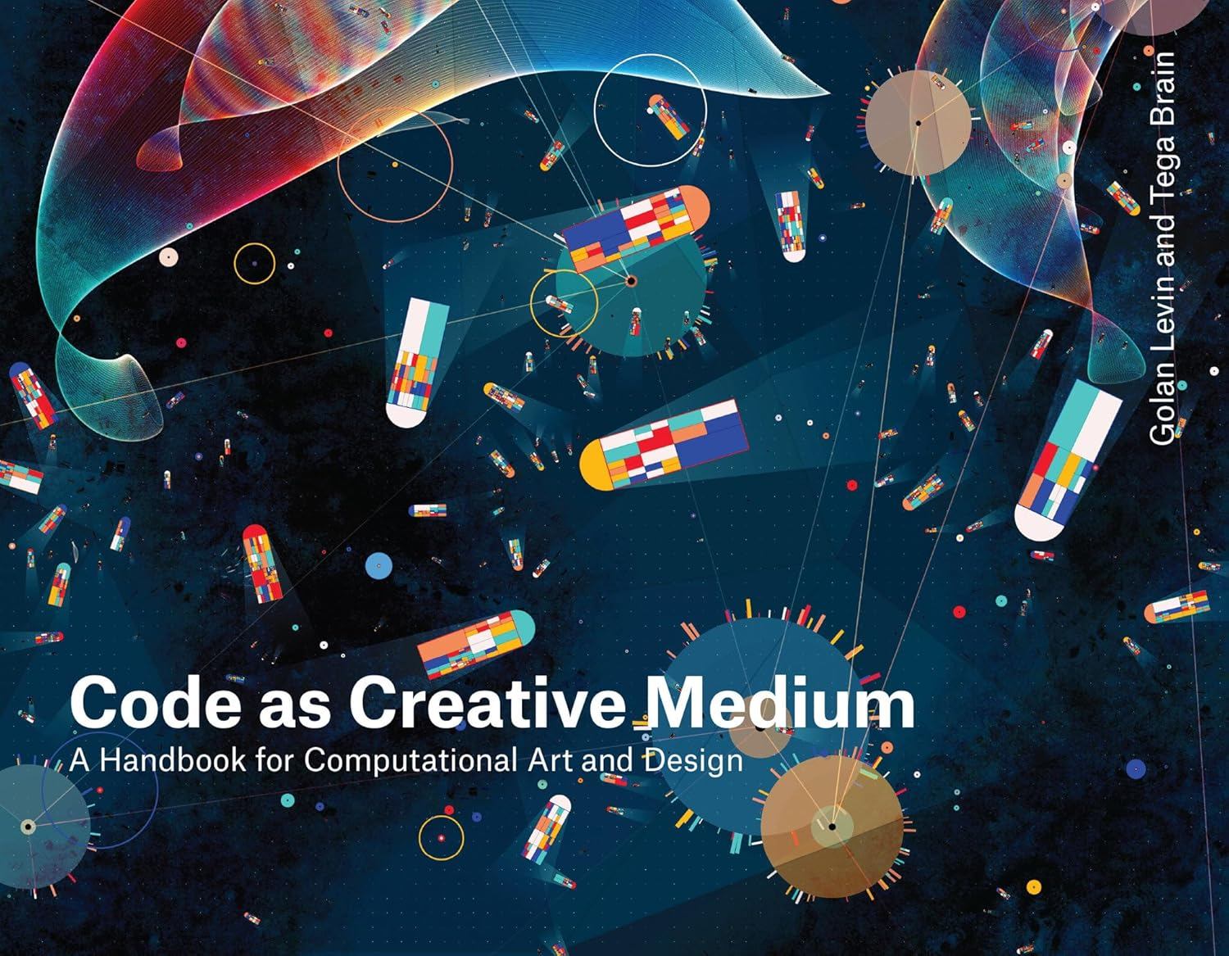
Reading List

