Slide 1
CPD in Applied Blended Learning Technologies
Instructional Design Models
Damian Gordon
To Design, Develop, and Evaluate Quality Blended Learning

Slide 2
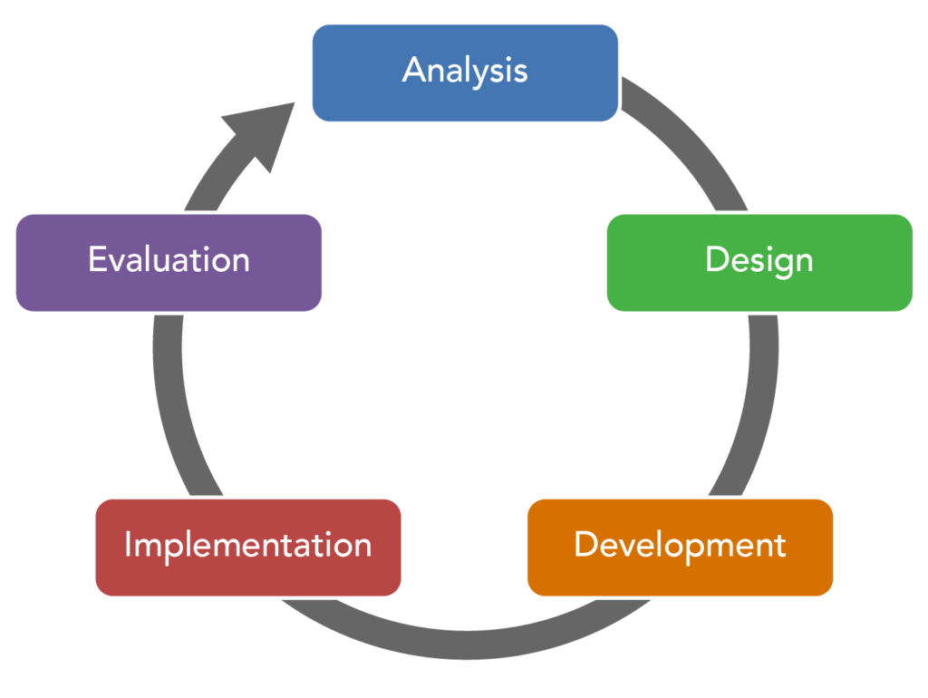
ADDIE Model
To Design, Develop, and Evaluate Quality Blended Learning

Slide 3
ADDIE Model
The ADDIE model is used by instructional designers and training developers. It is composed of five phases:
Analysis,
Design,
Development,
Implementation, and
Evaluation
To Design, Develop, and Evaluate Quality Blended Learning

Slide 4
ADDIE Model
This represents a dynamic, flexible model for building effective training and performance support tools.
This model attempts to save time by catching problems while they are still easy to fix.
To Design, Develop, and Evaluate Quality Blended Learning

Slide 5
ADDIE Model
In the Analysis stage we want to find out:
Who are the learners or audience?
(Audience analysis)
What is the goal or intended outcome?
(Goal analysis)
To Design, Develop, and Evaluate Quality Blended Learning

Slide 6
ADDIE Model
In the Design stage we are exploring:
The content of the course
(Subject matter analysis)
The steps of instruction
(Lesson planning-writing objectives)
The type of media or presentation mode
(Media selection)
To Design, Develop, and Evaluate Quality Blended Learning

Slide 7
ADDIE Model
In the Development stage we are:
Generating lesson plans (this is different from the lesson planning done in the Design phase) and lesson materials.
Completing all media and materials for instruction, as well as completing all of the supporting documents.
The end-result is a course or workshop ready for delivery.
To Design, Develop, and Evaluate Quality Blended Learning

Slide 8
ADDIE Model
In the Implementation stage we are:
Delivering of the instruction.
Aiming for effective and efficient delivery of instruction.
Promoting students’ understanding of materials and objectives, as well as ensuring a transfer of knowledge.
To Design, Develop, and Evaluate Quality Blended Learning

Slide 9
ADDIE Model
In the Evaluation stage we are:
Undertaking two related evaluations:
Formative Evaluation
Summative Evaluation
To Design, Develop, and Evaluate Quality Blended Learning

Slide 10
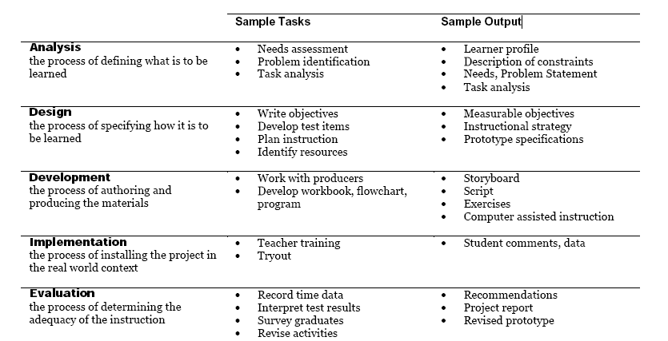
ADDIE Model
To Design, Develop, and Evaluate Quality Blended Learning

Slide 11
ADDIE Model
Remarkably it appears that the ADDIE model wasn’t specifically developed by any single author but rather to have evolved informally through oral tradition.
The ADDIE Model is merely a colloquial term used to describe a systematic approach to instructional development.
To Design, Develop, and Evaluate Quality Blended Learning

Slide 12
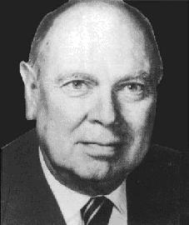
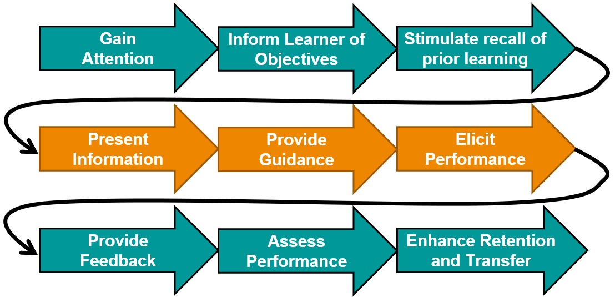
Gagné’s Nine Events of Instruction
To Design, Develop, and Evaluate Quality Blended Learning

Slide 13
Gagné’s Nine Events of Instruction
Robert M. Gagné developed a nine-step model to help people design lessons.
To Design, Develop, and Evaluate Quality Blended Learning

Slide 14
Robert Mills Gagné
Born in Aug 21, 1916
Died in April 28, 2002
Born in in North Andover, Massachusetts
educational psychologist
best known for his “Conditions of Learning” involved in applying instructional theory to the design of computer-based learning.
To Design, Develop, and Evaluate Quality Blended Learning

Slide 15
Gagné’s Nine Events of Instruction
If you have lectured for a while, you probably do most of these, and you found them out by trial and error.
To Design, Develop, and Evaluate Quality Blended Learning

Slide 16
Gagné’s Nine Events of Instruction
Gain
Attention
Inform Learner of Objectives
Stimulate recall of prior learning

Slide 17
Gagné’s Nine Events of Instruction
Gain
Attention
Inform Learner of Objectives
Stimulate recall of prior learning
Present Information
Provide
Guidance
Elicit Performance

Slide 18
Gagné’s Nine Events of Instruction
Gain
Attention
Inform Learner of Objectives
Stimulate recall of prior learning
Present Information
Provide
Guidance
Elicit Performance
Provide
Feedback
Assess
Performance
Enhance Retention
and Transfer

Slide 19
1. Gain the Students’ Attention
Curiosity motivates students to learn.
Silence
A joke
A magic trick
Music video / Clip of a film
A quote
To Design, Develop, and Evaluate Quality Blended Learning

Slide 21
2. Inform Learners of Objectives
These objectives should form the basis for assessment.
List the learning goals
Tell a simple story
Mention that this lesson might be coming up in a future assessment or the exam
To Design, Develop, and Evaluate Quality Blended Learning

Slide 22
3. Stimulate Recall of Prior Learning
Associating new information with prior knowledge can facilitate the learning process.
Something we covered in the last class
Something they covered in another module
Something they did in secondary school
To Design, Develop, and Evaluate Quality Blended Learning

Slide 23
4. Present the Content
This event of instruction is where the new content is actually presented to the learner.
Start with an example? (T/E or E/T)
Include specific notation? Include specific diagrams?
Explain the theory as well as the details?
Can we find content or videos of great lecturers
To Design, Develop, and Evaluate Quality Blended Learning

Slide 24
5. Provide “Learning Guidance”
Use of examples, non-examples, case studies, graphical representations, mnemonics, and analogies.
Links
Videos
Animations
Biographies
To Design, Develop, and Evaluate Quality Blended Learning

Slide 25
6. Elicit Performance (Practice)
Eliciting performance provides an opportunity for learners to confirm their correct understanding, and the repetition further increases the likelihood of retention.
Active Learning: Three things we’ve covered
Active Learning: Write a one-minute essay
Active Learning: Do a quiz
Tweet or Google
To Design, Develop, and Evaluate Quality Blended Learning

Slide 26
7. Provide Feedback
Give guidance and answers provided at this stage are called formative feedback.
Two stars and a wish (sandwich method)
I like that you and I would have liked if you.
I like that you… | I would have liked if you …
Sdcaclkmecioenc | Ecqeqecckmoim
Ecomeocimqeoicqio | Oiemcqoeimcqoe
Ecomqeocinqnece | oemcqoeimcoqeimcq
To Design, Develop, and Evaluate Quality Blended Learning

Slide 27
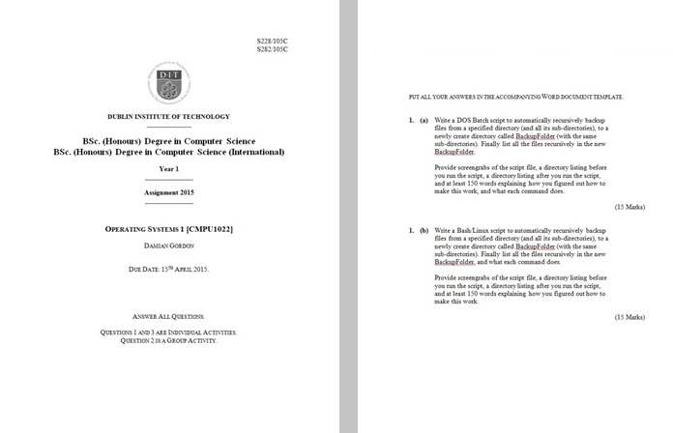
8. Assess Performance
Take a final assessment.
To Design, Develop, and Evaluate Quality Blended Learning

Slide 28
9. Enhance Retention (and transfer to the job)
Effective education will have a "performance" focus.
Summarize what we did…
Give any final instructions…
To Design, Develop, and Evaluate Quality Blended Learning

Slide 29
Also…
I usually write four versions of my lectures:
Version 1, first complete version
Version 2, is there any part that can be taken out (and maybe developed into a separate lecture? Or just removed)
Version 3, bring balance to all sections (harmony)
Version 4, add in some jokes
To Design, Develop, and Evaluate Quality Blended Learning

Slide 30
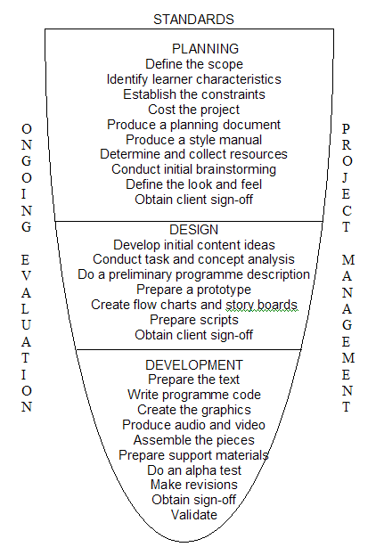
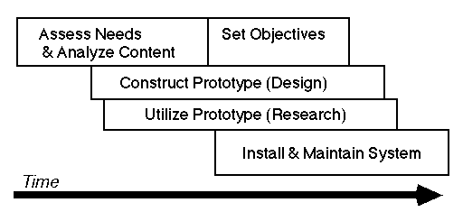
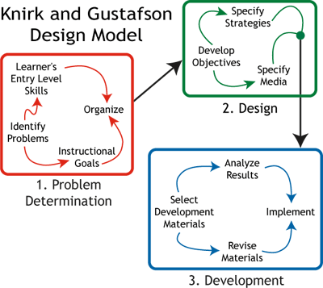
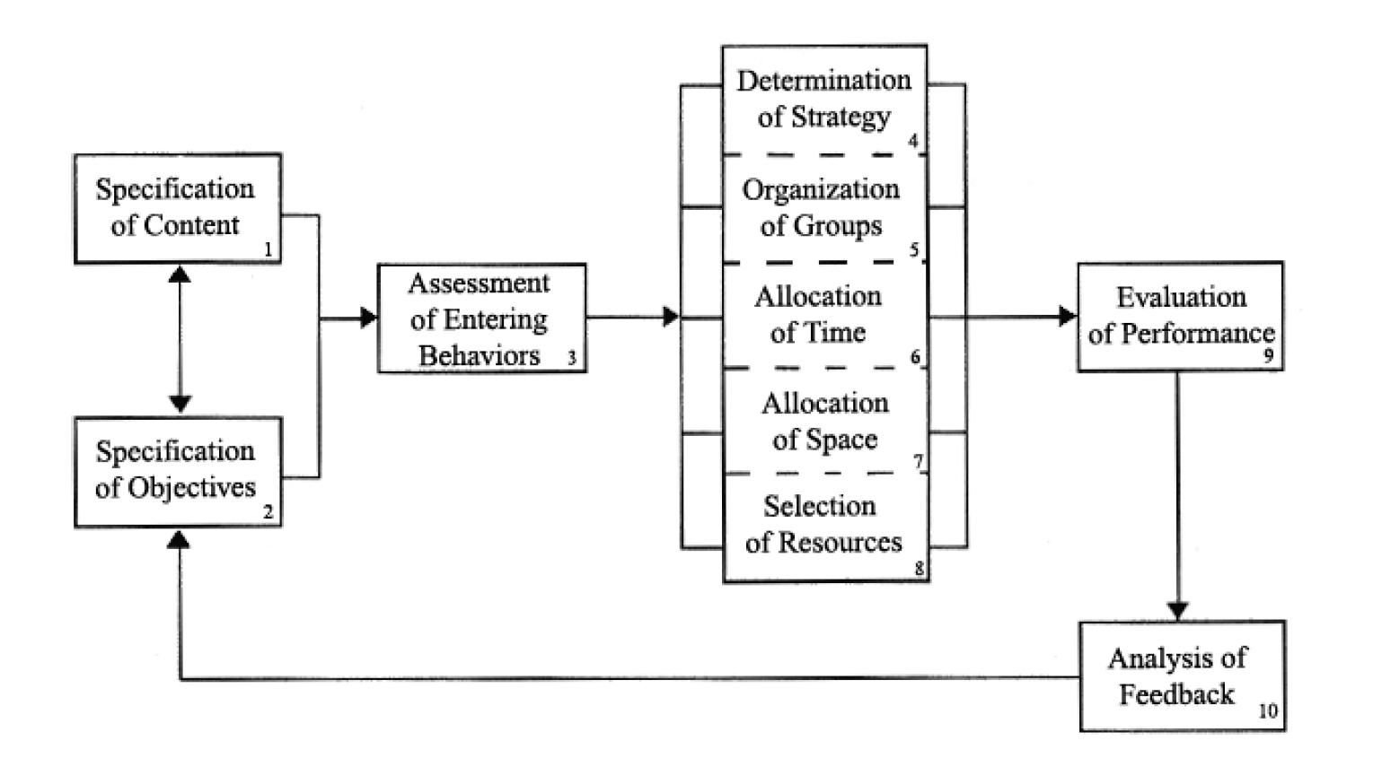
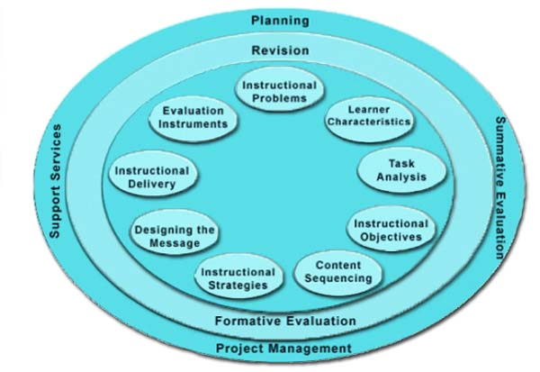
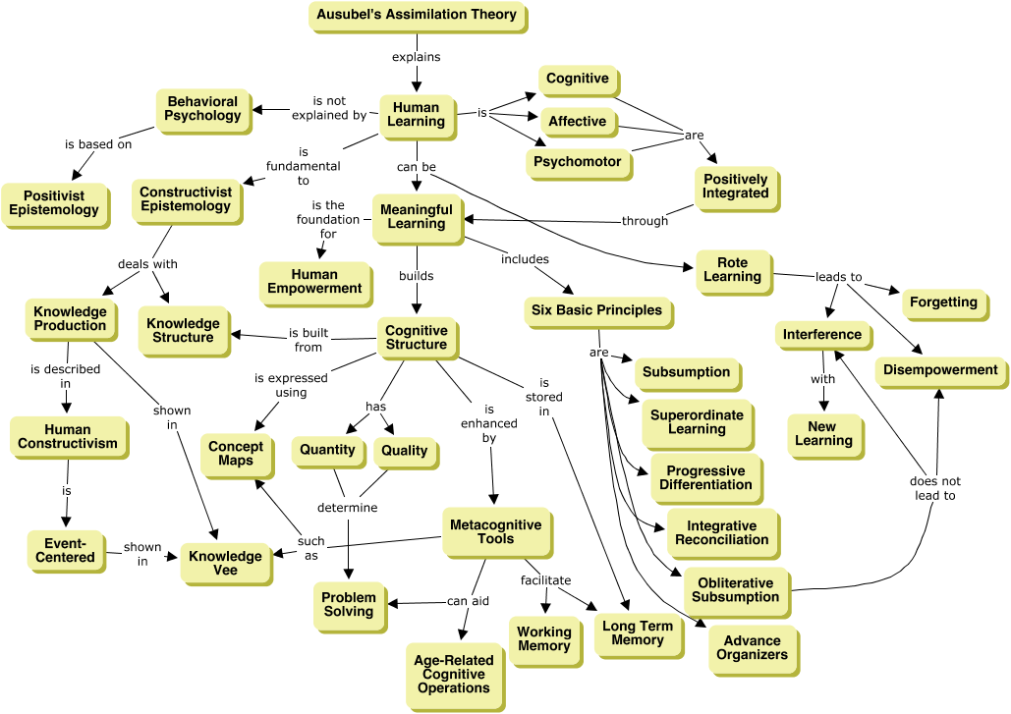
Other Models
ASSURE Model
Dick and Carey Model
Tripp and Bichelmeyer Model
Alessi and Trollip Model
Hannafin & Peck Model
Knirk & Gustafson Model
Jerrold Kemp Model
Gerlach-Ely Model
Ausubel’s Assimilation Theory
Instructional Design and e-Authoring

Slide 31
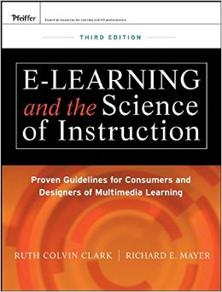
Other Models
Elaboration Model
Component Display Theory
ICARE model
Science of Instruction
Six Thinking Hats Model
Learning by teaching
Problem-based learning
Project-based learning
Inquiry-based learning
Action learning
Progressive inquiry
Service-learning
To Design, Develop, and Evaluate Quality Blended Learning

