Slide 1
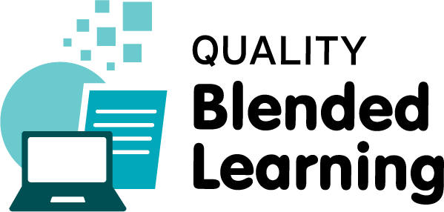
CPD in Applied Blended Learning Technologies
Creative Commons
Damian Gordon
Lecturer in Computer Science
To Design, Develop, and Evaluate Quality Blended Learning

Slide 2

Creative Commons
To Design, Develop, and Evaluate Quality Blended Learning

Slide 3
Creative Commons
To help avoid copyright pitfalls an American non-profit organization called Creative Commons (CC) was set up in 2001 by Harvard scholar Lawrence Lessig to expand “the range of creative works available for others to build upon legally and to share”.
To Design, Develop, and Evaluate Quality Blended Learning

Slide 4
Creative Commons
To achieve this the organisation have created a number of standard, free legal permissions (called Creative Commons licenses) that describe which rights the creator wants to reserve and which they are willing to waive for the benefit of other creators.
To Design, Develop, and Evaluate Quality Blended Learning

Slide 5
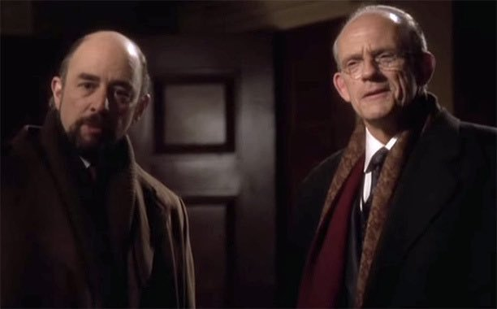

Slide 6
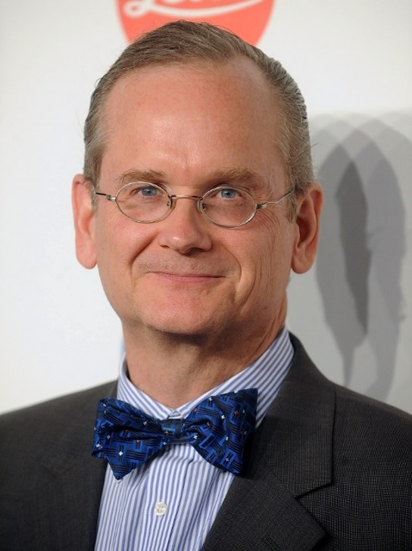

Slide 7
Creative Commons
Creative Commons licenses are not designed to replace copyright, but they can replace individual negotiations for specific rights between copyright owner and licensees, which are necessary under an "all rights reserved" copyright management. By 2015 over one billion works were licensed under the various Creative Commons licenses.
To Design, Develop, and Evaluate Quality Blended Learning

Slide 8
Creative Commons
Organisations like Google Images, flickr, YouTube, vimeo, SoundCloud, and Wikipedia use Creative Commons licenses, so when you upload content to them, you are asked which licence you wish to attach to that content. A useful website to search for content that has Creative Commons licenses is: https://search.creativecommons.org
To Design, Develop, and Evaluate Quality Blended Learning

Slide 9
Creative Commons
Creative Commons (CC) is an American non-profit organization devoted to expanding the range of creative works available for others to build upon legally and to share.
To Design, Develop, and Evaluate Quality Blended Learning

Slide 10
Creative Commons
The organization has released several copyright-licenses known as Creative Commons licenses free of charge to the public. These licenses allow creators to communicate which rights they reserve, and which rights they waive for the benefit of recipients or other creators. An easy-to-understand one-page explanation of rights, with associated visual symbols, explains the specifics of each Creative Commons license.
To Design, Develop, and Evaluate Quality Blended Learning

Slide 11
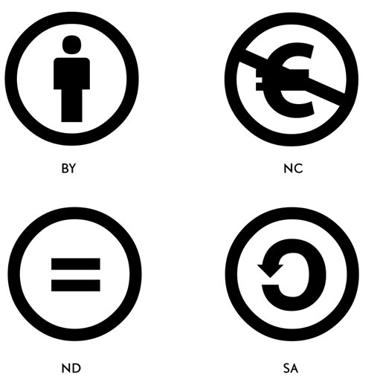
Creative Commons: licence elements
To Design, Develop, and Evaluate Quality Blended Learning

Slide 12

Creative Commons: licence elements
ATTRIBUTION
This means that others must credit you as the original creator of the work. All Creative Commons licences require users to provide attribution.
To Design, Develop, and Evaluate Quality Blended Learning

Slide 13

Creative Commons: licence elements
NON-COMMERCIAL
This means that others may not share, adapt or reuse use your work if their use is primarily intended for commercial advantage or monetary compensation.
To Design, Develop, and Evaluate Quality Blended Learning

Slide 14

Creative Commons: licence elements
NODERIVATIVES
This means that others can share your work, but they must not change it. Note that users still have the range of Fair Dealing rights granted to them under the Copyright Act 1994.
To Design, Develop, and Evaluate Quality Blended Learning

Slide 15

Creative Commons: licence elements
SHAREALIKE
This means that those who adapt or remix your work must use the same Creative Commons licence on any derivative works.
To Design, Develop, and Evaluate Quality Blended Learning

Slide 16

Creative Commons: licences
ATTRIBUTION
This licence lets others distribute, remix, tweak, and build upon your work, even commercially, as long as they credit you for the original creation.
To Design, Develop, and Evaluate Quality Blended Learning

Slide 17

Creative Commons: licences
ATTRIBUTION-NONCOMMERCIAL
This licence lets others remix, tweak, and build upon your work non-commercially with credit to you (their new works must also be non-commercial).
To Design, Develop, and Evaluate Quality Blended Learning

Slide 18

Creative Commons: licences
ATTRIBUTION-SHAREALIKE
This licence lets others remix, tweak, and build upon your work even for commercial purposes, as long as they credit you and license their new creations under the identical terms.
To Design, Develop, and Evaluate Quality Blended Learning

Slide 19

Creative Commons: licences
ATTRIBUTION-NONCOMMERCIAL-SHAREALIKE
This licence lets others remix, tweak, and build upon your work non-commercially, as long as they credit you and license their new creations under the identical terms.
To Design, Develop, and Evaluate Quality Blended Learning

Slide 20

Creative Commons: licences
ATTRIBUTION-NO DERIVATIVES
This licence allows for redistribution, commercial and non-commercial, as long as it is passed along unchanged and in whole, with credit to you.
To Design, Develop, and Evaluate Quality Blended Learning

Slide 21

Creative Commons: licences
ATTRIBUTION-NONCOMMERCIAL-NO DERIVATIVES
This licence is the most restrictive of our six main licences, only allowing others to download your works and share them with others as long as they credit you, but they can’t change them in any way or use them commercially.
To Design, Develop, and Evaluate Quality Blended Learning

Slide 22
Creative Commons: Sites
Some sites with creative commons sections are:
  Flickr: Flickr is a video and image hosting site.
  Google: Google text search.
  Google Images: Google image search.
  Jamendo: Jamendo is a music hosting site.
  Wikimedia Commons: includes text, images, audio and video.
To Design, Develop, and Evaluate Quality Blended Learning

Slide 23
Creative Commons: Sites
Some sites with creative commons sections are:
  YouTube: YouTube is a video hosting site.
  Pixabay: Pixabay is image and video hosting site.
  ccMixter: ccMixter is a music hosting site.
  SoundCloud: SoundCloud is a music hosting site.
To Design, Develop, and Evaluate Quality Blended Learning

Slide 24
Creative Commons: Sites
Some of these sites have direct links including:
Google Images
SoundCloud
YouTube
Flickr
To Design, Develop, and Evaluate Quality Blended Learning

Slide 25
Creative Commons: Sites
Some creative commons search tools are:
https://search.creativecommons.org
https://labs.tineye.com/multicolr/
To Design, Develop, and Evaluate Quality Blended Learning

Slide 26


