Slide 1
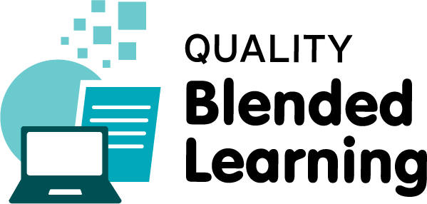
CPD in Applied Blended Learning Technologies
Copyright
Damian Gordon
Lecturer in Computer Science
To Design, Develop, and Evaluate Quality Blended Learning

Slide 2
Copyright ©
Copyright is a legal right that grants the creator of an original work exclusive rights for its use and distribution.
This is usually only for a limited time. The exclusive rights are not absolute but limited by limitations and exceptions to copyright law, including fair use.
To Design, Develop, and Evaluate Quality Blended Learning

Slide 3
Copyright ©
A major limitation on copyright is that copyright protects only the original expression of ideas, and not the underlying ideas themselves.
To Design, Develop, and Evaluate Quality Blended Learning

Slide 4
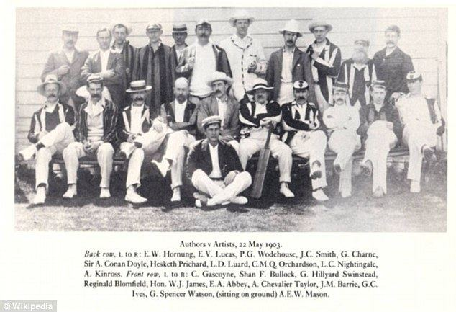

Slide 6
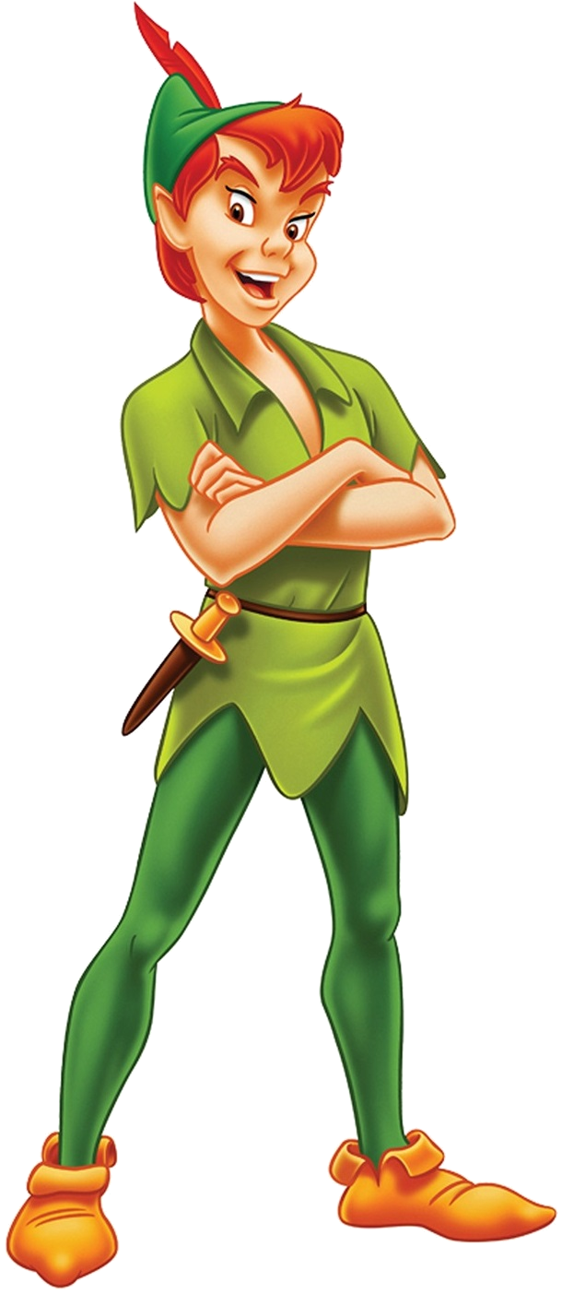

Slide 7


Slide 8
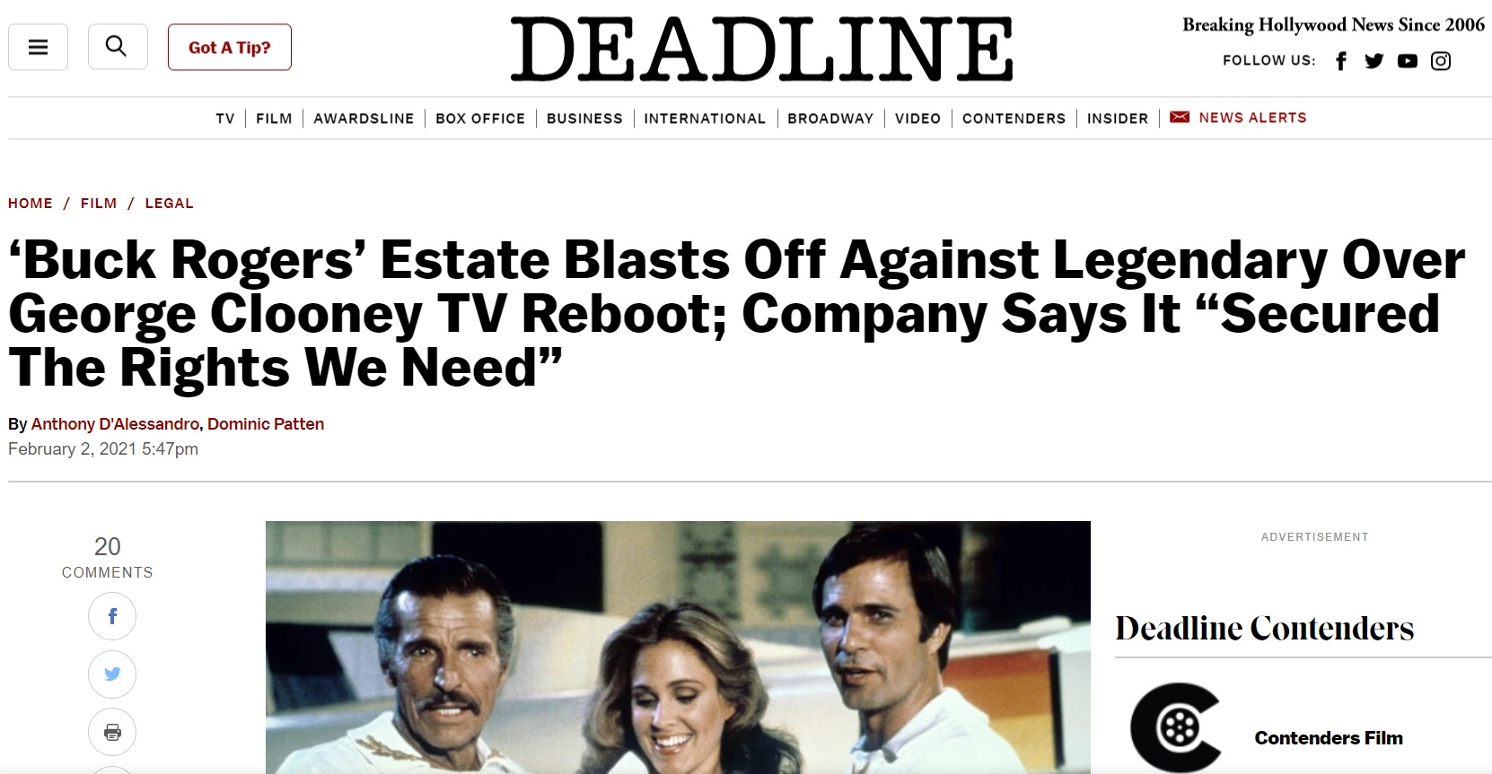
Buck Rogers
Feb 2nd 2021
https://deadline.com/2021/02/buck-rogers-estate-lawsuit-threat-legendary-entertainment-george-clooney-skydance-1234685992/
To Design, Develop, and Evaluate Quality Blended Learning

Slide 9
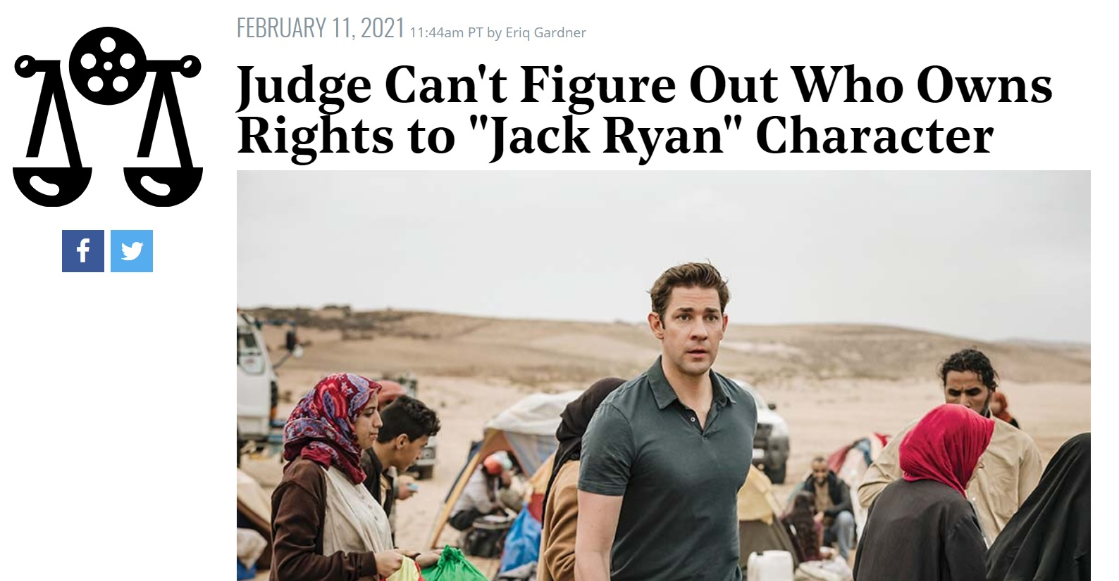
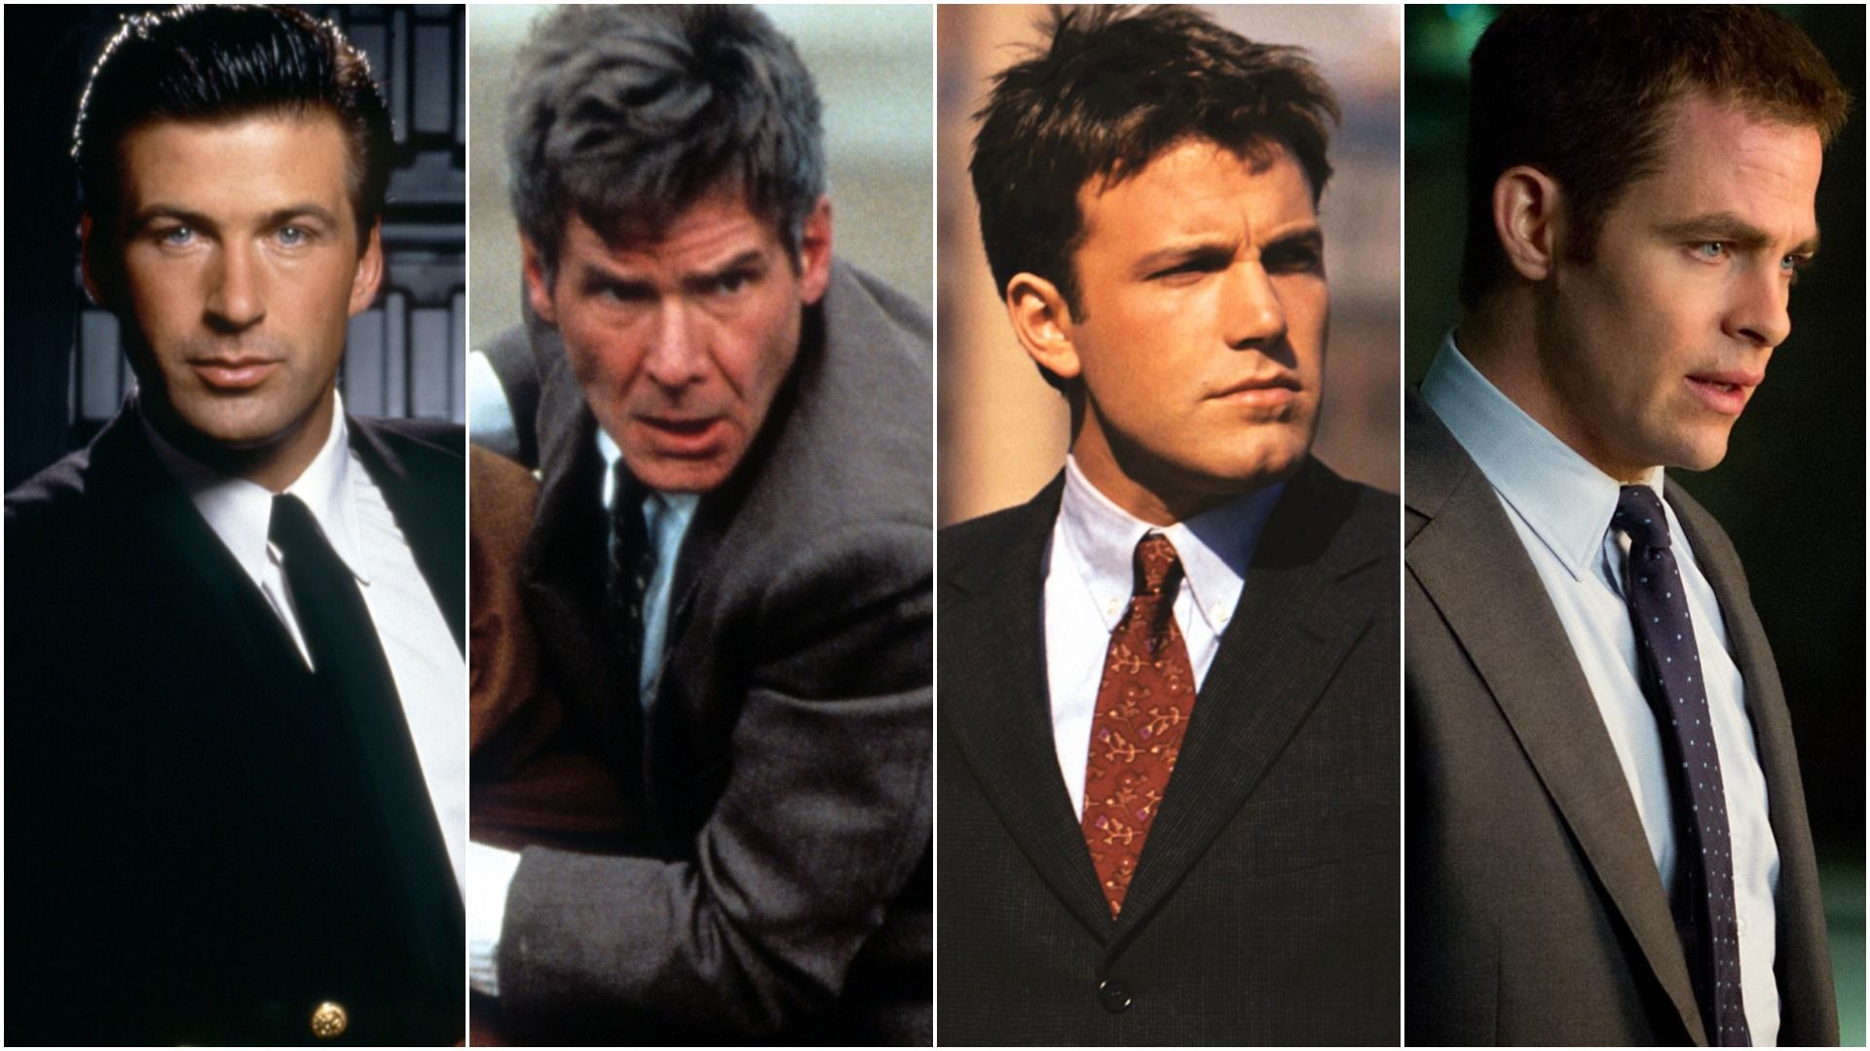
Tom Clancy’s Jack Ryan
Feb 11th 2021
https://www.hollywoodreporter.com/thr-esq/judge-cant-figure-out-who-owns-rights-to-jack-ryan-character
To Design, Develop, and Evaluate Quality Blended Learning

Slide 10
Copyright Law
Usually has educational provisions:
  flexible fair dealing - non-commercial uses for purposes of giving educational instruction
  communications in and to the classroom
  communications of free-to-air broadcasts eg webcasts and podcasts
To Design, Develop, and Evaluate Quality Blended Learning

Slide 11
Copyright Law
There are normally six rules:
Use must be for purposes of giving educational instruction
Use must be non-commercial
Must be a “special case”
Must not conflict with “normal exploitation” of copyright material by copyright owner
Use must not “unreasonably prejudice” copyright owner
Must not remove/disable an Access Technological Protection Measure
To Design, Develop, and Evaluate Quality Blended Learning

Slide 12
Copyright in Ireland
To Design, Develop, and Evaluate Quality Blended Learning

Slide 13
Copyright in Ireland
Generally, applies to works which are:
  Original,
  Literary,
  Dramatic,
  Musical,
  Artistic.
(Section 17(2)(a) CRRA)
To Design, Develop, and Evaluate Quality Blended Learning

Slide 14
Copyright in Ireland
Generally, applies to works which are:
  Original,
  Literary,
  Dramatic,
  Musical,
  Artistic.
(Section 17(2)(a) CRRA)
• Sound recordings, films, broadcast material
• Typographical setting of published works
• Table or compilation
• Computer programs
• Designs for computer programs
• Databases
• Dance, mime works
• Teaching and learning materials
To Design, Develop, and Evaluate Quality Blended Learning

Slide 15
Copyright
Is it OK to show a YouTube video in class?
To Design, Develop, and Evaluate Quality Blended Learning

Slide 16
Copyright
YES
Fair dealing?
Use of the performer’s official channel
Quoting from a work?
Would be better if I acknowledged the author, copyright holder, source of work
NO
If I embedded the video into my slides/content (especially if I make this available online e.g. via webcourses)
If I embed from unapproved channel
If I extracted clips from the video and circulated them later via email
To Design, Develop, and Evaluate Quality Blended Learning

Slide 17
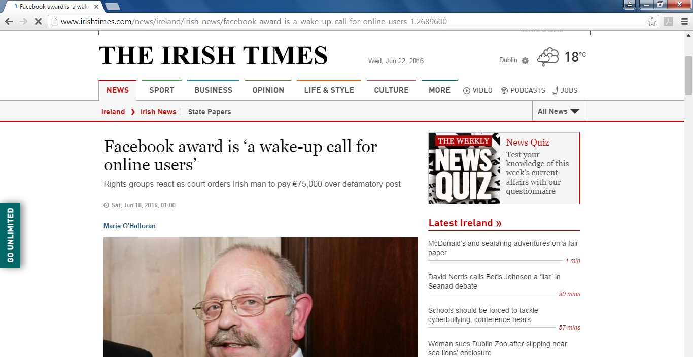
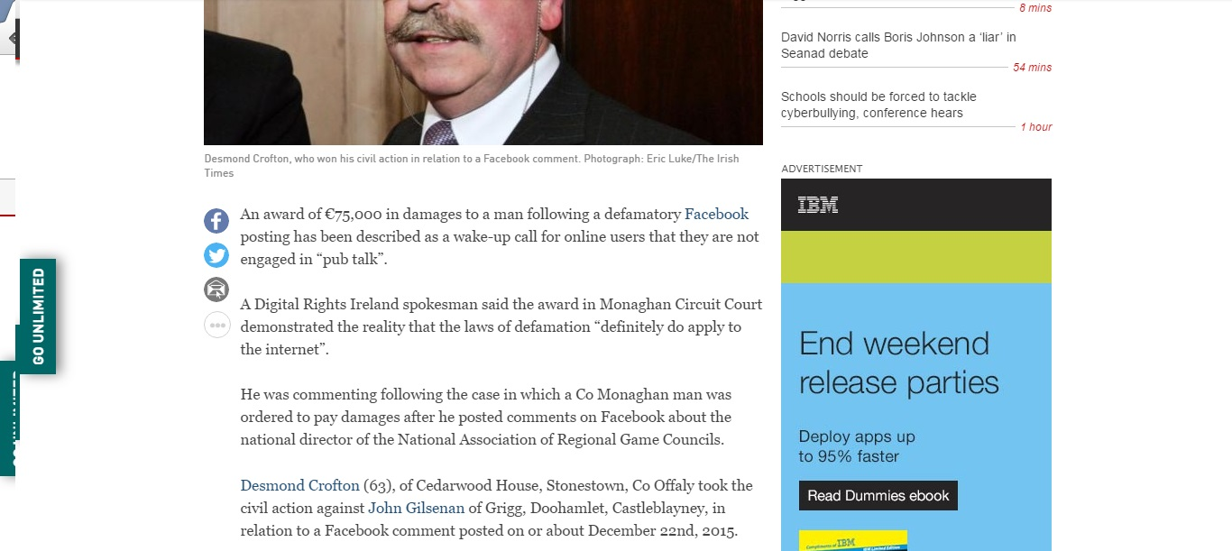

Slide 18

DAMIAN’S TIMES Wed. 6 Jun 2021

Slide 19
DAMIAN’S TIMES Wed. 6 Jun 2021

Slide 20
DAMIAN’S TIMES Wed. 6 Jun 2021

Slide 21
DAMIAN’S TIMES Wed. 6 Jun 2021
http://www.irishtimes.com/news/ireland/irish-news/facebook-award-is-a-wake-up-call-for-online-users-1.2689600

Slide 22
2012: The year Irish newspapers tried to destroy the web
To Design, Develop, and Evaluate Quality Blended Learning

Slide 23


National Newspapers of Ireland /
Newspaper Licensing Ireland
Irish Independent
Irish Examiner
The Irish Time
Irish Daily Star
Evening Herald
The Sunday Independent
Sunday World
The Sunday Business Post
Irish Mail on Sunday
Irish Farmers Journal
Irish Daily Mail
Irish Daily Mirror
Irish Sun
Irish Sunday Mirror
The Sunday Times
Irish Sun Sunday
To Design, Develop, and Evaluate Quality Blended Learning

Slide 24
The Bill
# of Links | Cost
1-5 | €300.00
6-10 | €500.00
11-15 | €700.00
16-25 | €950.00
26-50 | €1,350.00
50+ | Negotiable
To Design, Develop, and Evaluate Quality Blended Learning

Slide 25

The Threat
They told Women’s Aid “a licence is required to link directly to an online article even without uploading any of the content directly onto your own website.”
To Design, Develop, and Evaluate Quality Blended Learning

Slide 26
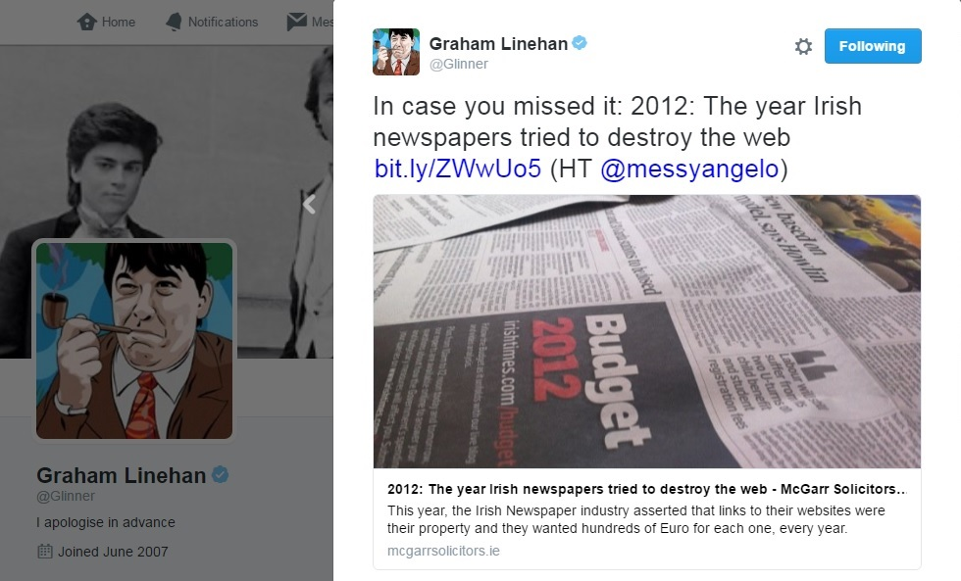
To Design, Develop, and Evaluate Quality Blended Learning

Slide 27
The Coverage
This story was covered:
  in the New York Observer,
  on Techcrunch,
  on Techdirt
  on Broadsheet.ie.
But, apparently, it wasn’t a story that Irish newspapers felt was newsworthy.
To Design, Develop, and Evaluate Quality Blended Learning

Slide 28

The Response
The Copyright Review Committee of the Department of Justice and Equality reply to NLI pointed out that the terms and conditions of the NLI's member newspaper websites in many cases explicitly grant permission to produce weblinks to articles and that some NLI member websites included up to 300 sharing buttons that permit and encourage easy creation of weblinks for use on social media.
To Design, Develop, and Evaluate Quality Blended Learning

Slide 30
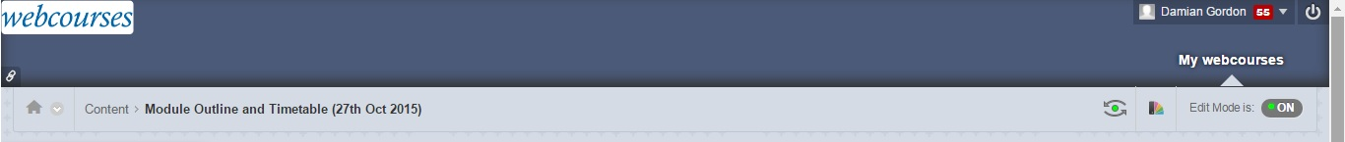
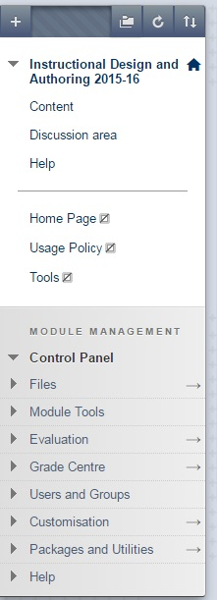

Slide 31
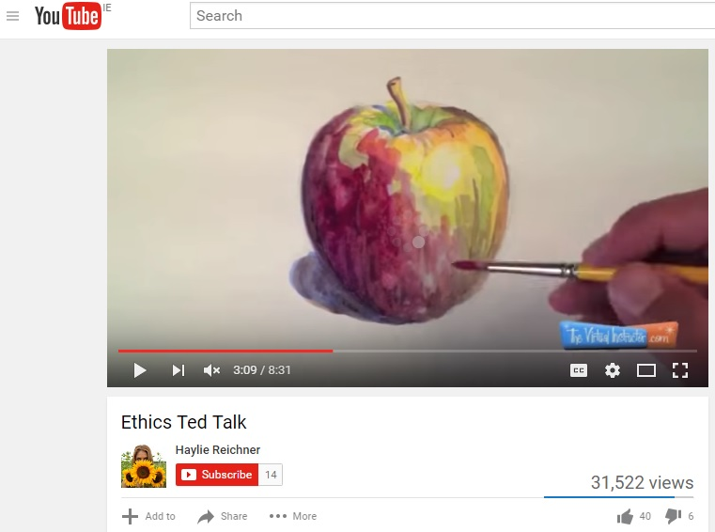

Slide 32


