Slide 1
CPD in Applied Blended Learning Technologies
Evaluation Techniques
Damian Gordon
To Design, Develop, and Evaluate Quality Blended Learning

Slide 2
Evaluation
There are any number of ways of evaluating teaching content, including OER metrics, Rubrics, Financial metrics, Business models, and UX models.
To Design, Develop, and Evaluate Quality Blended Learning

Slide 3
LORI
eLera is a distributed group that researches and evaluates e-learning. Their specific interests include learning objects, e-portfolios, and learning design specifications, and related topics.
To Design, Develop, and Evaluate Quality Blended Learning

Slide 4
LORI
eLera provides tools and information for learning object evaluation and research, maintains a database of learning object reviews, and supports communication and collaboration among researchers, evaluators and users of online learning resources.
To Design, Develop, and Evaluate Quality Blended Learning

Slide 5
LORI
The goals of eLera are to:
improve the quality of online learning resources through better design and evaluation
develop effective pedagogical models that incorporate learning objects
help students, teachers, professors, instructional designers and others to select pedagogical models and digital resources that meet their requirements
To Design, Develop, and Evaluate Quality Blended Learning

Slide 6
LORI
The Learning Object Review Instrument (LORI) is used to evaluate the quality of e-learning resources. LORI is an online form consisting of rubrics, rating scales and comment fields. The current version of LORI available from eLera is version 1.5.
http://www.elera.net/eLera/Home/Articles/LORI%201.5.pdf
To Design, Develop, and Evaluate Quality Blended Learning

Slide 7
LORI
The 9 Dimensions of LORI:
Content Quality
Learning Goal Alignment
Feedback and Adaptation
Motivation
Presentation Design
Interaction Usability
Accessibility
Reusability
Standards Compliance
To Design, Develop, and Evaluate Quality Blended Learning

Slide 8
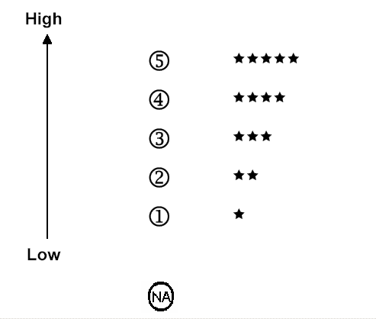
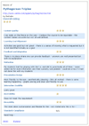
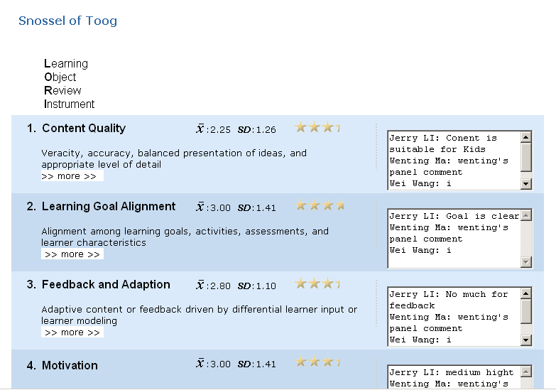
LORI
Diagram here is showing individual reviews merging to a panel review and then published on web.
To Design, Develop, and Evaluate Quality Blended Learning

Slide 9
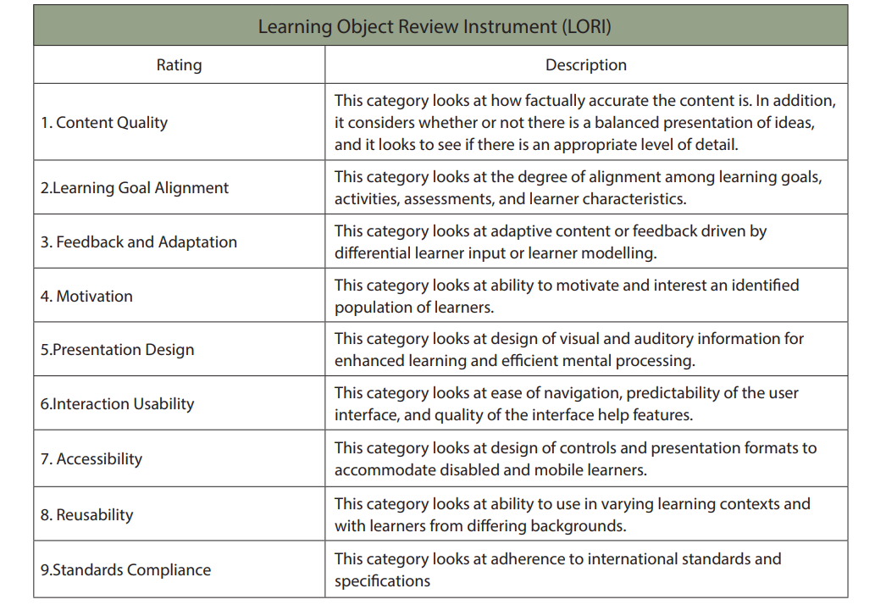

Slide 10
MERLOT
There are three general categories of evaluation standards used within MERLOT:
Quality of Content
Potential Effectiveness as a Teaching-Learning Tool
Ease of Use
To Design, Develop, and Evaluate Quality Blended Learning

Slide 11
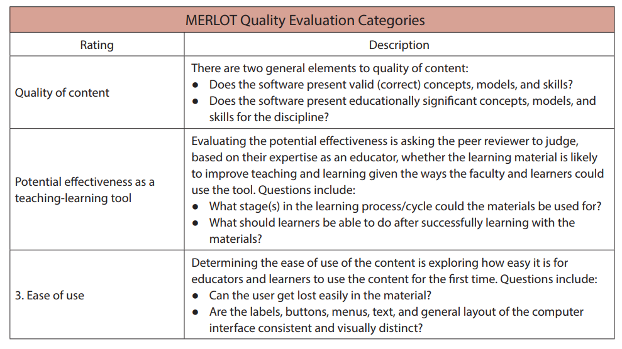

Slide 12
Anstey and Watson Rubric
A Rubric for Evaluating E-Learning Tools in Higher Education Authors: by Lauren Anstey and Gavan Watson
https://er.educause.edu/articles/2018/9/a-rubric-for-evaluating-e-learning-tools-in-higher-education
To Design, Develop, and Evaluate Quality Blended Learning

Slide 13
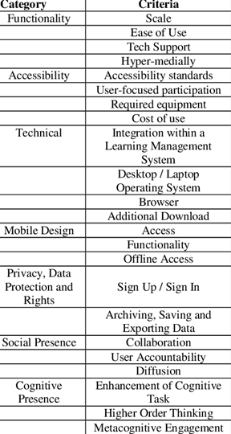
Anstey and Watson Rubric
Functionality
Accessibility
Technical
Mobile Design
Privacy, Data Protection, and Rights
Social Presence
Teaching Presence
Cognitive Presence
To Design, Develop, and Evaluate Quality Blended Learning

Slide 14
SECTIONS
SECTIONS was developed by Anthony Bates, and Gary Poole in their 2003 book “Effective Teaching With Technology In Higher Education”
To Design, Develop, and Evaluate Quality Blended Learning

Slide 15
SECTIONS
Students
Ease of use
Costs
Teaching and learning
Interactivity
Organization
Novelty
Speed
To Design, Develop, and Evaluate Quality Blended Learning

Slide 16
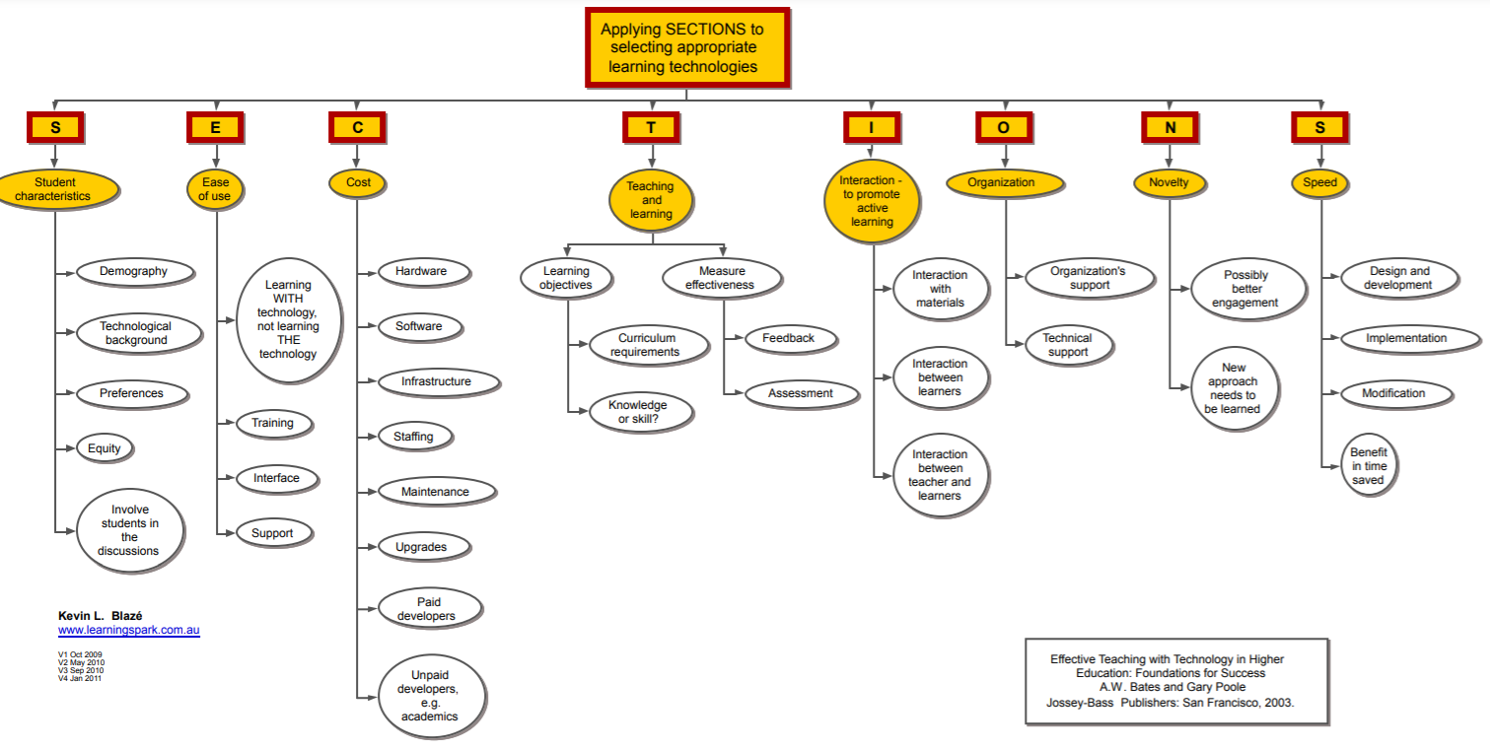
SECTIONS

Slide 17
Gartner Hype Cycle
Gartner, is a global research and advisory firm providing information, advice, and tools for leaders in IT, finance, HR, customer service and support, communications, legal and compliance, marketing, sales, and supply chain functions
To Design, Develop, and Evaluate Quality Blended Learning

Slide 18
Gartner Hype Cycle
Gartner have created the “hype cycle” as graphical presentation to represent the maturity, adoption, and social application of specific technologies.
The hype cycle claims to provide a graphical and conceptual presentation of the maturity of emerging technologies through five phases.
To Design, Develop, and Evaluate Quality Blended Learning

Slide 19
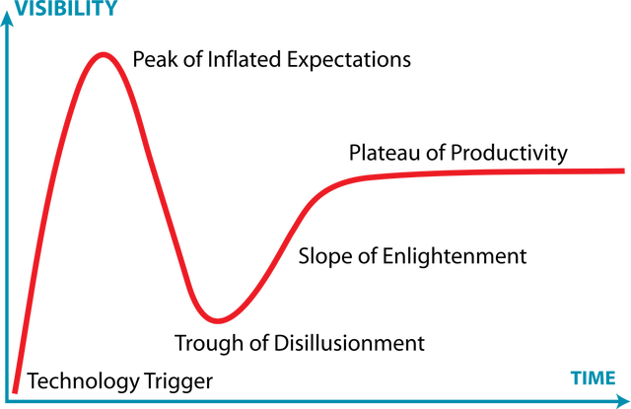
Gartner Hype Cycle
To Design, Develop, and Evaluate Quality Blended Learning

Slide 20
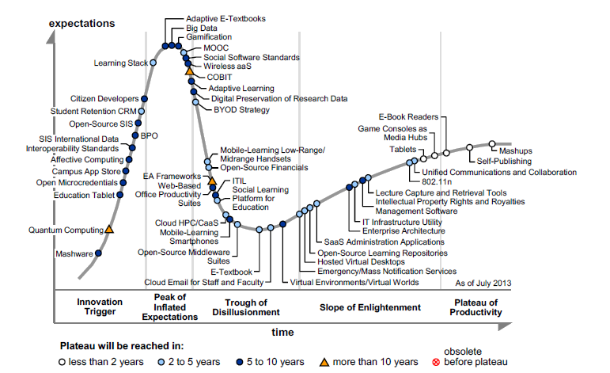

Slide 21
Financial Evaluation
Cost-Benefit Analysis
Cost-Benefit Analysis should really be called Benefit-Cost Analysis, as it describes the ratio between Benefits and Costs.
Cost-Benefit Analysis = Ratio (Benefits : Costs)
To Design, Develop, and Evaluate Quality Blended Learning

Slide 22
Financial Evaluation
Return on Investment
Return on Investment is calculated by first determining the Net Profit (with is Benefits minus Costs), dividing that by the costs, and multiplying the result by 100.
Return on Investment = (Benefits – Costs) * 100
------------------------------------
Costs
To Design, Develop, and Evaluate Quality Blended Learning

Slide 23
Digital Identity
Recognize the elements of a concept
Digital footprint which is all of the information we created online
Digital reputation which is perceptions this information generates in others,
Digital shadow is what other people say/show about us online
Digital tattoo which is the data that is permanently stored online about us.
To Design, Develop, and Evaluate Quality Blended Learning

Slide 24
SWOT Analysis
Developed originally as strategic planning tool for organizations to determine the internal and external factors that might be advantageous and detrimental to their business.
Although the origins of SWOT are elusive, generally it is credited to Albert S. Humphrey working at the Stanford Research Institute in the 1960s and 1970s.
To Design, Develop, and Evaluate Quality Blended Learning

Slide 25
SWOT Analysis
SWOT stands for:
S: Strengths - what is going well in this organisation?
W: Weaknesses - what is not going well in this organization?
O: Opportunities - what external elements are present to improve success?
T: Threats - what external elements are present that might be an impediment?
To Design, Develop, and Evaluate Quality Blended Learning

Slide 26
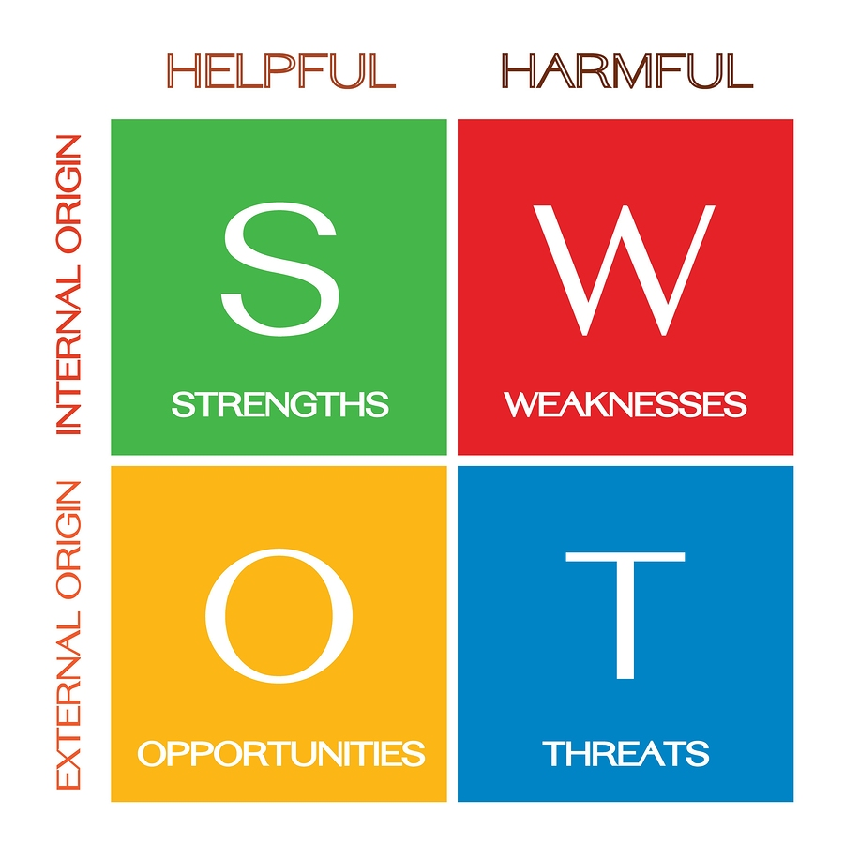
SWOT Analysis
SWOT can be used for any decision making scenario where a clear end goal has been established.
The Strengths and Weaknesses tend to look at the present whereas the Opportunities and Threats focus on the future.
To Design, Develop, and Evaluate Quality Blended Learning

