Slide 1
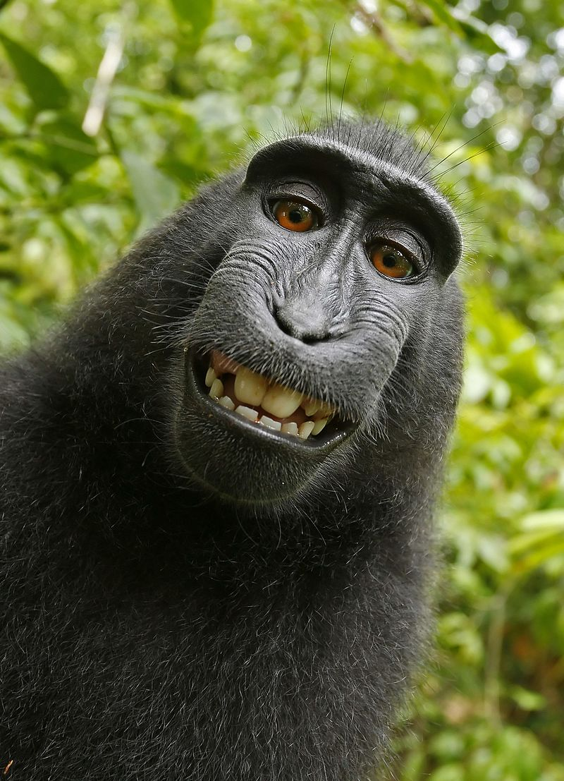

Slide 2
Monkey Selfie Copyright Dispute

Slide 3
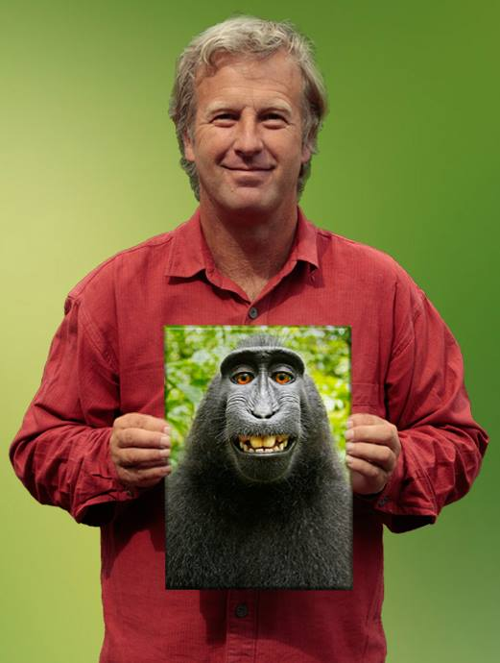
David J. Slater

Slide 4
Monkey selfie copyright dispute
Since 2008, British nature photographer David Slater had travelled to Indonesia to take photographs of the critically endangered Celebes crested macaques.

Slide 5
Monkey selfie copyright dispute
In 2011 he licensed several images to the Caters News Agency who released them, along with a written promotional press release with quotes from Slater, for publication in the British media.

Slide 6
Monkey selfie copyright dispute
On 4 July 2011 several publications including the Daily Mail, The Telegraph, and The Guardian picked up the story and published the pictures along with articles that quoted Slater as describing the photographs as self-portraits taken by the monkeys.

Slide 7
Monkey selfie copyright dispute
On 9 July 2011, an editor on Wikimedia Commons, a site that only accepts media available under a free content license, in the public domain, or otherwise ineligible for copyright, uploaded the selfie photographs from The Daily Mail.
The uploader asserted that the photographs were in the public domain as "the work of a non-human animal, it has no human author in whom copyright is vested".

Slide 8
Monkey selfie copyright dispute
Slater asked Wikimedia Commons to take down the pictures, which they did, but after a lot of internal discussion agreed that the monkey took the picture and they can’t hold copyright.

Slide 9
Monkey selfie copyright dispute
Slater asked Wikimedia Commons to take down the pictures, which they did, but after a lot of internal discussion agreed that the monkey took the picture and they can’t hold copyright.

Slide 10
Monkey selfie copyright dispute
Slater countered by saying "I put my camera on a tripod with a very wide angle lens, settings configured such as predictive autofocus, motorwind, even a flashgun, to give me a chance of a facial close up if they were to approach again for a play ... I had one hand on the tripod when this was going on, but I was being prodded and poked by would be groomers and a few playful juveniles who nibbled at my arms"

Slide 11
Monkey selfie copyright dispute
On 21 August 2014 the United States Copyright Office ruled that the picture can't be copyrighted, ruling that "only works created by a human can be copyrighted under United States law, which excludes photographs and artwork created by animals or by machines without human intervention" and that "Because copyright law is limited to 'original intellectual conceptions of the author,' the [copyright] office will refuse to register a claim if it determines that a human being did not create the work. The Office will not register works produced by nature, animals, or plants."

Slide 12
Monkey selfie copyright dispute
American and British intellectual property lawyers generally agree that because the creator of the photograph is an animal and not a person, there is no copyright on the photograph, regardless of who owns the equipment with which the photograph was create

Slide 13
Monkey selfie copyright dispute
However, British lawyer Serena Tierney stated "If he checked the angle of the shot, set up the equipment to produce a picture with specific light and shade effects, set the exposure or used filters or other special settings, light and that everything required is in the shot, and all the monkey contributed was to press the button, then he would seem to have a passable claim that copyright subsists in the photo in the UK and that he is the author and so first owner."

Slide 14
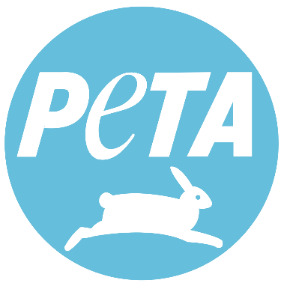
Monkey selfie copyright dispute
The photographs appeared in a book titled "Wildlife Personalities" that Slater had published via Blurb, Inc.
On 22 September 2015, People for the Ethical Treatment of Animals (PETA) filed a lawsuit against Slater and Blurb in the United States District Court for the Northern District of California to request that the monkey, whom they named Naruto, be assigned copyright and that PETA be appointed to administer proceeds from the photos for the benefit of Naruto and other crested macaques in the reserve on Sulawesi.

Slide 15
Monkey selfie copyright dispute
Slater told BBC News that he had suffered financial loss as a result of the pictures being available on Wikimedia Commons, "I made £2,000 [for that picture] in the first year after it was taken. After it went on Wikipedia all interest in buying it went. It's hard to put a figure on it but I reckon I've lost £10,000 or more in income. It's killing my business.“
By July 2017, Slater was reported to be broke and unable to pay his attorney.

Slide 16
Monkey selfie copyright dispute
Slater was unable to travel to the July 2017 court hearing in the United States for lack of funds and said he was considering alternative careers as a dog walker or tennis coach.

