Slide 1

ClassPoint
Turn slides into quizzes and engage your students

Slide 2
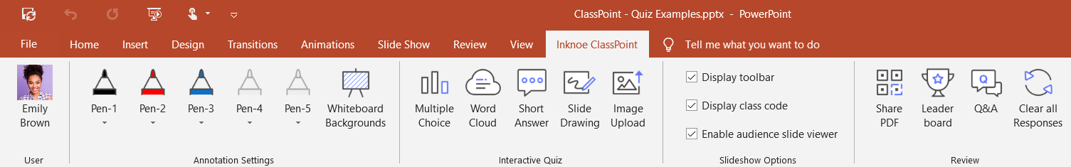
What is ClassPoint
ClassPoint is an interactive teaching add-in for PowerPoint that empowers every educator to teach interactively and build strong live engagement with students.
Notes:
What can CP do
Why we develop CP

Slide 3





The Workflow
1
Design a slide with the question you want to ask
2
Add a question button and set its properties
Multiple Choice
Word Cloud
Short Answer
3
During slide show, click the question button and students will be able to submit their answers
Slide Drawing
Image Upload
4
View student responses live or review them anytime after class, right inside PowerPoint

Slide 4


Example: Multiple Choice
Which of the following are NOT insects?
Ant
Tadpole
Ladybug
Spider
Bee

Slide 5


Example: Word Cloud
What are some of your favourite local food?

Slide 6


Example: Short Answer
How should we slow down global warming?

Slide 7


Example: Slide Drawing
Plot $y={−x}^{2}+3$

Slide 8


Example: Image Upload
Show a real-life example of Triangle

Slide 9
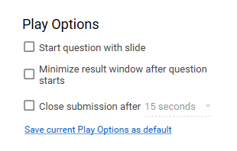
Play Options Explained
Start question with slide
When you navigate to this slide, the question will automatically start
Minimize result window after question starts
After question starts, the submission window will automatically minimize itself so you can go back to the slide
Close submission after a countdown
Create some excitement for your students by closing submission automatically after a countdown

Slide 10
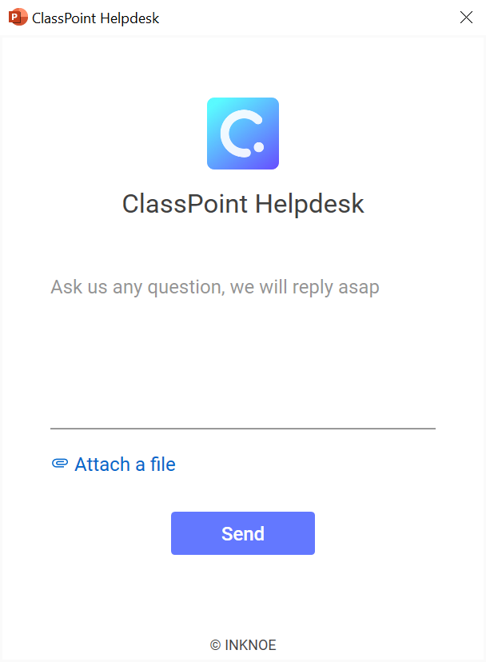
Still have questions?
Contact us and we will get back to you as soon as possible.
Watch our tutorial videos
Message us from in-app Helpdesk from ClassPoint ribbon
Email us at support@inknoe.com
1
2
3
Notes:
In Slide Show mode, select the arrows to visit links.

