Slide 1

Blended Learning International Train the Train (BLITT)
Interactive Slides: Action Buttons
Damian Gordon
Lecturer in Computer Science
To Design, Develop, and Evaluate Quality Blended Learning

Slide 2
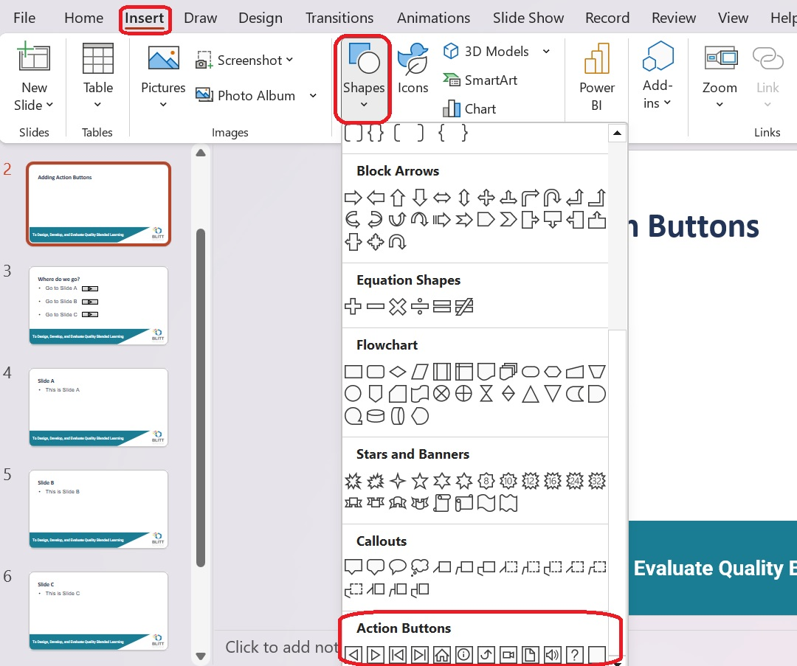
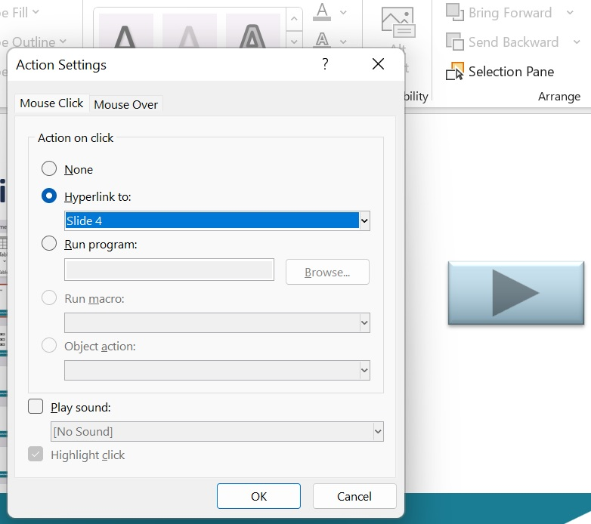
Adding Action Buttons
Who’s presenting?
To Design, Develop, and Evaluate Quality Blended Learning

Slide 3
Where do we go?
Go to Slide A
Go to Slide B
Go to Slide C
Who’s presenting?
To Design, Develop, and Evaluate Quality Blended Learning

Slide 4
Slide A
This is Slide A
Who’s presenting?
To Design, Develop, and Evaluate Quality Blended Learning

Slide 5
Slide B
This is Slide B
Who’s presenting?
To Design, Develop, and Evaluate Quality Blended Learning

Slide 6
Slide C
This is Slide C
Who’s presenting?
To Design, Develop, and Evaluate Quality Blended Learning

Slide 7


