Slide 1

Blended Learning International Train the Train (BLITT)
Learning Styles
Damian Gordon
To Design, Develop, and Evaluate Quality Blended Learning

Slide 2
Learning Styles
Learning depends on a large number of factors, many of which are specific to the individual person.
The individual learning style represents the particular set of strengths and preferences that an individual or group of people have in how they take in and process information
To Design, Develop, and Evaluate Quality Blended Learning

Slide 3
Learning Styles
The most commonly accepted definition is by Keefe (1979) who defines it as "the composite of characteristic cognitive, affective, and physiological factors that serve as relatively stable indicators of how a learner perceives, interacts with, and responds to the learning environment.“
Keefe, J.W. (1979) “Learning Style: An Overview" in NASSP's Student Learning Styles: Diagonosing and Prescribing Programs” (pp. 1-17), Reston, VA: National Association of Secondary Schools.
To Design, Develop, and Evaluate Quality Blended Learning

Slide 4
The VARK Model

Slide 5
The VARK Model
VARK stands for:
  VISUAL – Likes pictures and imagery
  AUDITORY – Likes to listen and speak
  READ/WRITE – Likes to read, and to write
  KINESTHETIC – Likes hands-on activities

Slide 6
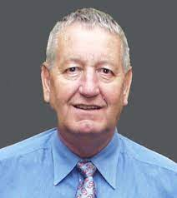
The VARK Model
Neil Fleming
Born: 1940
Born in New Zealand
Died: June 16 2022
Creator of VAK/VARK

Slide 7
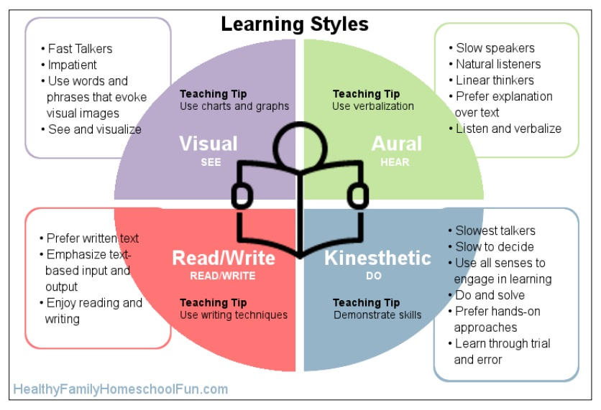

Slide 8
The VARK Model
Take the test here:
https://vark-learn.com/the-vark-questionnaire/
To Design, Develop, and Evaluate Quality Blended Learning

Slide 9
History of Learning Styles

Slide 10
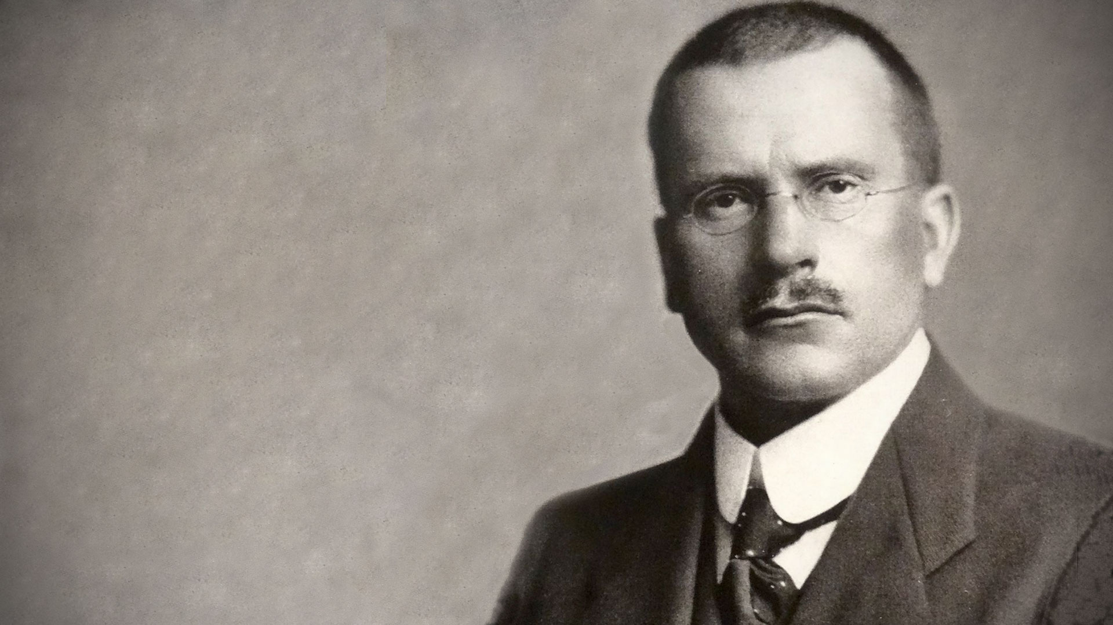
Carl Jung
Born: July 26, 1875,
Born in Kesswil, Switzerland
Died: June 6, 1961
A psychiatrist and psychoanalyst who founded analytical psychology.

Slide 11
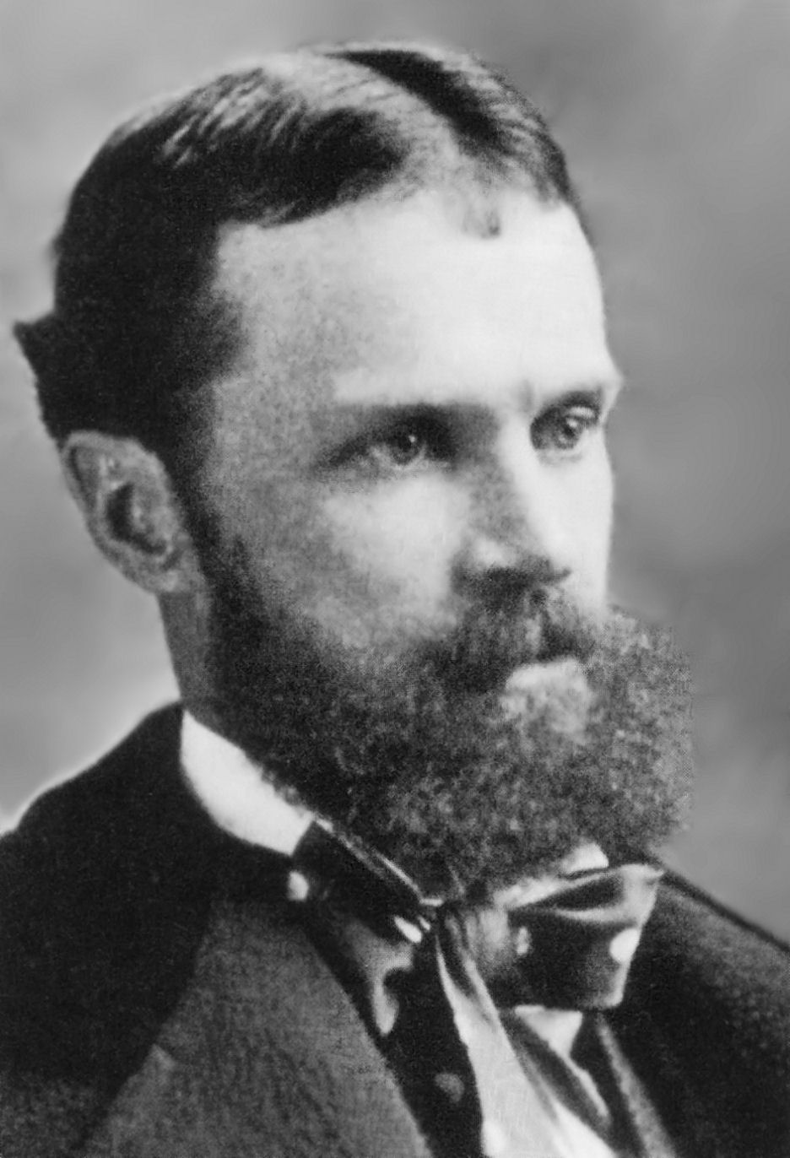
William James
Born: January 11, 1842
Born in New York City
Died: August 26, 1910
A philosopher, historian, psychologist, and educator.

Slide 12

Learning Styles
Based on letters exchanged with William James, Carl Jung developed a theory early in the 20th century to describe basic individual preferences and explain similarities and differences between people.
To Design, Develop, and Evaluate Quality Blended Learning

Slide 13
Learning Styles
Main postulate of the theory is that people have inborn behavioral tendencies and preferences:
  Your natural response in daily situations
  Used when we are generally not stressed and feel competent, and energetic
  Could be defined as those behaviors you often don’t notice
To Design, Develop, and Evaluate Quality Blended Learning

Slide 14

Learning Styles
Environment
Cognitive
Senses
To Design, Develop, and Evaluate Quality Blended Learning

Slide 15
Learning Styles
Environment
Cognitive
Senses
To Design, Develop, and Evaluate Quality Blended Learning

Slide 16
Learning Styles
Environment
Sensing
Cognitive
Senses
Intuiting
To Design, Develop, and Evaluate Quality Blended Learning

Slide 17
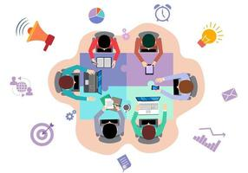
Learning Styles
Environment
Sensing
Cognitive
Senses
Intuiting
To Design, Develop, and Evaluate Quality Blended Learning

Slide 18
Learning Styles
Feeling
Environment
Sensing
Cognitive
Senses
Thinking
Intuiting
To Design, Develop, and Evaluate Quality Blended Learning

Slide 19
The Myers–Briggs Type Indicator

Slide 20
The Myers–Briggs Type Indicator
Isabel Myers and Katherine Briggs (mother-daughter team) expanded on Jung’s work by developing an instrument to help people identify their preferences
To Design, Develop, and Evaluate Quality Blended Learning

Slide 21
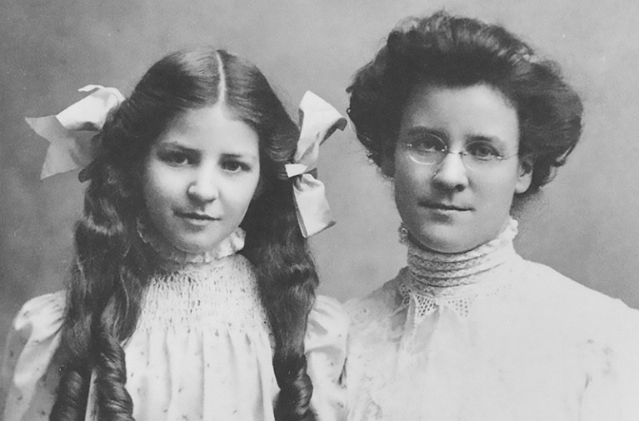

Slide 22
Isabel Briggs Myers
Born: October 18, 1897
Born in Washington
Died: May 5, 1980
Katharine Cook Briggs
Born: January 3, 1875
Born in Pennsylvania
Died: July 10, 1968

Slide 23
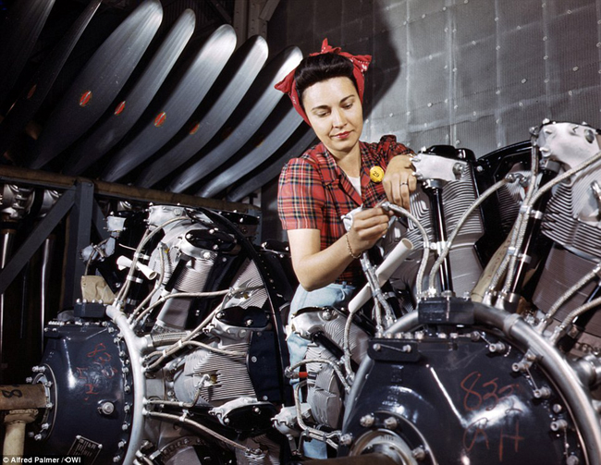
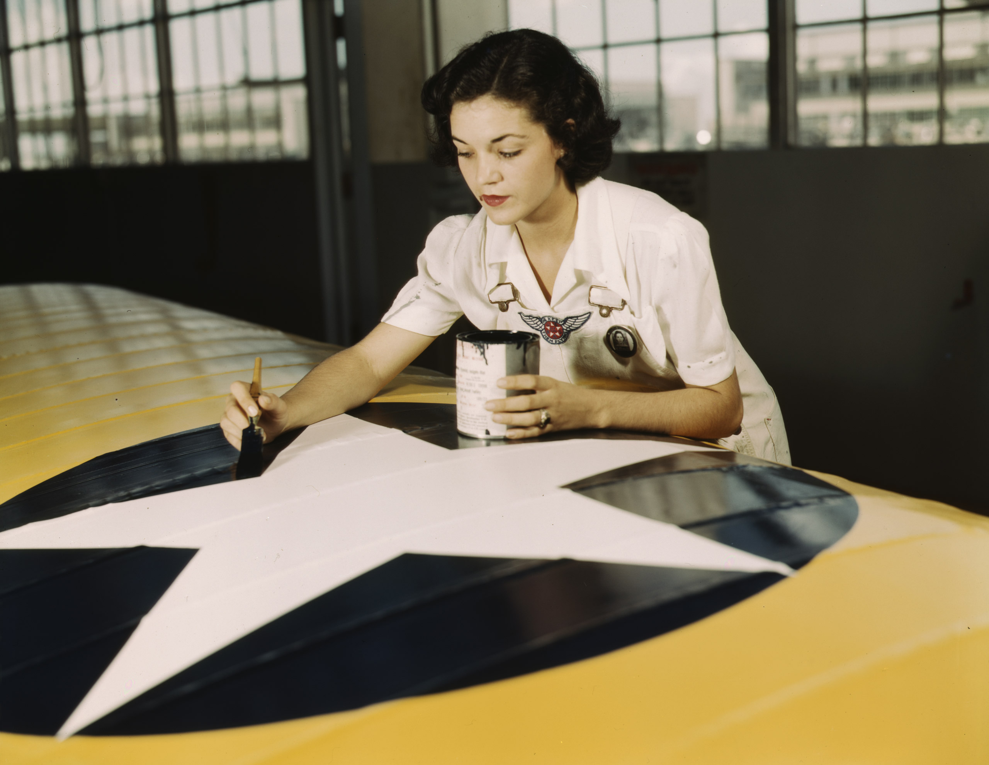
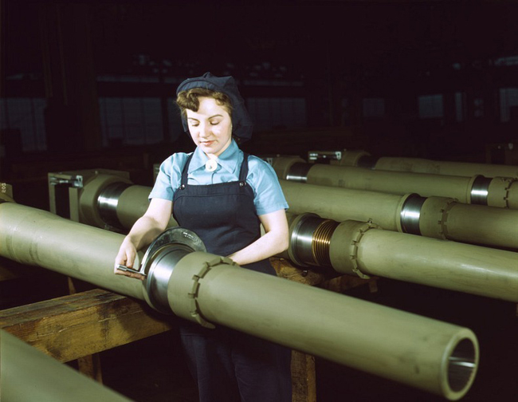
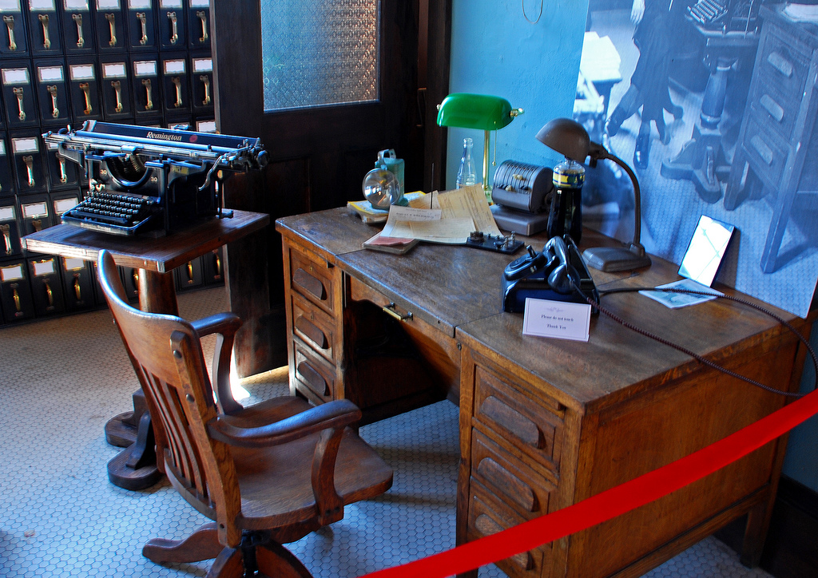

Learning Styles
To Design, Develop, and Evaluate Quality Blended Learning

Slide 24
Learning Styles
JUNG
Feeling
Environment
Sensing
Cognitive
Senses
Thinking
Intuiting
To Design, Develop, and Evaluate Quality Blended Learning

Slide 25
Learning Styles
MBTI
Feeling
Introvert
Judger
Environment
Sensing
Cognitive
Senses
Thinking
Extrovert
Perceiver
Intuiting
To Design, Develop, and Evaluate Quality Blended Learning

Slide 26
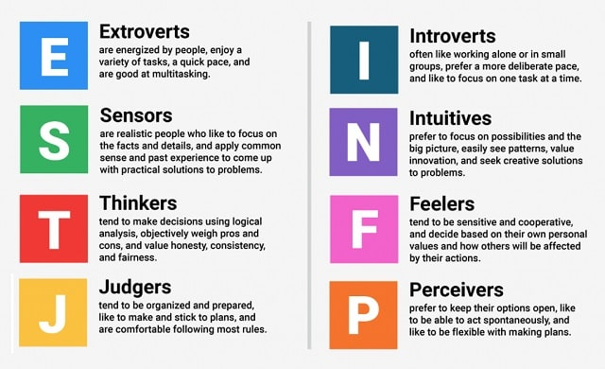
The Myers–Briggs Type Indicator
How we are
energized
How we
gather data
How we make
decisions
How we
approach life

Slide 27
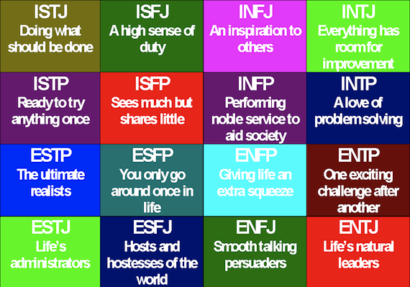
The Myers–Briggs Type Indicator

Slide 28
I
E

Slide 29
S
N
I
E

Slide 30
S
N
J
I
P
E
J

Slide 31
S
N
J
I
P
E
J
T
F
T

Slide 32
ISTJ
Management
Administration
Law enforcement
Accounting
ISFJ
Education
Health care
Religious settings
INFJ
Religion
Counseling
Teaching
Arts
INTJ
Scientific or technical fields
Computers
Law
ISTP
Skilled trades
Technical fields
Agriculture
Law Enforcement
Military
ISFP
Health care
Business
Law enforcement
INFP
Counseling
Writing
Arts
INTP
Scientific or technical fields
ESTP
Marketing
Skilled trades
Business
Law enforcement
Applied technology
ESFP
Health care
Teaching
Coaching
Childcare worker
Skilled trades
ENFP
Counseling
Teaching
Religion
Arts
ENTP
Science
Management
Technology
Arts
ESTJ
Management
Administration
Law enforcement
ESFJ
Education
Health care
Religion
ENFJ
Religion
Arts
Teaching
ENTJ
Management
Leadership

Slide 33
The Myers–Briggs Type Indicator
So what does this tell us about training:
Some people like working in groups and others don’t
Some people like quiet time to reflect and others spontaneous
Some people like facts and some like to connect emotionally
Some people like creative problems and others practical ones
To Design, Develop, and Evaluate Quality Blended Learning

Slide 34
The Myers–Briggs Type Indicator
Take the test here:
https://www.humanmetrics.com/personality/test
To Design, Develop, and Evaluate Quality Blended Learning

Slide 35
The Keirsey Temperament Sorter

Slide 36
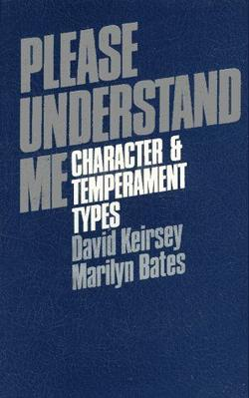
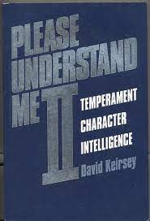
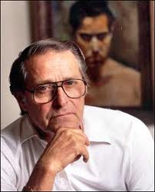
The Keirsey Temperament Sorter

Slide 37
The Keirsey Temperament Sorter

Slide 38
The Keirsey Temperament Sorter
NT

Slide 39
The Keirsey Temperament Sorter
NF
NT

Slide 40
The Keirsey Temperament Sorter
NF
NT
SP

Slide 41
The Keirsey Temperament Sorter
NF
NT
SJ
SP
SJ

Slide 42
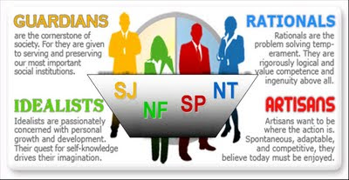
The Keirsey Temperament Sorter

Slide 43
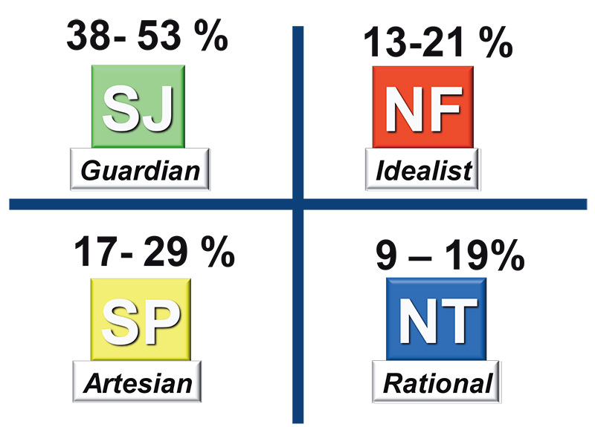
The Keirsey Temperament Sorter

Slide 44
Dunn and Dunn Learning Styles Inventory

Slide 45
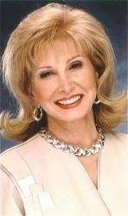

Dunn and Dunn Learning Styles Inventory
Rita Dunn
&
Kenneth Dunn

Slide 47
Other Models of Learning Styles

Slide 48
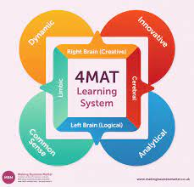
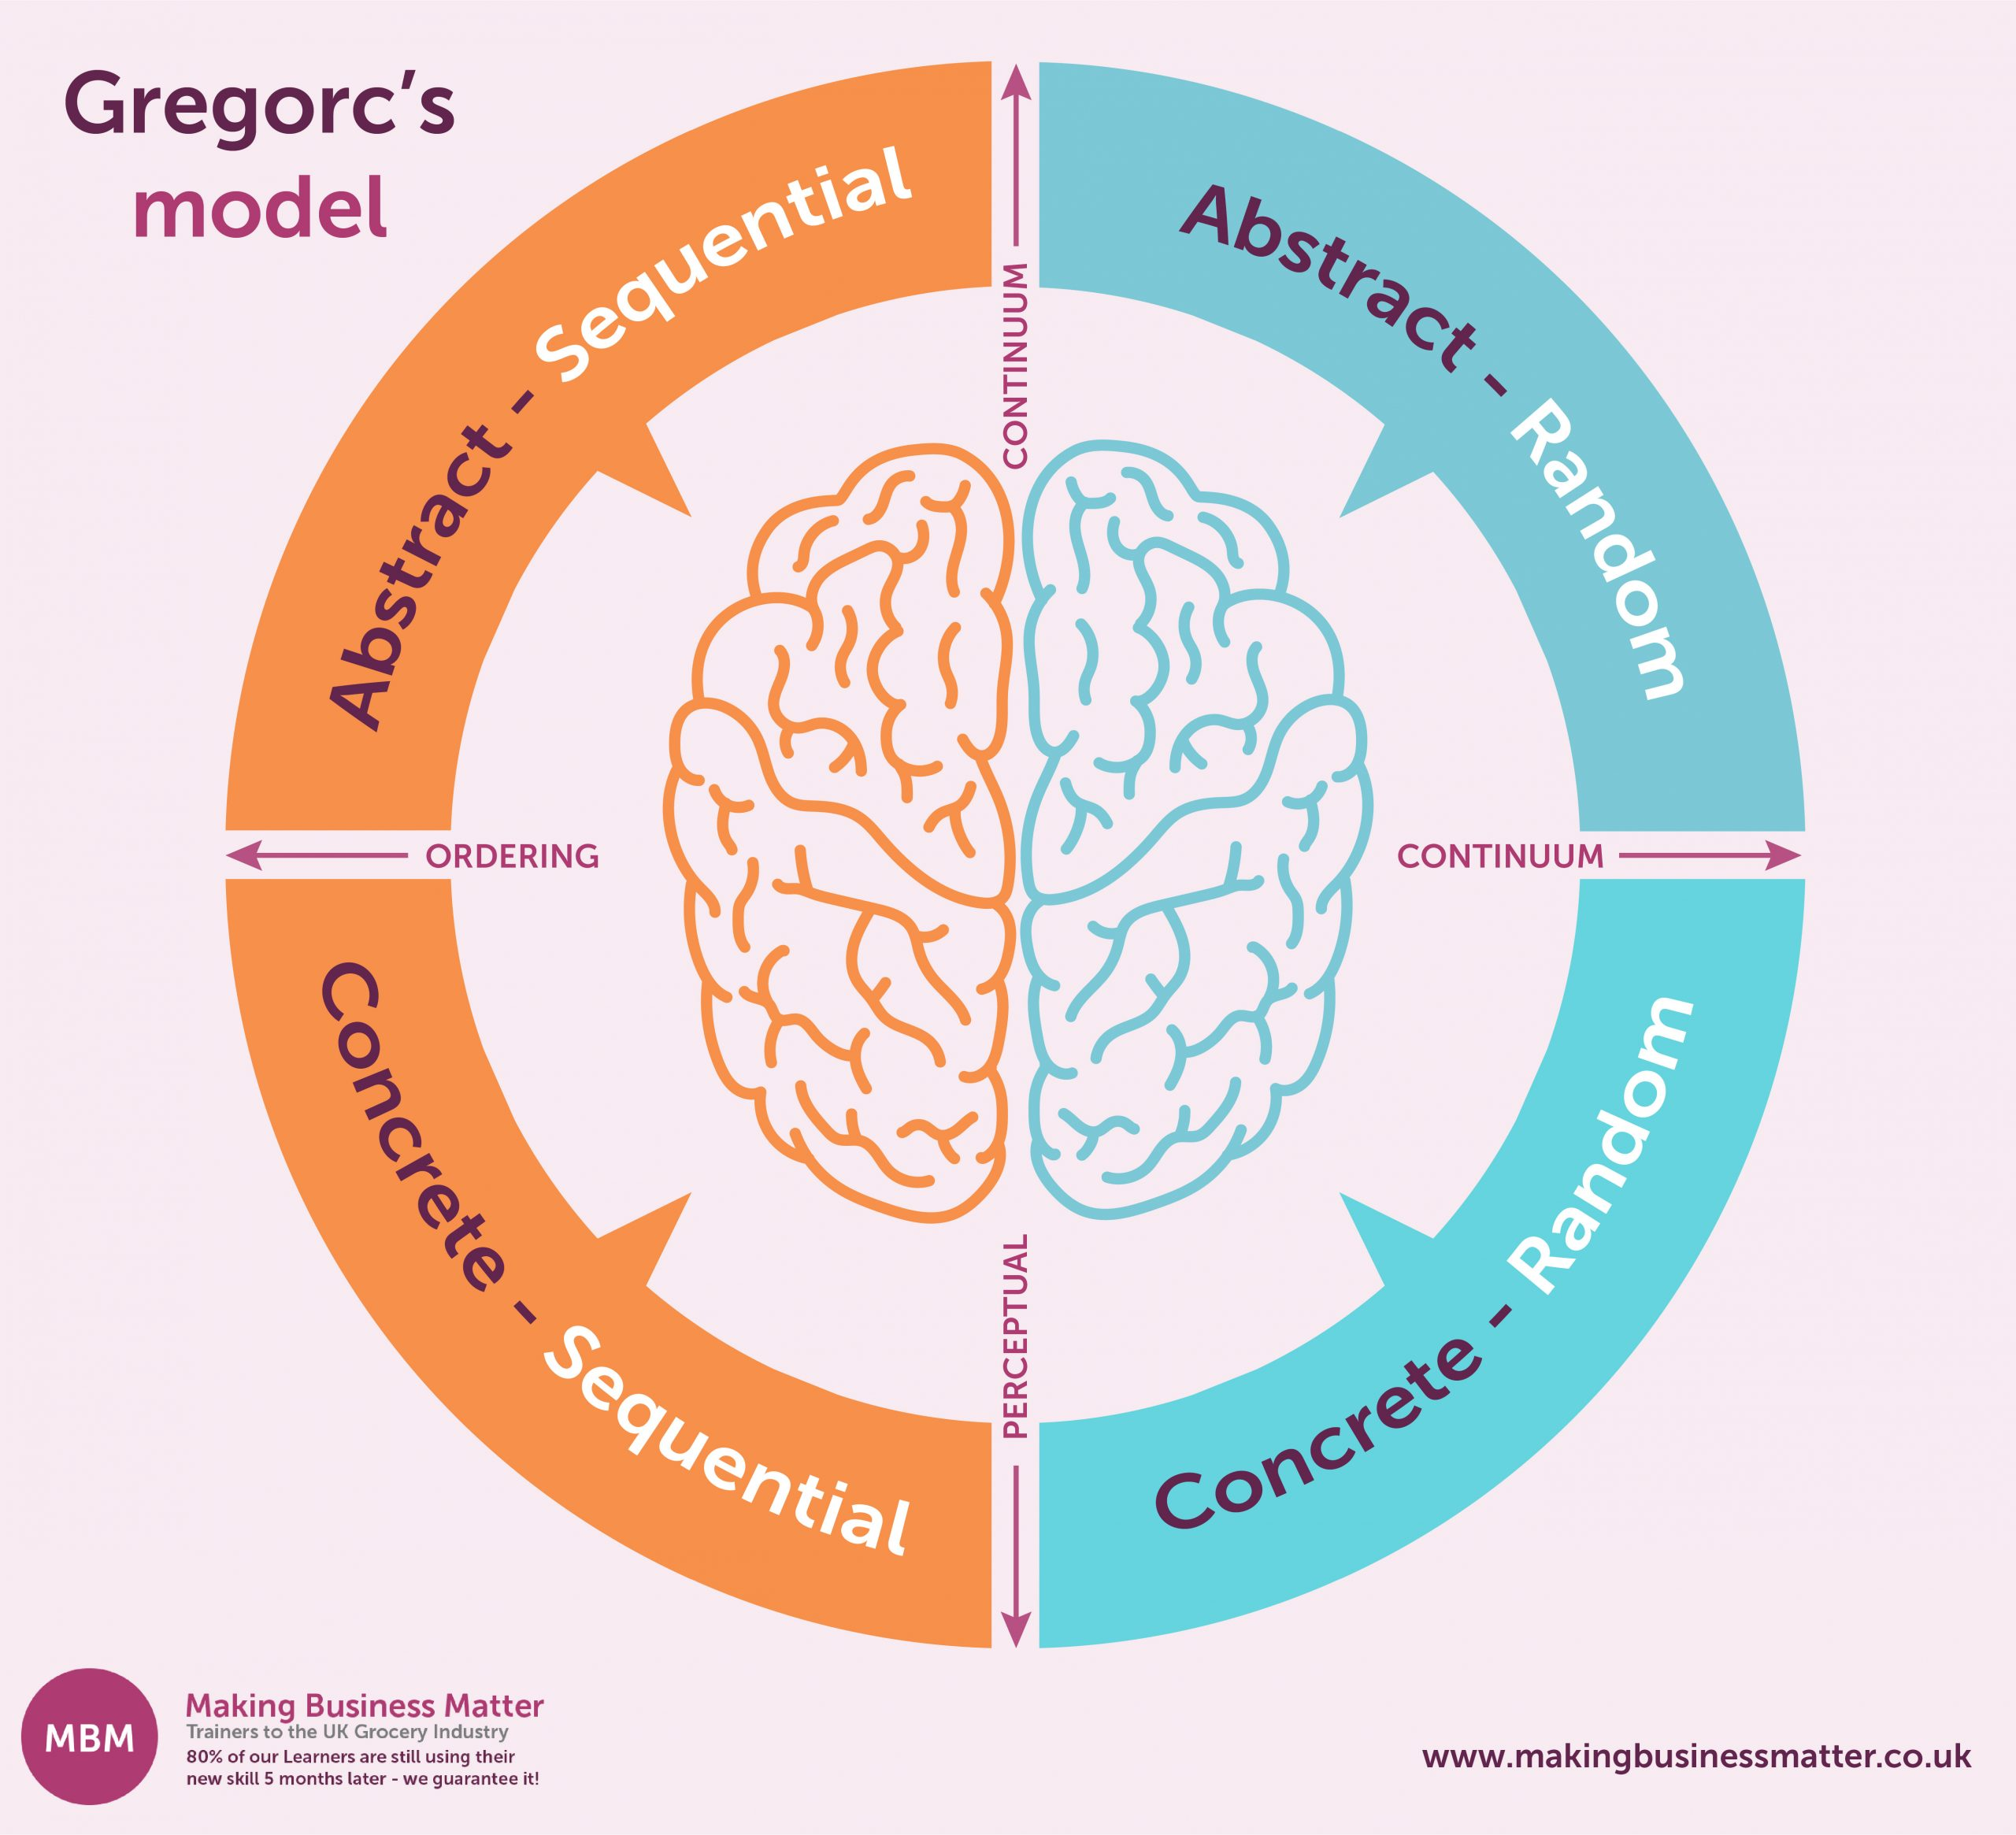
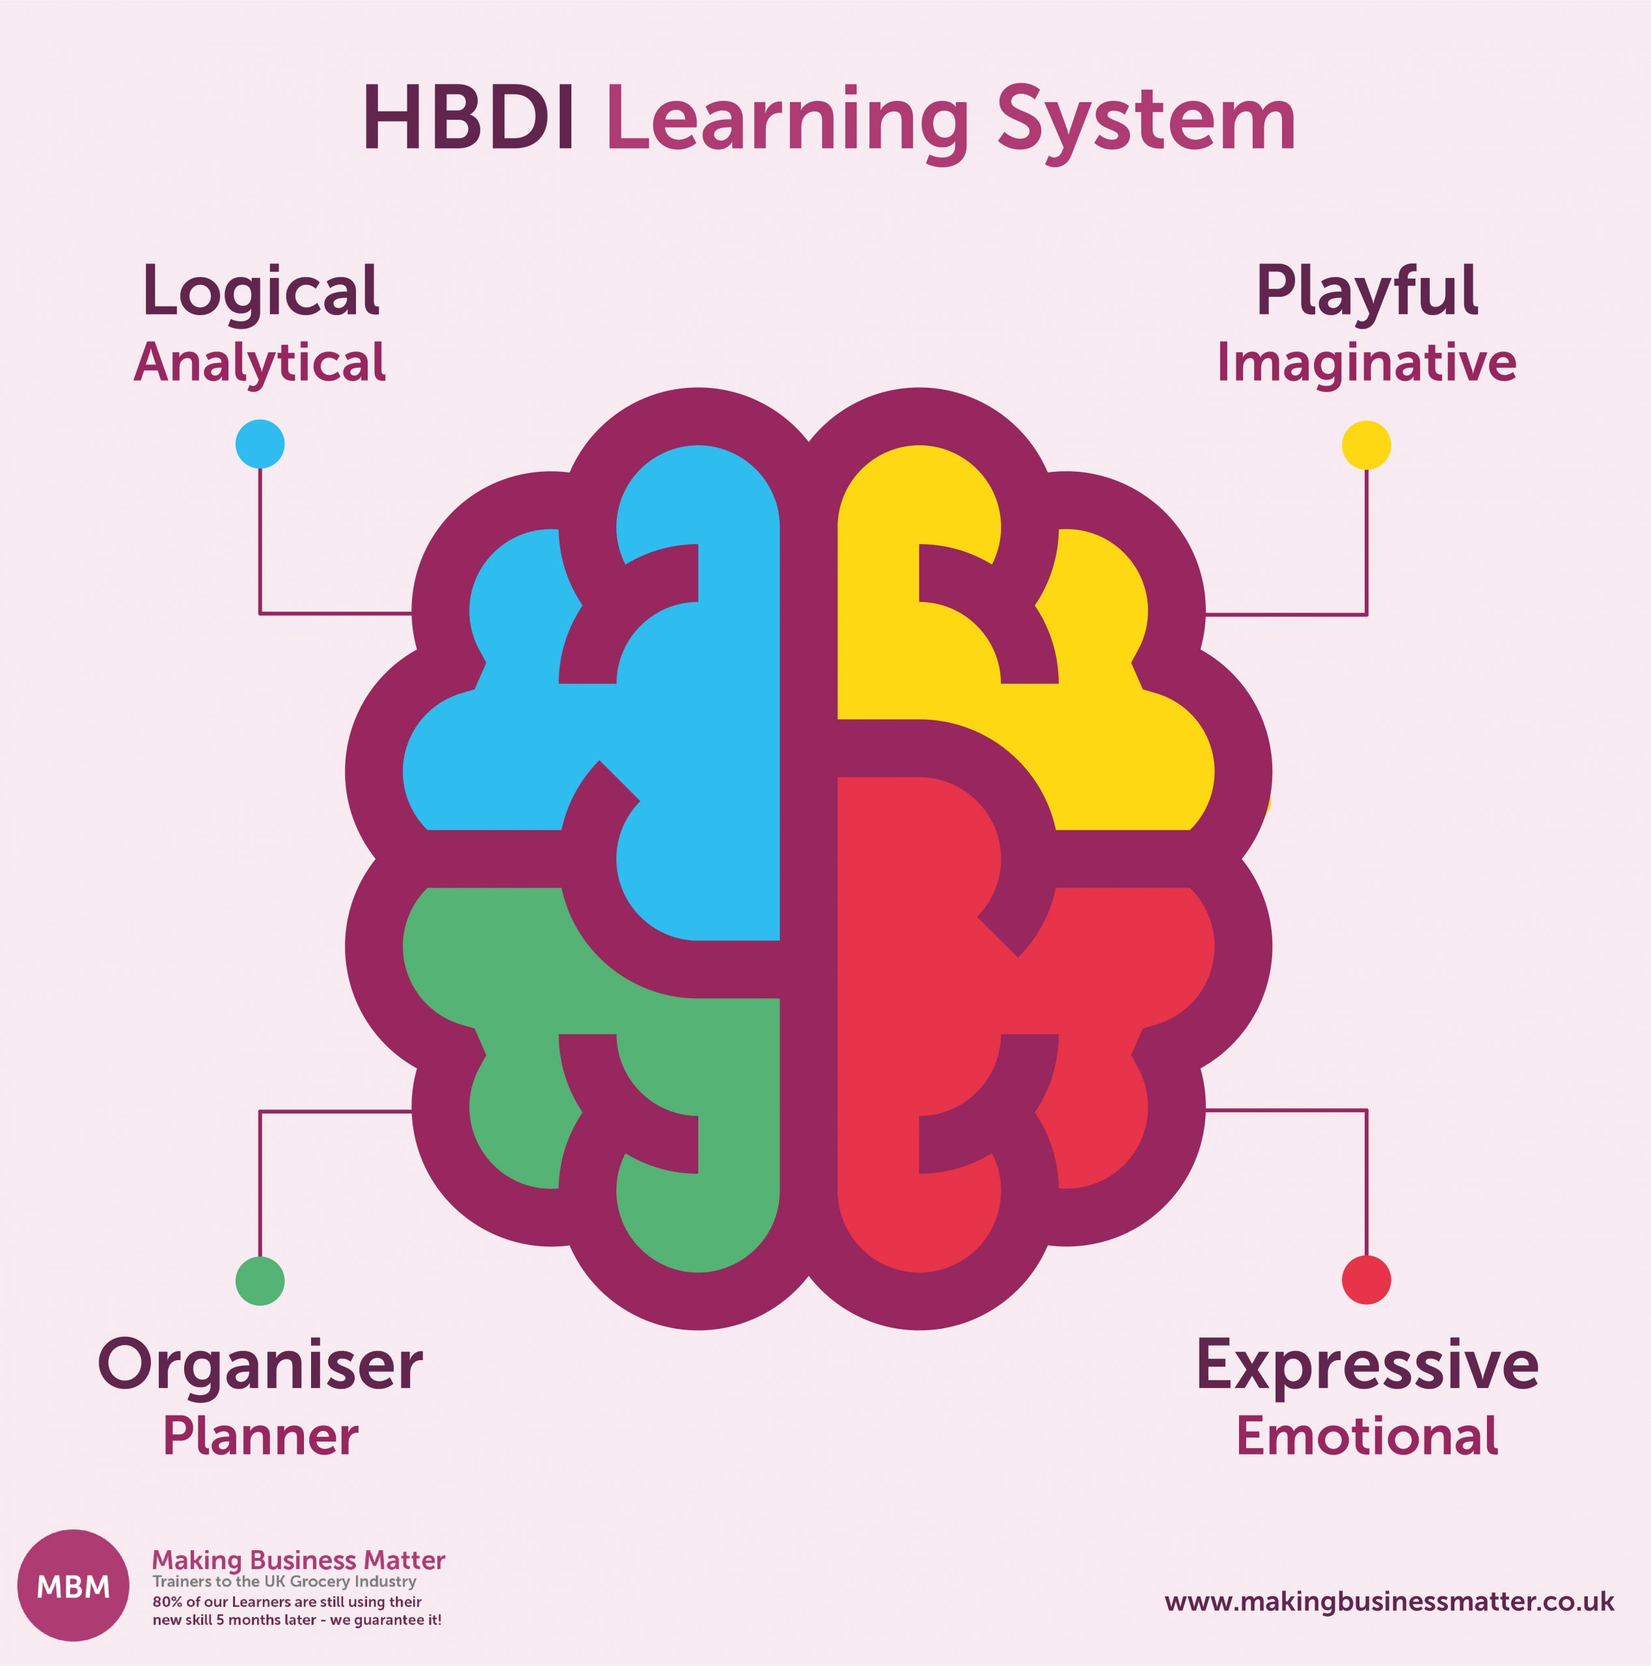
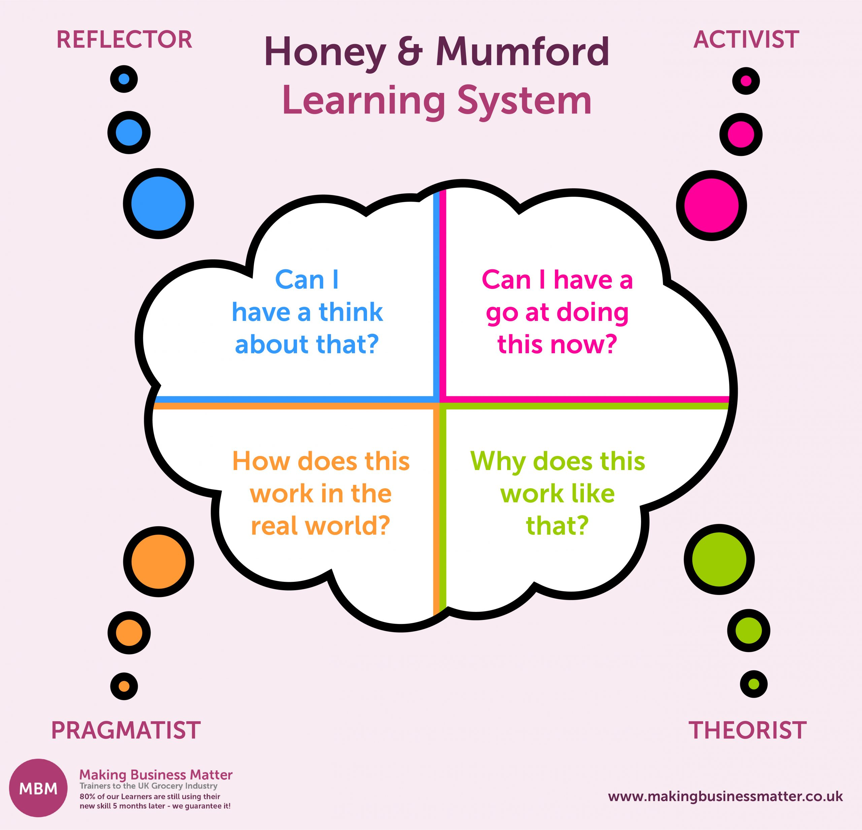
Other Models of Learning Styles
4MAT Model
Gregorc Model
Kolb Model
Honey-Mumford Model
Herrmann Brain Dominance
To Design, Develop, and Evaluate Quality Blended Learning

Slide 49
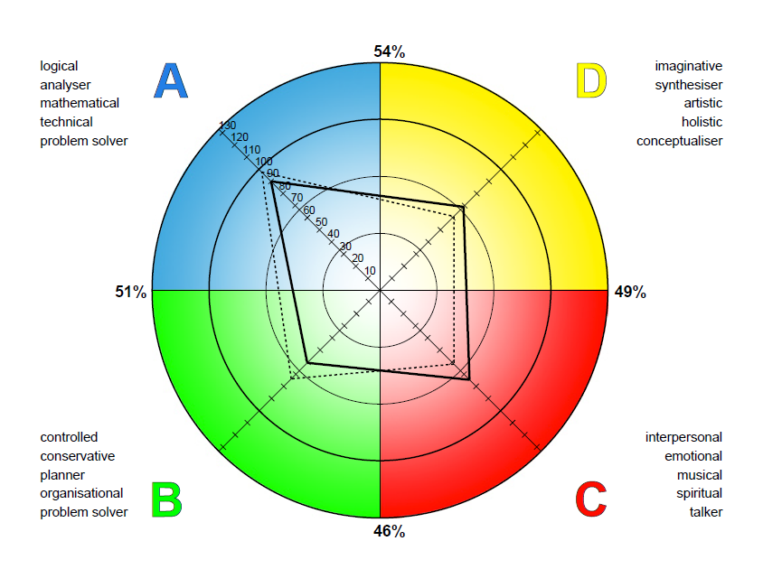
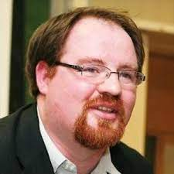
Other Models of Learning Styles
The Nexus Metamodel:
Developed by Damian Gordon
Analytical
Students
Emotional
Students
Practical
Students
Creative
Students
To Design, Develop, and Evaluate Quality Blended Learning

Slide 50
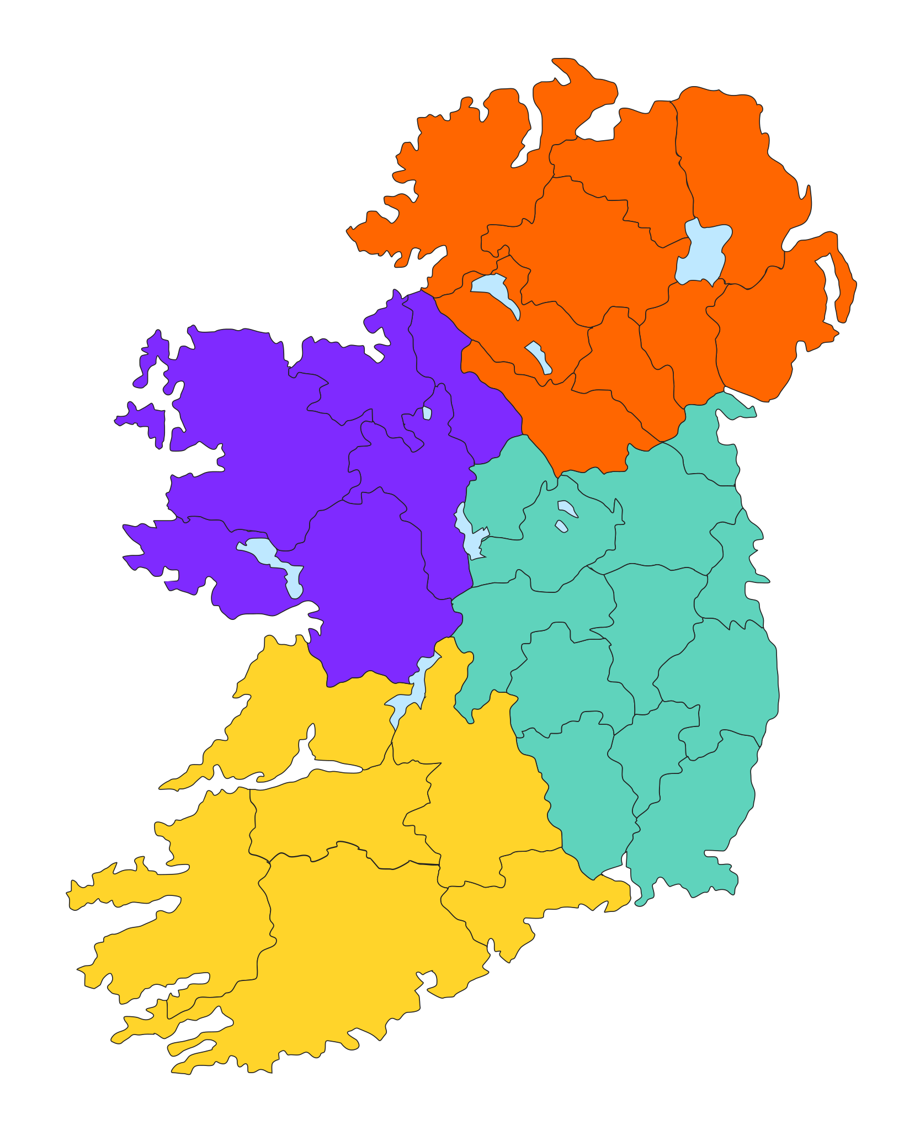
Connacht in the west is the kingdom of learning, the seat of the greatest and wisest druids and magicians; the men of Connacht are famed for their eloquence, their handsomeness and their ability to pronounce true judgement.
Ulster in the north is the seat of battle valour, of haughtiness, strife, boasting; the men of Ulster are the fiercest warriors of all Ireland, and the queens and goddesses of Ulster are associated with battle and death
Munster in the south is the kingdom of music and the arts, of harpers, of skilled ficheall players and of skilled horsemen. The fairs of Munster were the greatest in all Ireland.
Leinster, the eastern kingdom, is the seat of prosperity, hospitality, the importing of rich foreign wares like silk or wine; the men of Leinster are noble in speech and their women are exceptionally beautiful.

Slide 51



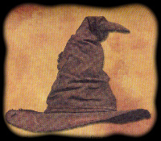

"You might belong in Gryffindor,
Where dwell the brave at heart,
There daring, nerve, and chivalry
Set Gryffindors apart”
"You belong in Hufflepuff,
Where they are just and loyal,
Those patient Hufflepuffs are true
And unafraid to toil"
"Here in wise old Ravenclaw,
If you've a ready mind,
Those of wit and learning,
Will always find their kind."
"Here you are in Slytherin,
Where you'll make your real friends,
Those cunning folk use any means
To achieve their ends."

Slide 52
Learning Styles
BOTTOM LINE:
Vary your mode of delivery (visual, auditory, text, practical, groupwork, individual work, emotional, logical, puzzle, problems, games).
To Design, Develop, and Evaluate Quality Blended Learning

Slide 53


