Slide 1

Blended Learning International Train the Train (BLITT)
Instructional Design Models
Damian Gordon
To Design, Develop, and Evaluate Quality Blended Learning

Slide 2
Instructional Design
Instructional Design is an approach to teaching that attempts to maximise the effectiveness, efficiency and appeal of instruction and other learning experiences.
The process consists of determining the current state and needs of the learner, defining the end goal of instruction, and creating some "intervention" to assist in the transition.
The outcome of this instruction may be directly observable and scientifically measured or completely hidden and assumed.
To Design, Develop, and Evaluate Quality Blended Learning

Slide 3
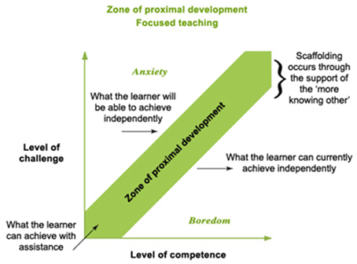
Instructional Design
To Design, Develop, and Evaluate Quality Blended Learning

Slide 4
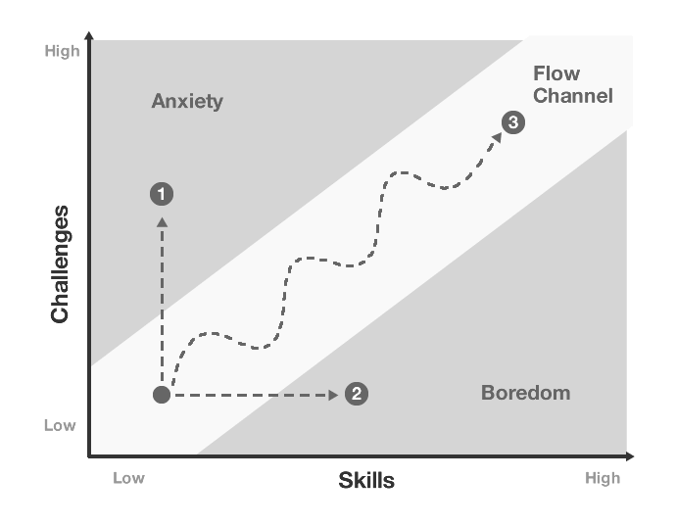
Instructional Design
To Design, Develop, and Evaluate Quality Blended Learning

Slide 5
Instructional Design
I divide models of instructional design broadly into two categories:
  MACRO: Models which concern themselves with the design and planning of an entire module or programme
  MICRO: Models which concern themselves with the design and planning of an individual lecture or teaching session
To Design, Develop, and Evaluate Quality Blended Learning

Slide 6
CPD in Applied Blended Learning Technologies
Macro Models
Damian Gordon
To Design, Develop, and Evaluate Quality Blended Learning

Slide 7
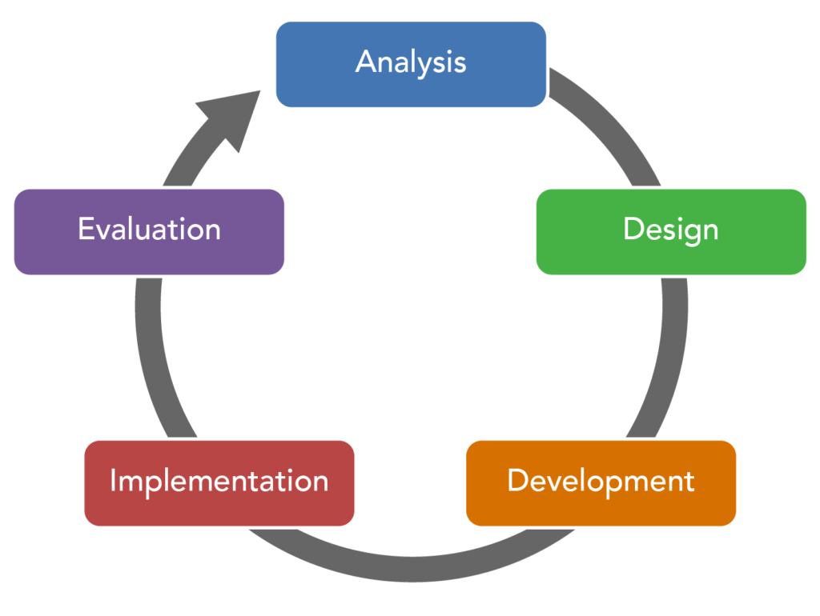
ADDIE Model
To Design, Develop, and Evaluate Quality Blended Learning

Slide 8
ADDIE Model
The ADDIE model is used by instructional designers and training developers. It is composed of five phases:
  Analysis,
  Design,
  Development,
  Implementation, and
  Evaluation
To Design, Develop, and Evaluate Quality Blended Learning

Slide 9
ADDIE Model
This represents a dynamic, flexible model for building effective training and performance support tools.
This model attempts to save time by catching problems while they are still easy to fix.
To Design, Develop, and Evaluate Quality Blended Learning

Slide 10
ADDIE Model
In the Analysis stage we want to find out:
  Who are the learners or audience?
    (Audience analysis)
  What is the goal or intended outcome?
    (Goal analysis)
To Design, Develop, and Evaluate Quality Blended Learning

Slide 11
ADDIE Model
In the Design stage we are exploring:
  The content of the course
    (Subject matter analysis)
  The steps of instruction
    (Lesson planning-writing objectives)
  The type of media or presentation mode
    (Media selection)
To Design, Develop, and Evaluate Quality Blended Learning

Slide 12
ADDIE Model
In the Development stage we are:
  Generating lesson plans (this is different from the lesson planning done in the Design phase) and lesson materials.
  Completing all media and materials for instruction, as well as completing all of the supporting documents.
  The end-result is a course or workshop ready for delivery.
To Design, Develop, and Evaluate Quality Blended Learning

Slide 13
ADDIE Model
In the Implementation stage we are:
  Delivering of the instruction.
  Aiming for effective and efficient delivery of instruction.
  Promoting students’ understanding of materials and objectives, as well as ensuring a transfer of knowledge.
To Design, Develop, and Evaluate Quality Blended Learning

Slide 14
ADDIE Model
In the Evaluation stage we are:
  Undertaking two related evaluations:
    Formative Evaluation
    Summative Evaluation
To Design, Develop, and Evaluate Quality Blended Learning

Slide 15
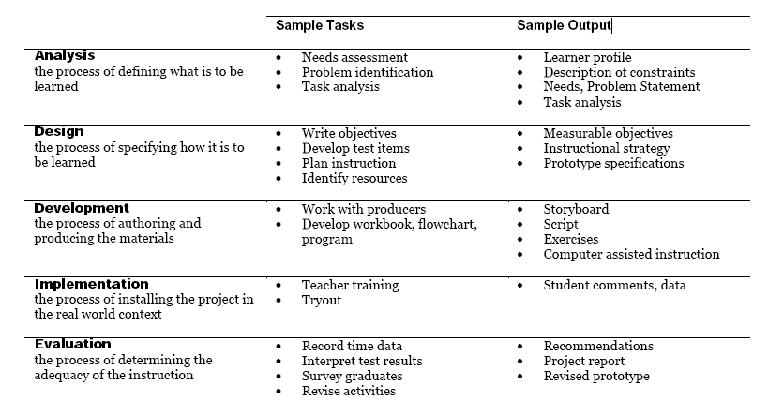
ADDIE Model
To Design, Develop, and Evaluate Quality Blended Learning

Slide 16
ADDIE Model
Remarkably it appears that the ADDIE model wasn’t specifically developed by any single author but rather to have evolved informally through oral tradition.
The ADDIE Model is merely a colloquial term used to describe a systematic approach to instructional development.
To Design, Develop, and Evaluate Quality Blended Learning

Slide 17
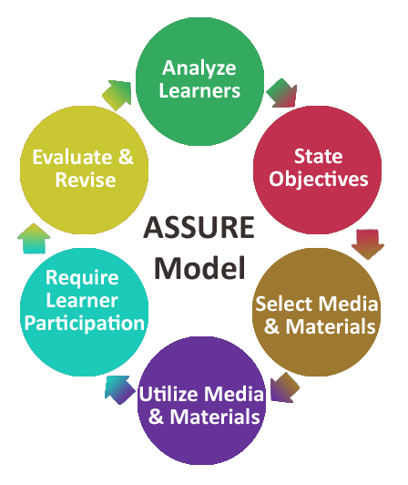
ASSURE Model
To Design, Develop, and Evaluate Quality Blended Learning

Slide 18
ASSURE Model
The ASSURE model is composed of six phases:
  Analyze learners
  State learning objectives
  Select approach
  Utilize approach
  Require participation
  Evaluate outcomes
To Design, Develop, and Evaluate Quality Blended Learning

Slide 19
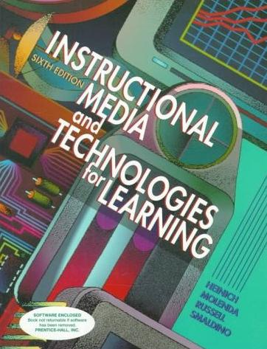
ASSURE Model
From “Instructional Media and Technologies for Learning” by Robert Heinich, Michael Molenda, James D. Russell, Sharon E. Smaldino
To Design, Develop, and Evaluate Quality Blended Learning

Slide 20
ASSURE Model
1. Analyze learners
  Analyze learners’ characteristics, competencies, and learning styles.
To Design, Develop, and Evaluate Quality Blended Learning

Slide 21
ASSURE Model
2. State learning objectives
  State objectives for what your lesson should accomplish in ABCD format.
To Design, Develop, and Evaluate Quality Blended Learning

Slide 22
ASSURE Model
2. State learning objectives: ABCD Format
  Audience
  Behaviour
  Condition
  Degree
To Design, Develop, and Evaluate Quality Blended Learning

Slide 23
ASSURE Model
2. State learning objectives: ABCD Format
  Audience: The audience is the group of individuals who are targeted for instruction. While at first this seems straight forward, many times employees will ask “will I get anything out of this training?” or “should I attend this training?” or “who is supposed to go to this training?” Without a clear-cut audience in mind, it is difficult to pinpoint exactly who gains from the training and who would be better served in a different class.
To Design, Develop, and Evaluate Quality Blended Learning

Slide 24
ASSURE Model
2. State learning objectives: ABCD Format
  Behaviour: The behaviour element of the objective indicates the desired outcome of the particular learning event. The behaviour will be stated in the following form “will be able to detail properly”. The behaviour is what you want the person to be able to do as a result of the training. It is important to clarify the behaviour because training programs can get off track when the desired outcome of the training activity is not clearly defined.
To Design, Develop, and Evaluate Quality Blended Learning

Slide 25
ASSURE Model
2. State learning objectives: ABCD Format
  Condition: The term “condition” describes circumstances under which the behaviour should occur. An example would be “when calling on a doctor,” The condition describes a trigger for the desired behaviour.
To Design, Develop, and Evaluate Quality Blended Learning

Slide 26
ASSURE Model
2. State learning objectives: ABCD Format
  Degree: The term “degree” represents how well the employee must perform to be considered acceptable. The degree of the objective is the measurable component. Measures can be expressed as level of productivity, quantity, quality, time, internal or external customer requirements, or other criteria gained from actual or anticipated work practices.
To Design, Develop, and Evaluate Quality Blended Learning

Slide 27
ASSURE Model
3. Select Approach
  Select, modify, and design methods, media, and materials.
To Design, Develop, and Evaluate Quality Blended Learning

Slide 28
ASSURE Model
4. Utilize Approach
  Utilize methods, media and materials - implement the lesson.
To Design, Develop, and Evaluate Quality Blended Learning

Slide 29
ASSURE Model
5. Require Participation
  Require learner participation in lesson.
To Design, Develop, and Evaluate Quality Blended Learning

Slide 30
ASSURE Model
6. Evaluate Outcomes
  Evaluate learner outcomes with objectives and revise as necessary.
To Design, Develop, and Evaluate Quality Blended Learning

Slide 31
ASSURE Model
The ASSURE model is composed of six phases:
  Analyze learners’ characteristics, competencies, and learning styles
  State objectives for what your lesson should accomplish (ABCD)
  Select, modify, and design methods, media, and materials
  Utilize methods, media and materials—implement the lesson
  Require learner participation in lesson
  Evaluate learner outcomes with objectives and revise as necessary
To Design, Develop, and Evaluate Quality Blended Learning

Slide 32
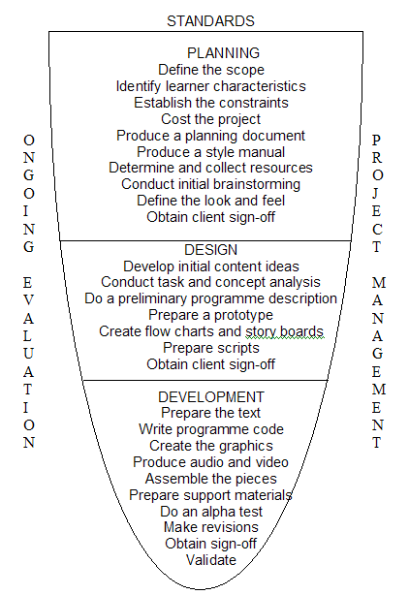
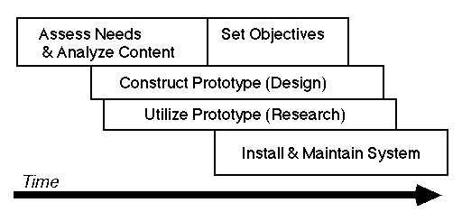
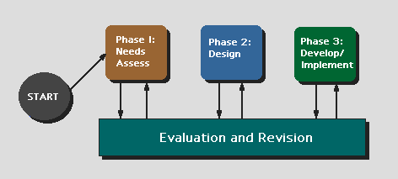
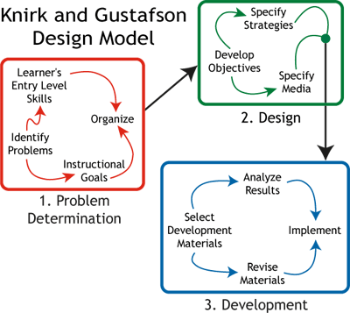
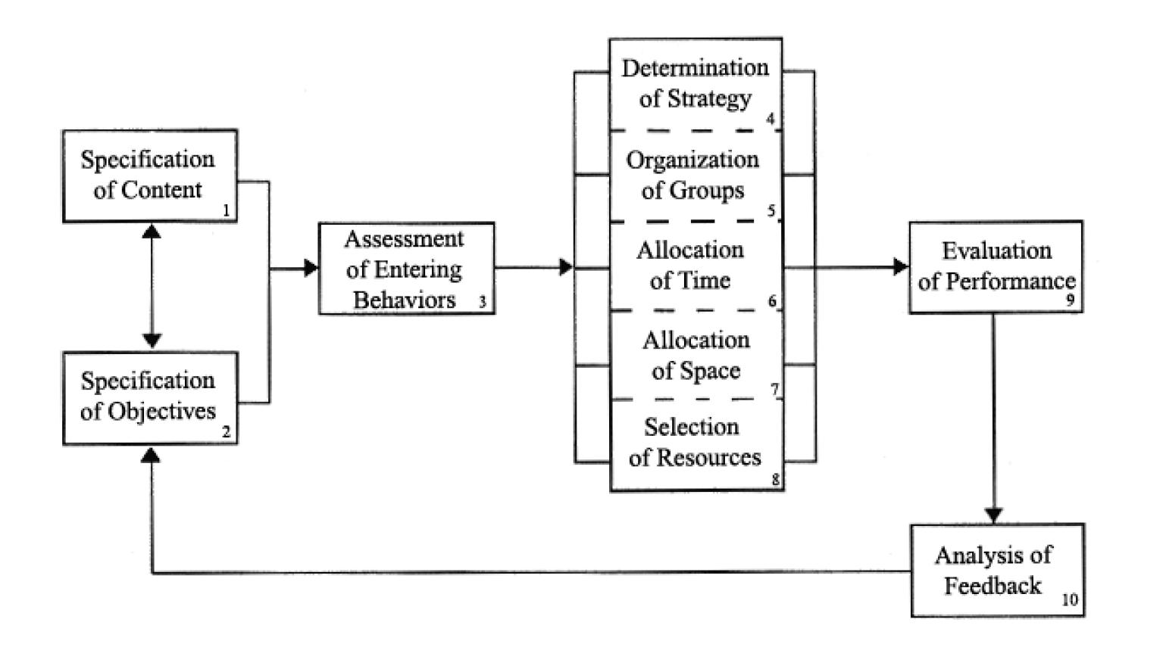
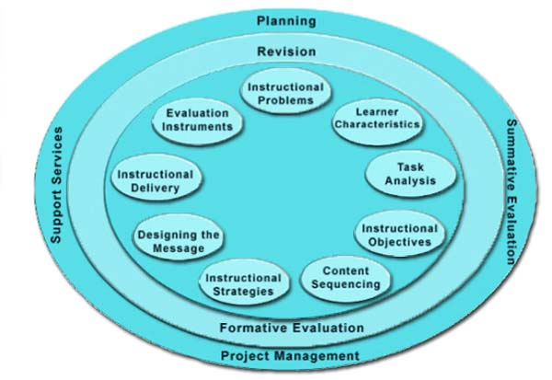
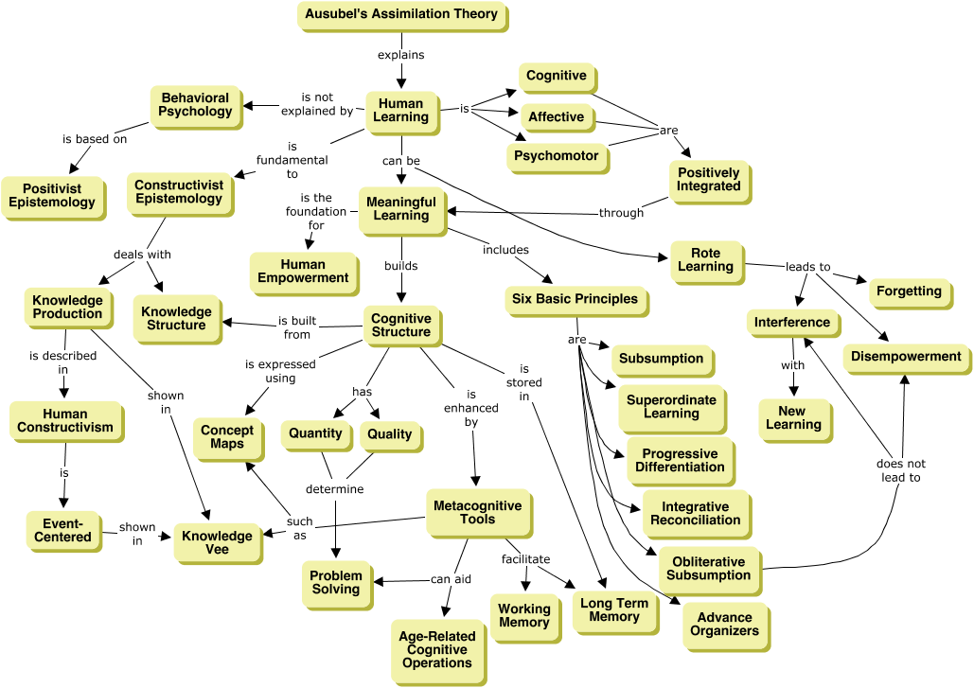
Other Models
Dick and Carey Model
Tripp and Bichelmeyer Model
Alessi and Trollip Model
Hannafin & Peck Model
Knirk & Gustafson Model
Jerrold Kemp Model
Gerlach-Ely Model
Ausubel’s Assimilation Theory
Instructional Design and e-Authoring

Slide 33
CPD in Applied Blended Learning Technologies
Micro Models
Damian Gordon
To Design, Develop, and Evaluate Quality Blended Learning

Slide 34
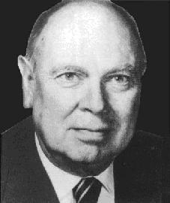
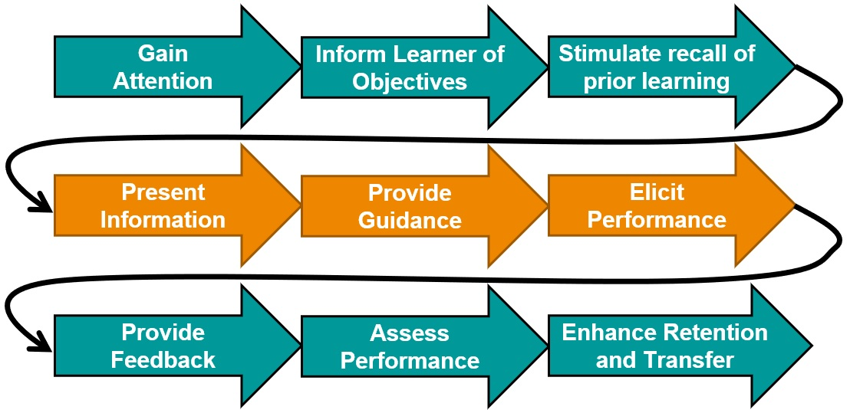
Gagné’s Nine Events of Instruction
To Design, Develop, and Evaluate Quality Blended Learning

Slide 35
Gagné’s Nine Events of Instruction
Robert M. Gagné developed a nine-step model to help people design lessons.
To Design, Develop, and Evaluate Quality Blended Learning

Slide 36
Robert Mills Gagné
Born in Aug 21, 1916
Died in April 28, 2002
Born in in North Andover, Massachusetts
educational psychologist
best known for his “Conditions of Learning” involved in applying instructional theory to the design of computer-based learning.
To Design, Develop, and Evaluate Quality Blended Learning

Slide 37
Gagné’s Nine Events of Instruction
If you have lectured for a while, you probably do most of these, and you found them out by trial and error.
To Design, Develop, and Evaluate Quality Blended Learning

Slide 38
Gagné’s Nine Events of Instruction
Gain
Attention
Inform Learner of Objectives
Stimulate recall of prior learning

Slide 39
Gagné’s Nine Events of Instruction
Gain
Attention
Inform Learner of Objectives
Stimulate recall of prior learning
Present Information
Provide
Guidance
Elicit Performance

Slide 40
Gagné’s Nine Events of Instruction
Gain
Attention
Inform Learner of Objectives
Stimulate recall of prior learning
Present Information
Provide
Guidance
Elicit Performance
Provide
Feedback
Assess
Performance
Enhance Retention
and Transfer

Slide 41
1. Gain the Students’ Attention
Curiosity motivates students to learn.
  Silence
  A joke
  A magic trick
  Music video / Clip of a film
  A quote
To Design, Develop, and Evaluate Quality Blended Learning

Slide 42


Slide 43
2. Inform Learners of Objectives
These objectives should form the basis for assessment.
  List the learning goals
  Tell a simple story
  Mention that this lesson might be coming up in a future assessment or the exam
To Design, Develop, and Evaluate Quality Blended Learning

Slide 44
3. Stimulate Recall of Prior Learning
Associating new information with prior knowledge can facilitate the learning process.
  Something we covered in the last class
  Something they covered in another module
  Something they did in secondary school
To Design, Develop, and Evaluate Quality Blended Learning

Slide 45
4. Present the Content
This event of instruction is where the new content is actually presented to the learner.
  Start with an example? (T/E or E/T)
  Include specific notation? Include specific diagrams?
  Explain the theory as well as the details?
  Can we find content or videos of great lecturers
To Design, Develop, and Evaluate Quality Blended Learning

Slide 46
5. Provide “Learning Guidance”
Use of examples, non-examples, case studies, graphical representations, mnemonics, and analogies.
  Links
  Videos
  Animations
  Biographies
To Design, Develop, and Evaluate Quality Blended Learning

Slide 47
6. Elicit Performance (Practice)
Eliciting performance provides an opportunity for learners to confirm their correct understanding, and the repetition further increases the likelihood of retention.
  Active Learning: Three things we’ve covered
  Active Learning: Write a one-minute essay
  Active Learning: Do a quiz
  Tweet or Google
To Design, Develop, and Evaluate Quality Blended Learning

Slide 48

7. Provide Feedback
Give guidance and answers provided at this stage are called formative feedback.
  Two stars and a wish (sandwich method)
  I like that you and I would have liked if you.
I like that you… | I would have liked if you …
Sdcaclkmecioenc | Ecqeqecckmoim
Ecomeocimqeoicqio | Oiemcqoeimcqoe
Ecomqeocinqnece | oemcqoeimcoqeimcq
To Design, Develop, and Evaluate Quality Blended Learning

Slide 49
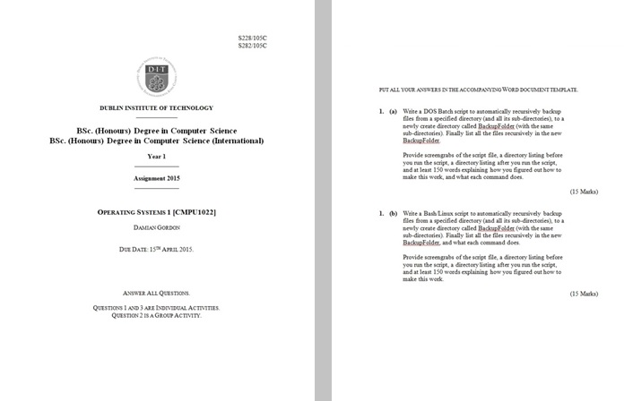
8. Assess Performance
Take a final assessment.
To Design, Develop, and Evaluate Quality Blended Learning

Slide 50
9. Enhance Retention (and transfer to the job)
Effective education will have a "performance" focus.
  Summarize what we did…
  Give any final instructions…
To Design, Develop, and Evaluate Quality Blended Learning

Slide 51
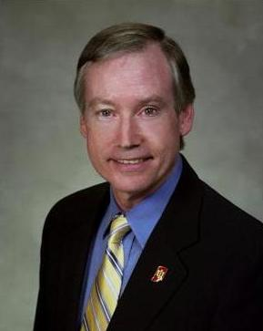
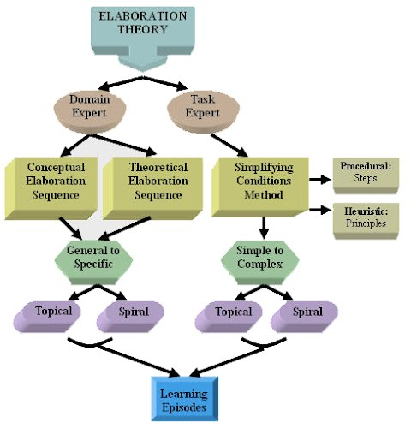
Reigeluth’s Elaboration Theory
To Design, Develop, and Evaluate Quality Blended Learning

Slide 52
Reigeluth’s Elaboration Theory
Charles Reigeluth’s theory suggests that instruction is made up of layers and that each layer of instruction elaborates on the previously presented ideas.
By elaborating on the previous ideal, it reiterates, thereby improving retention
To Design, Develop, and Evaluate Quality Blended Learning

Slide 53
Reigeluth’s Elaboration Theory
The steps are as follows:
    Present overview of simplest and most fundamental ideas
    Add complexity to one aspect
    Review the overview and show relationships to the details
    Provide additional elaboration of details
    Provide additional summary and synthesis
To Design, Develop, and Evaluate Quality Blended Learning

Slide 54
Reigeluth’s Elaboration Theory
Organizing Course Structure
Simple to complex
Within-lesson sequence
Summarizers
Synthesizers
Analogies
Cognitive strategies
Learner control
To Design, Develop, and Evaluate Quality Blended Learning

Slide 55
Reigeluth’s Elaboration Theory
1. Organizing Course Structure
  Single organisation for complete course.
To Design, Develop, and Evaluate Quality Blended Learning

Slide 56
Reigeluth’s Elaboration Theory
2. Simple to Complex
  Start with simplest ideas, in the first lesson, and then add elaborations in subsequent lessons.
To Design, Develop, and Evaluate Quality Blended Learning

Slide 57
Reigeluth’s Elaboration Theory
3. Within-lesson Sequence
  General to detailed
  Simple to complex
  Abstract to concrete
To Design, Develop, and Evaluate Quality Blended Learning

Slide 58
Reigeluth’s Elaboration Theory
4. Summarizers
  Content reviews presented in rule-example-practice format.
To Design, Develop, and Evaluate Quality Blended Learning

Slide 59
Reigeluth’s Elaboration Theory
5. Synthesizers
  Presentation devices that help the learner integrate content elements into a meaningful whole and assimilate them into prior knowledge, e.g. a concept hierarchy, a procedural flowchart or decision table, or a cause-effect model.
To Design, Develop, and Evaluate Quality Blended Learning

Slide 60
Reigeluth’s Elaboration Theory
6. Analogies
  Analogies relate the content to learners' prior knowledge, use multiple analogies, especially with a highly divergent group of learners.
To Design, Develop, and Evaluate Quality Blended Learning

Slide 61
Reigeluth’s Elaboration Theory
7. Cognitive Strategies
  Use a variety of cues - pictures, diagrams, mnemonics, etc. - can trigger cognitive strategies needed for processing of material.
To Design, Develop, and Evaluate Quality Blended Learning

Slide 62
Reigeluth’s Elaboration Theory
8. Learner Control
  Learners are encouraged to exercise control over both content and instructional strategy. Clear labelling and separation of strategy components facilitates effective learner control of those components.
To Design, Develop, and Evaluate Quality Blended Learning

Slide 63
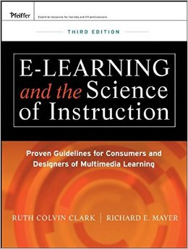
Other Models
Component Display Theory
Science of Instruction
Six Thinking Hats Model
Learning by teaching
Problem-based learning
Project-based learning
ICARE model
Inquiry-based learning
Action learning
Progressive inquiry
Service-learning
To Design, Develop, and Evaluate Quality Blended Learning

Slide 64


Slide 65
How I write lectures
Damian Gordon

Slide 66
Format of Talk
Three parts:
  Prepare
  Develop
  Reflect

Slide 67
Format of Talk
Three parts:
  Prepare
  Develop
  Reflect
  Define
  Design
  Redesign

Slide 68
Format of Talk
Three parts:
  Prepare
  Develop
  Reflect
  Define
  Design
  Redesign
  Beginning
  Middle
  End

Slide 69
Format of Talk
Three parts:
  Prepare
  Develop
  Reflect
1
  Define
  Design
  Redesign
  Beginning
  Middle
  End
2
3

Slide 70
Format of Talk
Three parts:
  Prepare
  Develop
  Reflect
1
  Define
  Design
  Redesign
  Beginning
  Middle
  End
2
3
4
5
6

Slide 71
Format of Talk
Three parts:
  Prepare
  Develop
  Reflect
1
  Define
  Design
  Redesign
  Beginning
  Middle
  End
2
3
4
5
6
7
8
9

Slide 72
Prepare

Slide 73
Prepare
What resources do I use to get started?

Slide 74
Prepare
Previous lecturer’s notes
Other lecture notes online
My own college notes ☺

Slide 75
Prepare
Textbooks
Conference and Journal papers
Magazines

Slide 76
Prepare
News events
My work experience
Other Web content
  e.g. Wikipedia
  e.g. On-line resources
  e.g. Slideshare

Slide 77
Develop

Slide 78
Develop
Define
Design
Redesign

Slide 79
Develop:
Define

Slide 80
Define
What is the theme of this lecture?

Slide 81
Define
What is the theme of this lecture?
  I find it hard to write the lesson until I know the theme

Slide 82
Define
What is the theme of this lecture?
  I find it hard to write the lesson until I know the theme, e.g. efficiency, simplicity, accuracy

Slide 83
Define
I like to base my lectures around a number.

Slide 84
Define
I like to base my lectures around a number.
  In this case 3, everything comes in 3s

Slide 85
Define
I like to base my lectures around a number.
  In this case 3, everything comes in 3s
  Sometimes I use 6 or 8

Slide 86
Define
Sometime I visualize the lecture as a shape

Slide 87
Define
Sometime I visualize the lecture as a shape

Slide 88
Define
Sometime I visualize the lecture as a shape

Slide 89
Define
Sometime I visualize the lecture as a shape

Slide 90
Define
Sometime I visualize the lecture as a shape

Slide 91
Develop:
Design

Slide 92
Design
Lectures have 3 parts:
  Beginning
  Middle
  End

Slide 93
Design
Lectures have 3 parts:
  Beginning
  Middle
  End
  1. Gain the students’ attention
  2. Tell them the goal of this class
  3. Tie it into what they know already

Slide 94
Design
Lectures have 3 parts:
  Beginning
  Middle
  End
  1. Gain the students’ attention
  2. Tell them the goal of this class
  3. Tie it into what they know already
  4. Present an example and the information
  5. Provide help on understanding the material
  6. Ask them to do something to learn

Slide 95
Design
Lectures have 3 parts:
  Beginning
  Middle
  End
  1. Gain the students’ attention
  2. Tell them the goal of this class
  3. Tie it into what they know already
  4. Present an example and the information
  5. Provide help on understanding the material
  6. Ask them to do something to learn
  7. Give feedback and advice to the students
  8. Give they students a proper assessment
  9. Finish it off

Slide 96
Design
Beginning
  1. Gain the students’ attention
  2. Tell them the goal of this class
  3. Tie it into what they know already

Slide 97
Design
Beginning
  1. Gain the students’ attention
  2. Tell them the goal of this class
  3. Tie it into what they know already

Slide 98
  1. Gain the students’ attention
Silence
A joke
A magic trick
Music video
Clip of a film
A quote

Slide 99





Slide 100
Design
Beginning
  1. Gain the students’ attention
  2. Tell them the goal of this class
  3. Tie it into what they know already

Slide 101
  2. Tell them the goal of this class
List the learning goals
Tell a simple story
Mention this might be coming up in the exam

Slide 102
Design
Beginning
  1. Gain the students’ attention
  2. Tell them the goal of this class
  3. Tie it into what they know already

Slide 103
  3. Tie it into what they know already
Something we covered in the last class
Something they covered in another module
Something they did in secondary school

Slide 104
Design
Middle
  4. Present an example and the information
  5. Provide help on understanding the material
  6. Ask them to do something to learn

Slide 105
DesigN
Middle
  4. Present an example and the information
  5. Provide help on understanding the material
  6. Ask them to do something to learn

Slide 106
  4. Present an example and the information
THE CONTENT
  Start with an example
  Present the information
  Include computer science specific notation
  Include computer science specific diagrams
  Explain the theory as well as the details

Slide 107
  4. Present an example and the information
Find excellent online videos from great computer lecturers.

Slide 108
DesigN
Middle
  4. Present an example and the information
  5. Provide help on understanding the material
  6. Ask them to do something to learn

Slide 109
  5. Provide help on understanding the material
Links
Videos
See Sample Notes

Slide 110
Design
Middle
  4. Present an example and the information
  5. Provide help on understanding the material
  6. Ask them to do something to learn

Slide 111
  6. Ask them to do something to learn
Active Learning
  Three things we’ve covered
  Write a one-minute essay
  Do a quiz
  Tweet or Google

Slide 112
Design
End
  7. Give feedback and advice to the students
  8. Give they students a proper assessment
  9. Finish it off

Slide 113
Design
End
  7. Give feedback and advice to the students
  8. Give they students a proper assessment
  9. Finish it off

Slide 114
  7. Give feedback and advice to the students
I like that you…
I would have liked if you…

Slide 115
Design
End
  7. Give feedback and advice to the students
  8. Give they students a proper assessment
  9. Finish it off

Slide 116
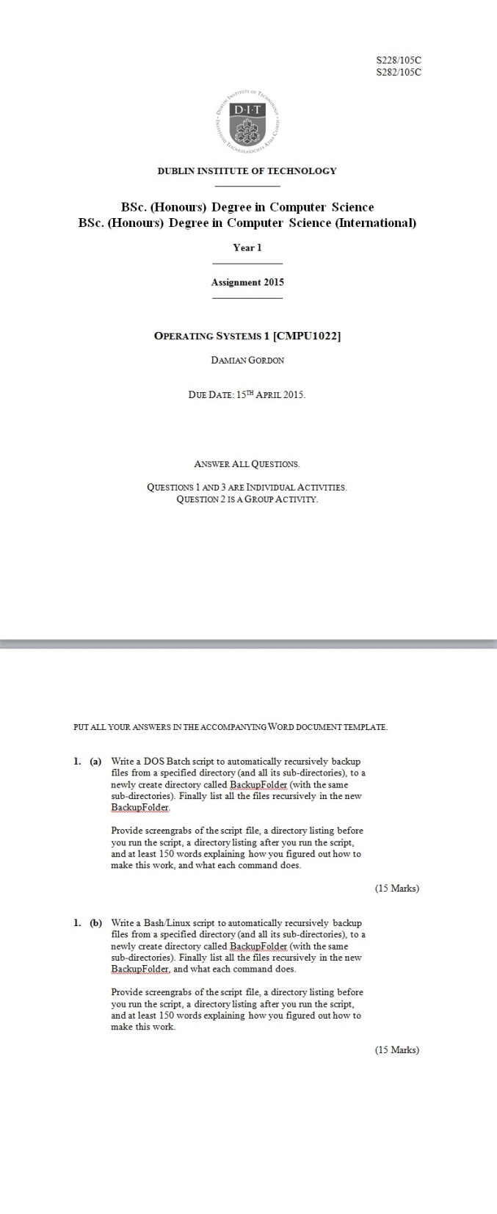

Slide 117
Design
End
  7. Give feedback and advice to the students
  8. Give they students a proper assessment
  9. Finish it off

Slide 118
  9. Finish it off
Summarize what we did…
Give any final instructions…

Slide 119
Develop:
Redesign

Slide 120
  Redesign
Rewrite lecture:
  Version 1, first complete version

Slide 121
  Redesign
Rewrite lecture:
  Version 1, first complete version
  Version 2, is there any part that can be taken out (and maybe developed into a separate lecture? Or just removed)

Slide 122
  Redesign
Rewrite lecture:
  Version 1, first complete version
  Version 2, is there any part that can be taken out (and maybe developed into a separate lecture? Or just removed)
  Version 3, bring balance to all sections (harmony)

Slide 123
  Redesign
Rewrite lecture:
  Version 1, first complete version
  Version 2, is there any part that can be taken out (and maybe developed into a separate lecture? Or just removed)
  Version 3, bring balance to all sections (harmony)
  Version 4, add in some jokes

Slide 124
  Redesign
Simplify the language
Prepare
Develop
Reflect

Slide 125
  Redesign
Simplify the language
Preparation
Development
Reflection
Prepare
Develop
Reflect

Slide 126
  Redesign
Rehearsal, rehearsal, rehearsal,

Slide 127

  Redesign
Rehearsal, rehearsal, rehearsal,

Slide 128
  Redesign
Rehearsal, rehearsal, rehearsal,
Tiny

Slide 129
Reflect

Slide 130
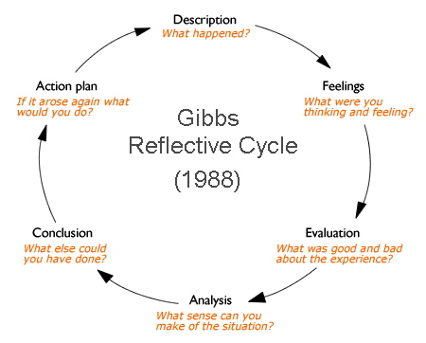
Reflect

Slide 131
Open Education
Full-package courses (1 of 2)
      Connexions http://cnx.org/
      MIT OpenCourseWare http://ocw.mit.edu/index.htm
      MITx http://mitx.mit.edu/
      Open Course Library http://opencourselibrary.org/

Slide 132
Open Education
Full-package courses (2 of 2)
      Saylor Foundation http://www.saylor.org/
      Coursera https://www.coursera.org/
      FutureLearn https://www.futurelearn.com/
      Udacity https://www.udacity.com/courses/all

Slide 133
Open Education
Video
      Academic Earth http://academicearth.org/
      Khan Academy http://www.khanacademy.org/
      YouTube http://www.youtube.com

Slide 134
Open Education
Repositories
      Merlot http://www.merlot.org/
      OER Commons http://www.oercommons.org/
      National Repository of Online Courses (NROC)
        http://www.montereyinstitute.org/nroc/nrocdemos.html
      iTunesU http://www.apple.com/education/itunes-u

Slide 135
Open Education
Textbooks
      Flatworld Knowledge http://www.flatworldknowledge.com/
      Global Textbook Project http://globaltext.terry.uga.edu/.
      National Academies Press http://www.nap.edu/.
      WikiBooks http://en.wikibooks.org/wiki/Main_Page.

Slide 136

Reflect

Slide 137
Reflect
More rehearsal
Tiny

Slide 138
Thank You

Slide 139
Blended Learning International Train the Train (BLITT)
ACTIVITY 3: DEVELOPMENT
Damian Gordon
Lecturer in Computer Science
To Design, Develop, and Evaluate Quality Blended Learning

Slide 140
Activity 3
This is our third brainstorming activity…
Just a few sentences needed here also, but you can write as much as you want. So this is just your initial ideas on the tools you will use for your blended activities, but again as we know plans will change over time, so please don’t feel tied down to anything you write here, it’s just to get you initial ideas. Here are some questions that might help you write this section, but don’t feel constrained by these:
Who’s presenting?
To Design, Develop, and Evaluate Quality Blended Learning

Slide 141
Activity 3
How might this impact how you teach the students?
How might it impact how you communicate with the students?
What technology skills might you have to learn (e.g. video editing, audio editing, game design, interactivity design, accessibility design, quiz development, digital badges, assessment tools, blogs, wikis, simulations, social media tools, forums)?
Who’s presenting?
To Design, Develop, and Evaluate Quality Blended Learning

Slide 142
Activity 3
What new teaching approaches might you try out?
How will you deliver this content, e.g. in a VLE, on a website, on a USB, in the classroom?
How will you evaluate the changes?
As your ideas change, please do note both the old ideas and the new ones here.
Who’s presenting?
To Design, Develop, and Evaluate Quality Blended Learning

Slide 143
Activity 3: Sample
4-Oct-2022
I had a very exciting guest lecture lined up, one of the developers of the current version of the Python Complier was going to give a talk (I would have found that really fascinating), unfortunately I realised that the students really wouldn’t care, so instead I’ve asked a friend of mine who works in the computer industry has agreed to come in online and let them know how the skills they are learning in my class can get them a job in the real world. They love that sort of thing.
Who’s presenting?
To Design, Develop, and Evaluate Quality Blended Learning

Slide 144
Activity 3: Sample
4-Oct-2022 (Cont.)
I’ve created a calendar online showing a timeline of which classes are online and which are in person, the calendar also have deadlines for assignments and labs. Also I’ve added important dates in the history of Python, e.g. 20th Feb (1991) is the first release of the Python complier, 16th October (2000) Python 2.0 Released, 31st January (1956) is Python creator, Guido van Rossum’s birthday. I’ve also created a bunch of email reminders.
Who’s presenting?
To Design, Develop, and Evaluate Quality Blended Learning

Slide 145
Activity 3: Sample
4-Oct-2022 (Cont.)
As usual, for communication purposes, I’ve created an additional Classroom session called “The Canteen” that will run for the whole term, and a second forum called “The Noticeboard”. “The Canteen” is their session; they can log in whenever they want to, but I’ve put a notice on the room that they can discuss any topic they want, but nothing to do with the module. “The Noticeboard” is a forum where I put up all the important documents related to the module, I will also encourage students to ask questions about the assignments & module topics in this forum, and answer each other’s questions.
Who’s presenting?
To Design, Develop, and Evaluate Quality Blended Learning

Slide 146
Activity 3: Sample
4-Oct-2022 (Cont.)
I’ll have to practice using the Breakout rooms on our VLE, I can never remember how to put students into different groups on the new VLE tool.
I’m going to try a classroom activity where the students each play a small role, and we simulate how a compiler works, based on this paper: https://scholarworks.lib.csusb.edu/cgi/viewcontent.cgi?article=1016&context=ciima
Who’s presenting?
To Design, Develop, and Evaluate Quality Blended Learning

Slide 147
Activity 3: Sample
10-Oct-2022
Our Head of Learning Development, Ciarán O’Leary, just sent an email saying that we are moving away from CATME as a groupwork tool, and we are going to use FeedbackFruits instead, so I better learn how to use it, and teach the students.
Who’s presenting?
To Design, Develop, and Evaluate Quality Blended Learning

Slide 148
Activity 3: Sample
14-Oct-2022
The students aren’t using the Noticeboard forum, so I’ll change the assignment about the use of a forum, as they have no interest in forums (too old fashioned, I guess. So, I’ll change the individual assignment for them to writing an individual computer program off-line instead.
Who’s presenting?
To Design, Develop, and Evaluate Quality Blended Learning

