Slide 1
Blended Learning International Train the Train (BLITT)
Blended Learning Model:
Paul Doyle
Head of School, Computer Science
To Design, Develop, and Evaluate Quality Blended Learning

Slide 2
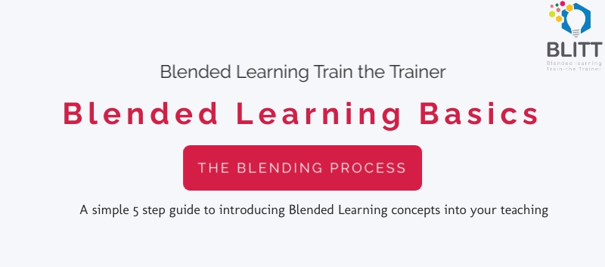
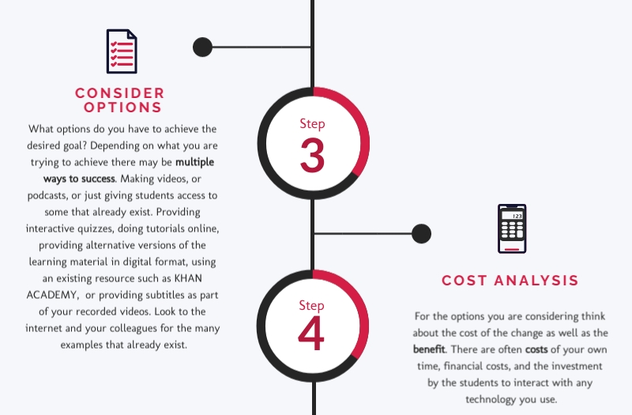
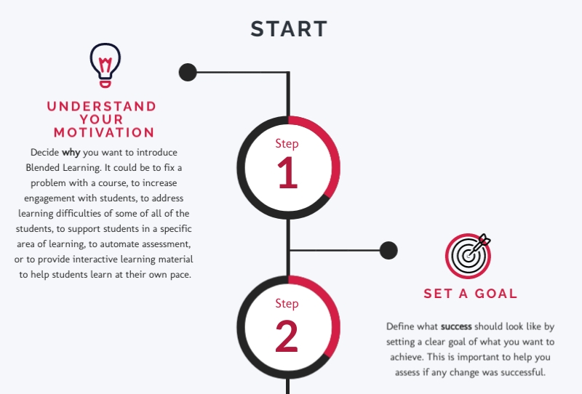
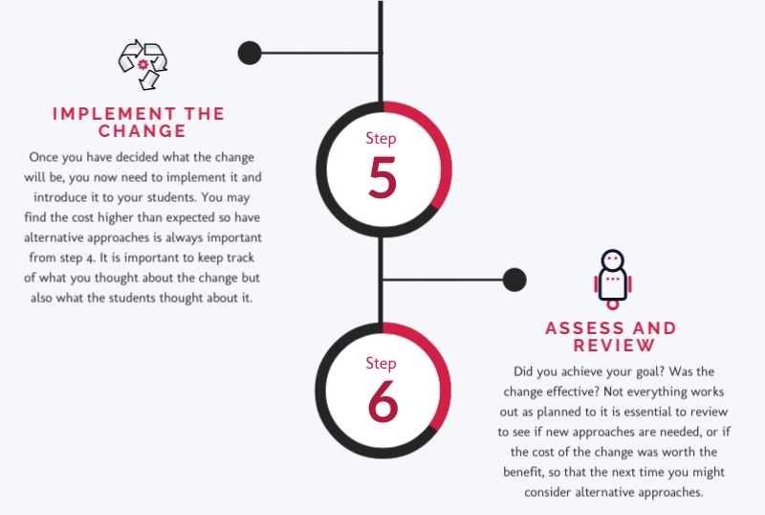

Slide 3
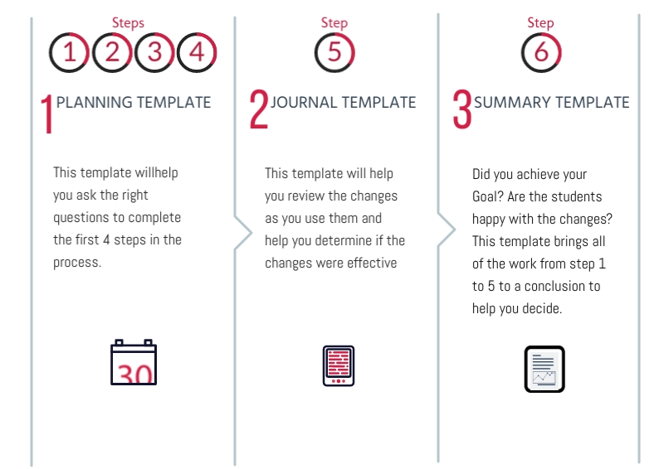

Slide 4
Questions to Answer
1. What is your own definition of Blended Learning?
2. When do you think it is a good idea to blend?
3. What might stop you introducing blended learning?

Slide 5
Blended Learning International Train the Train (BLITT)
CASE STUDY: Applying Blending Learning and Flipped Learning Techniques in Korea using English: Case Study 1
Paul Doyle
Head of School, Computer Science
To Design, Develop, and Evaluate Quality Blended Learning

Slide 6
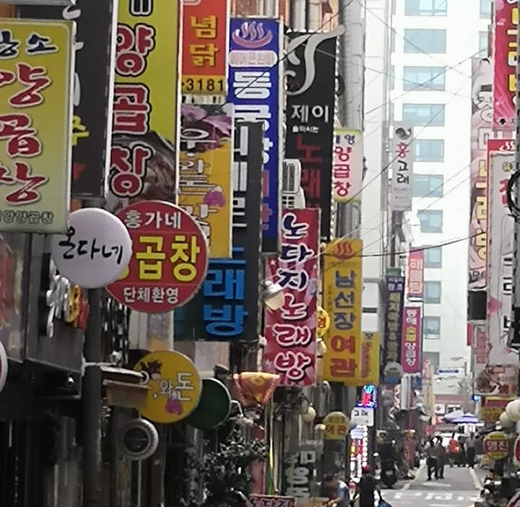
Applying Blending Learning and Flipped Learning Techniques in Korea using English: A Case Study
P. Doyle,
M Szappanyos, B. Gillespie, C. Ennis, V. Rebay, R Shapiro

Slide 7
INTRODUCTION
To Design, Develop, and Evaluate Quality Blended Learning

Slide 8
The Team
P. Doyle, M Szappanyos, B. Gillespie, C. Ennis, V. Rebay, R Shapiro
Notes:
melinda szappanyos, Brian Gillespie, Cathy Ennis, Paul Doyle

Slide 9
Introduction
In 2018 the School of Computer Science, Technological University of Dublin, Ireland (formerly known as Dublin Institute of Technology), decided to develop a new programme for Korean Computing Students on a course called Cloud Computing Technologies.
The team built a flipped classroom compressed delivery module for delivery in Korea with resources provided from Dublin, and evaluation done on-site with the students to evaluate the effectiveness of the delivery model.
To Design, Develop, and Evaluate Quality Blended Learning

Slide 10
Overview
Introduction
AIM of the Case Study
Flipped Learning
What we built
Case Study Assessment
Results and Lessons
Reflections

Slide 11
KNU & TU Dublin
Student Exchange for 6 years
Shared ONLINE courses
Multiple Projects
HUBLINKED, GETM3, GlobalWorkIT
Summer Schools
Double Degree validation

Slide 12
THE CASE
To Design, Develop, and Evaluate Quality Blended Learning

Slide 13
Aim of the Case Study
Strength & weakness of Flipped Classroom approach
Course development with Partners

Slide 14
Overview of Course
Based on blended TU Dublin module
5 ECTS
Target non-native English speakers in South Korea
Compressed delivery (two weeks)
Use Flipped Classroom approach

Slide 15
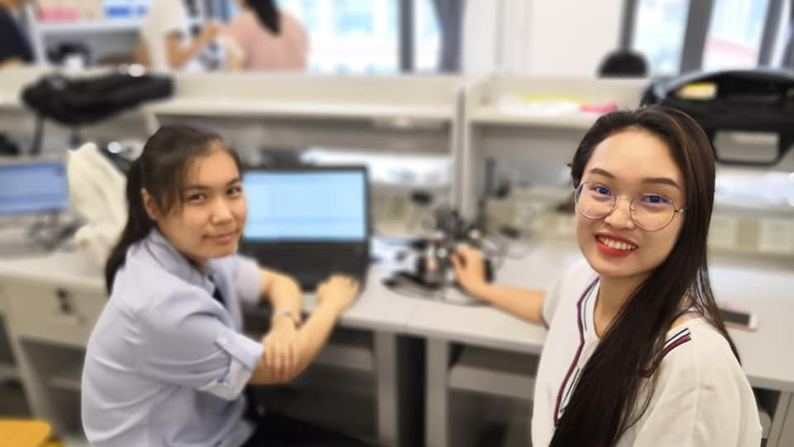
What is Flipped Classroom?

Slide 16
Traditional Learning
Lecture
Homework
Activity
Conversation
Interaction
Collaboration
Motivation
Notes:
Karsh,Yousef-Robert_Oppenheimer-9_February_1956-m

Slide 17
Online Learning
Online
Activity
Online
Lecture
Mobility
Tracking Progress
Globalisation
Flexibility
Notes:
Some of the advantages of online learning.
Mobility – you can learn in any location
Tracking – You can track the progress of students using technology
Globalisation – you can teach people in any location
Flexibility – because you can learn at the pace you want

Slide 18
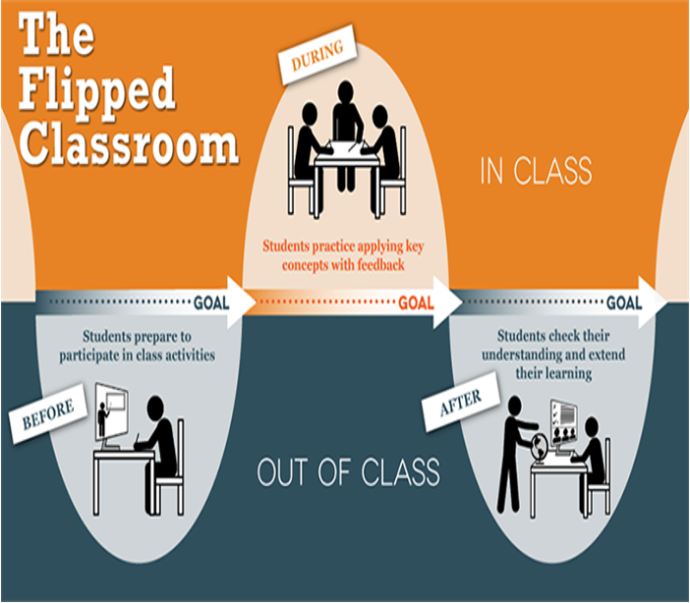
Flipped Learning
Classroom
Activity
Online
Lecture
Classroom/Lab
Interaction
Live
Demonstrations
Web Based Assessments
Digital audio and video content
Notes:
Some of the advantages of online learning.
Mobility – you can learn in any location
Tracking – You can track the progress of students using technology
Globalisation – you can teach people in any location
Flexibility – because you can learn at the pace you want

Slide 19
Teaching & Learning MODEL
2 Week Compressed Delivery
Online Video Material
Daily Labs
(30hrs)
ASSESSMENT Daily
TU Dublin CREDIT
Native Teaching Assistant

Slide 20
What we built
Web platform
slides, transcripts, subtitles
ONLINE VM Environment
Worksheets, Starter code
Live coding
Video lessons, tutorials

Slide 21
Daily Structure

Slide 22
Case Study Assessment
Survey 1. Expectations of the course.
Survey 2: Daily feedback
Survey 3: End of survey
Interview 1: Midpoint of the delivery
Interview 2: End of the course

Slide 23
Student Expectations
1
“I expect to be more prepared for the lectures”
2
“I expect my English skills to improve”
3
“I expect better job opportunities after this experience”

Slide 24
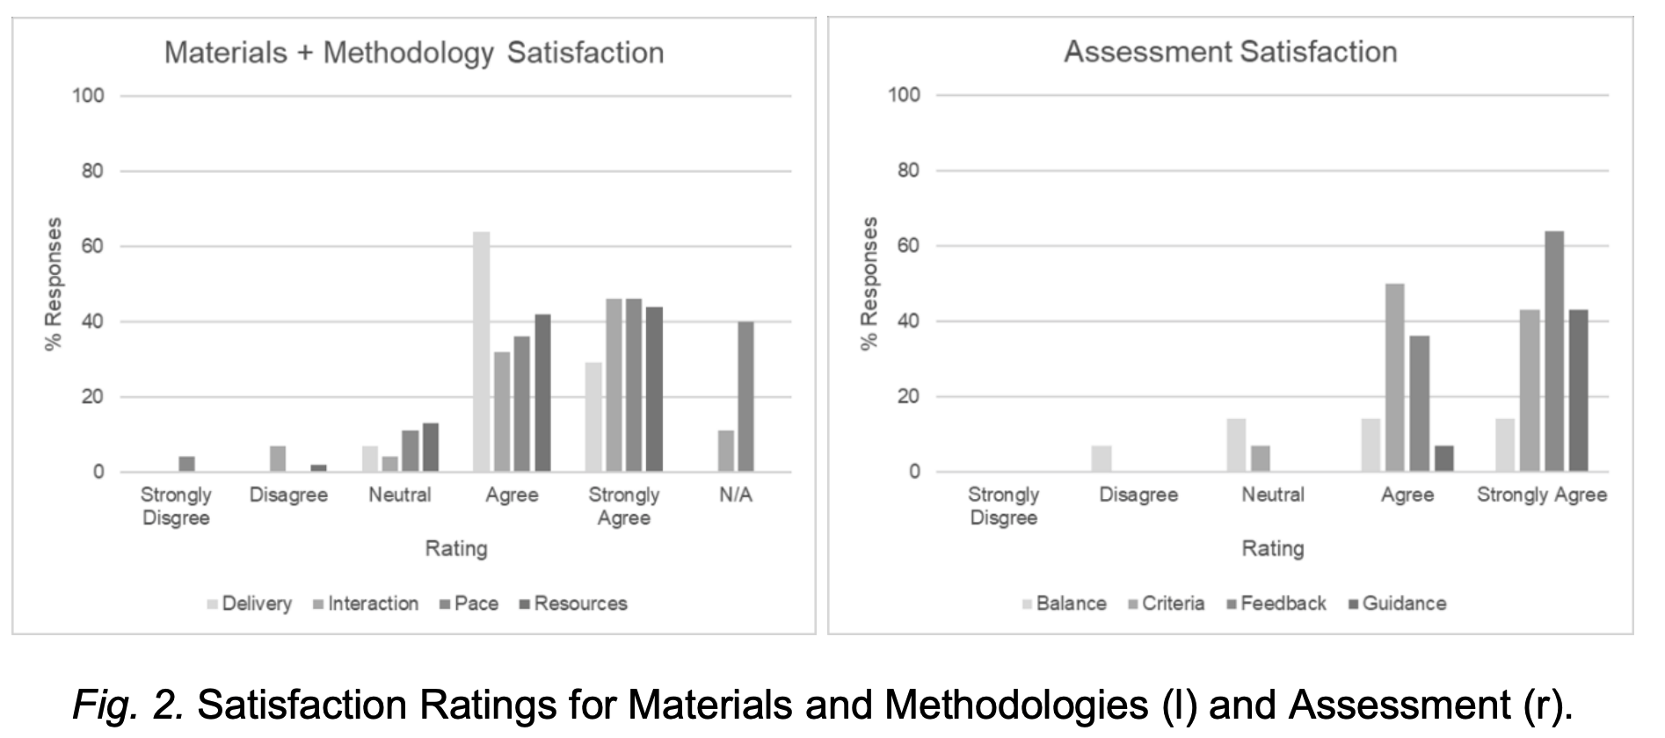
Results

Slide 25
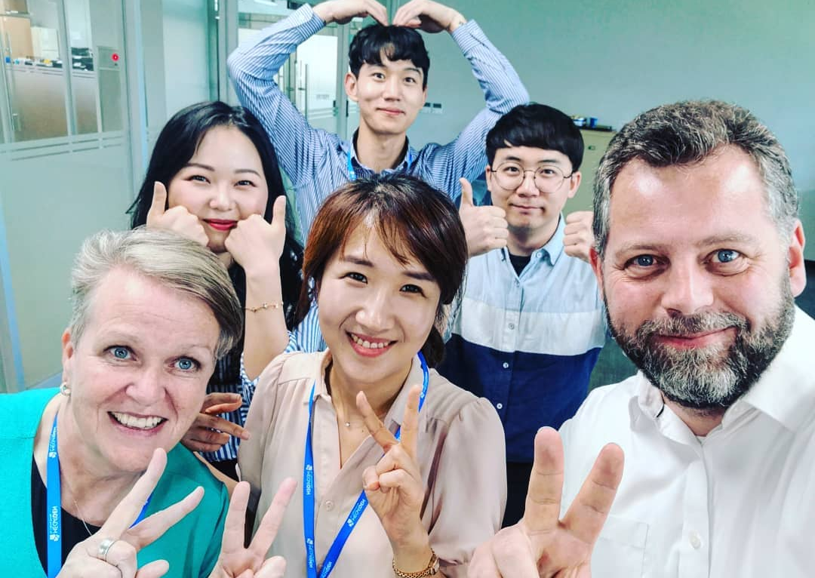
What worked well
LIVE Coding experience
Improving English confidence
Increased interaction over time
Pair programming

Slide 26
ISSUES RAISED
To Design, Develop, and Evaluate Quality Blended Learning

Slide 27
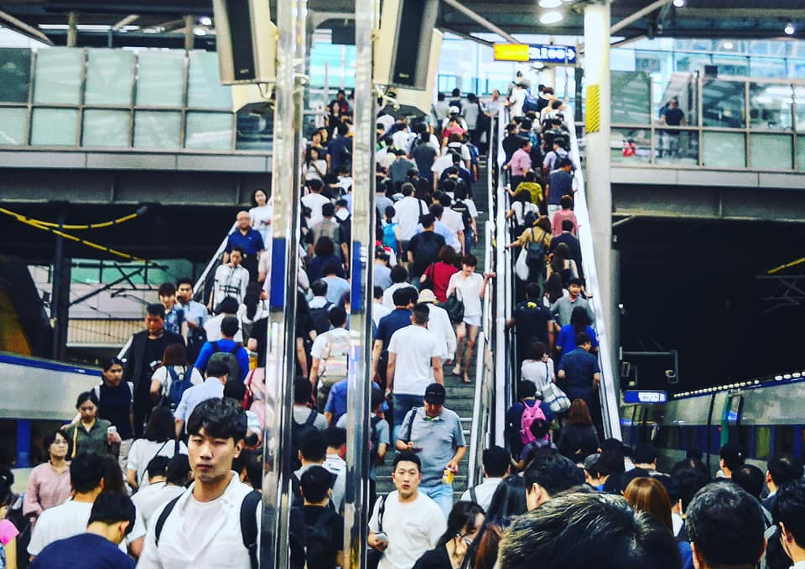
Challenges
Hierarchy within the classroom
Culture
Student Workload
Competitive grading on a curve

Slide 28
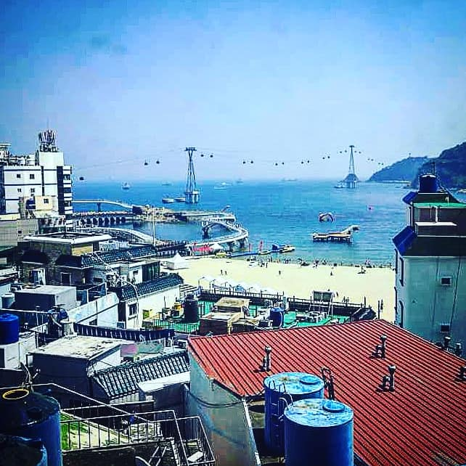
Lessons
Motivation for joining was English not type of delivery
Satisfied with quality of material but struggled with evening work
Pace of course constantly needed adjustment based on daily feedback

Slide 29
Lessons
Need to constant moderate pace of delivery
Constant feedback critical to success of the course (both directions)

Slide 30
CONCLUSIONS
To Design, Develop, and Evaluate Quality Blended Learning

Slide 31
Characteristics of Quality Flipped Learning
It is still about content
Feedback is essential
The assessment is still critical
Preparation is king
The Digital Media used should be of high quality
The use of the media should be cost effective to produce
Notes:
Results from interviews across Europe

Slide 32
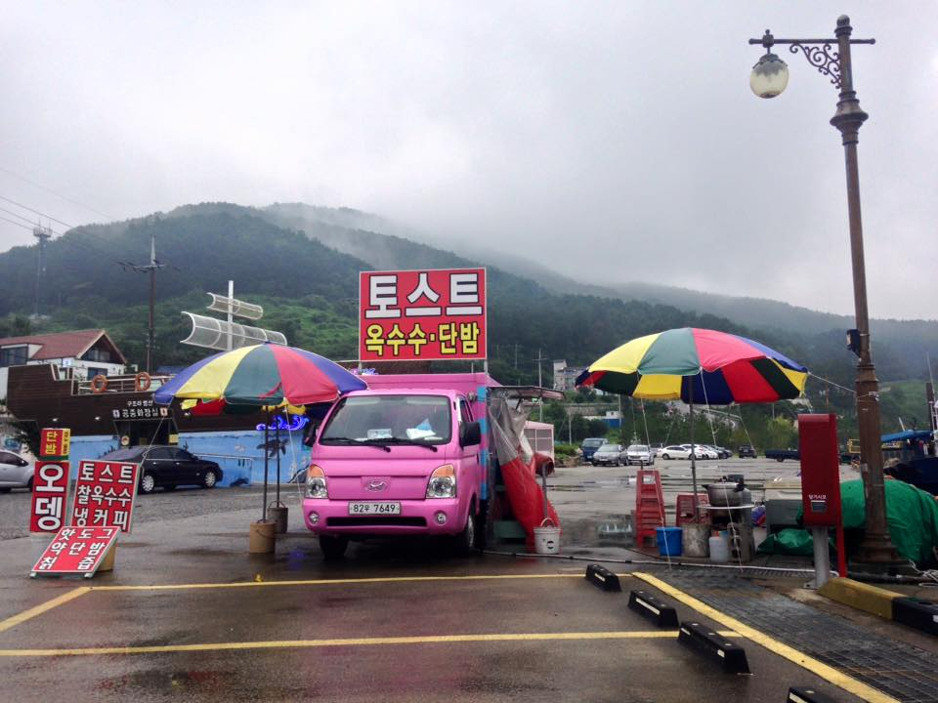
Reflections
Compressed delivery left no room for students to pace
Constant assessment key to keep things focused
Students didn’t understand nature of flipped before taking it
Teamwork and learner engagement was dramatically up despite cultural barrier
Feedback was essential to success

Slide 33
Blended Learning International Train the Train (BLITT)
CASE STUDY: Distributed Team Project “Global Classroom” Case Study 2
Paul Doyle
Head of School, Computer Science
To Design, Develop, and Evaluate Quality Blended Learning

Slide 34
INTRODUCTION
To Design, Develop, and Evaluate Quality Blended Learning

Slide 35
Introduction
In 2016-2022 the School of Computer Science, Technological University of Dublin, Ireland decided to develop a new module to support students studying abroad to integrate in a multi-national team project. This module still runs and is a feature of our international curriculum development.
The team built an online class environment using collaborative technology to develop a project in a distributed team environment.
To Design, Develop, and Evaluate Quality Blended Learning

Slide 36
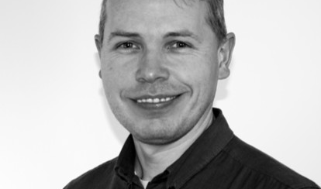
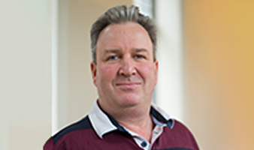
The Team
P. Doyle, B. Gillespie, Paul Bourke, Michael Collins
Notes:
melinda szappanyos, Brian Gillespie, Cathy Ennis, Paul Doyle

Slide 37
THE CASE
To Design, Develop, and Evaluate Quality Blended Learning

Slide 38
Motivation
Notes:
Almost all work in the real world is done by teams regardless of the size of the enterprise
Increasingly, with globalisation, those teams are working in a distributed manner across the globe in different time zones, cultures, assumptions, etc
Global Classroom aims to recreate some of the most important aspects distributed team development, simulating a real-world experience

Slide 39
DETAILS
4-6 MEMBER TEAMS (HIGHLY AUTONOMOUS)
GLOBALLY DISTRIBUTED UP TO 9 HOURS
KOREA AND CHINA
DESIGN & BUILD PROJECTS
TU Dublin-BASED INSTRUCTOR / MENTOR

Slide 40
T&L MODEL
WEEKLY SYNCHRONOUS CHECKPOINT LECTURES AND PRESENTATIONS
ASYNCHRONOUS THEORY VIDEO LESSONS
WEEKLY MENTOR TELECONFERENCES
CONTINUOUS ASSESSMENT
TU Dublin AWARDS CREDIT

Slide 41
How is it Assessed? 100% CA
Team mark
Project Plan 25%
Design document 25%
Implementation 25%
Test Plan & results 10%
Presentation 10%
Project Management 5%
Individual factoring (Team mark) +/- 20%
Weekly participation
Personal Diary Team mean = Team mark
Exit interview

Slide 42
How is it Run?
Student defined meetings
Notes:
Blended Learning Material for lectures (offline)
Coordinator defined online interactive sessions
Student defined team meeting time, some with Mentor

Slide 43
Reflective Diary
Notes:
Weekly
Activities
Reflections
Assessed
Week 3
Week 6
Week 10
Importance
Self awareness
Self improvement
Empowerment
Key to learning process
Strongly sought by employers

Slide 44
WHAT WE BUILT
VIDEO LESSONS (GUEST TEACHERS)
SUPPORTING SLIDES, TEMPLATES, PAPERS
VLE AS COORDINATION POINT
LIVE STREAMING AND RECORDING

Slide 45
ISSUES RAISED
To Design, Develop, and Evaluate Quality Blended Learning

Slide 46
CHALLENGES
COMMUNICATIONS TECHNOLOGY
CULTURE (Expectations)
LANGUAGE
TIMETABLES for distributed groups
“Not invented here” syndrome
Building a team spirit
Notes:
most all work in the real world is done by teams regardless of the size of the enterprise
Increasingly, with globalisation, those teams are working in a distributed manner across the globe in different time zones, cultures, assumptions, etc
Global Classroom aims to recreate some of the most important aspects distributed team development, simulating a real-world experience

Slide 47
CONCLUSIONS
To Design, Develop, and Evaluate Quality Blended Learning

Slide 48
WHAT WORKS WELL
MAINTAINING REGULAR TOUCH POINTS
FEEDBACK AND STATUS REPORTS
VIDEO LESSONS supported learning
REAL-WORLD SCENARIOS caused focus
TEAM DEVELOPMENT using reflective practices
DEVELOPMENT OF INDIVIDUAL CONFIDENCE

Slide 49
Blended Learning International Train the Train (BLITT)
CASE STUDY: Mobile Application Development Case Study 3
Paul Doyle
Head of School, Computer Science
To Design, Develop, and Evaluate Quality Blended Learning

Slide 50
Case Study 3
MOBILE APP DEVELOPMENT
ENGLISH LANGUAGE TECHNICAL LEARNING

Slide 51
INTRODUCTION
To Design, Develop, and Evaluate Quality Blended Learning

Slide 52
Introduction
In 2018 the School of Computer Science, Technological University of Dublin, Ireland decided to develop a new module in collaboration with a Chinese Partner to teaching Chinese students about mobile application development.
The team built an online class environment with supporting local teaching practices.
To Design, Develop, and Evaluate Quality Blended Learning

Slide 53
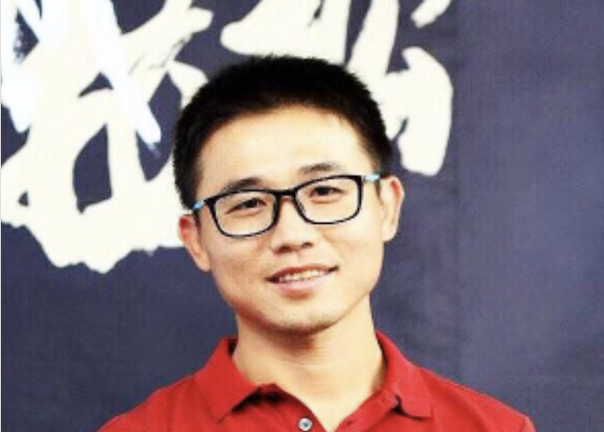
The Team
P. Doyle, B. Gillespie, Jiang Zheng,
Notes:
melinda szappanyos, Brian Gillespie, Cathy Ennis, Paul Doyle

Slide 54
THE CASE
To Design, Develop, and Evaluate Quality Blended Learning

Slide 55
Distance blended learning
Existing university Partnerships
Students located in Europe / Asia
courses design in TU DUBLIN
Computer science theory and practice

Slide 56
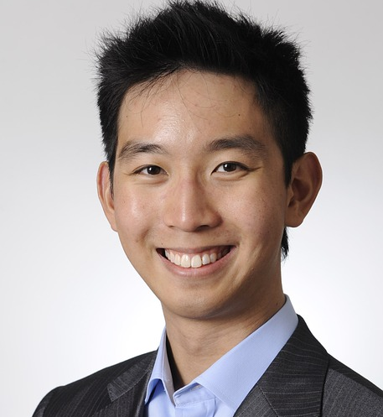
DETAILS
SINGLY-LOCATED CLASS (~30 STUDENTS)
BEIJING, CHINA
MOBILE APP TECHNOLOGY THEORY & PRACTICE
FOREIGN LANGUAGE (ENGLISH)
TU Dublin PRIMARY INSTRUCTORS

Slide 57
Teaching & Learning MODEL
WEEKLY SYNCHRONOUS CHECKPOINT LECTURES
ASYNCHRONOUS VIDEO LESSONS AND TUTORIALS
WEEKLY LABORATORIES (LOCAL TA)
CONTINUOUS ASSESSMENT WITH CAPSTONE PROJECT
PARTNER CREDIT AWARD

Slide 58
Online Lab Reports daily
Lab Worksheets
Capstone Project
Assessment
Solutions to
worksheets
Notes:
Assessment consisted of an online lab reports completed daily, In-lab worksheets of increasing difficulty and a capstone project. As each day passed, students had access to solutions for previous labs, helping them review any areas where they did not score well.

Slide 59
WHAT WE BUILT
VIDEO LESSONS, TUTORIALS & EXPLAINERS
SLIDES, TRANSCRIPTS, SUBTITLES
LABORATORY WORKSHEETS
GROUP FORUM
FINAL FACE-TO-FACE PRESENTATION

Slide 60
ISSUES RAISED
To Design, Develop, and Evaluate Quality Blended Learning

Slide 61
CHALLENGES
COMMUNICATIONS TECHNOLOGY
LANGUAGE COMPREHENSION
INITIAL WORKLOAD
MATERIAL DISTRIBUTION

Slide 62
CONCLUSIONS
To Design, Develop, and Evaluate Quality Blended Learning

Slide 63
WHAT WORKS WELL
STUDENTS LOVE LEARNING EXPERIENCE
IMPROVING ENGLISH SKILLS / CONFIDENCE
GREAT PROJECTS
PARTNER RELATIONS

Slide 64
Focus on Engagement
Practice contact hours have strong continuous assessment component
Weekly or bi-weekly submissions for credit
Attendance of a particular % required
Teamwork and learner engagement is dramatically up

Slide 65
Characteristics of Quality Blended Learning
It is still about content
We can reach more people
The assessment is still critical
Notes:
Results from interviews across Europe

Slide 66
Focus on content quality
The Digital Media used should be of high quality (especially Audio)
The use of the media should be cost effective to produce
We want to build a better learning experience

Slide 67
It is still about content!

Slide 68
Internship (video blogs not reports) Robots (Virtual environments during covid, then hybrid)

Slide 69
Final Thoughts
FAILURE is always an option
The size of the change doesn’t matter, just the impact

Slide 70
Thanks Q&A
Failure is always an option!

