Slide 1
Biographies

Slide 2
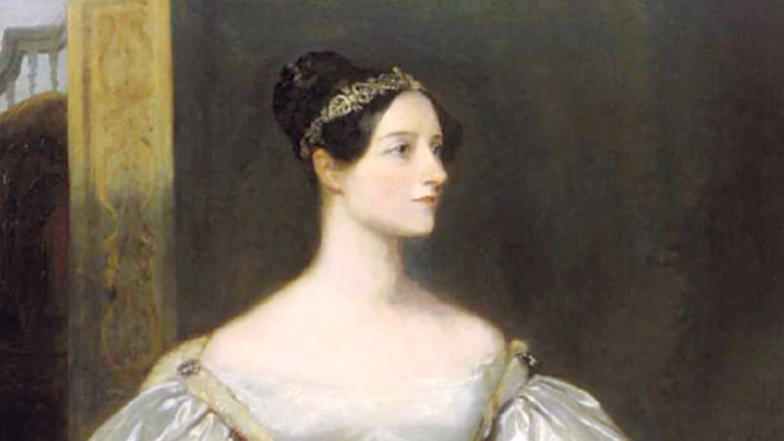
Ada Lovelace
Born: Dec 10, 1815
Died: Nov 27, 1852
Born in London
THE WORLD’S FIRST COMPUTER PROGRAMMER

Slide 3
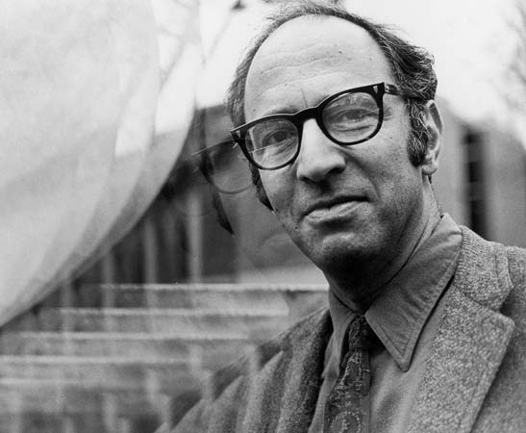
Thomas Kuhn
Born: July 18, 1922
Died: June 17, 1996
Born in Cincinnati, Ohio
Wrote extensively on the history of science

Slide 4
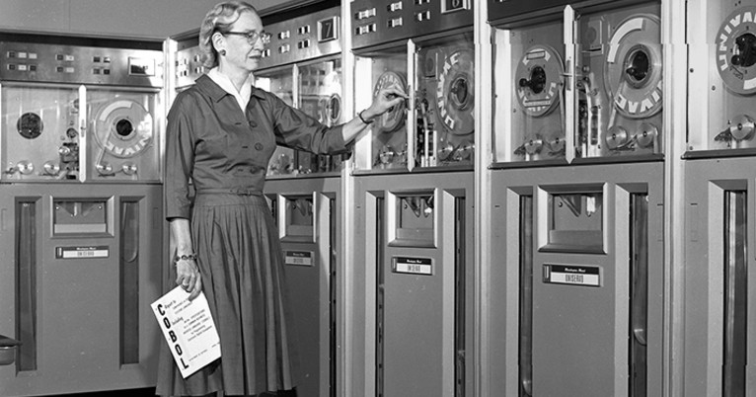
Grace Hopper
Born: Dec 9, 1906
Died: Jan 1, 1992
Born in New York
Pioneer of computer programming

Slide 5
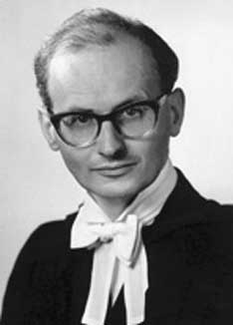
Imre Lakatos
Born: Nov 9, 1922
Died: Feb 2, 1974
Born in Debrecen, Hungary
Philosopher of mathematics and science

Slide 6
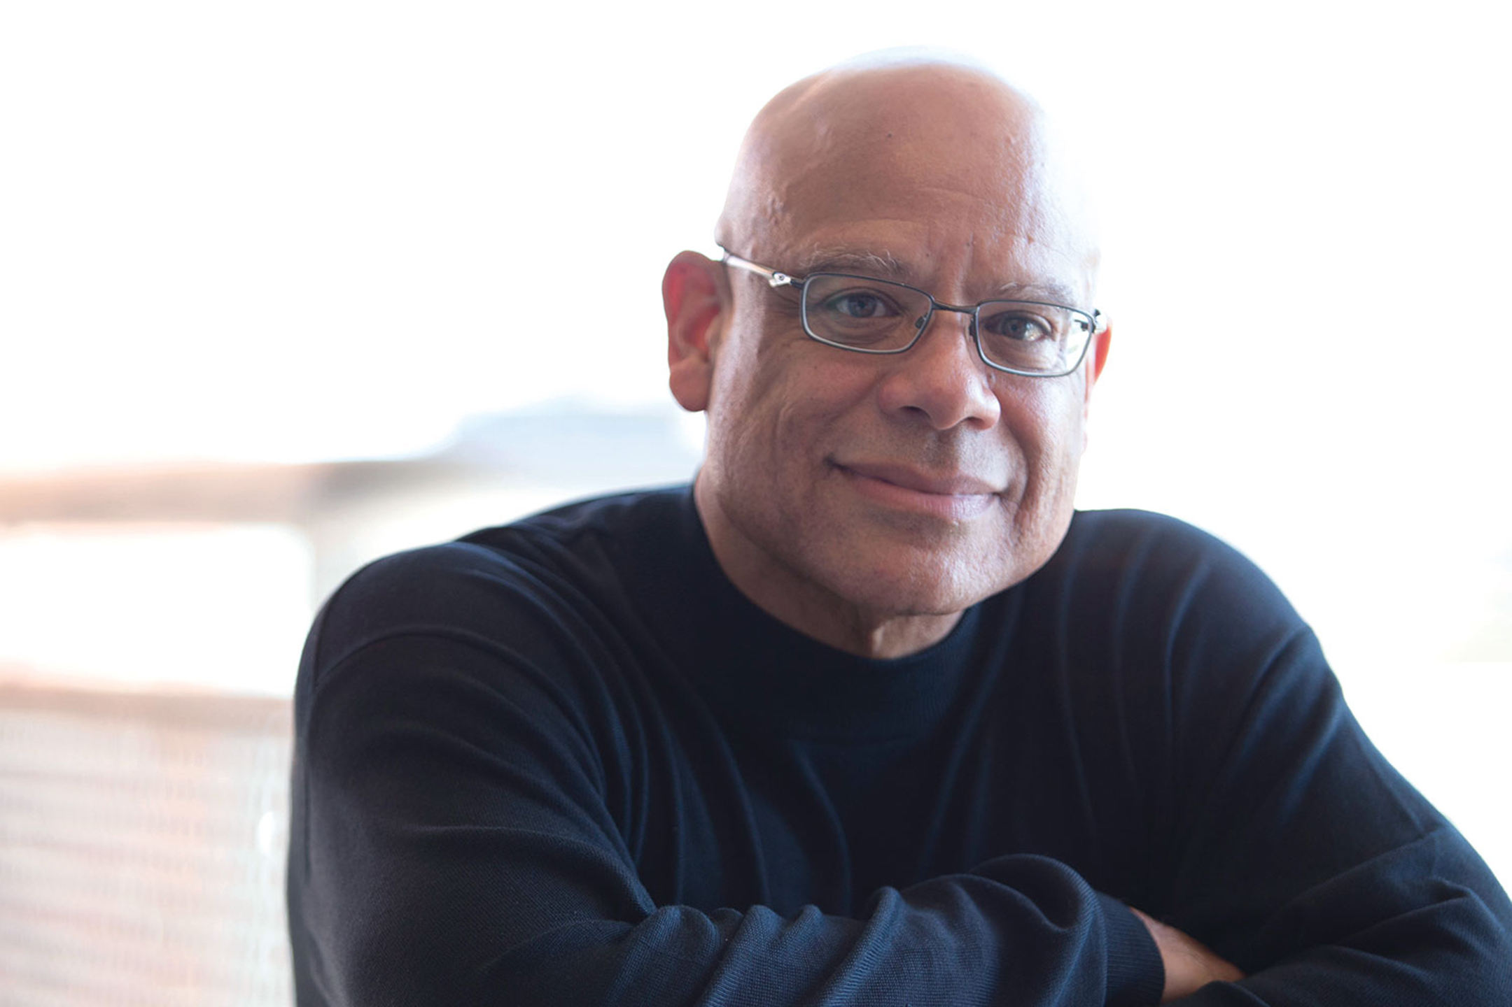
Mark Dean
Born: March 2, 1957
Born in Jefferson City, Tennessee
Co-creator of the IBM PC

Slide 7
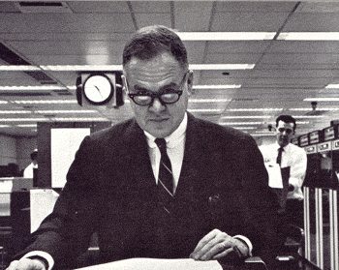

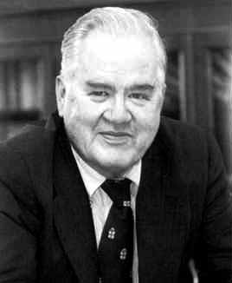
John Tukey
Born June 16, 1915
Died July 26, 2000
Born in New Bedford, Massachusetts
He introduced the box plot in his 1977 book,"Exploratory Data Analysis"
Also the Cooley–Tukey FFT algorithm and jackknife estimation

Slide 8
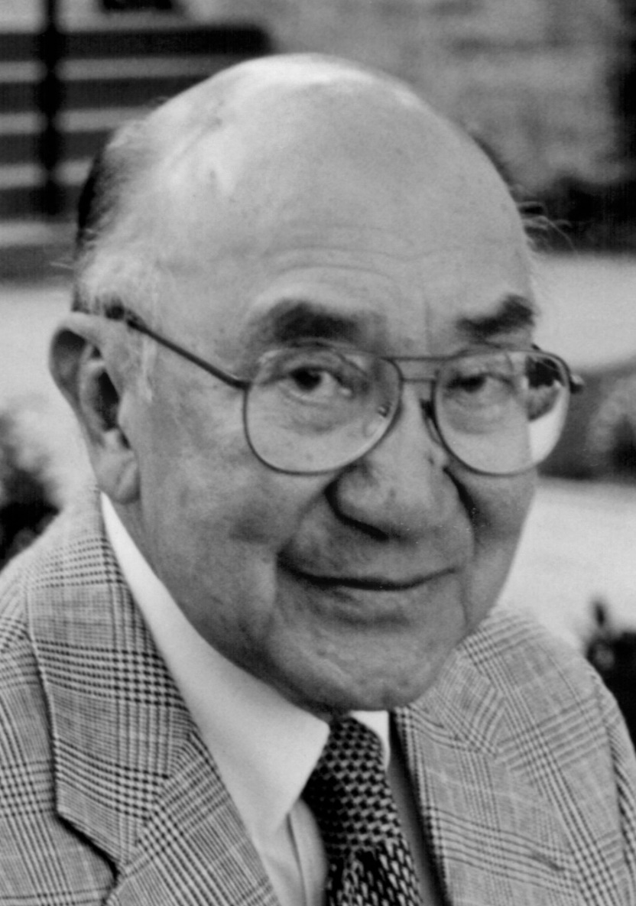
Jeffrey Chuan Chu 朱傳榘
Born July 14, 1919
Died June 6, 2011
Born in Tianjin, China
A pioneer computer engineer, a member of the engineering team that designed the first American electronic computer, the ENIAC.
He was awarded the 1981 (the first) IEEE Computer Society Computer Pioneer Award.

Slide 9
Timelines

Slide 10
Scientific
Method
280BC Libraries with Index
1000 Collaborative Encyclopedia
1410 Cross-referenced Encyclopedia
1550 Invention of the Fact
1590 Controlled Experiments
1609 Scopes and Laboratories
1687 Hypothesis/Prediction
1650 Societies of Experts
1665 Necessary Repeatability
1752 Peer Review Referee
1780 Journal Network
1920 Falsifiable Testability
1926 Randomized Design
1937 Controlled Placebo
1950 Double Bind Refinement
1946 Computer simulations
1974 Meta-analysis

Slide 11
1992
V0.01
1993
Slackware
1994
SUSE
1996
V2
2000
Knoppix
2002
Gentoo
2004
Ubuntu
2006
Alpine
2008
Musix
2011
Mageia
1993
Debian
1994
V1
1995
Red Hat
2002
Arch
2003
Fedora
2004
CentOS
2006
Oracle
2008
Android
2011
V3

Slide 12
Pictures of animals

Slide 13
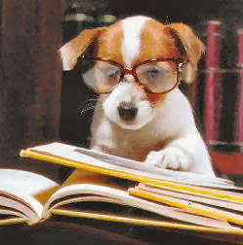
During the late nineteenth century, the public was especially interested in animal intelligence due in a large part to Charles Darwin’s, and Francis Galton’s, then-recent publications.

Slide 14
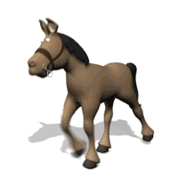
Clever Hans
Hans was a horse owned by Wilhelm von Osten, who said he had taught Hans to add, subtract, multiply, divide, work with fractions, tell time, keep track of the calendar, differentiate musical tones, and read, spell, and understand German.

Slide 15
Poems

Slide 16
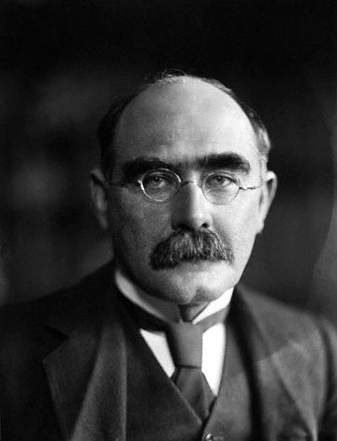
"I Keep Six Honest Serving Men ..."
I keep six honest serving-men
(They taught me all I knew);
Their names are What and Why and When
And How and Where and Who.
I send them over land and sea,
I send them east and west;
But after they have worked for me,
I give them all a rest.
I let them rest from nine till five,
For I am busy then,
As well as breakfast, lunch, and tea,
For they are hungry men.
But different folk have different views;
I know a person small-
She keeps ten million serving-men,
Who get no rest at all!
She sends'em abroad on her own affairs,
From the second she opens her eyes-
One million Hows, two million Wheres,
And seven million Whys!
- Rudyard Kipling

Slide 17
Tell a story

Slide 18
A Typical Day

Slide 19
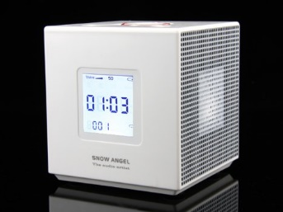
A Typical Day
Wake up

Slide 20
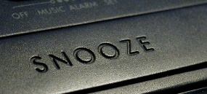
A Typical Day
Wake up

Slide 21
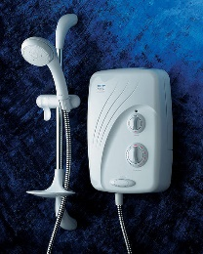
A Typical Day
Wake up
Shower

Slide 22
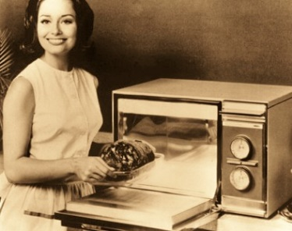
A Typical Day
Wake up
Shower
Microwave

Slide 23
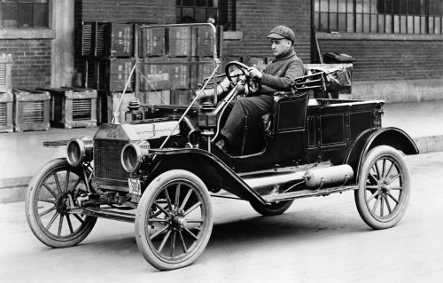
A Typical Day
Wake up
Shower
Microwave
Car

Slide 24
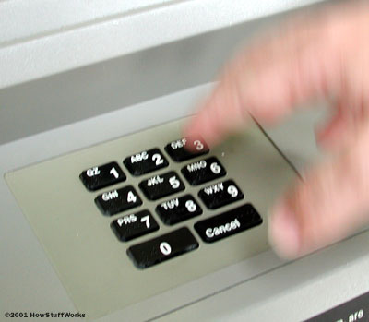
A Typical Day
Wake up
Shower
Microwave
Car
ATM

Slide 25

A Typical Day
Wake up
Shower
Microwave
Car
ATM
Work

Slide 26

A Typical Day
Wake up
Shower
Microwave
Car
ATM
Work

Slide 27
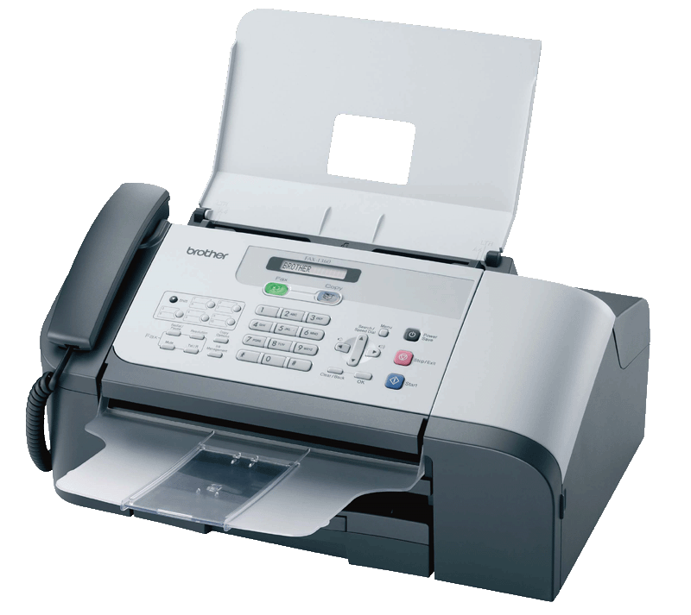
A Typical Day
Wake up
Shower
Microwave
Car
ATM
Work

Slide 28
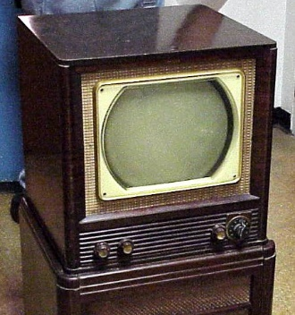
A Typical Day
Wake up
Shower
Microwave
Car
ATM
Work
Home

Slide 29
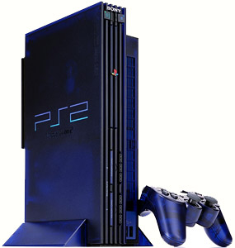
A Typical Day
Wake up
Shower
Microwave
Car
ATM
Work
Home

Slide 30
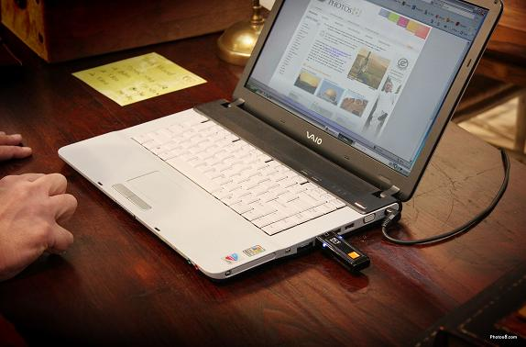
A Typical Day
Wake up
Shower
Microwave
Car
ATM
Work
Home

Slide 31
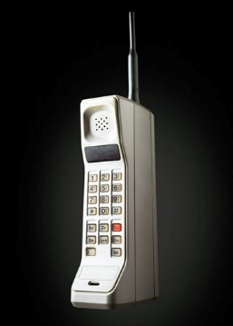
A Typical Day
Wake up
Shower
Microwave
Car
ATM
Work
Home

Slide 32
BIG Pictures

Slide 33
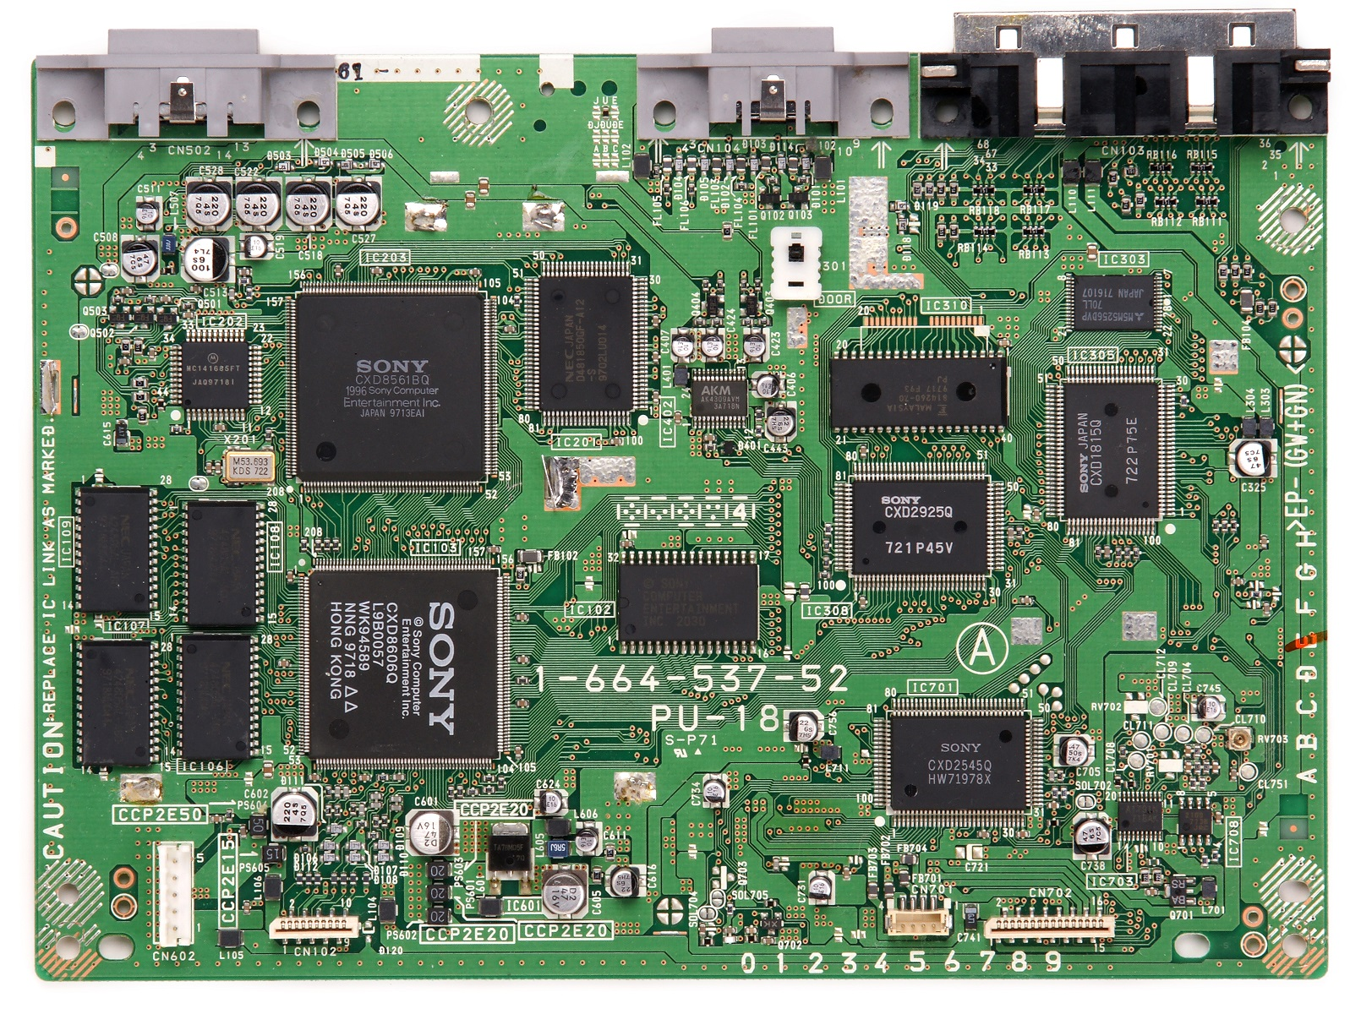

Slide 34
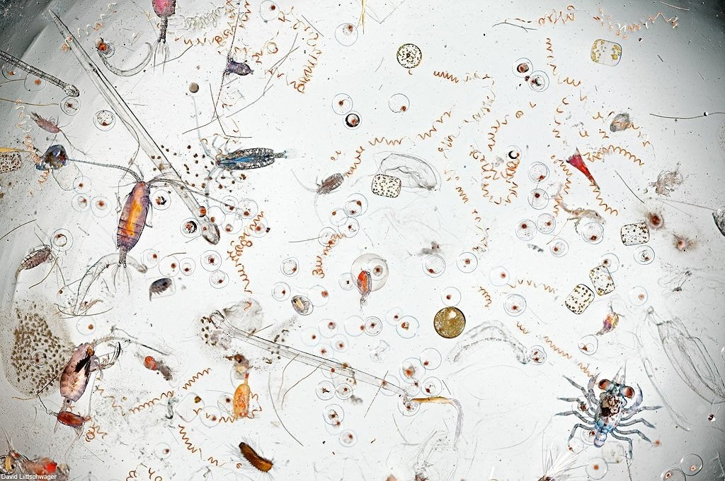

Slide 35
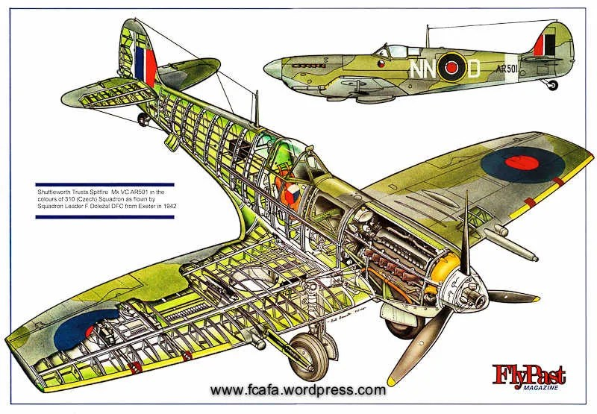

Slide 36
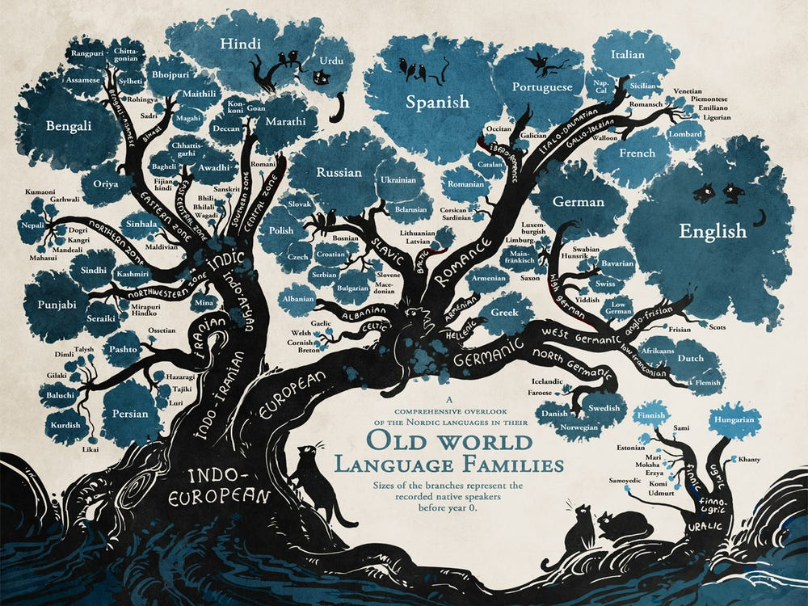

Slide 37
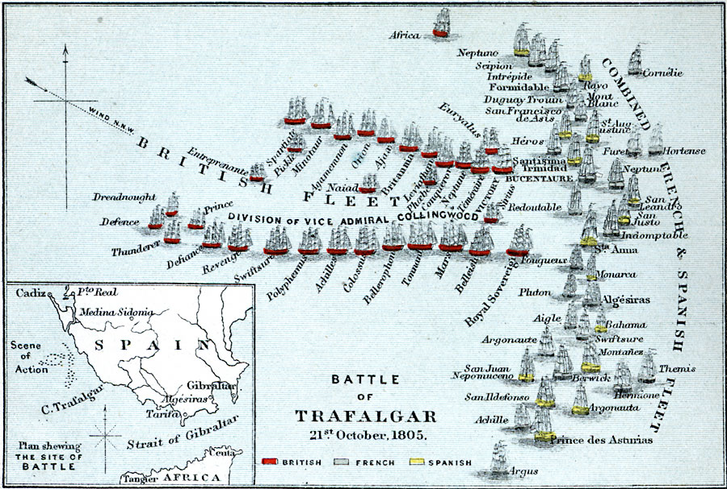

Slide 38
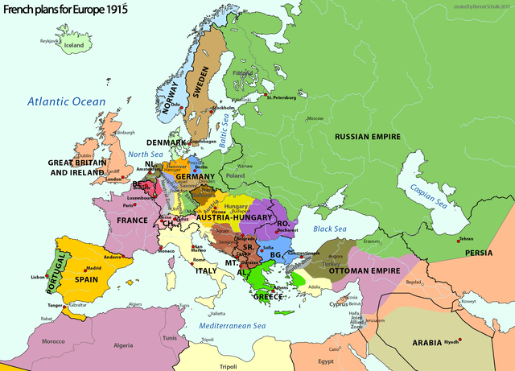

Slide 39
Animations

Slide 40

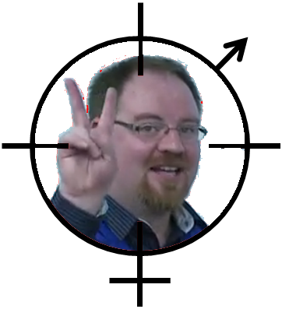
Target
GPS ON
GAME STARTING 3 2 1

Slide 41



Proportion of all APPs downloaded US/China
November 2011
January 2011
November 2011

