Slide 1
How I write lectures
Damian Gordon

Slide 2
Format of Talk
Three parts:
Prepare
Develop
Reflect

Slide 3
Format of Talk
Three parts:
Prepare
Develop
Reflect
Define
Design
Redesign

Slide 4
Format of Talk
Three parts:
Prepare
Develop
Reflect
Define
Design
Redesign
Beginning
Middle
End

Slide 5
Format of Talk
Three parts:
Prepare
Develop
Reflect
1
Define
Design
Redesign
Beginning
Middle
End
2
3

Slide 6
Format of Talk
Three parts:
Prepare
Develop
Reflect
1
Define
Design
Redesign
Beginning
Middle
End
2
3
4
5
6

Slide 7
Format of Talk
Three parts:
Prepare
Develop
Reflect
1
Define
Design
Redesign
Beginning
Middle
End
2
3
4
5
6
7
8
9

Slide 8
Prepare

Slide 9
Prepare
What resources do I use to get started?

Slide 10
Prepare
Previous lecturer’s notes
Other lecture notes online
My own college notes ☺

Slide 11
Prepare
Textbooks
Conference and Journal papers
Magazines

Slide 12
Prepare
News events
My work experience
Other Web content
e.g. Wikipedia
e.g. On-line resources
e.g. Slideshare

Slide 13
Develop

Slide 14
Develop
Define
Design
Redesign

Slide 15
Develop: Define

Slide 16
Define
What is the theme of this lecture?

Slide 17
Define
What is the theme of this lecture?
I find it hard to write the lesson until I know the theme

Slide 18
Define
What is the theme of this lecture?
I find it hard to write the lesson until I know the theme, e.g. efficiency, simplicity, accuracy

Slide 19
Define
I like to base my lectures around a number.

Slide 20
Define
I like to base my lectures around a number.
In this case 3, everything comes in 3s

Slide 21
Define
I like to base my lectures around a number.
In this case 3, everything comes in 3s
Sometimes I use 6 or 8

Slide 22
Define
Sometime I visualize the lecture as a shape

Slide 23
Define
Sometime I visualize the lecture as a shape

Slide 24
Define
Sometime I visualize the lecture as a shape

Slide 25
Define
Sometime I visualize the lecture as a shape

Slide 26
Define
Sometime I visualize the lecture as a shape

Slide 27
Develop: Design

Slide 28
Design
Lectures have 3 parts:
Beginning
Middle
End

Slide 29
Design
Lectures have 3 parts:
Beginning
Middle
End
1. Gain the students’ attention
2. Tell them the goal of this class
3. Tie it into what they know already

Slide 30
Design
Lectures have 3 parts:
Beginning
Middle
End
1. Gain the students’ attention
2. Tell them the goal of this class
3. Tie it into what they know already
4. Present an example and the information
5. Provide help on understanding the material
6. Ask them to do something to learn

Slide 31
Design
Lectures have 3 parts:
Beginning
Middle
End
1. Gain the students’ attention
2. Tell them the goal of this class
3. Tie it into what they know already
4. Present an example and the information
5. Provide help on understanding the material
6. Ask them to do something to learn
7. Give feedback and advice to the students
8. Give they students a proper assessment
9. Finish it off

Slide 32
Design
Beginning
1. Gain the students’ attention
2. Tell them the goal of this class
3. Tie it into what they know already

Slide 33
Design
Beginning
1. Gain the students’ attention
2. Tell them the goal of this class
3. Tie it into what they know already

Slide 34
1. Gain the students’ attention
Silence
A joke
A magic trick
Music video
Clip of a film
A quote

Slide 36
Design
Beginning
1. Gain the students’ attention
2. Tell them the goal of this class
3. Tie it into what they know already

Slide 37
2. Tell them the goal of this class
List the learning goals
Tell a simple story
Mention this might be coming up in the exam

Slide 38
Design
Beginning
1. Gain the students’ attention
2. Tell them the goal of this class
3. Tie it into what they know already

Slide 39
3. Tie it into what they know already
Something we covered in the last class
Something they covered in another module
Something they did in secondary school

Slide 40
Design
Middle
4. Present an example and the information
5. Provide help on understanding the material
6. Ask them to do something to learn

Slide 41
DesigN
Middle
4. Present an example and the information
5. Provide help on understanding the material
6. Ask them to do something to learn

Slide 42
4. Present an example and the information
THE CONTENT
Start with an example
Present the information
Include computer science specific notation
Include computer science specific diagrams
Explain the theory as well as the details

Slide 43
4. Present an example and the information
Find excellent online videos from great computer lecturers.

Slide 44
DesigN
Middle
4. Present an example and the information
5. Provide help on understanding the material
6. Ask them to do something to learn

Slide 45
5. Provide help on understanding the material
Links
Videos
See Sample Notes

Slide 46
Design
Middle
4. Present an example and the information
5. Provide help on understanding the material
6. Ask them to do something to learn

Slide 47
6. Ask them to do something to learn
Active Learning
Three things we’ve covered
Write a one-minute essay
Do a quiz
Tweet or Google

Slide 48
Design
End
7. Give feedback and advice to the students
8. Give they students a proper assessment
9. Finish it off

Slide 49
Design
End
7. Give feedback and advice to the students
8. Give they students a proper assessment
9. Finish it off

Slide 50
7. Give feedback and advice to the students
I like that you…
I would have liked if you…

Slide 51
Design
End
7. Give feedback and advice to the students
8. Give they students a proper assessment
9. Finish it off

Slide 52
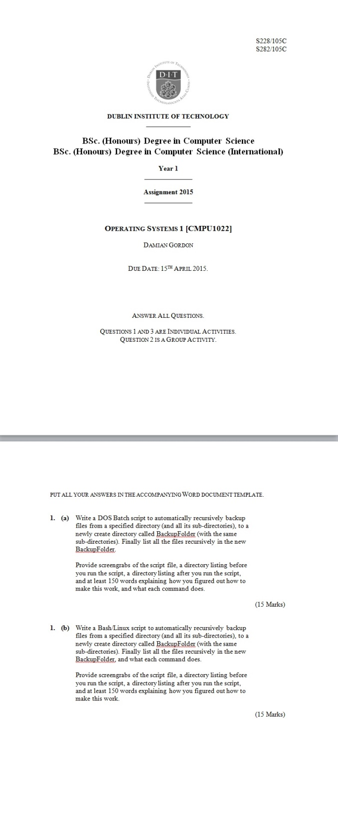

Slide 53
Design
End
7. Give feedback and advice to the students
8. Give they students a proper assessment
9. Finish it off

Slide 54
9. Finish it off
Summarize what we did…
Give any final instructions…

Slide 55
Develop: Redesign

Slide 56
Redesign
Rewrite lecture:
Version 1, first complete version

Slide 57
Redesign
Rewrite lecture:
Version 1, first complete version
Version 2, is there any part that can be taken out (and maybe developed into a separate lecture? Or just removed)

Slide 58
Redesign
Rewrite lecture:
Version 1, first complete version
Version 2, is there any part that can be taken out (and maybe developed into a separate lecture? Or just removed)
Version 3, bring balance to all sections (harmony)

Slide 59
Redesign
Rewrite lecture:
Version 1, first complete version
Version 2, is there any part that can be taken out (and maybe developed into a separate lecture? Or just removed)
Version 3, bring balance to all sections (harmony)
Version 4, add in some jokes

Slide 60
Redesign
Simplify the language
Prepare
Develop
Reflect

Slide 61
Redesign
Simplify the language
Preparation
Development
Reflection
Prepare
Develop
Reflect

Slide 62
Redesign
Rehearsal, rehearsal, rehearsal,

Slide 63
Redesign
Rehearsal, rehearsal, rehearsal,

Slide 64
Redesign
Rehearsal, rehearsal, rehearsal,
Tiny

Slide 65
Reflect

Slide 66
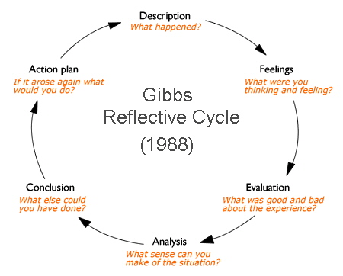
Reflect

Slide 67
Open Education
Full-package courses (1 of 2)
Connexions http://cnx.org/
MIT OpenCourseWare http://ocw.mit.edu/index.htm
MITx http://mitx.mit.edu/
Open Course Library http://opencourselibrary.org/

Slide 68
Open Education
Full-package courses (2 of 2)
Saylor Foundation http://www.saylor.org/
Coursera https://www.coursera.org/
FutureLearn https://www.futurelearn.com/
Udacity https://www.udacity.com/courses/all

Slide 69
Open Education
Video
Academic Earth http://academicearth.org/
Khan Academy http://www.khanacademy.org/
YouTube http://www.youtube.com

Slide 70
Open Education
Repositories
Merlot http://www.merlot.org/
OER Commons http://www.oercommons.org/
National Repository of Online Courses (NROC)
http://www.montereyinstitute.org/nroc/nrocdemos.html
iTunesU http://www.apple.com/education/itunes-u

Slide 71
Open Education
Textbooks
Flatworld Knowledge http://www.flatworldknowledge.com/
Global Textbook Project http://globaltext.terry.uga.edu/.
National Academies Press http://www.nap.edu/.
WikiBooks http://en.wikibooks.org/wiki/Main_Page.

Slide 72
Reflect

Slide 73
Reflect
More rehearsal
Tiny

Slide 74
Thank You

