Slide 1
Blended Learning International Train the Train (BLITT)
Case study: The potential of a student response system in a hybrid learning scenario
Mariana Rocha
Assistant Lecturer
To Design, Develop, and Evaluate Quality Blended Learning

Slide 2
INTRODUCTION
To Design, Develop, and Evaluate Quality Blended Learning

Slide 3
Introduction
In 2021, students returned to campus for in person classes
However, the COVID-19 pandemic was still a reality and the government guidelines required students who tested positive for COVID or were a close contact of someone who tested positive to isolate at home
To Design, Develop, and Evaluate Quality Blended Learning

Slide 4
Introduction
To avoid students missing classes, TU Dublin motivated lecturers to stream the classes online, allowing a hybrid learning mode
Hybrid learning has many positive aspects – however, the level of student’s engagement can be an issue
To Design, Develop, and Evaluate Quality Blended Learning

Slide 5
Introduction
Classes were streamed online using Microsoft Teams or the University’s VLE classroom system (Bongo) to students who could not join in person
Some student learning from home could feel isolated and not comfortable to interact using the chat, microphone or camera
To Design, Develop, and Evaluate Quality Blended Learning

Slide 6
Introduction
Large groups of students suffer from high levels of peer pressure, which can lead to lower levels of student interaction
Student engagement can be directly related to academic achievement – high levels of engagement result in higher performance and development of critical thinking
To Design, Develop, and Evaluate Quality Blended Learning

Slide 7
THE CASE
To Design, Develop, and Evaluate Quality Blended Learning

Slide 8
The Case
Large groups of students in a hybrid environment
Databases 1 – 120 students
Rich Web App – 65 students
Low levels of student’s engagement / interaction
Difficulty in diagnosing learning performance
To Design, Develop, and Evaluate Quality Blended Learning

Slide 9
The Case
Intervention:
Student Response System (SRS): Kahoot! and Vevox, combined with a empathic approach
The approach resulted in a higher level of student engagement
To Design, Develop, and Evaluate Quality Blended Learning

Slide 10
Empathic teaching
According to Feshbach & Feshbach (2009), the empathic communication by the teacher can result in greater understanding and acceptance, leading students to have more positive attitudes towards themselves and their learning process.
To Design, Develop, and Evaluate Quality Blended Learning

Slide 11
Empathic teaching
CMPU 2007 – Databases 1: very low levels of engagement on Mondays; empathic communication allowed to identify students had a number of other classes on that day and felt tired.
Possible solution: adoption of a game-based learning approach.
To Design, Develop, and Evaluate Quality Blended Learning

Slide 12
Game-based learning
Game-based learning is well known in the literature to improve classroom engagement and active participation. The tools adopted to implement this approach:
Kahoot!: user-generated multiple-choice quizzes that can be accessed via a web browser or the Kahoot! app
Vevox: An audience engagement tool that enhances online, hybrid, and face-to-face sessions with options for live polling, quizzes
To Design, Develop, and Evaluate Quality Blended Learning

Slide 13
Game-based learning: comparing the tools
Kahoot! | Vevox
Better use of game mechanics – colourful animations, final podium, response time included in the final score | Formal, very simple implementation of leaderboard (multiple participants taking the same position), no final podium
Free version limited to 20 players per game | TU Dublin license allows up to 5,000 players
Both tools allow participants to answer the questions from their phones, tablets or laptops.
To Design, Develop, and Evaluate Quality Blended Learning

Slide 14
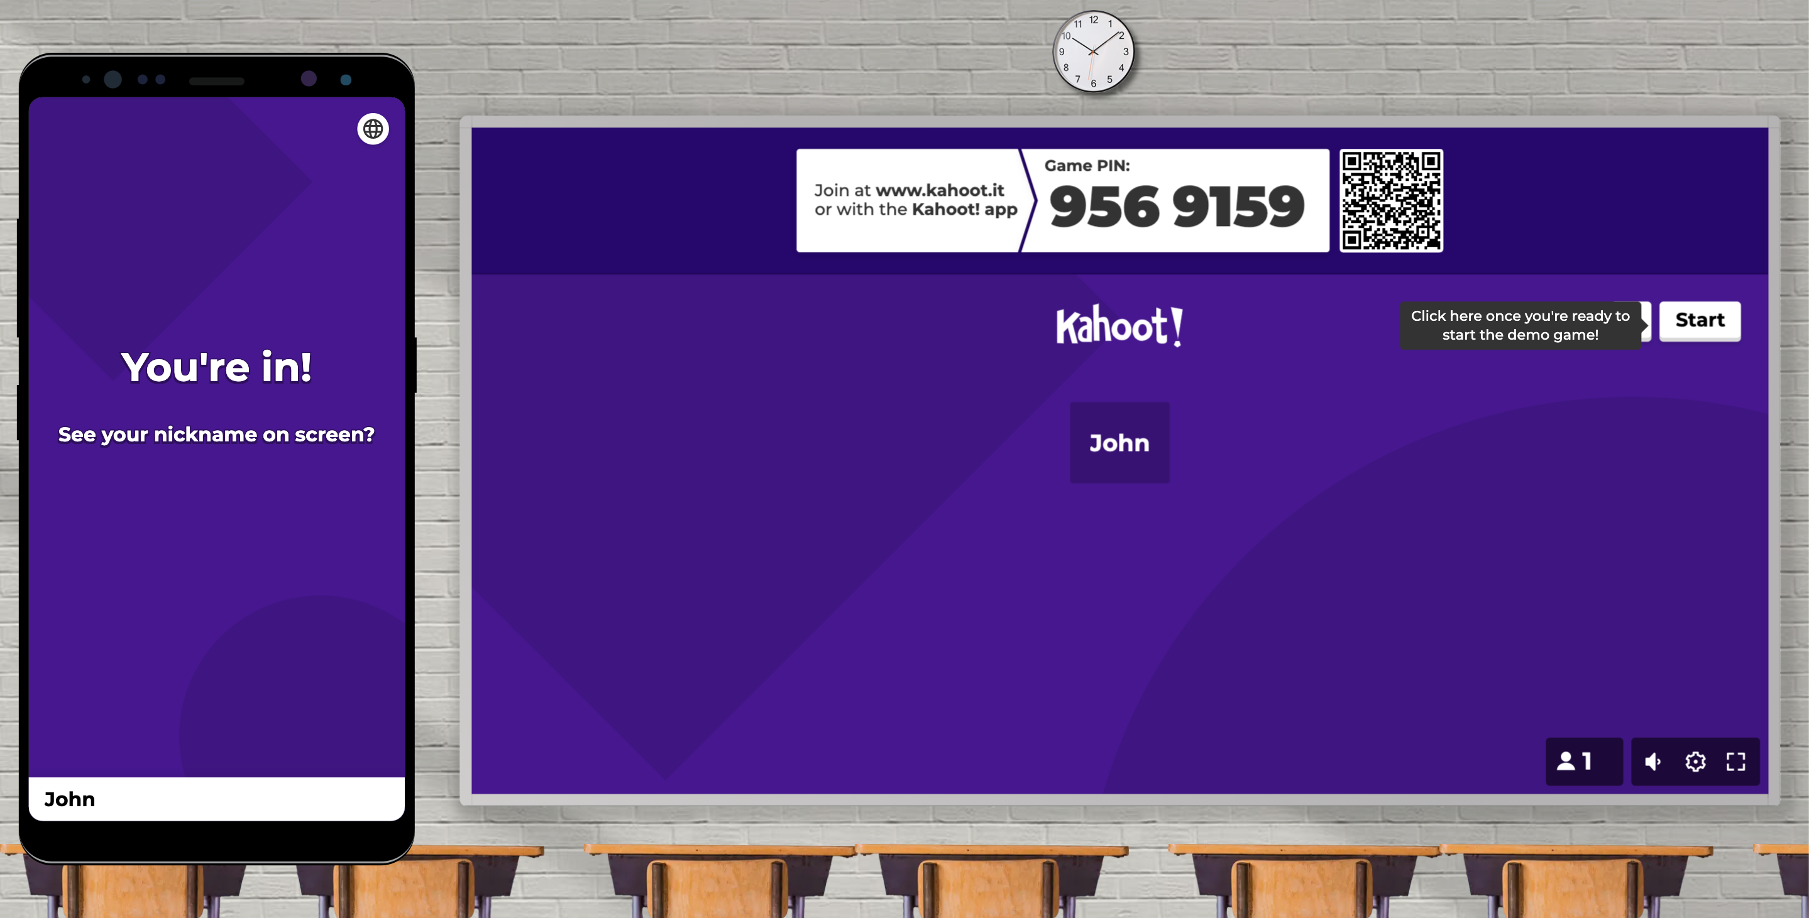
To Design, Develop, and Evaluate Quality Blended Learning

Slide 15
To Design, Develop, and Evaluate Quality Blended Learning

Slide 16
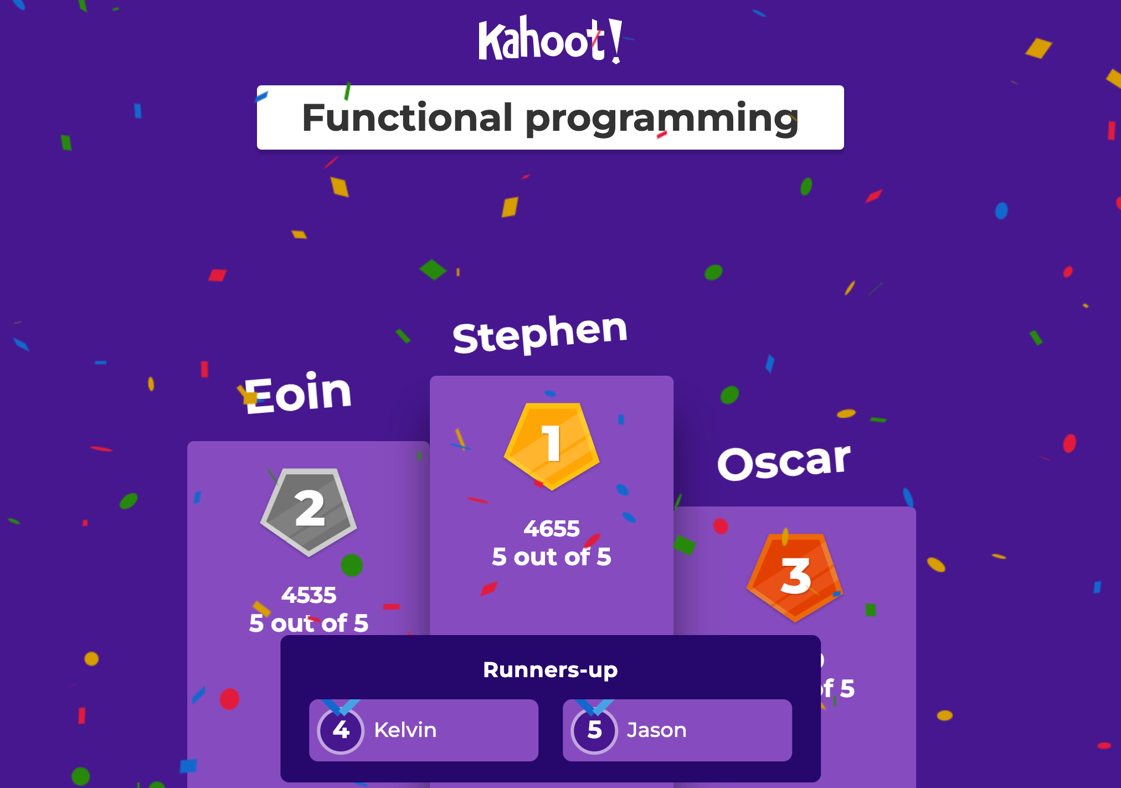
To Design, Develop, and Evaluate Quality Blended Learning

Slide 17
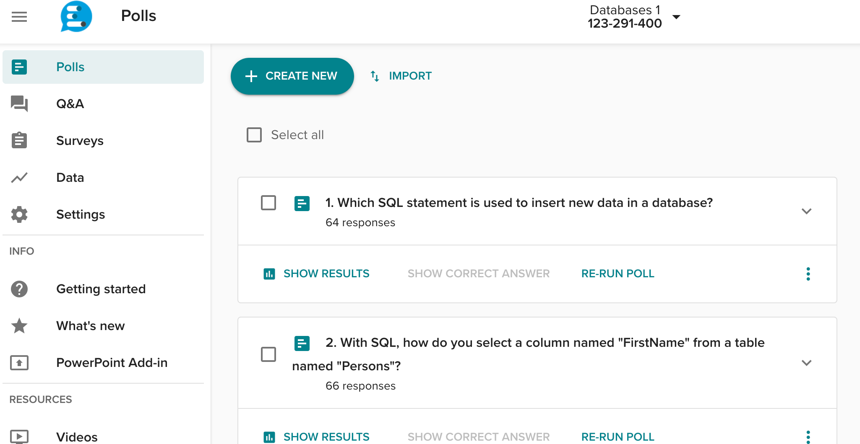
To Design, Develop, and Evaluate Quality Blended Learning

Slide 18
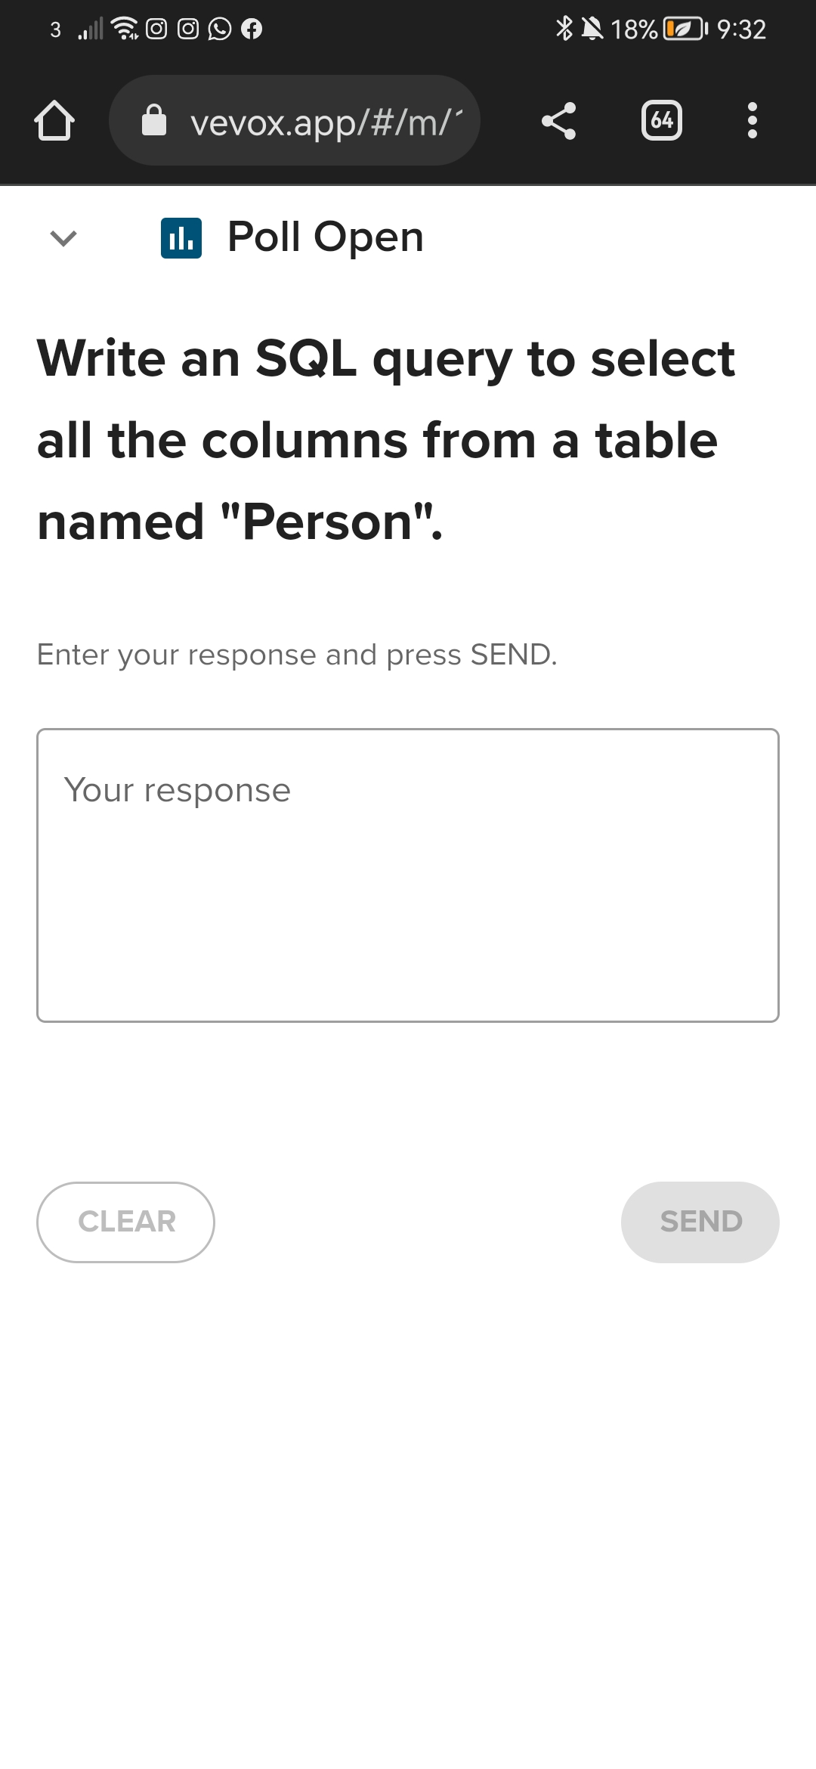
To Design, Develop, and Evaluate Quality Blended Learning

Slide 19
To Design, Develop, and Evaluate Quality Blended Learning

Slide 20
Peer observation
Two hybrid sessions were part of a peer observation activity
Benefits of peer observation have been described in the literature, including improvements to teaching practice, development of confidence to teach and learn more about teaching, the transformation of educational perspectives.
To Design, Develop, and Evaluate Quality Blended Learning

Slide 21
Peer observation
The peers observed case-studies questions were included in the quizzes, illustrating the implementation of concepts to solve real-life problems
Real-life application of concepts is essential for developing problem-solving skills, a critical competency in the computer science
To Design, Develop, and Evaluate Quality Blended Learning

Slide 22
Peer observation
The peer observer noticed that, for one of the modules, there was not enough time to complete the list of questions as the class was limited to 45 minutes
That can be solved by better planning the number of questions included in the quiz
To Design, Develop, and Evaluate Quality Blended Learning

Slide 23
ISSUES RAISED
To Design, Develop, and Evaluate Quality Blended Learning

Slide 24
Issues Raised
Using SRS in a blended learning classroom proved to be efficient.
Students were allowed to join using nicknames to avoid anxiety due to the game competition
The game was an opportunity for to students review the content, clarify queries and get feedback on their responses, which also increased the level of communication.
To Design, Develop, and Evaluate Quality Blended Learning

Slide 25
Issues Raised
At the end of the semester, students described the experience as very positive and useful for practicing more theoretical concepts
Although this is an interesting strategy, it might not be feasible to every hybrid learning situation / group
The tools can be limited or expensive, and the preparation of questions requires effort
To Design, Develop, and Evaluate Quality Blended Learning

Slide 26
CONCLUSIONS
To Design, Develop, and Evaluate Quality Blended Learning

Slide 27
Conclusions
SUMMARY
The use of SRS including a game-based learning approach demonstrated to be positive for increasing the level of engagement.
Students who might not feel confident to ask questions have the opportunity to participate
Lecturers have a chance to evaluate students performance and identify any sort of confusing / misunderstood topics
To Design, Develop, and Evaluate Quality Blended Learning

Slide 28
Conclusions
THEMES
Empathic Teaching: The first stage in addressing the challenges was to authentically reflect on the students’ situations.
Games-Based Learning: The games-based approach was designed to be educational, but also fun, and this proved to be highly motivating.
Resources: The School provided equipment and processes to help create an environment where this initiative could succeed.
To Design, Develop, and Evaluate Quality Blended Learning

Slide 29
THANK YOU.
To Design, Develop, and Evaluate Quality Blended Learning

Slide 30
Blended Learning International Train the Train (BLITT)
ACTIVITY 2: DESIGN
Damian Gordon
Lecturer in Computer Science
To Design, Develop, and Evaluate Quality Blended Learning

Slide 31
Activity 2
This is our second brainstorming activity…
Just a few sentences needed here, but you can write as much as you want. So this is just your initial ideas on the design of your blended activities, but again as we know plans will change over time, so please do feel tied down to anything you write here, it’s just to get you initial ideas. Here are some questions that might help you write this section, but don’t feel constrained by these:
Who’s presenting?
To Design, Develop, and Evaluate Quality Blended Learning

Slide 32
Activity 2
Will this new approach mean that some of the learning outcomes might be addressed in new ways?
Will this impact how the module is assessed (New Assessments or Exams?)?
What new eLearning techniques will you consider (e.g. videos, audios, quizzes, interactive documents, games, interactive presentations, searching activities, forums, Mind Maps, peer evaluation)?
What new classroom techniques will you consider (e.g. peer evaluation, debates, role playing, problem solving, case studies, reflection activities, active learning techniques)?
Who’s presenting?
To Design, Develop, and Evaluate Quality Blended Learning

Slide 33
Activity 2
Will the addition of technology be:
Substitution (a direct substitute, with no functional change)
Augmentation (a direct substitute, with some functional change)
Modification (significant task redesign)
Redefinition (the creation of new tasks previously impossible)
As your ideas change, please do note both the old ideas and the new ones here.
Who’s presenting?
To Design, Develop, and Evaluate Quality Blended Learning

Slide 34
Activity 2: Sample
25-Sept-2022
The overall goals of the module aren’t going to change, but one of the learning outcomes is that the students demonstrate excellent communication skills, both individually and in groups, so I’m going to get to contribute at least 5 messages of minimum of 400 words in total to a discussion board (forum) for the individual part, and work on a group assessment online, and use a group management tool like CATME to give peer feedback, for the group communication.
Who’s presenting?
To Design, Develop, and Evaluate Quality Blended Learning

Slide 35
Activity 2: Sample
25-Sept-2022 (Cont.)
I’m going to find some good videos that explain the benefits of Object-Oriented programming, and in particular why the concept of Inheritance is important.
I’m also going to find a good on-line complier, the one I used during lockdown was OK, but it had a few functionality limitations that I had to work around, so I’ll look for something better.
Who’s presenting?
To Design, Develop, and Evaluate Quality Blended Learning

Slide 36
Activity 2: Sample
25-Sept-2022 (Cont.)
I’ll look for a game (or a fun quizzing tool as formative assessment) to teach some of the key concepts of this module.
I have a plan for a surprise guest lecturer for one of the online sessions.
Who’s presenting?
To Design, Develop, and Evaluate Quality Blended Learning

Slide 37
Activity 2: Sample
14-Oct-2022
As mentioned in the Analysis section, I am only going to do one assessment online, I think I’ll do the group-based assignment online, but to test out the individual assessment, I got the students to do a few small activities using the forum, and they really don’t enjoy using it AT ALL, so I’ll change the individual assignment for them to writing an individual computer program off-line instead.
Who’s presenting?
To Design, Develop, and Evaluate Quality Blended Learning

