Slide 1
Blended Learning International Train the Train (BLITT)
Google Searching
Damian Gordon
Lecturer in Computer Science
To Design, Develop, and Evaluate Quality Blended Learning

Slide 2
Google Searching
The Google search engine has become the standard way of finding information from web pages on the world-wide web.
To Design, Develop, and Evaluate Quality Blended Learning

Slide 3
Google Searching
How does Google searching work?
To Design, Develop, and Evaluate Quality Blended Learning

Slide 4
Google Searching
How does Google searching work?
The Google search engine uses the PageRank algorithm to do the search process and return results, the specifics of which are a closely guarded secret.
To Design, Develop, and Evaluate Quality Blended Learning

Slide 5
Google Searching
The PageRank algorithm
Larry Page and Sergey Brin developed the PageRank at Stanford University in 1996 as part of a research project about a new kind of search engine.
To Design, Develop, and Evaluate Quality Blended Learning

Slide 6
Google Searching
The PageRank algorithm
Sergey Brin had the initial idea that information on the web could be ordered in a hierarchy by "link popularity": “a page ranks higher as there are more links to it”.
To Design, Develop, and Evaluate Quality Blended Learning

Slide 7
Google Searching
But also: “the more sites that a webpage with the search phrase has, the higher the rating it will get (and the higher it’s “credibility score”)”.
To Design, Develop, and Evaluate Quality Blended Learning

Slide 8
Google Searching
And: “Also if two pages are pointed to by the same number of sites, but if for one of these pages each of the pointing sites have higher credibility scores that the sites pointing to the other page, then the first page will end up with a higher credibility score.”.
To Design, Develop, and Evaluate Quality Blended Learning

Slide 9
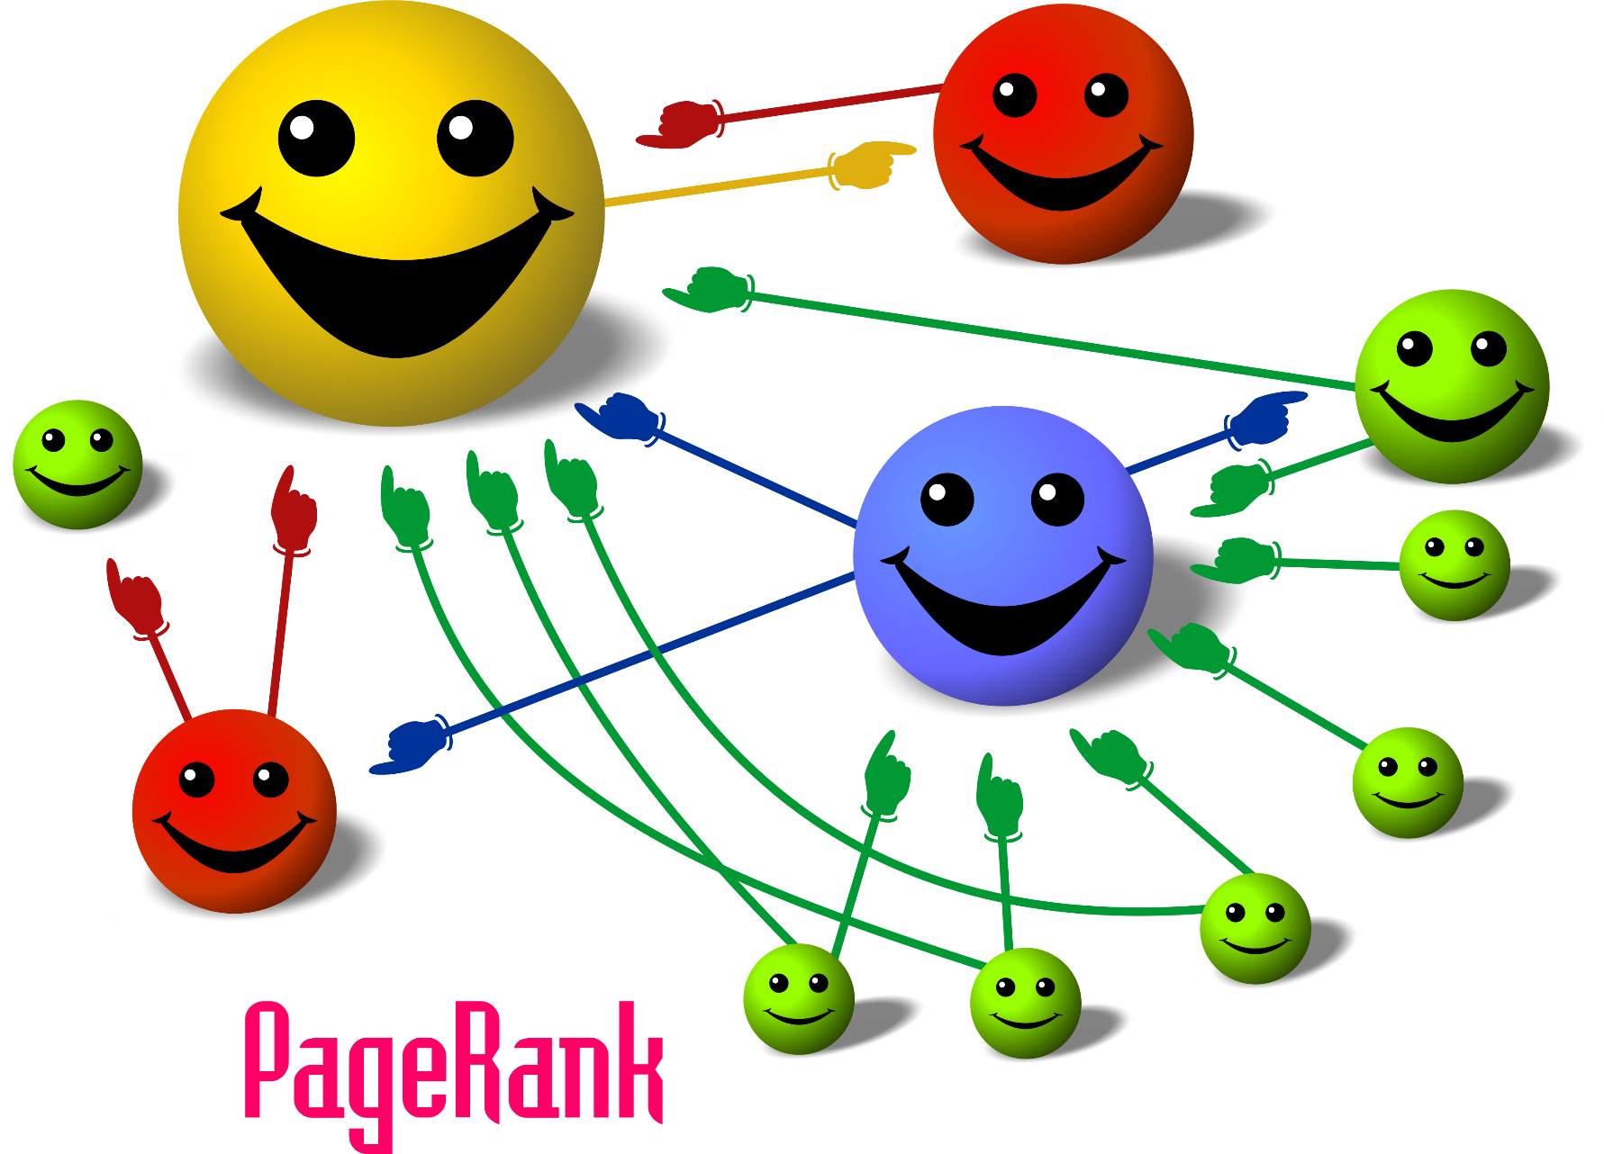
To Design, Develop, and Evaluate Quality Blended Learning

Slide 10
Google Searching
However, there are other ways to improve the order of webpage results that are returned form a search.
Including the following >>>
To Design, Develop, and Evaluate Quality Blended Learning

Slide 11
Google Searching
Money
Organizations and individuals can pay Google to improve their placement in the ranking of results returned.
To Design, Develop, and Evaluate Quality Blended Learning

Slide 12
Google Searching
Search Engine Optimization (SEO)
Organizations and individuals can hire companies that specialize in improving their placement in the ranking of results returned by doing things like:
To Design, Develop, and Evaluate Quality Blended Learning

Slide 13
Google Searching: SEO
1. Cross-linking pages on the same site, this increases the number of links pointing to each page
To Design, Develop, and Evaluate Quality Blended Learning

Slide 14
Google Searching: SEO
2. Cross-linking pages on different sites, these are called Link Farms.
To Design, Develop, and Evaluate Quality Blended Learning

Slide 15
Google Searching: SEO
3. Constantly updating the content on the site, which increases its rank.
To Design, Develop, and Evaluate Quality Blended Learning

Slide 16
Google Searching: SEO
4. Adding information to the “Header” page of the webpage (called the “metatag” section), that doesn’t appear on the browser, but is used in ranking the order of webpages.
To Design, Develop, and Evaluate Quality Blended Learning

Slide 17
Basic Google Search Operations
To Design, Develop, and Evaluate Quality Blended Learning

Slide 18
Google Search
I’m Feeling Lucky
To Design, Develop, and Evaluate Quality Blended Learning

Slide 19
Blended Learning
Google Search
I’m Feeling Lucky
To Design, Develop, and Evaluate Quality Blended Learning

Slide 20
Google Searching
This means
Look for webpages that have the words “Blended” and “Learning” in them, it doesn’t matter if the words are together on the page as long as they are somewhere in the page.
To Design, Develop, and Evaluate Quality Blended Learning

Slide 21
“Blended Learning”
Google Search
I’m Feeling Lucky
To Design, Develop, and Evaluate Quality Blended Learning

Slide 22
Google Searching
This means
Look for webpages that have the phrase (all together) “Blended Learning” in them. The words have to be together on the page.
To Design, Develop, and Evaluate Quality Blended Learning

Slide 23
Blended OR Learning
Google Search
I’m Feeling Lucky
To Design, Develop, and Evaluate Quality Blended Learning

Slide 24
Blended | Learning
Google Search
I’m Feeling Lucky
To Design, Develop, and Evaluate Quality Blended Learning

Slide 25
Google Searching
You can use “|” or “OR” and that means
Look for webpages that have either the word “Blended” or “Learning” in them, or both.
To Design, Develop, and Evaluate Quality Blended Learning

Slide 26
Blended | Learning TU Dublin
Google Search
I’m Feeling Lucky
To Design, Develop, and Evaluate Quality Blended Learning

Slide 27
Google Searching
This means
Look for webpages that have either the word “Blended” or “Learning TU Dublin” in them, or both.
To Design, Develop, and Evaluate Quality Blended Learning

Slide 28
(Blended | Learning) TU Dublin
Google Search
I’m Feeling Lucky
To Design, Develop, and Evaluate Quality Blended Learning

Slide 29
Google Searching
This means
Look for webpages that have either the word “Blended” or “Learning” in them, or both. But the pages must also contain “TU” and “Dublin” in them
To Design, Develop, and Evaluate Quality Blended Learning

Slide 30
Blended -learning
Google Search
I’m Feeling Lucky
To Design, Develop, and Evaluate Quality Blended Learning

Slide 31
Google Searching
This means
Look for webpages that have word “Blended” in it, but do not have or “Learning” in them
To Design, Develop, and Evaluate Quality Blended Learning

Slide 32
“Blended *”
Google Search
I’m Feeling Lucky
To Design, Develop, and Evaluate Quality Blended Learning

Slide 33
Google Searching
“*” is called the wildcard operator and it means
Look for webpages that have the word “Blended” followed by a space, followed by any other word. So “Blended Learning” would be found, but “Blended.” would not
To Design, Develop, and Evaluate Quality Blended Learning

Slide 34
“Blended *” TU Dublin
Google Search
I’m Feeling Lucky
To Design, Develop, and Evaluate Quality Blended Learning

Slide 35
Google Searching
“*” is called the wildcard operator and it means
Look for webpages that have the word “Blended” followed by a space, followed by any other word. So “Blended Learning” would be found, but “Blended.” would not. The page also has to have “TU” and “Dublin” in them
To Design, Develop, and Evaluate Quality Blended Learning

Slide 36
~Blended ~Learning
Google Search
I’m Feeling Lucky
To Design, Develop, and Evaluate Quality Blended Learning

Slide 37
Google Searching
“~” is called the tilde operator and it means
Look for webpages that have the words “Blended” and “Learning” in them, or look for words that are similar to them
To Design, Develop, and Evaluate Quality Blended Learning

Slide 38
“Blended Learning” 2012..2020
Google Search
I’m Feeling Lucky
To Design, Develop, and Evaluate Quality Blended Learning

Slide 39
Google Searching
“..” is called the range operator and it means
Look for webpages that have the phrase (all together) “Blended Learning” in them. The words have to be together on the page. And the page must also have one of the following numbers in it: 2012, 2013, 2014, 2015, 2016, 2017, 2018, 2019, 2020
To Design, Develop, and Evaluate Quality Blended Learning

Slide 40
Advanced Google Search Operations
To Design, Develop, and Evaluate Quality Blended Learning

Slide 41
site:www.damiantgordon.com blended
Google Search
I’m Feeling Lucky
To Design, Develop, and Evaluate Quality Blended Learning

Slide 42
Google Searching
This means
Look on the website www.damiantgordon.com for all of the occurrences of the word “Blended”
To Design, Develop, and Evaluate Quality Blended Learning

Slide 43
intitle:blended
Google Search
I’m Feeling Lucky
To Design, Develop, and Evaluate Quality Blended Learning

Slide 44
Google Searching
This means
Look for webpages that have the word “Blended” in the title of the page
To Design, Develop, and Evaluate Quality Blended Learning

Slide 45
allintitle:blended learning
Google Search
I’m Feeling Lucky
To Design, Develop, and Evaluate Quality Blended Learning

Slide 46
Google Searching
This means
Look for webpages that have the words “Blended” and “learning” somewhere in the title of the page
To Design, Develop, and Evaluate Quality Blended Learning

Slide 47
inurl:blended
Google Search
I’m Feeling Lucky
To Design, Develop, and Evaluate Quality Blended Learning

Slide 48
Google Searching
This means
Look for webpages that have the word “blended” as part of the webpage address (URL) of the page
To Design, Develop, and Evaluate Quality Blended Learning

Slide 49
allinurl:blended learning
Google Search
I’m Feeling Lucky
To Design, Develop, and Evaluate Quality Blended Learning

Slide 50
Google Searching
This means
Look for webpages that have both of the words “blended” and “learning” as part of the webpage address (URL) of the page
To Design, Develop, and Evaluate Quality Blended Learning

Slide 51
filetype:pdf blended
Google Search
I’m Feeling Lucky
To Design, Develop, and Evaluate Quality Blended Learning

Slide 52
Google Searching
This means
Look for pdf documents that have the word “blended” in them.
To Design, Develop, and Evaluate Quality Blended Learning

Slide 54
Blended Learning International Train the Train (BLITT)
Google Searching (Ethics)
Damian Gordon
Lecturer in Computer Science
To Design, Develop, and Evaluate Quality Blended Learning

Slide 55
Google Searching
When you are typing in a phrase to search for, Google uses an autocompletion process help in searching.
To Design, Develop, and Evaluate Quality Blended Learning

Slide 56
Google Searching
The autocompletion works based on phrases that people have actually searched for in the past.
To Design, Develop, and Evaluate Quality Blended Learning

Slide 57
Google Searching
This can sometimes result in some very funny suggestions, however sometimes it results in suggestions that are not at all funny.
To Design, Develop, and Evaluate Quality Blended Learning

Slide 58
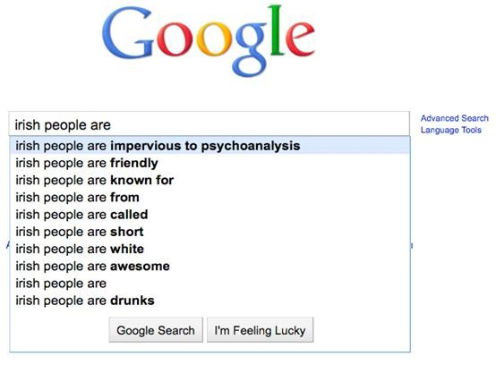
October
2010
To Design, Develop, and Evaluate Quality Blended Learning

Slide 59
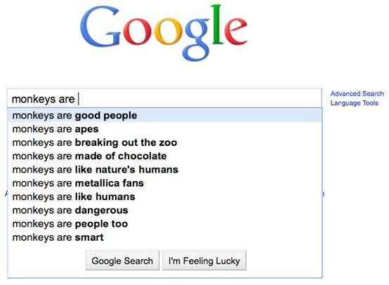
October
2010
To Design, Develop, and Evaluate Quality Blended Learning

Slide 60
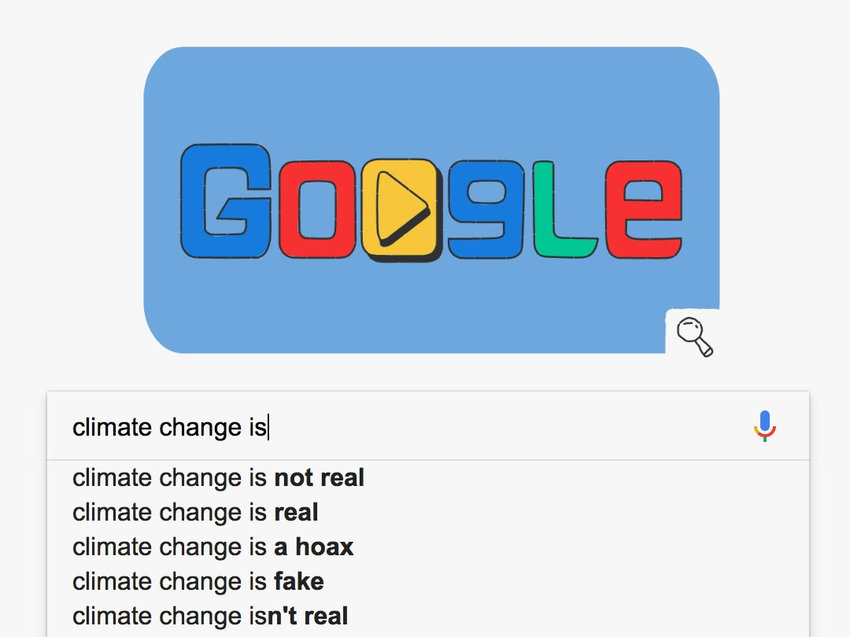
December
2018
To Design, Develop, and Evaluate Quality Blended Learning

Slide 61
Google Searching
Google image search has a few issues as well, it can sometimes promote gender-based stereotyping (These are all from December 2020).
To Design, Develop, and Evaluate Quality Blended Learning

Slide 62
Search: Teacher
To Design, Develop, and Evaluate Quality Blended Learning

Slide 63
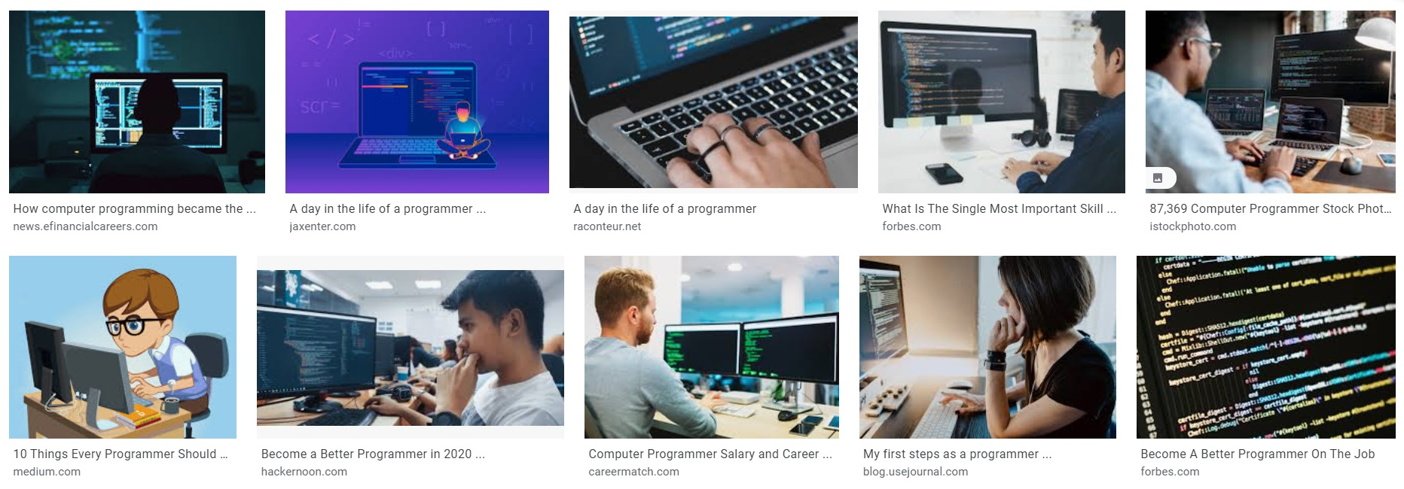
Search: Programmer
To Design, Develop, and Evaluate Quality Blended Learning

Slide 64
Search: Homemaker
To Design, Develop, and Evaluate Quality Blended Learning

Slide 65
Google Searching
There may be some evidence that Google itself is changing the ranking order of content for political reasons.
To Design, Develop, and Evaluate Quality Blended Learning

Slide 66
Google Searching
in 2019 senior Google engineer Gregory Coppola contacted watchdog group Project Veritas to talk about the Google bias that affects the information users get about political choices.
To Design, Develop, and Evaluate Quality Blended Learning

Slide 67
Google Searching
Coppola noticed that in 2014 Google search was neutral, but by 2016 it was showing clear bias for the US Democratic Party.
To Design, Develop, and Evaluate Quality Blended Learning

Slide 68
Google Searching
This was supported by Research Psychologist Robert Epstein who showed that biased search results generated by Google likely impacted undecided voters in a way that gave at least 2.6 million votes to Hillary Clinton.
To Design, Develop, and Evaluate Quality Blended Learning

Slide 69
Google Searching
Epstein showed that a lot of people think that if something is more highly rated on Google Search than another story, then it would be more important and more correct.
To Design, Develop, and Evaluate Quality Blended Learning

Slide 70
Google Searching
Epstein also noted that “searches for Hillary Clinton did not autocomplete to words that were popular searches if they reflected negatively on the Democratic candidate .”
To Design, Develop, and Evaluate Quality Blended Learning

Slide 71
Google Searching
Coppola doesn’t believe there is a vast conspiracy in Google, but rather that: “And in fact, I think it would only take a couple out of an organization of 100,000, you know, to make sure that the product is a certain way…”
To Design, Develop, and Evaluate Quality Blended Learning

Slide 72
Google Searching
In October 2022, Mark Finchem (Republican candidate for Arizona secretary of state) tweeted that Google's search algorithm was biased against his campaign because its website did not come up in searches on his name.
To Design, Develop, and Evaluate Quality Blended Learning

Slide 73
Google Searching
Grid, a tech news website, found that that was true, but that Google apparently had nothing to do with it. Instead, the noindex tag, which tells webcrawlers not to list the site in results, was present in the META portion of the site's HTML code.
To Design, Develop, and Evaluate Quality Blended Learning

Slide 74
Google Searching
Whether that was the result of an error in coding the page was not known; the tag had apparently been added to it in late July. Finchem did not respond to Grid's request for an explanation when they called him.
Finchem lost the election.
To Design, Develop, and Evaluate Quality Blended Learning

Slide 76
Blended Learning International Train the Train (BLITT)
Google Searching for Hacking
Damian Gordon
Lecturer in Computer Science
To Design, Develop, and Evaluate Quality Blended Learning

Slide 77
Google Searching
The Google search engine has become the standard way of finding information from web pages on the world-wide web.
To Design, Develop, and Evaluate Quality Blended Learning

Slide 78
Google Searching
…but it can also be used for hacking, because sometimes leave webpages and files open to search engines when they shouldn’t
To Design, Develop, and Evaluate Quality Blended Learning

Slide 79
Google Searching
To Design, Develop, and Evaluate Quality Blended Learning

Slide 80
site:tudublin.ie -site:www.tudublin.ie
Google Search
I’m Feeling Lucky
To Design, Develop, and Evaluate Quality Blended Learning

Slide 81
Google Searching
This means
Look for sites hosted on a server other than the WWW domain, e.g.
arrow.tudublin.ie
To Design, Develop, and Evaluate Quality Blended Learning

Slide 82
intitle:index.of
Google Search
I’m Feeling Lucky
To Design, Develop, and Evaluate Quality Blended Learning

Slide 83
Google Searching
This means
Look for sites that don’t have a homepage set up, but you can see a listing of folders on this site
To Design, Develop, and Evaluate Quality Blended Learning

Slide 84
intitle:error "access denied for user" "on line"
Google Search
I’m Feeling Lucky
To Design, Develop, and Evaluate Quality Blended Learning

Slide 85
Google Searching
This means
Look for pages that have given error warnings on them, there may be passwords or other details on it.
To Design, Develop, and Evaluate Quality Blended Learning

Slide 86
login | logon
Google Search
I’m Feeling Lucky
To Design, Develop, and Evaluate Quality Blended Learning

Slide 87
Google Searching
This means
Look for pages that are login portals
To Design, Develop, and Evaluate Quality Blended Learning

Slide 88
site:www.tudublin.ie employee.ID | username | userid
Google Search
I’m Feeling Lucky
To Design, Develop, and Evaluate Quality Blended Learning

Slide 89
Google Searching
This means
Look for pages that have the words “employee.ID” or “username” or “userid” on them, there may be default user login details on the page
To Design, Develop, and Evaluate Quality Blended Learning

Slide 90
password | passcode | “your password is”
Google Search
I’m Feeling Lucky
To Design, Develop, and Evaluate Quality Blended Learning

Slide 91
Google Searching
This means
Look for pages that have the phrases “password” or “passcode” or “your password is” on them, there may be default user login details on the page
To Design, Develop, and Evaluate Quality Blended Learning

Slide 92
admin | administrator
Google Search
I’m Feeling Lucky
To Design, Develop, and Evaluate Quality Blended Learning

Slide 93
Google Searching
This means
Look for pages that have the words “admin” or “administrator, there may be default user login details on the page
To Design, Develop, and Evaluate Quality Blended Learning

Slide 94
“admin login”
Google Search
I’m Feeling Lucky
To Design, Develop, and Evaluate Quality Blended Learning

Slide 95
Google Searching
This means
Look for pages that have the words “admin login”, there may be default user login details on the page
To Design, Develop, and Evaluate Quality Blended Learning

Slide 96
login -html -php -htm -asp -pdf -cgi -cfm -shtml -jsp -php3
Google Search
I’m Feeling Lucky
To Design, Develop, and Evaluate Quality Blended Learning

Slide 97
Google Searching
This means
Look for pages that have pages that have strange logins
To Design, Develop, and Evaluate Quality Blended Learning

Slide 98
login -html -php -htm -asp -pdf -cgi -cfm -shtml -jsp -php3 -aspx
Google Search
I’m Feeling Lucky
To Design, Develop, and Evaluate Quality Blended Learning

Slide 99
Google Searching
This means
Look for pages that have pages that have even stranger logins
To Design, Develop, and Evaluate Quality Blended Learning

Slide 100
filetype:xlsx "email" "@" "first name" "last name" "company" -sample "website" -template "contacts"
Google Search
I’m Feeling Lucky
To Design, Develop, and Evaluate Quality Blended Learning

Slide 101
Google Searching
This means
Look for Excel spreadsheets with a list of contact details
To Design, Develop, and Evaluate Quality Blended Learning

Slide 103
Blended Learning International Train the Train (BLITT)
Search Engines
Damian Gordon
Lecturer in Computer Science
To Design, Develop, and Evaluate Quality Blended Learning

Slide 104
Search Engines
Everyone know the Google search engine, but what other search engines are there?
To Design, Develop, and Evaluate Quality Blended Learning

Slide 105
DuckDuckGo
To Design, Develop, and Evaluate Quality Blended Learning

Slide 106
DuckDuckGo
https://duckduckgo.com/
Key concept: Privacy
To Design, Develop, and Evaluate Quality Blended Learning

Slide 107
DuckDuckGo
DuckDuckGo presents itself as “Privacy – simplified“.
The site claims that it does not collect data of people using it.
To Design, Develop, and Evaluate Quality Blended Learning

Slide 108
DuckDuckGo
As a consequence, the results on a search are independent on who is searching.
Technically it is a combination of a meta search engine and a web crawler.
To Design, Develop, and Evaluate Quality Blended Learning

Slide 109
DuckDuckGo
The name goes back to a childrens’ game by the name of Duck Duck Goose.
The site is run by a small company in the USA.
To Design, Develop, and Evaluate Quality Blended Learning

Slide 110
Ecosia
To Design, Develop, and Evaluate Quality Blended Learning

Slide 111
Ecosia
https://www.ecosia.org/?c=en
Key concept: Green
To Design, Develop, and Evaluate Quality Blended Learning

Slide 112
Ecosia
Ecosia is run by a small company in Berlin, Germany.
It focusses on a sustainable, ecological mission: 80 per cent of its profits are claimed to go into reforestation projects in Africa and elsewhere.
To Design, Develop, and Evaluate Quality Blended Learning

Slide 113
Ecosia
According to the company, the number of trees planted through their financing was 40 million in October 2018.
Technology-wise, the search results are taken from Bing.
To Design, Develop, and Evaluate Quality Blended Learning

Slide 114
Ecosia
The company in Berlin received various startup awards.
To Design, Develop, and Evaluate Quality Blended Learning

Slide 115
MetaGer
To Design, Develop, and Evaluate Quality Blended Learning

Slide 116
MetaGer
https://metager.org/
Key concept: Non-Commerical
To Design, Develop, and Evaluate Quality Blended Learning

Slide 117
MetaGer
MetaGer is a meta-search engine. It uses the results of many (in this case: up to 60) different search engines, filtering these results in a meaningful way.
To Design, Develop, and Evaluate Quality Blended Learning

Slide 118
MetaGer
In addition, MetaGer has its own crawlers and indexers (like DuckDuckGo).
MetaGer is a university project (started in 1996) by Hannover University in Germany (that’s a university with a focus on technology).
To Design, Develop, and Evaluate Quality Blended Learning

Slide 119
MetaGer
In 2012 they created an association (NGO), the Association for free Access to Knowledge“ to help maintain the project.
Since 2013, MetaGer is available also in English.
To Design, Develop, and Evaluate Quality Blended Learning

Slide 120
MetaGer
MetaGer has a very high level of privacy for the user.
To Design, Develop, and Evaluate Quality Blended Learning

Slide 121
Qwant
To Design, Develop, and Evaluate Quality Blended Learning

Slide 122
Qwant
https://www.qwant.com/?l=en
Key concept: Privacy, Non-Commerical
To Design, Develop, and Evaluate Quality Blended Learning

Slide 123
Qwant
Qwant is a search engine that respects privacy. For example, cookies are deleted with the end of the session.
To Design, Develop, and Evaluate Quality Blended Learning

Slide 124
Qwant
It is based in France (a small company), and recent data said that about 65 per cent of its use are from French users.
To Design, Develop, and Evaluate Quality Blended Learning

Slide 125
Qwant
In independent tests, search results of Google, Bing, DuckDuckGo and Qwant turned out to be of similar quality.
To Design, Develop, and Evaluate Quality Blended Learning

Slide 126
Wolfram|Alpha
To Design, Develop, and Evaluate Quality Blended Learning

Slide 127
Wolfram|Alpha
https://www.wolframalpha.com/
Key concept: Smart
To Design, Develop, and Evaluate Quality Blended Learning

Slide 128
Wolfram|Alpha
WolframAlpha is a complex search engine, sometimes called a computational knowledge engine or answer engine.
To Design, Develop, and Evaluate Quality Blended Learning

Slide 129
Wolfram|Alpha
It answers factual queries directly by computing the answer from externally sourced data and works out problems in maths, science, media, and everyday life.
To Design, Develop, and Evaluate Quality Blended Learning

Slide 130
Wolfram|Alpha
Users submit queries and computation requests via a text field. WolframAlpha then computes answers and relevant visualizations from a knowledge base of curated, structured data that come from other sites and books.
To Design, Develop, and Evaluate Quality Blended Learning

Slide 132
Blended Learning International Train the Train (BLITT)
Accessible Video Searching
Damian Gordon
Lecturer in Computer Science
To Design, Develop, and Evaluate Quality Blended Learning

Slide 133
Closed Captioning
Closed
Captioning
Instructional Design and e-Authoring

Slide 134
Accessible Video Searching
Closed captioning = Subtitles + Additional Info
So closed captioning isn’t just the dialogue but also other relevant parts of the soundtrack – describing background noises, phones ringing and other audio cues that need to be included to fully understand the video.
To Design, Develop, and Evaluate Quality Blended Learning

Slide 135
Google
Google has a video searching tool, which will search for videos over the entire web, using this link: https://www.google.com/advanced_video_search, and you can choose to search only for closed captioned videos, by selecting the following options:
“Subtitles > closed captioned only”.
To Design, Develop, and Evaluate Quality Blended Learning

Slide 136
YouTube
To search for videos with proper closed captioning on YouTube (not just the auto generated closed captioning, which can sometime be inaccurate), type in your search term and add in “, cc”.
To Design, Develop, and Evaluate Quality Blended Learning

Slide 138
Blended Learning International Train the Train (BLITT)
What is a WebQuest?
Damian Gordon
Lecturer in Computer Science
To Design, Develop, and Evaluate Quality Blended Learning

Slide 139
WebQuests
A WebQuest is an online activity that involves students visiting a number of websites to learn about a particular topic.
The sites are pre-selected by the teacher.
To Design, Develop, and Evaluate Quality Blended Learning

Slide 140
WebQuests
A WebQuest has six (6) essential parts:
1. Introduction
2. Task
3. Process
4. Resources
5. Evaluation
6. Conclusion
To Design, Develop, and Evaluate Quality Blended Learning

Slide 141
WebQuests
1. The “Introduction” provides the learners with background information that is needed to begin the process of inquiry.
To Design, Develop, and Evaluate Quality Blended Learning

Slide 142
WebQuests
2. The “Task” is often a single question is posed that requires students to analyze a lot of information.
To Design, Develop, and Evaluate Quality Blended Learning

Slide 143
WebQuests
3. The “Process” lets you lead the learner through the task. You can offer advice on how to manage time, collect data, and provides strategies for working in group situations.
To Design, Develop, and Evaluate Quality Blended Learning

Slide 144
WebQuests
4. The “Resources” are links to websites and videos, or clues to tools that can help them complete the task.
To Design, Develop, and Evaluate Quality Blended Learning

Slide 145
WebQuests
5. The “Evaluation” tells the learners how to complete the task and how it will be evaluated.
To Design, Develop, and Evaluate Quality Blended Learning

Slide 146
WebQuests
6. The “Conclusion” asks the learners for feedback.
To Design, Develop, and Evaluate Quality Blended Learning

