Slide 1

Blended Learning International Train the Train (BLITT)
CASE STUDY: Blended a Programming Module for Non-Traditional Students
Damian Gordon
Lecturer
To Design, Develop, and Evaluate Quality Blended Learning

Slide 2
INTRODUCTION
To Design, Develop, and Evaluate Quality Blended Learning

Slide 3


Introduction
In 2015 the School of Computer Science, Technological University of Dublin, Ireland (formerly known as Dublin Institute of Technology), decided to develop a new programme for non-traditional students (those who couldn’t attend a full-time schedule of classes).
The entire staff of the School of Computer Science (approximately 35 staff) were involved in the design of the programme, and they spent about four months in the design of this new programme.
To Design, Develop, and Evaluate Quality Blended Learning

Slide 4
Introduction
The programme was developed as a blended programme, with some modules in the classroom, some online, and some a mixture of both
This new programme was based on a pre-existing evening programme in Information Systems & Information Technology
The new programme was given the code of DT255.
To Design, Develop, and Evaluate Quality Blended Learning

Slide 5
Introduction
In the first year of the programme, the students do a year-long module entitled “Programming and Algorithms” which is the focus of this case.
In this new programme, this specific module was designed to be blended, with some content to be delivered online, and some content to be delivered in-person.
To Design, Develop, and Evaluate Quality Blended Learning

Slide 6
THE CASE
To Design, Develop, and Evaluate Quality Blended Learning

Slide 7
The Case
SOURCES OF EVIDENCE
The Programming and Algorithms content is available here:
http://www.damiantgordon.com/Videos/ProgrammingAndAlgorithms/MainMenu2.html
Biography of the Instructional Designer (Peter Manifold)
https://ascnet.ie/people/peter-manifold/
To Design, Develop, and Evaluate Quality Blended Learning

Slide 8
The Case
PRE-INTERVENTION
A module from an existing programme was used as the basis of this new “Programming and Algorithms” module.
In the old programme the module consisted of 3 hours in the evening, from 6:30pm-9:30pm once a week, for 24 weeks.
This created a barrier for non-traditional students to attend, and an alternative had to be developed
To Design, Develop, and Evaluate Quality Blended Learning

Slide 9
The Case
THE INTERVENTION
The new module was initially designed in two parts:
  Lectures: All on-line, 2 hours per week, the same information delivered both live and as pre-recorded videos.
  Labs: All in person, 2 hours per week, the students attend a programming practical session (also broadcast on-line)
To Design, Develop, and Evaluate Quality Blended Learning

Slide 10
The Case
THE INTERVENTION
After some reflection it was felt that having no lectures face-to-face might be too challenging for students undertaking such a practical subject like programming.
It was therefore decided to have the first and last lecture in person (per semester), and after further reflection, the middle week of each semester (Week 7) also in person.
To Design, Develop, and Evaluate Quality Blended Learning

Slide 11
The Case
THE INTERVENTION
To create the pre-recorded videos, a great deal of organisational support was provided.
The management of the School of Computer Science allocated significant additional time on staff timetables for the preparation and recording of this content.
To Design, Develop, and Evaluate Quality Blended Learning

Slide 12
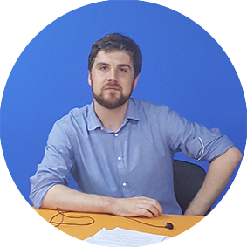
The Case
THE INTERVENTION
An Instructional Designer was hired to work with the staff in developing and recording the content
He also brough significant skills in undertaking post-production work on the content.
To Design, Develop, and Evaluate Quality Blended Learning

Slide 13
The Case
THE INTERVENTION
The School of Computer Science decreed that all recording for the module had to be complete before that module began.
The School dedicated a specific room for recording these videos, and it was fitted out with lighting, greenscreens, and recording equipment (audio, and video).
The room was not soundproofed.
To Design, Develop, and Evaluate Quality Blended Learning

Slide 14
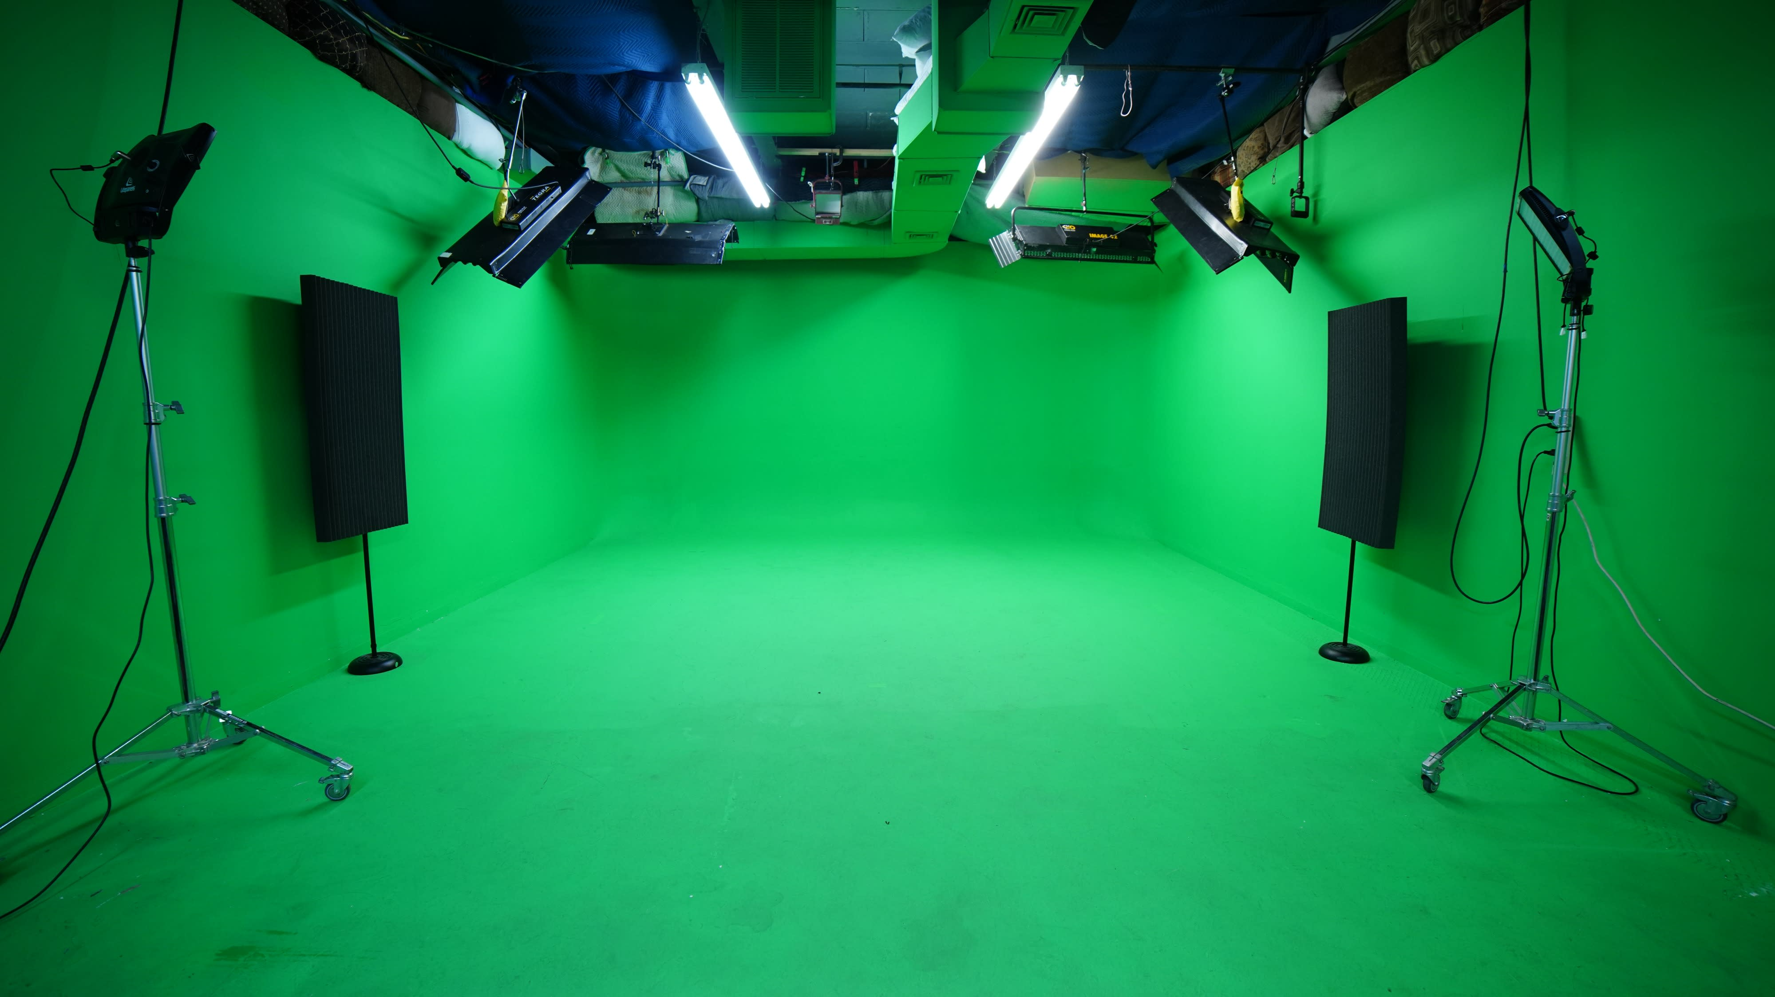

Slide 15
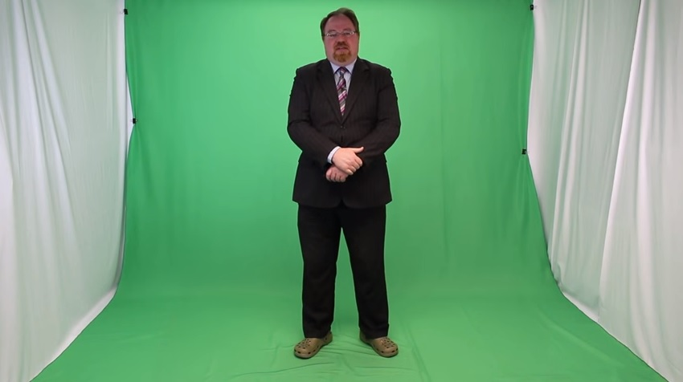

Slide 16
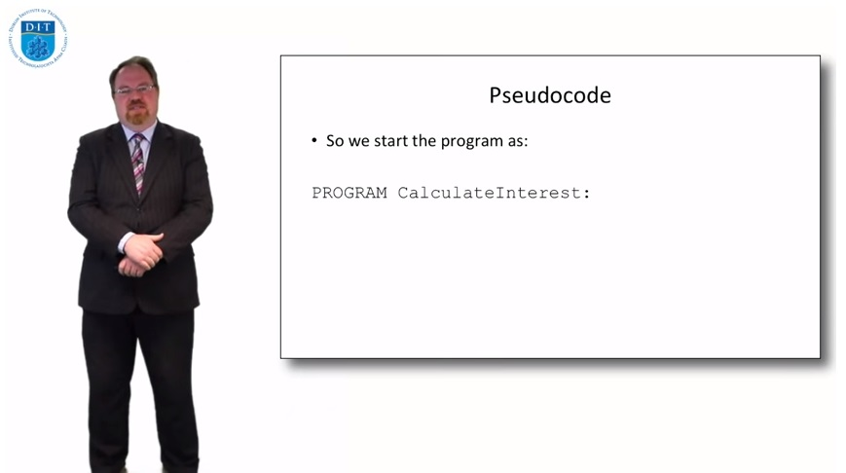

Slide 17
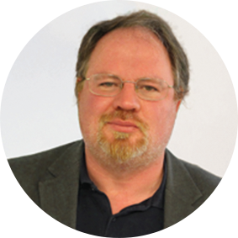
The Case
THE INTERVENTION
The lecturer involved in teaching this module had significant experience in Blended learning.
He decided to film the lessons out of sequence, as it would typically be the case that first few attempts would have some gremlins, so the first week recorded was Week 3, then Week 4, and then Week 1, once everything was going smoothly.
To Design, Develop, and Evaluate Quality Blended Learning

Slide 18
The Case
THE INTERVENTION
He also took the decision to break the content into 5-7 mini-lessons (15-20 mins each) , rather than a single 2 hour lesson.
This required some planning and restructuring, but ultimately it meant that the students could look at the content in chunks, e.g. on the bus, while waiting in queues, etc.
To Design, Develop, and Evaluate Quality Blended Learning

Slide 19
The Case
THE INTERVENTION
These 5-7 mini-lessons provided an additional benefit, it came to light when recording content for Week 10 that if the basics of that content had been mentioned in Week 3 (where similar material was already being mentioned), it would make the recording for Week 10 much clearer. Therefore this was done, as all recording was completed before the module began.
To Design, Develop, and Evaluate Quality Blended Learning

Slide 20
The Case
THE INTERVENTION
The on-line lessons were housed in a Virtual Learning Environment, and they were also designed to leverage the benefits of being on-line, including having asynchronous discussions using a Forum (to accommodate different student schedules), the use of on-line compliers and simulators, the ability to create simple quizzes, and shared noticeboards.
To Design, Develop, and Evaluate Quality Blended Learning

Slide 21
The Case
THE INTERVENTION
The lessons were delivered over 2 semesters.
The first semester was from Sept-Dec 2015 for 12 weeks, with 9 weeks of online lectures, and 3 weeks of in-person lectures.
The second semester was from Jan-Apr 2016 for 12 weeks, with 9 weeks of online lectures, and 3 weeks of in-person lectures.
To Design, Develop, and Evaluate Quality Blended Learning

Slide 22
The Case
POST-INTERVENTION
Given that there was a pre-existing course that taught a similar module, it was possible for a direct comparison of outcomes.
Since 2016, the students undertaking the blended module achieved a higher average mark on exams (+6%), and a larger percent of students on the blended module achieved over 70% in this module.
To Design, Develop, and Evaluate Quality Blended Learning

Slide 23
The Case
POST-INTERVENTION
The students were extremely satisfied with the module and rated it highly on their QA feedback, they also developed their own programming projects that they worked on in parallel with their assignments for this module, as they had become extremely engaged in the programming lifestyle.
To Design, Develop, and Evaluate Quality Blended Learning

Slide 24
ISSUES RAISED
To Design, Develop, and Evaluate Quality Blended Learning

Slide 25
Issues Raised
KEY ISSUES
Good: The blended programme gave access to education to non-traditional students, most of whom thrived in the blended environment. This process also created a lot of teaching assets, that can be used in both further teaching, and also in marketing and promoting the School, and University.
Bad: A few students needed more one-to-one time, and additional tutorials were arranged them, also small number of topics needed to be recapped in lab-time for those students.
To Design, Develop, and Evaluate Quality Blended Learning

Slide 26
Issues Raised
CASE COMPLEXITY
Most of the students were highly motivated as they saw this programme as a chance for success, they therefore worked extremely hard.
The lecturer was already familiar with blending, and therefore was able to develop the recording content quite quickly.
Although the skills being taught were practical, they were nonetheless still on a computer (programming), if the skill had been a real-world practical skill how different might the outcomes be?
To Design, Develop, and Evaluate Quality Blended Learning

Slide 27
Issues Raised
CONFIRMING AND DISCONFIRMING EVIDENCE
As part of the module, the students were required to fill out a feedback form, and they highlighted the module was “fun” and “enjoyable”, and they learned a lot, and they stated they were “excited about programming”. Some also stated that they would like more face-to-face interaction (or a phone number for the lecturer), because sometimes they felt that they could not express some of their questions in email form, or on the discussion board. Also they mentioned there was less camaraderie and class identity.
To Design, Develop, and Evaluate Quality Blended Learning

Slide 28
CONCLUSIONS
To Design, Develop, and Evaluate Quality Blended Learning

Slide 29
Conclusions
SUMMARY
This case focuses on the development of a blended programming module for non-traditional students. Much of the teaching consisted of pre-recorded mini-lessons. Almost all of the students succeeded in this environment and developed an enthusiasm for programming, and lauded the flexibility provided. A few students wanted more one-to-one time, and most of those students transferred to the full-time version of this programme.
To Design, Develop, and Evaluate Quality Blended Learning

Slide 30
Conclusions
THEMES
Motivation: Both the students and the lecturer where highly motivated because of the topic being taught, and the novel manner of delivery.
Topic: The topic of programming is practical, but still, it is a computer-based skill, and therefore amenable to being delivered on-line.
Resources: The School provided time, equipment, processes, and additional staff to help produce a high quality module.
To Design, Develop, and Evaluate Quality Blended Learning

Slide 31
Conclusions
QUESTIONS RAISED
What parts of topics are easy to blend, and what parts are harder to blend?
How much of a factor is motivation, for students and lecturers?
Why do some students need more face-to-face time on topics, and is there some way to measure this (e.g. psychometric test, motivation test)?
Do the students need to see the lecturer in all mini-lessons, or is it OK just hear them talking over slides?
How do we help form a class identity in a remote classgroup?
To Design, Develop, and Evaluate Quality Blended Learning

Slide 32
Conclusions
REFLECTIONS/ALTERNATIVES
Most of the lessons were presented by a single lecturer, speaking to directly to camera, perhaps alternative presentation forms could have been used, e.g.
>>> A pair of lecturers expressing their individual opinions on topics might have been interesting and motivating for the students.
>>> The use of more real-world props in the videos might have been useful.
>>> The development of more complex videos, for example, where the lecturer is physically stepping through the code might be interesting.
>>> More gamification in the lessons might be worth exploring.
To Design, Develop, and Evaluate Quality Blended Learning

Slide 33
THANK YOU.
To Design, Develop, and Evaluate Quality Blended Learning

