Slide 1

Blended Learning International Train the Train (BLITT)
Writing Learning Outcomes
Damian Gordon
To Design, Develop, and Evaluate Quality Blended Learning

Slide 2
Learning Outcomes
We know what these are:
To Design, Develop, and Evaluate Quality Blended Learning

Slide 3
Learning Outcomes
On successful completion of this module the learner will be able to:
1. Demonstrate a clear understanding of the principles of blended learning, and how they relate to a variety of technology-related situations.
2. Critically assess and evaluate existing blended learning case studies.
3. Select and evaluate the use of different technological solutions for a specific blended context.
4. Compare and contrast traditional teaching approaches to blended approaches.
To Design, Develop, and Evaluate Quality Blended Learning

Slide 4
Learning Outcomes
How to write Learning outcomes:
  We typically write 3-7 learning outcomes
  We begin with a verb (one of Bloom’s)
  Limit the length of each learning outcome to about 400 characters
  Exclude special characters (e.g., accents, umlats, ampersands, etc.)
  Exclude special formatting (e.g., dashes, numbering, etc.)
To Design, Develop, and Evaluate Quality Blended Learning

Slide 5

Benjamin S. Bloom
Born: Feb 21, 1913
Died: Sept 13, 1999
Born in Lansford, Pennsylvania.
Educational psychologist
Editor of “Taxonomy of Educational Objectives, Handbook 1: Cognitive Domain” (1956)

Slide 6

Bloom’s Taxonomy
In 1956 Bloom helped developed a taxonomy of cognitive objectives in “Taxonomy of Educational Objectives, Handbook 1”
As a means of expressing qualitatively different kinds of thinking
To Design, Develop, and Evaluate Quality Blended Learning

Slide 7
Bloom’s Taxonomy
It’s been adapted for classroom use as a planning tool and is one of the most universally applied models
Provides a way of organizing thinking skills into six levels, from basic to the more complex levels of thinking
To Design, Develop, and Evaluate Quality Blended Learning

Slide 8
Bloom’s Taxonomy
Evaluation
Synthesis
Analysis
Application
Comprehension
Knowledge
Higher-order thinking
To Design, Develop, and Evaluate Quality Blended Learning

Slide 9
Bloom’s Taxonomy
Evaluation: compare and discriminate between ideas, assess value of theories, presentations make choices based on reasoned argument, verify value of evidence, recognize subjectivity
To Design, Develop, and Evaluate Quality Blended Learning

Slide 10
Bloom’s Taxonomy
Synthesis: use old ideas to create new ones, generalize from given facts, relate knowledge from several areas, predict, draw conclusions
To Design, Develop, and Evaluate Quality Blended Learning

Slide 11
Bloom’s Taxonomy
Analysis: seeing patterns, organization of parts, recognition of hidden meanings, identification of components
To Design, Develop, and Evaluate Quality Blended Learning

Slide 12
Bloom’s Taxonomy
Application: use information use methods, concepts, theories in new situations, solve problems using required skills or knowledge
To Design, Develop, and Evaluate Quality Blended Learning

Slide 13
Bloom’s Taxonomy
Comprehension: understanding information, grasp meaning, translate knowledge into new context
To Design, Develop, and Evaluate Quality Blended Learning

Slide 14
Bloom’s Taxonomy
Knowledge: observation and recall of information, knowledge of dates, events, places knowledge of major ideas
To Design, Develop, and Evaluate Quality Blended Learning

Slide 15
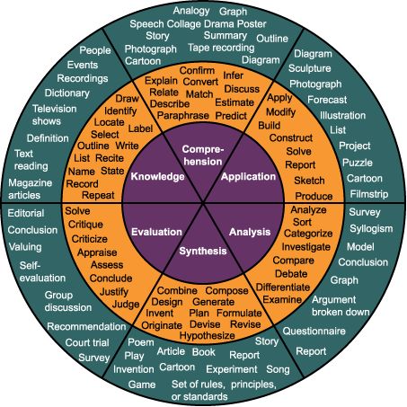
Bloom’s Taxonomy
To Design, Develop, and Evaluate Quality Blended Learning

Slide 16
Bloom’s Taxonomy
Evaluation: appraise, argue, assess, attach, choose, compare, defend estimate, judge, predict, rate, score, select, support, value
To Design, Develop, and Evaluate Quality Blended Learning

Slide 17
Bloom’s Taxonomy
Synthesis: arrange, assemble, collect, compose, construct, create, design, develop, formulate, manage, organize, plan, prepare
To Design, Develop, and Evaluate Quality Blended Learning

Slide 18
Bloom’s Taxonomy
Analysis: analyze, appraise, calculate, categorize, compare, contrast, criticize, differentiate, discriminate, distinguish, examine
To Design, Develop, and Evaluate Quality Blended Learning

Slide 19
Bloom’s Taxonomy
Application: apply, choose, demonstrate, dramatize, employ, illustrate, interpret, operate, practice, schedule, sketch, solve, use
To Design, Develop, and Evaluate Quality Blended Learning

Slide 20
Bloom’s Taxonomy
Comprehension: classify, describe, discuss, explain, express, identify, indicate, locate, recognize, report, restate, review
To Design, Develop, and Evaluate Quality Blended Learning

Slide 21
Bloom’s Taxonomy
Knowledge: arrange, define, duplicate, label, list, memorize, name, order, recognize, relate, recall, repeat, reproduce, state
To Design, Develop, and Evaluate Quality Blended Learning

Slide 22


